Slide 1
Luca Roverelli
IMATI-CNR
The EXTraS Portal
Exploring the X-ray Transient
and variable Sky
Notes:
Today I want to present you the extras project and in particular the s.g. that we have developed for this project.

Slide 2
Outline
1
2
3
EXTraS
Intro
The EXTras Portal
EGI FedCloud
PortalTS
Json-GUI
Architecture
Virtual Appliance
Accessing FedCloud
Contextualization
µServices
Notes:
after a brief introduction of the extras project, I’ll describe the implementation of the s.g. for the extras project. Then, I will focus on how we use the EGI FedCloud resources

Slide 3
Outline
1
2
3
EXTraS
Intro
The EXTras Portal
EGI FedCloud
PortalTS
Json-GUI
Architecture
Virtual Appliance
Accessing FedCloud
Contextualization
µServices

Slide 4
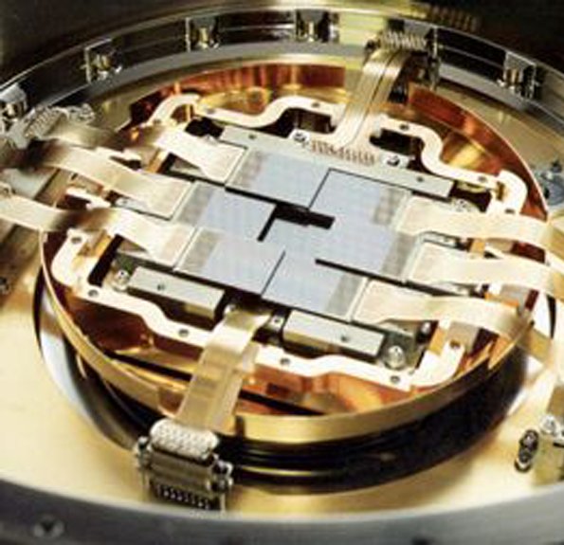
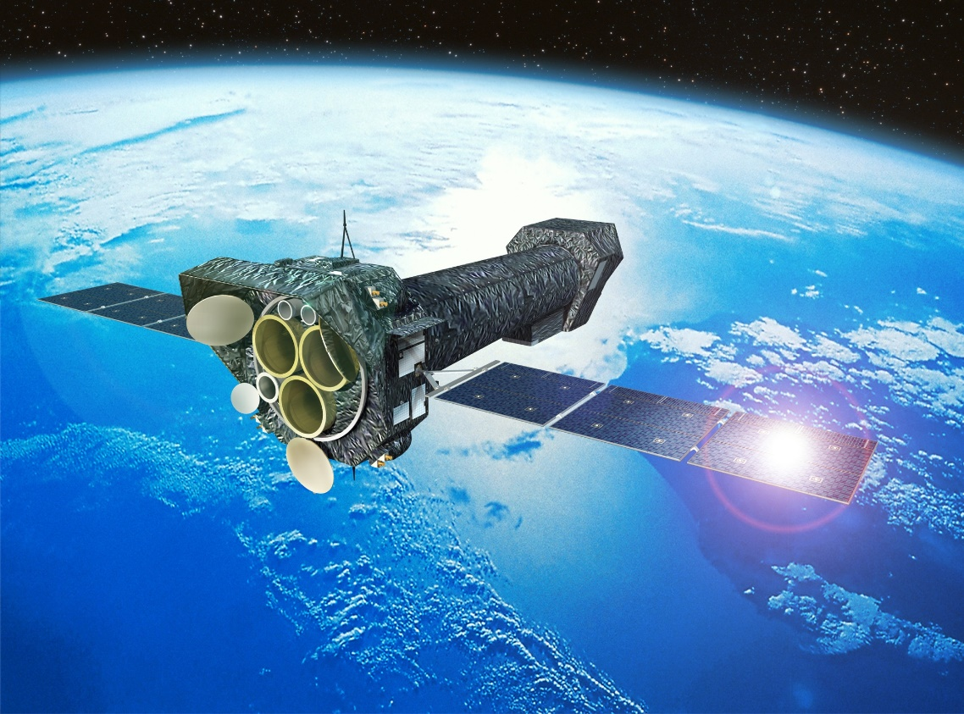
The EXTraS Project
EPIC camera
XMM-Newton
Notes:
The EXTraS Project is an FP7 project started in the 2014 that will end this year
Its aim is to analyze the data retrieved from the XMM-Newton, a X-ray space observatory launched by the European Space Agency

Slide 5
The EXTraS Project
Systematic analysis of European Photon Imaging Camera archival data to:
Detect new X-ray transients
Detect new X-ray pulsators
Characterize their long-term variability
Compile and public release of the variable source catalogue
Notes:
In particular, the project analyzes the EPIC data to detect new X-ray transients and pulsators and the characterization of long-term variability.
So the output of Extras is a catalogue of variable sources. Then, each variable must be individually analyzed.

Slide 6
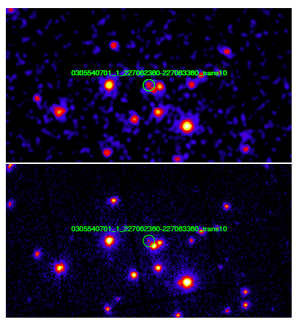
The EXTraS Project
1000s
For each observation, source detection is performed on images integrated on short (e.g. 1,000 s) time intervals and results compared with the list of sources detected in the full observation (5,000 – 130,000 s), searching for new point sources
Full Observation
Notes:
The data elaborated are images taken from the EPIC instrument.
For example, one of the kinds of analysis developed in the project perform sources detection on images
that are integrated on short time interval with respect to the full observation.
Than, candidate sources are compared to the sources detected on full observation images.

Slide 7
The EXTraS Project
SW Characteristics and requirements:
Independent analysis tools
Notes:
This new analysis result in new software tools with the following requirements:
Indipendent analysis tools (no workflows)

Slide 8
The EXTraS Project
SW Characteristics and requirements:
Complex libraries!
Notes:
We have complex library, so the software is not easy to install
SAS library diversi giga

Slide 9
The EXTraS Project
SW Characteristics and requirements:
Configurations and results sharing
Notes:
Scientists needs to share the experiment configurations and results

Slide 10
The EXTraS Project
SW Characteristics and requirements:
New data every day
Notes:
Every day new data will be available, so it is necessary that this tools will be available also after the project expiration.

Slide 11
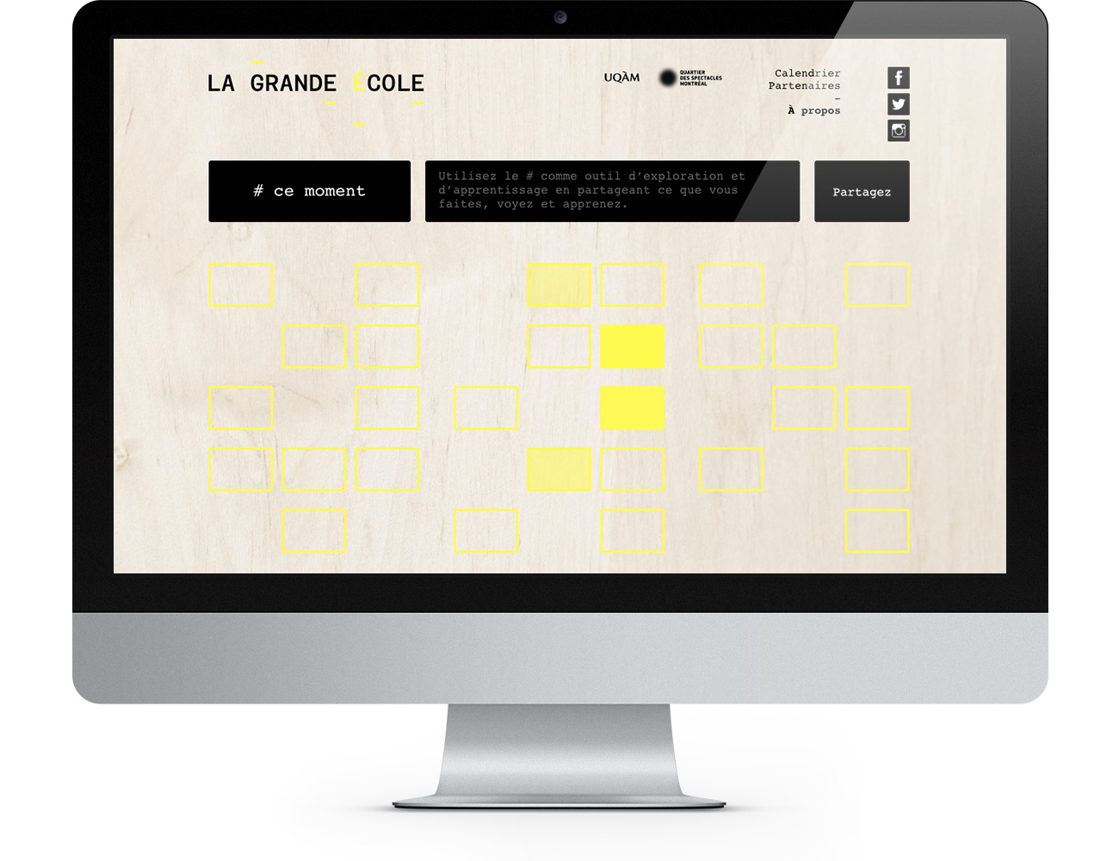
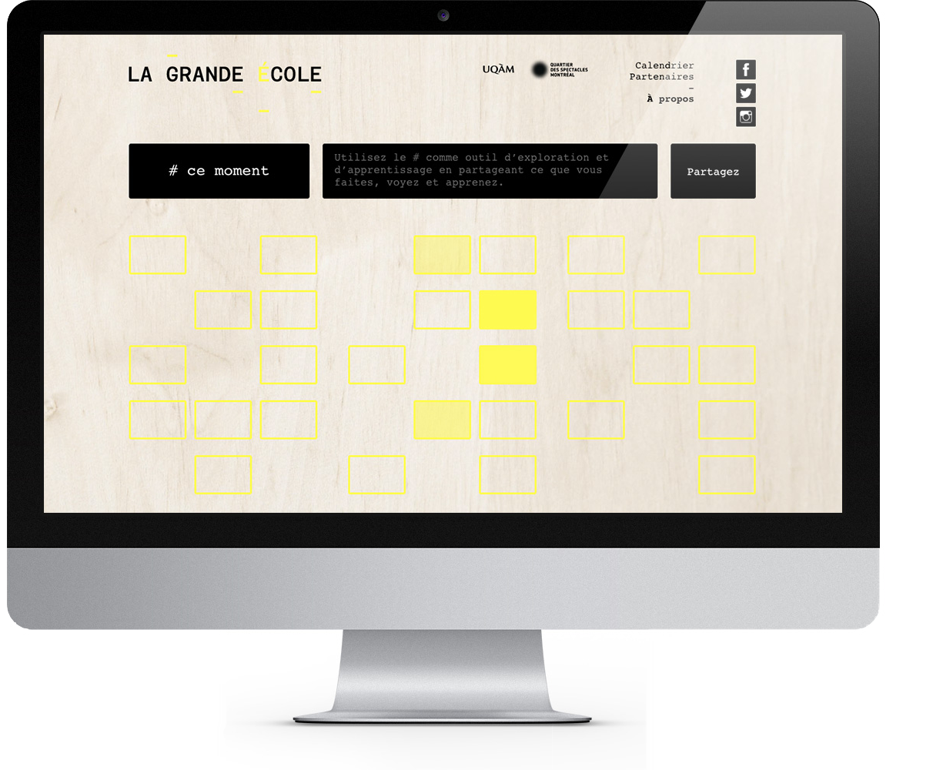
The EXTraS Project
Solution: Science Gateway
Notes:
To addresses all of this requirements and characteristics, we decide to develop a new science gateway to help scientists to configure and submit to EGI Federated cloud resources their analysis and also to allow them to share their results.

Slide 12
Outline
1
2
3
EXTraS
Intro
The EXTras Portal
EGI FedCloud
PortalTS
Json-GUI
Architecture
Virtual Appliance
Accessing FedCloud
Contextualization
µServices
Notes:
after a brief introduction of the extras project, I’ll describe the implementation of the s.g. for the extras project. Then, I will focus on how we use the EGI FedCloud resources

Slide 13
PortalTS
Modern Web Portal
Implemented using new technologies
Composed by a set of reusable modules
Notes:
PortalTS is a moden web portal written in typescript, and it uses the nodejs framework and mongodb as database. Moreover, the administration interface is developed as an AngularJS web application.
It is formed by a set of reusable modules.

Slide 14
PortalTS - Internal Architecture
z
CMS Module
Persistence API Module
User Management Module
Theme Module
Mail Module
Database Module
Notes:
addresses
This is the internal architecture and, in particular, we have the persistence api module, that allows as to save and retrieve data.
PortalTS includes some ready-to-use modules.
There are some basic modules, like theme module that defines the web page header and the footer that can be used by other modules to define a standard theme across the portal.
The database module enable the connection to mongodb and its cofiguration.
The user management module is extremely important. It defines API for user registration, login and logout. Each user must have a role, like administrator or standard user. This module defines also groups, that are set of users. A user can belong to zero or more groups. For example, there can be the expert users group, or the moderetors group.
The Persistence API Module defines API to save and retrieve data. It exposes both a RESTFull API and an interal API, that can be used directly by other modules. The RESTFull API is very important since it allows to store date directly from a web app, that can be built upon this modules. The Persistence API defines entity and collections. An entity is the saved data with some additional metadata, like the creation date and the user owner. A collection is a set of entity. As defaults, an entity can be accessed only by the owner, but it is possible to change this using a group-base policy. Thus, an entity can be accessed by a particular group of user.
On top of this modules, there is the CMS module, that defines some web pages for user login and registration, and it allows to create web pages and menu. Each web page and each menu element can be public or accessed by only a particular group of user, since the cms module uses the Persistence API module.

Slide 15
Json-GUI
...
{
"parameterType": "integer",
"value":18,
"displayName": "Parental Grid Ratio",
"dbName": "parental_grid_ratio",
"dependencies": ["grid_spacing"],
"computedResult": "return
dependencies['grid_spacing'].value +this.value",
"isValid": "if(this.value < dependencies['grid_spacing'].value) {
message = 'Specific Error’; return false;}",
}
...
Notes:
We also developed an AngularJS library, called JsonGUI. The library automatically converts a json object describing the user interface into a web form based interface. Moreover, the library allows as to specify constraint against the different parameters.

Slide 16
EXTraS Project - Architecture
AppDB
EGI
FedCloud
EXTraS
V.A.
WP2 GUI
WP3 GUI
...
WP5 GUI
OCCI
Jobs Management UI
Json-GUI
OCCI
Jobs Management
OCCI
µS
WP2
µS
WP3
µS
WP5
...
Notes:
Extras virtual appliance
So, this is the architecture of the extras s.g. On top of portalts, we developed a jobs management module. We use the Json-GUI to create the different user interface for the different tools.
Since each analysis tools is independent and we don’t have any models chain, we decide to develop different microservices, and e microservice is responsible to submit a particular tool.
The jobs management module can directly communicate with the microservices, and microservices interact with the egi federated cloud to perform the computation using the occi api. We also developed an extras virtual appliance, available on the appdb of fed cloud, that is contextualized by the microserves to run the correct tools

Slide 17
Outline
1
2
3
EXTraS
Intro
The EXTras Portal
EGI FedCloud
PortalTS
Json-GUI
Architecture
Virtual Appliance
Accessing FedCloud
Contextualization
µServices
Notes:
after a brief introduction of the extras project, I’ll describe the implementation of the s.g. for the extras project. Then, I will focus on how we use the EGI FedCloud resources

Slide 18
EXTraS Project - EGI FedCloud: Personalized V.A.
EGI AppDB
WP2
WP3
WP4
EXtraS
Virtual
Appliance
Library 1
Library 2
Library 3
Library 4
Library 5
Library 6
Library 7
Ubuntu 14.04 LTS
Notes:
Create a fresh virtual machine
We installed all the necessary dependences
We installed the software tools
Deploy to AppDB
And then, the virtual machine became available on different recources
OCCI -> start/stop instance of the virtual machine

Slide 19
EXTraS Project - EGI FedCloud
Accessing FedCloud?
Robot Certificate
Notes:
Then, we have the problem to access the fed cloud resource. We choose to use a robot certificates, since it simplify the authentication process for the end users.

Slide 20
EXTraS Project - EGI FedCloud
Accessing FedCloud: Robot Certificate
Associated with a specific set of applications
Notes:
A robot certificate is associated with a specific application or function

Slide 21
EXTraS Project - EGI FedCloud
Accessing FedCloud: Robot Certificate
Shared by the all VO members
Notes:
And can be shared by the all VO members, so that each user doesn’t need to create and provide a personal certificate.

Slide 22
EXTraS Project - V.A. Contextualization
Download SW Tool specific script
Execute the SW Tool specific script
Send to µService the execution logs
Notify completion to the µService
Notes:
The contextualization allows to choose

Slide 23
EXTraS Project - Microservice
µS
WP2
CloudResource1
OCCI create
OCCI destroy
Callback!
CloudResource2
Inst.1
Job Submission!
Notes:
When the µservice receives a new job submission, it choose a cloud resource between the available resources, and then create a new instance of the virtual appliance with a specific context.
At the end of the execution, the µservice is notified, and than it can destroy the instance
With this solution, the µservice doesn’t need to perform polling to detect when the job is completed.

Slide 24
EXTraS Project - Microservices
What we need?
REALTIME LOGS!
Notes:
happening
Another important aspect is that when a job is in execution, you don’t know what it’s doing, and it is a general problem with s.g.
So, what we need is realtime logs!
With realtime logs, the scientist can check the job status, and if something is going wrong.

Slide 25
EXTraS Project - Microservices
µS
WP2
CloudResource1
LOG!
CloudResource2
Inst.1
LOG!
Notes:
So we modified the contextualization script in order that, when a new standard output or error is available, it is immediately sent to the µservice.
And then, the µservice send the log using web socket to the scientist.

Slide 26
portalts.it
portal.extras-fp7.eu
Questions?

