Slide 1
Integration of gCube and the D4Science infrastructure with the EGI FedCloud
Pasquale Pagano, CNR
pasquale.pagano@cnr.it

Slide 2
Outline
Context
VA Creation and Publication
New gCube Service (backend)
New gCube Interface (frontend)

Slide 3
Context
Data Curation
Data Sharing
VRE Builder
Data Preparation
Data Publication
Security
Data Analysis
Data Provenance
Monitoring
Mediator
Connector
Mediator
Connector
Data Infrastructures
Computing Infrastructures

Slide 4
D4Science manages heterogeneous communities via Virtual Research Environment
a distributed and dynamically created environment
where subset of resources (data, services, computational, and storage resources)
regulated by tailored policies (e.g. data encryption with VRE specific key, quota on service calls and storage usage, …)
are assigned to a subset of users via interfaces
for a limited timeframe
at little or no cost for the providers of the participatory data e-infrastructures
L. Candela, D. Castelli, P. Pagano (2013) Virtual Research Environments: An Overview and a Research Agenda. Data Science Journal, Vol. 12

Slide 5
VA Creation
Experience in making the process repeatable without labour

Slide 6
Goal
The images must be identical to the instances working for the CNR data center
working images from the standard Ubuntu ISO installation disks without any manual intervention, following the principle of immutable servers*
*An immutable server once deployed, is never modified, merely replaced with a new updated instance

Slide 7
Solution: tool chain
Packer
VirtualBox
Ansible
Shell scripting
the same playbook used to provision the running instances on the CNR data center runs from packer inside the VM
build different images from the same tools
tool for creating machine and container images for multiple platforms from a single source configuration
supports the creation and management of guest virtual machines running Linux
The images build procedure is manually started each time an upgrade is needed
Next steps:
the build system could start the image creation
the newly created image could be uploaded to the EGI app DB when a new release is needed

Slide 8
New gCube Support
Designing a solution capable to meet the D4Science communities

Slide 9
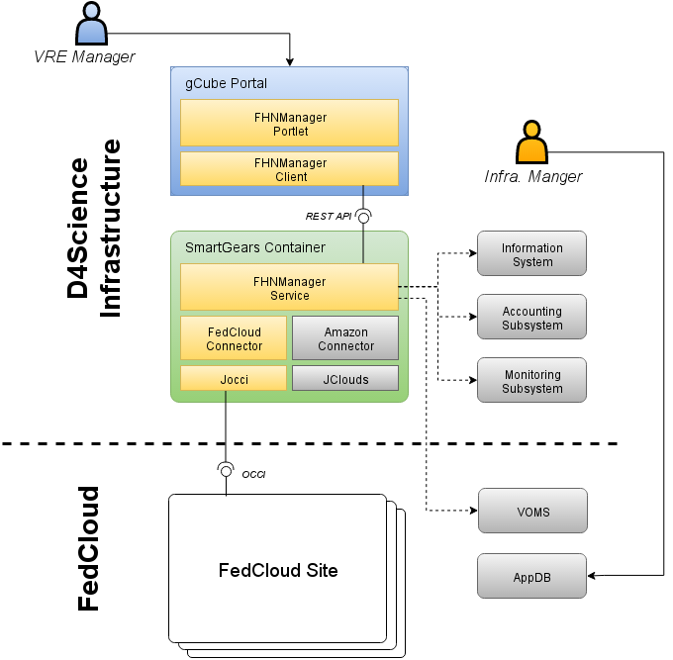
gCube Architecture
Cloud Libraries
Connectors
Federated Hosting Node Manager Service
Federated Hosting Node Manager Portlet:
third-party software providing language-specific APIs and data model to easily interact with clouds from within applications
built on top of cloud libraries in order to abstract the specifics of their APIs and data models and expose a uniform interface to the upper layers.
core part of the integration and is the place where all the business logic resides
provides infrastructure and VRE administrators with a dashboard and a control panel to easily monitor and manage resources in external infrastructures

Slide 10
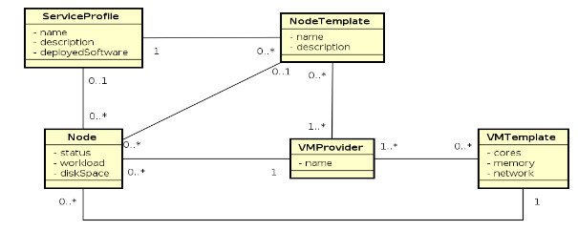
Data model
representing the information related to cloud providers, nodes, templates, accounting and monitoring in a homogenous way independently from the cloud provider exposed API and technology

Slide 11
FHN Manager Service
Web Service implemented in Java and running in a gCube SmartGears container
REST API allowing
access data on nodes and cloud providers
execute create, destroy, start and stop nodes
GET /nodes?vmProvider={vmProviderId}&serviceProfile={serviceProfileId}
GET /nodes/{id}
POST /nodes?cloneFrom={id}
UPDATE /nodes/{id}/start
UPDATE /nodes/{id}/stop
DEL /nodes/{id}
GET /vmproviders?serviceProfile={serviceProfileId}&vmTemplate={vmTemplateId}
GET /vmproviders/{id}
GET /vmtemplates?serviceProfile={serviceProfileId}&vmProvider={vmProviderId}
GET /serviceprofiles

Slide 12
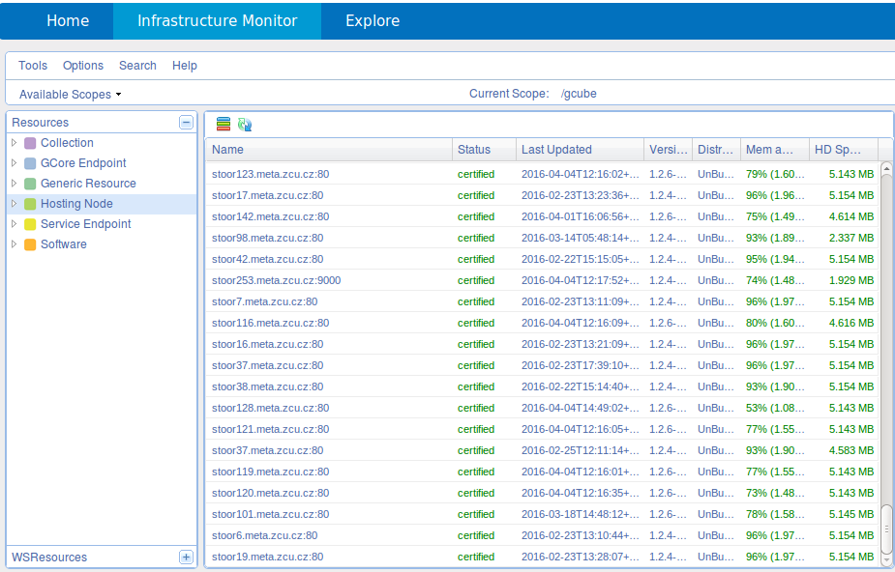
Status
D4Science users do not own a x509 certificate; the usage of any resource is completely transparent to them
Second-level proxy of the manager's cert to access FedCloud
The D4Science Key Store contains the encrypted .pem certificated associated to each VRE or Infrastructure Manager.
FHNM is authorized to access the Key Store and it uses such certificate to create a runtime short-lived VOMS proxy to interact with FedCloud.
First production version: gCube 3.11 (end of April)
Next steps
Support other computing infrastructures
Support some of the OCCUPUS capabilities

Slide 13
FHN Manager Portlet
GWT portlet using Bootstrap and deployed in Liferay. Interact with the service via the fhn-manager-client Java library.
First production version: gCube 3.11 (end of April)
Next steps
gCube Social Integration
Create / Destroy for : Service Profiles, VM Templates, VM Providers
Filtering of displayed resources
Rules definition for automatic node instantiation and start

Slide 14
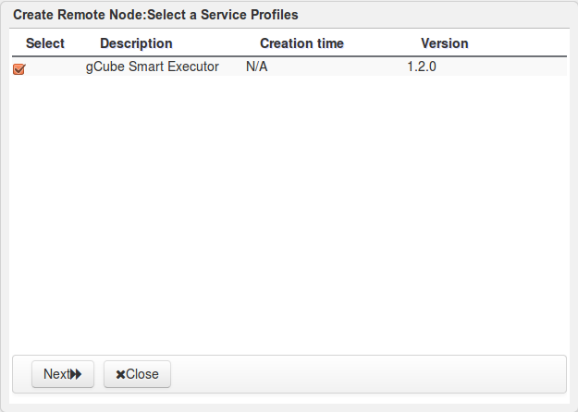
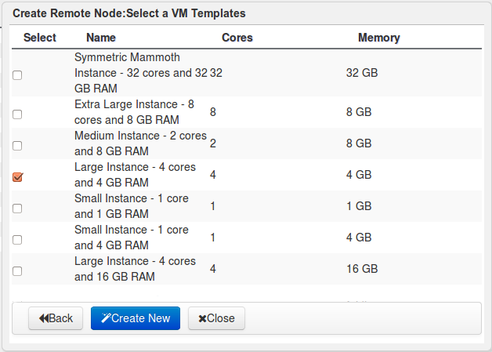
Status
Resources Panel
- Remote Node - Service Profile
- VM Templates - VM Providers
Resources grid
Lists available resources according to selected view
Pinned Resource
Detailed resource information
Create New
Opens wizard for resource creation.
Select Service Profile
Select VM Template

Slide 15
Conclusion
gCube System
Software tested in pre-production environment
Under integration
Planned release: end of April
D4Science exploitation
EGI SLA and EGI OLA to finalize
D4Science Infrastructure Manager trained
VRE Managers campaign to promote EGI FedCloud started

Slide 16
Read More
Service Details
Maven coordinates for each developed component:
<groupId>org.gcube.resources.federation</groupId>
<artifactId>fhn-manager-api</artifactId>
<version>0.0.1-SNAPSHOT</version>
<groupId>org.gcube.resources.federation</groupId>
<artifactId>fhn-manager-service</artifactId>
<version>0.0.1-SNAPSHOT</version>
<groupId>org.gcube.resourcemanagement</groupId>
<artifactId>fhn-manager-client</artifactId>
<version>0.0.1-SNAPSHOT</version>
<groupId>org.gcube.resources.federation</groupId>
<artifactId>fhn-occi-connector</artifactId>
<version>1.0.0-SNAPSHOT</version>
<groupId>org.gcube.portlets.admin</groupId>
<artifactId>fhn-manager-portlet</artifactId>
<version>1.0.0-SNAPSHOT</version>
www.d4science.org
wiki.d4science.org
www.gcube-system.org
wiki.gcube-system.org
Contact Points
pasquale.pagano@isti.cnr.it
info@d4science.org
info@gcube-system.org

