Slide 1
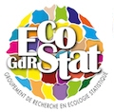
IndexMed, a consortium responsible for the task of indexing Mediterranean biodiversity data: a new way for data mining in ecology
romain.david@imbe.fr – jean-pierre.feral@imbe.fr – thierry.tatoni@imbe.fr
www.indexmed.eu
EGI Conference 2016 - IndexMed consortium - Science Park - Amsterdam
6 - 8 april 2016 - www.indexmed.eu – romain.david@imbe.fr / jean-pierre.feral@imbe.fr

Slide 2
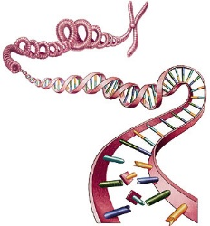
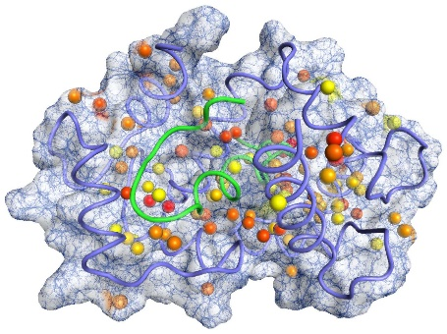
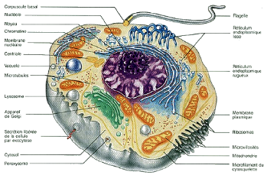
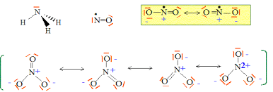
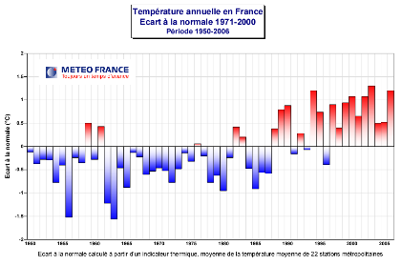
Multi-scale – Multi-formats – Multi-sources…
1. Background : context in ecological studies
Landscape, regional and human interactions levels
Habitats – population levels
Living organism levels
Physical and Chimical levels
Genomic, cells, transcriptomic
Proteomic, metabolimic, epigenetic
Phylogeography,
Ecosystem
functionning
Sociology,
Economy,
Law and well being…
Which holistic approach for a patchwork of contexts at each level of organization?
EGI Conference 2016 - IndexMed consortium - Science Park - Amsterdam
6 - 8 april 2016 - www.indexmed.eu – romain.david@imbe.fr / jean-pierre.feral@imbe.fr

Slide 3
1. Background : context in ecological studies
However, we want to describe a
hardly multi-connected system with many interlinkages
Physico-chimical level
Molecular level
Organism level
Habitat and community levels
Human level (Sociology, Economy, Law, Well being…
Landscape and regional levels
EGI Conference 2016 - IndexMed consortium - Science Park - Amsterdam
6 - 8 april 2016 - www.indexmed.eu – romain.david@imbe.fr / jean-pierre.feral@imbe.fr

Slide 4
Factors are:
1. Background : context in ecological studies
 Biological and ecological functionning is linked to a huge number of factors, not easy to measure,
 Indication « value » of factors is very dependant of the context
and moreover, they interact
(potentialization, antagonists,
cascade effects, etc.)
with a huge local variability
mixed,
not easy (or presently impossible) to measure …
numerous,
EGI Conference 2016 - IndexMed consortium - Science Park - Amsterdam
6 - 8 april 2016 - www.indexmed.eu – romain.david@imbe.fr / jean-pierre.feral@imbe.fr

Slide 5
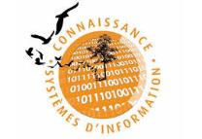
1. Background : context in ecological studies
Heterogeneous communities structure
SINP
Biodiversity
transmission
Organize nodal points
International nodal points
National nodal point
Regional nodal point (naturalist data)
SINP regional platform
Ocean
Regional and national scale
National agregator
International scale
Research tools
on the INEE environment
➲
- Provide technical assistance
- Support good practices
- …
Marine stations (benthos and pelagos)
Manage
Actors network
Database network
(all research establishment)
= interconnected information system in the environmental domain
Thematics networks
EGI Conference 2016 - IndexMed consortium - Science Park - Amsterdam
6 - 8 april 2016 - www.indexmed.eu – romain.david@imbe.fr / jean-pierre.feral@imbe.fr

Slide 6
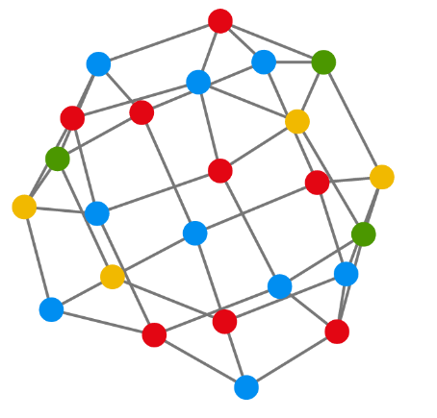
1. Background : IndexMed community & tools
Proposed tool: GRAPHS!!
Objects = Nodes
Attributes modalities = Links
Principle :
All objects with close values of factors in comparable contexts are attracted by each other.
More you have links between
data, more powerfull and accurate can be the graph.
Colors : another attribute non used as a link
EGI Conference 2016 - IndexMed consortium - Science Park - Amsterdam
6 - 8 april 2016 - www.indexmed.eu – romain.david@imbe.fr / jean-pierre.feral@imbe.fr

Slide 7
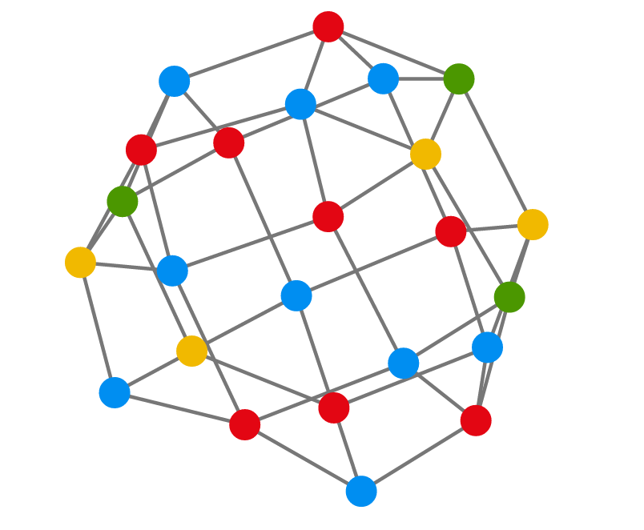
1. Background : IndexMed community & tools
How to integrate heterogeneous non linked data ?
Technical needs :
Simples data models
Several open databases
Traceability
Accessibility
“Perennial” identifier
(cycle of life)
Resolution
(via the index)
of non centralized data
EGI Conference 2016 - IndexMed consortium - Science Park - Amsterdam
6 - 8 april 2016 - www.indexmed.eu – romain.david@imbe.fr / jean-pierre.feral@imbe.fr

Slide 8
Mono-scale – Mono-disciplinar, Not well connected
2. Users : the planned community-specific e-infrastructure
Scope
Human sciences
History
Archeology
Law
Economy
Sociology
…
Vegetal biology
Botany
Palinology
Dendrology
Molecular Sciences
Phylogenetic
Phylogeography
Polulation genetic
…
Animal biology
Comportemental biology
Anatomy
Phyto-sociology
Taxonomy
Taxonomy
Ecology
Functionning
Structure study
GES approaches
Metagenomic
Indicators
…
Trophic studies
…
…
…
Species interactions
( ) x Region x Habitat…
Due to an oversectored
specialization?
EGI Conference 2016 - IndexMed consortium - Science Park - Amsterdam
6 - 8 april 2016 - www.indexmed.eu – romain.david@imbe.fr / jean-pierre.feral@imbe.fr

Slide 9
2. Users : the planned community-specific e-infrastructure
Contributors 2015: Mostly in France
EGI Conference 2016 - IndexMed consortium - Science Park - Amsterdam
6 - 8 april 2016 - www.indexmed.eu – romain.david@imbe.fr / jean-pierre.feral@imbe.fr

Slide 10
2. Users : the planned community-specific e-infrastructure
Some of them in Greece, Spain, Luxembourg, Belgium and UK
EGI Conference 2016 - IndexMed consortium - Science Park - Amsterdam
6 - 8 april 2016 - www.indexmed.eu – romain.david@imbe.fr / jean-pierre.feral@imbe.fr

Slide 11
3. Current status : the visualization prototype
First tool for environmental experts :
A prototype to construct dynamical map of data and their links, based on Graphs
Objectives :
helpful to construct links between objects from different disciplinary fields
able to connect data without centralizing them
didactic interface to increase level of users
able to conserve new models and objects
provide a unique flux for computing centers
There we are!!!
EGI Conference 2016 - IndexMed consortium - Science Park - Amsterdam
6 - 8 april 2016 - www.indexmed.eu – romain.david@imbe.fr / jean-pierre.feral@imbe.fr

Slide 12
3. Current status : the visualization prototype
First tool for environmental experts :
A prototype to construct dynamical map of data and their links, based on Graphs
Objectives :
helpful to construct links between objects from different disciplinary fields
able to connect data without centralizing them
didactic interface to increase level of users
able to conserve new models and objects
provide a unique flux for computing centers
Prerequisites :
Fluxes with objects, attributes, values of attributes
Normalization OR correspondences (thesaurus, ontologies)
Indexing : Connecting data without centralizing them
Construct a community with all necessary competencies
Convince funders to explore the capacity of graphs by means of a prototype
There we are !!!
EGI Conference 2016 - IndexMed consortium - Science Park - Amsterdam
6 - 8 april 2016 - www.indexmed.eu – romain.david@imbe.fr / jean-pierre.feral@imbe.fr

Slide 13
3. Current status : the visualization prototype
There we are !!!
EGI Conference 2016 - IndexMed consortium - Science Park - Amsterdam
6 - 8 april 2016 - www.indexmed.eu – romain.david@imbe.fr / jean-pierre.feral@imbe.fr

Slide 14
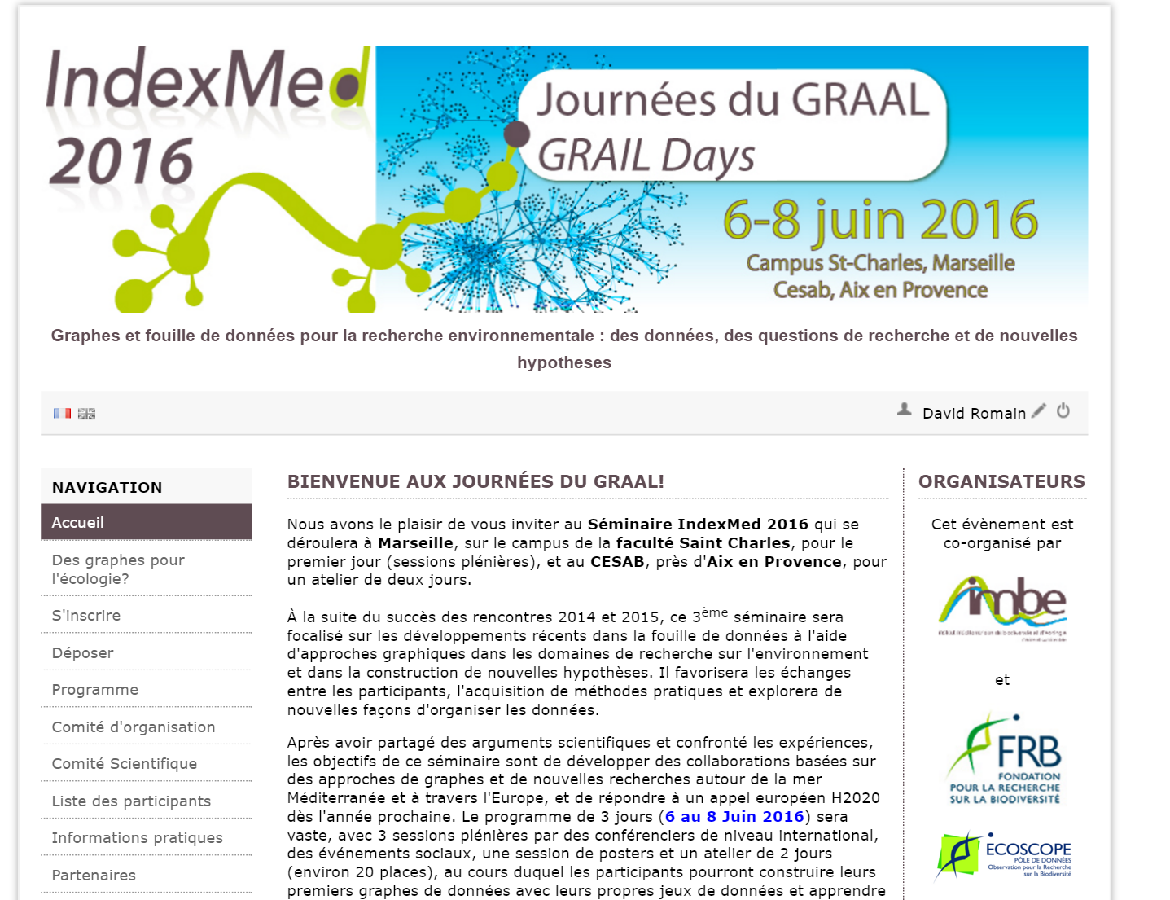
indexmed2016.sciencesconf.org
3. Current status : the grow of the community
A first prototype for visualization
A community of about 150 interested researchers, mostly in environmental sciences
A web service indexing data
1 year of presentation of the project in each disciplinary communities
2 workshops done for presentation and conception of graphs
Everything must be
improve next years!

Slide 15
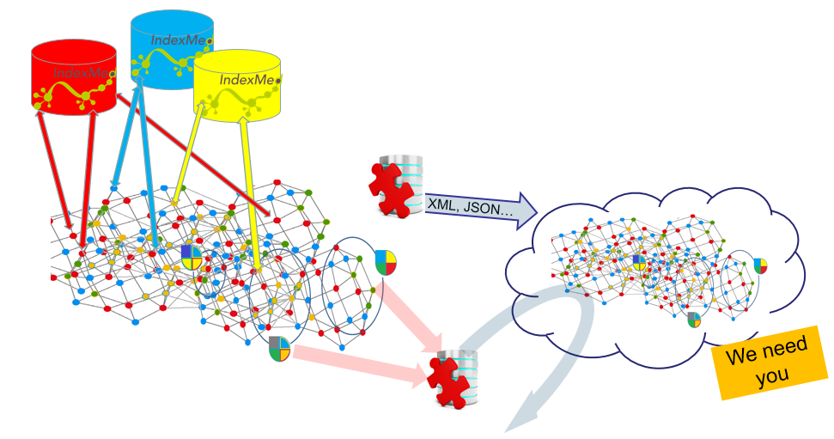
3. Current status : Architecture under construction
1) Generating a stream containing the setting and objects of the graph and their relationships
There we are !!!
2) EGI Place
3) Conservation of patterns
of contexts and their frequency for intelligence decision support
EGI Conference 2016 - IndexMed consortium - Science Park - Amsterdam
6 - 8 april 2016 - www.indexmed.eu – romain.david@imbe.fr / jean-pierre.feral@imbe.fr

Slide 16
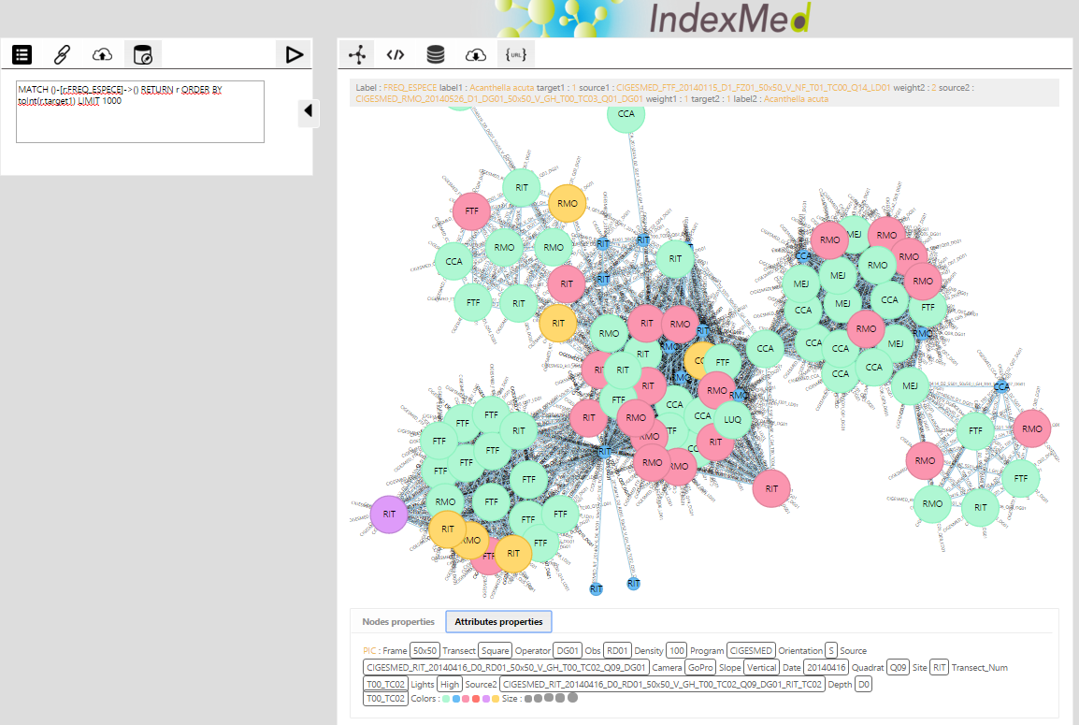
3. Current status : ANR MRSEI
Perspectives : Participating to H2020 proposal ?
Encouraged to grow!!!
OPEN SOURCE!!
Copy and paste system
Open data
EGI Conference 2016 - IndexMed consortium - Science Park - Amsterdam
6 - 8 april 2016 - www.indexmed.eu – romain.david@imbe.fr / jean-pierre.feral@imbe.fr

Slide 17
3. Current status : Which components/services do you expect to get from EGI?
Needs
There we are
… we need
Complementary competencies to improve
Graph parameters possibilities
Data storage and organization
Statistical functionalities
Flux Service capacities
Algorithm choices
Calculation and graph analyses
We need you!
EGI Conference 2016 - IndexMed consortium - Science Park - Amsterdam
6 - 8 april 2016 - www.indexmed.eu – romain.david@imbe.fr / jean-pierre.feral@imbe.fr

Slide 18
4. Plans for today : questions and issues to address
and to resolve
Questions to be addressed
What are the EGI relevant components to seek in our case?
Witch competencies and level of participation can we seek in EGI?
How can we elaborate an international proposal including EGI?
Can EGI contribute to build our network?
We need you!
EGI Conference 2016 - IndexMed consortium - Science Park - Amsterdam
6 - 8 april 2016 - www.indexmed.eu – romain.david@imbe.fr / jean-pierre.feral@imbe.fr

Slide 19
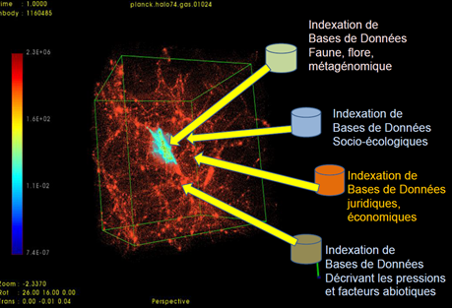
2020 BIODIVERSITY INTERNATIONAL PROJECT ODYSSEE
Thanks for your attention… questions?

Slide 20
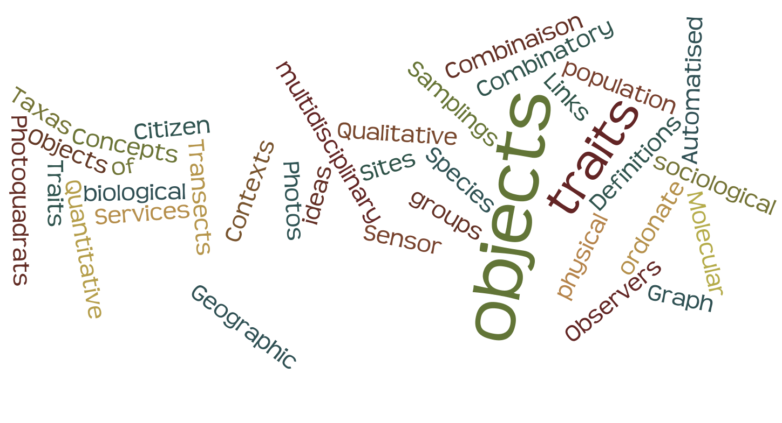
Gaps for a realistic representation of contexts
Questions?
EGI Conference 2016 - IndexMed consortium - Science Park - Amsterdam
6 - 8 april 2016 - www.indexmed.eu – romain.david@imbe.fr / jean-pierre.feral@imbe.fr

Slide 22
How to integrate heterogeneous non linked data ?
Proposed tool GRAPHS!!
Objects = Nodes
Attributes modalities = Links
Principle :
All objects which closed values of factors in comparable contexts are attracted together.
More you have links between
data, more powerfull and accurate is the graph
Colors : another attribute non used as a link
EGI Conference 2016 - IndexMed consortium - Science Park - Amsterdam
6 - 8 april 2016 - www.indexmed.eu – romain.david@imbe.fr / jean-pierre.feral@imbe.fr

Slide 23
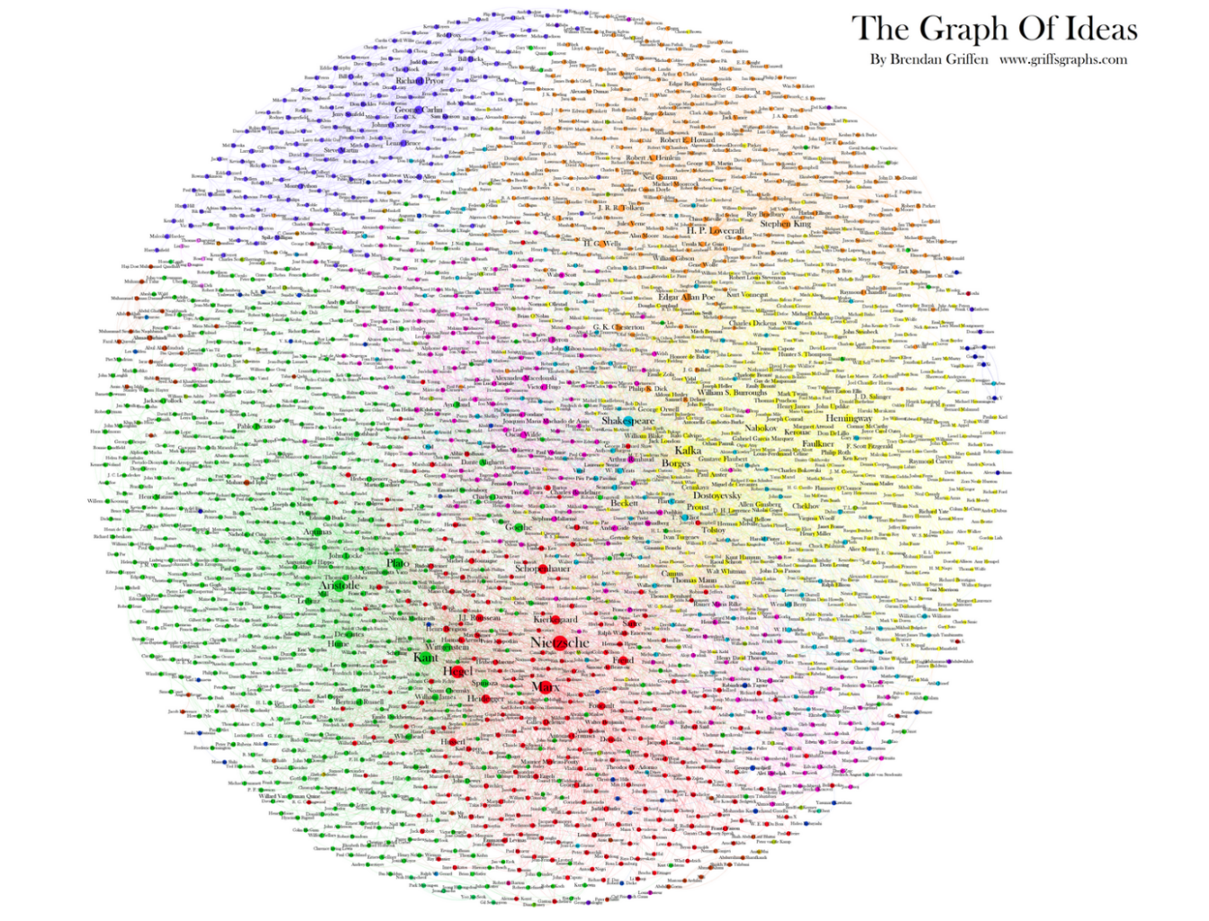
How to integrate heterogeneous non linked data ?
Proposed tool
GRAPHS!!
Principle :
All objects which closed values of factors in comparable contexts are attracted together.
More you have links between
data, more powerfull and accurate is the graph
EGI Conference 2016 - IndexMed consortium - Science Park - Amsterdam
6 - 8 april 2016 - www.indexmed.eu – romain.david@imbe.fr / jean-pierre.feral@imbe.fr

Slide 24
Multidisciplinary graphs for biodiversity studies?
Objects can be
Geographic objects (sites)
Observers
Species /Taxas
Traits
Combinaison of traits
EGI Conference 2016 - IndexMed consortium - Science Park - Amsterdam
6 - 8 april 2016 - www.indexmed.eu – romain.david@imbe.fr / jean-pierre.feral@imbe.fr

Slide 25
Multidisciplinary graphs for biodiversity studies?
Objects can be
Geographic objects (sites)
Transects
Photoquadrats
Observers
Species /Taxas
Traits
Combinaison of traits
Theoritical Graph with 3 type of object
EGI Conference 2016 - IndexMed consortium - Science Park - Amsterdam
6 - 8 april 2016 - www.indexmed.eu – romain.david@imbe.fr / jean-pierre.feral@imbe.fr

Slide 26
Multidisciplinary graphs for biodiversity studies?
Objects can be too
Definitions
Services
Concepts / ideas
Combinatory objects
Samplings population
Molecular « objects »
Photos
Citizen groups
…
Objects can be
Geographic objects (sites)
Transects
Photoquadrats
Observers
Species /Taxas
Traits
Combinaison of traits

Slide 27
Multidisciplinary graphs for biodiversity studies?
Links can be all the objects or their attributes values
Definitions
Services
Concepts / ideas
Combinatory objects
Samplings population
Molecular « objects »
Photos
Citizen groups
…
Geographic objects (sites)
Transects
Photoquadrats
Observers
Species /Taxas
Traits
Combinaison of traits
EGI Conference 2016 - IndexMed consortium - Science Park - Amsterdam
6 - 8 april 2016 - www.indexmed.eu – romain.david@imbe.fr / jean-pierre.feral@imbe.fr

Slide 28
Multidisciplinary graphs for biodiversity studies?
Links can be all the objects or their attributes values
Definitions
Services
Concepts / ideas
Combinatory objects
Samplings population
Molecular « objects »
Photos
Citizen groups
…
Geographic objects (sites)
Transects
Photoquadrats
Observers
Species /Taxas
Traits
Combinaison of traits
To construct graphs with several Database
All objects (NODES)
and modalities of factors (LINKS)
NEEDS STANDARDS!!
EGI Conference 2016 - IndexMed consortium - Science Park - Amsterdam
6 - 8 april 2016 - www.indexmed.eu – romain.david@imbe.fr / jean-pierre.feral@imbe.fr

Slide 29
Multidisciplinary graphs for biodiversity studies?
Links can be all the objects or their attributes values
To construct graphs with several Database
All objects (NODES)
and falue of factors (LINKS)
NEEDS STANDARDS!!
As a vertebral column ...
EGI Conference 2016 - IndexMed consortium - Science Park - Amsterdam
6 - 8 april 2016 - www.indexmed.eu – romain.david@imbe.fr / jean-pierre.feral@imbe.fr

Slide 30
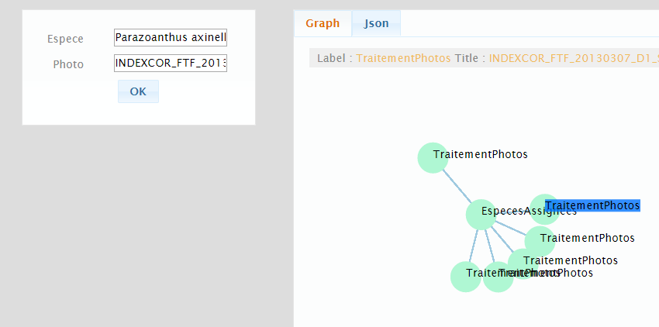
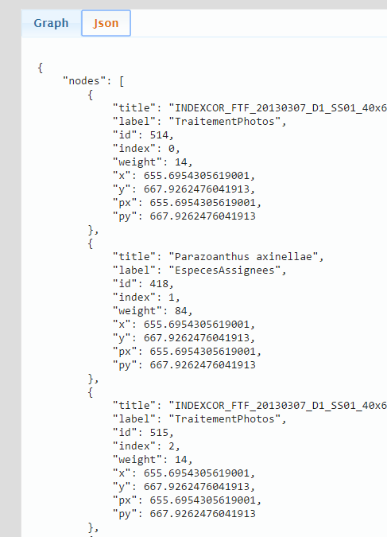
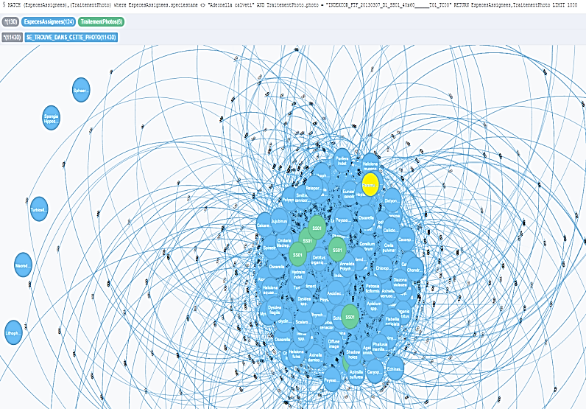
Visualization of data produced protocol (WP2)
Dynamical map of data and their links, based on a complex system approach (Graphs)
Photoquadrats
EGI Conference 2016 - IndexMed consortium - Science Park - Amsterdam
6 - 8 april 2016 - www.indexmed.eu – romain.david@imbe.fr / jean-pierre.feral@imbe.fr

Slide 31
Dynamical map of data and their links, based on a complex system approach (Graphs)
Photoquadrat
EGI Conference 2016 - IndexMed consortium - Science Park - Amsterdam
6 - 8 april 2016 - www.indexmed.eu – romain.david@imbe.fr / jean-pierre.feral@imbe.fr

Slide 32
Visualization
of data
Dynamical map of data and their links, based on a complex system approach (Graphs)
Photoquadrats
Observers, species recognizable on photoquadrats and French sites
are used to construct the first version of user friendly interface
EGI Conference 2016 - IndexMed consortium - Science Park - Amsterdam
6 - 8 april 2016 - www.indexmed.eu – romain.david@imbe.fr / jean-pierre.feral@imbe.fr

Slide 33
Data science mostly used in money worlds :
Banks, inssurances, social networks…
Why not for biodiversity???
EGI Conference 2016 - IndexMed consortium - Science Park - Amsterdam
6 - 8 april 2016 - www.indexmed.eu – romain.david@imbe.fr / jean-pierre.feral@imbe.fr

Slide 34
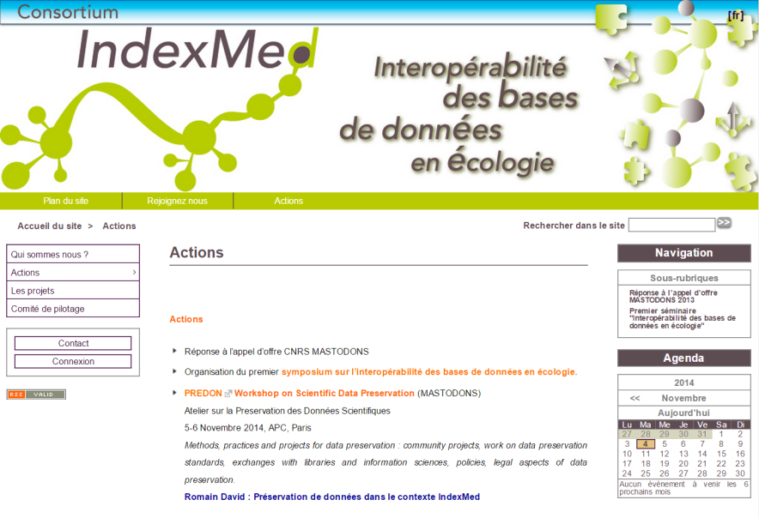
Any helpful consortium in the future
Open to your participation
The project will develop an “object resolution service”
(i.e. a web service which finds links and dependencies
among indexed objects, based on unique identification of objects).
www.indexmed.eu
EGI Conference 2016 - IndexMed consortium - Science Park - Amsterdam
6 - 8 april 2016 - www.indexmed.eu – romain.david@imbe.fr / jean-pierre.feral@imbe.fr

Slide 35
Any helpful consortium in the future
Open to your participation
The project will develop an “object resolution service”
(i.e. a web service which finds links and dependencies
among indexed objects, based on unique identification of objects).
This object resolution service should permit
an inventory of biodiversity descriptors,
will estimate the capacity of data to describe socio-ecological systems at each scale
and must permit research and linked economic and social approaches
www.indexmed.eu

Slide 36
How to integrate heterogeneous non linked data ?
What are the main principles?
Principle :
All objects which closed values of factors in comparable contexts are attracted together.
More you have links between
data, more powerfull and accurate is the graph
EGI Conference 2016 - IndexMed consortium - Science Park - Amsterdam
6 - 8 april 2016 - www.indexmed.eu – romain.david@imbe.fr / jean-pierre.feral@imbe.fr

Slide 37
How to integrate heterogeneous non linked data ?
Exemple of Graph of ideas
Objects = Nodes
Caracteristiks = Links
HERE
Objects : littérature authors
Links : Ideas
How to class ideas (links) without redondancy (as much as possible) = Thesaurus
EGI Conference 2016 - IndexMed consortium - Science Park - Amsterdam
6 - 8 april 2016 - www.indexmed.eu – romain.david@imbe.fr / jean-pierre.feral@imbe.fr

Slide 38
Indexmed : de l’interopérabilité des BDD au big data en écologie
First results
Authors are grouped by Ideas =
Ideas are organised by clusturs of humans
AND Ideas who are more shared by the same cluser, as well very differents ideas are closed in the graph
Outils de prospection
envisagés
Identifying by links density,
values of categories
which are closed together
Université de Nice
2013 / 2014
R.DAVID Séminaire PREDON – 5-6 Nov 2014
Notes:
Mettre maxi à la place de Large

Slide 39
How to integrate heterogeneous non linked data ?
Exemple of Graph of ideas
Objects = Nodes
Caracteristiks = Links
HERE
Objects : littérature authors
Links : Ideas
How to class ideas (links) without redondancy (as much as possible) = Thesaurus
RESULT :
CLUSTERS of
closed objects
(here, the authors
grouped by ideas)
EGI Conference 2016 - IndexMed consortium - Science Park - Amsterdam
6 - 8 april 2016 - www.indexmed.eu – romain.david@imbe.fr / jean-pierre.feral@imbe.fr

Slide 40
Results with adding secondary links!
Exemple 1 :
Adding the link « Origin country of authors » (i.e., France, Greece, Turquie…)
= grouping authors by ideas AND their origin country
RESULT : the origine country of ideas (and cluster of ideas)
EGI Conference 2016 - IndexMed consortium - Science Park - Amsterdam
6 - 8 april 2016 - www.indexmed.eu – romain.david@imbe.fr / jean-pierre.feral@imbe.fr

Slide 41
Results with adding secondary links!
Exemple 1 :
Adding the link « Origin country of authors » (i.e., France, Greece, Turquie…)
= grouping authors by ideas AND their origin country
RESULT : the origine country of ideas (and cluster of ideas) -> possible map!!
OPTION 1 : ponderate links
(= ponderate ideas OR/AND author importance with a weight)
More an object is heavy, more he attract others (with the links)
More a link have weight, more it will attractive the objects he linked
RESULT : the origine country of main school of thinkings
(and cluster of countries = zone of influence) -> possible map!!
EGI Conference 2016 - IndexMed consortium - Science Park - Amsterdam
6 - 8 april 2016 - www.indexmed.eu – romain.david@imbe.fr / jean-pierre.feral@imbe.fr

Slide 42
Results with adding secondary links!
Exemple 1 :
Adding the link « Origin country of authors » (i.e., France, Greece, Turquie…)
= grouping authors by ideas AND their origin country
RESULT : the origine country of ideas (and cluster of ideas) -> possible map!!
OPTION 2 : classify ideas with caracteristics/in groups
How to do exemple :
classification of ideas between main and secondary (in school of thinking) of them
(closed of a thesaurus of ideas)
RESULT : the origine of main ideas (and the diffusion of secondary from the first main ideas)
-> possible map more complex!!
EGI Conference 2016 - IndexMed consortium - Science Park - Amsterdam
6 - 8 april 2016 - www.indexmed.eu – romain.david@imbe.fr / jean-pierre.feral@imbe.fr

Slide 43
Results with adding secondary links!
Exemple 1 :
Adding the link « Origin country of authors » (i.e., France, Greece, Turquie…)
= grouping authors by ideas AND their origin country
RESULT : the origine country of ideas (and cluster of ideas) -> possible map!!
OPTION 3 : classify authors by their dates of « first » or « last » productions
How to do exemple :
Attribute the death / birthday to the author
Select the authors by periods
RESULT : the history of ideas (and the diffusion of ideas per period)
-> possible map more complex!!
EGI Conference 2016 - IndexMed consortium - Science Park - Amsterdam
6 - 8 april 2016 - www.indexmed.eu – romain.david@imbe.fr / jean-pierre.feral@imbe.fr

Slide 44
Results with adding secondary links!
EXEMPLE of others OPTIONS
Prefered vacations place…
Politics groups
… color of eyes or other human traits….
And you can add all links you want
(complex graphs have thousand objects, hundred type of links and million links)
EGI Conference 2016 - IndexMed consortium - Science Park - Amsterdam
6 - 8 april 2016 - www.indexmed.eu – romain.david@imbe.fr / jean-pierre.feral@imbe.fr

Slide 45
Results with adding secondary links!
EXEMPLE of others OPTIONS
Prefered vacations place…
Politics groups
… color of eyes or other human traits….
And you can add all links you want
(complex graphs have thousand objects, hundred type of links and million links)
ONLY IMPORTANT POINT :
all objects should have at least one modality for each attribute
EGI Conference 2016 - IndexMed consortium - Science Park - Amsterdam
6 - 8 april 2016 - www.indexmed.eu – romain.david@imbe.fr / jean-pierre.feral@imbe.fr

Slide 46
Results with adding secondary links!
EXEMPLE of others OPTIONS
Prefered vacations place…
Politics groups
… color of eyes or other human traits….
And you can add all links you want
(complex graphs have thousand objects, hundred type of links and million links)
ONLY IMPORTANT POINT :
all objects should have at least one modality for each attribute
(= each object need to have the possibility to be linked to other with an attribute)
Huge possibility when you have the possibility
to select the type and the values of links
for the graph analyses
EGI Conference 2016 - IndexMed consortium - Science Park - Amsterdam
6 - 8 april 2016 - www.indexmed.eu – romain.david@imbe.fr / jean-pierre.feral@imbe.fr

Slide 47
Any helpful consortium in the future
Open to your participation
Open source, simple datastructure
Open and non-centralized data
Open and free science
EGI Conference 2016 - IndexMed consortium - Science Park - Amsterdam
6 - 8 april 2016 - www.indexmed.eu – romain.david@imbe.fr / jean-pierre.feral@imbe.fr

