Slide 1
EGI, EGI-ENGAGE and the Open Data Platform - Introduction
Matthew Viljoen
EGI-ENGAGE WP4

Slide 2
24 countries
CERN, EMBL-EBI
1 coordinating organization – EGI.eu

Slide 3
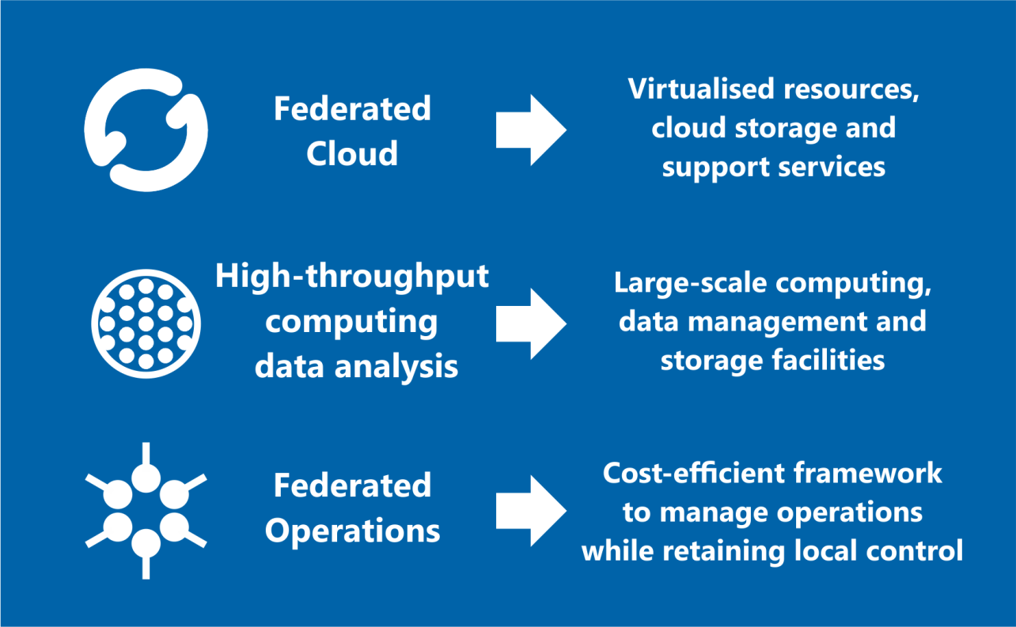
Open Solutions

Slide 4
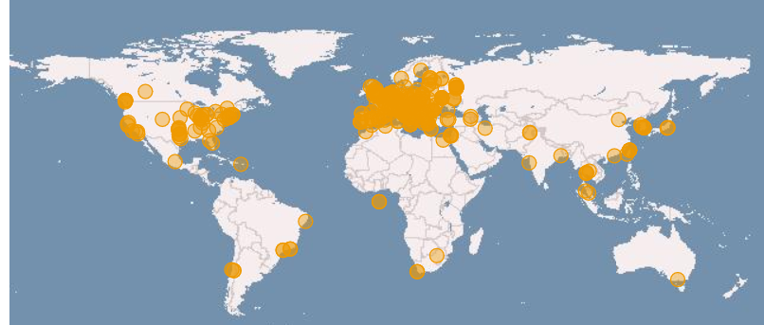
Global collaborations
Russia
Ukraine
Canada
USA
Asia
Pacific
Latin America
Africa
Arabia
www.egi.eu

Slide 5
EGI-ENGAGE
The flagship project of EGI
30 Months from Mar ‘15
€8M
1169 PMs
42 Beneficiaries

Slide 6
EGI-ENGAGE - User Engagement
User-centric approach, 39% of project effort for user-driven developments and integration, community engagement
User-driven co-development of federated HTC and cloud infrastructure with the support of 7 RIs on the ESFRI roadmap
Multiple user groups
long tail ad hoc services and policies
Research Infrastructures
Industry/SMEs
Data as a service
On-demand VREs (data products for information as a service)
Scientific software as a service

Slide 7
EGI-ENGAGE - Services
Evolution of the AAI infrastructure and security operations infrastructure
Technical evolution of the tools for federation including accounting, monitoring, resource allocation, operations tools)
Integration with infrastructure for PID registration and resolution
Development of the cloud solution
From IaaS to community-managed and/or EGI-managed PaaS
Federated secure cloud storage
Data as a service
Scalable access to “active” archives, no more separation between data and computing

Slide 8
EGI-ENGAGE - New Platforms
Federated:
services for education (supported by the federated cloud)
GPGPU infrastructure (via Cloud/Grid)
Infrastructure for citizen science
Virtual appliance library
On-demand VREs

Slide 9
EGI-ENGAGE - Business Models
From federation of community services to
Pay for use
Free at point of use
SLAs in a federated environment
Cross-border procurement of public services
Big data exploitation across domains

Slide 10
EGI-ENGAGE - Open Data Platform
Development of a prototype of a solution providing:
open data publishing/use/reuse of integrated data/computing services
integration of existing cloud infrastructures
integration of accelerated computing facilities (GPGPUs)
implementing AAI design from AARC
distributed AuthN, AuthZ
technology interoperation
Notes:
inc. scientific data released into the public domain
e.g. canadian CAMFAR
AuthN – IdP federations integration
AuthZ – att. authorities integration

Slide 11
EGI Open Data Platform Technical Introduction
slides by Lukasz Dutka
EGI Engage JRA2.1 (WP4.1)

Slide 12
Community requirements collection
REQ1. Publication of open research data based on policies
REQ2. Make large data sets available without transferring them completely
REQ3. Enabling complex metadata queries
REQ4. Integration of the open data access data management with community portals
REQ5. Data identification, linking and citation
REQ6. Enabling sharing of data between researchers under certain conditions
REQ7. Sharing and accessing data across federations
REQ8. Long term data preservation
REQ9. Data provenance

Slide 13
Main Objectives
lower barrier for EGI users in publishing their data as open
simplify access and processing of open data for EGI users
integrate and virtualize existing EGI data storage solutions
persistent data identification (DOI)
optimize access to open data provided by both external and internal EGI open data providers
provide means for tracking open data usage statistics
data as a service solution

Slide 14
Open Data Platform Interactions
Public Services
For Data Discovery
2: opendata publish
collection Data-set-1.1
-> DOI.1
3: discover data
3: discover data
-> DOI.1
-> DOI.1
Snapshot
Data-set-1.1
4: Visit Collection
Web Page (HTTP)
5: opendata mount remote
DOI.1 /localdir/
Data-set-1.1
Mounted to
/localdir/
1: opendata create
snapshot Data-set-1
6: opendata fork DOI.1
Lazy Replication
Data–set-1
Cloned
Data-set-1.1
Private Resources
Private Resources

Slide 15
Publish
Data as Open
Register Metadata
Register Metadata
Heterogenous
storage
Open Data Platform
Access To
Open Data
Access To
Open Data
Register Metadata
Discover
Open Data
Metadata
Comp. Resources Grid / Cloud
Migrate Data
When Neccessary
EGI Resource Center
Non-EGI Open Data Provider
Access To
Open Data
Open Data Persistent Repository
Migrate Data
When Neccessary
Discover
Open Data
Publish
Data as Open
Heterogenous
storage
Open Data Platform
Community X Indexing Service
Access To
Open Data
Register Metadata
Discover
Open Data
Comp. Resources Grid / Cloud
Metadata
Register
Discovered Data
EGI Resource Center
User

Slide 16
Summary
The Open Science needs:
to share and discover the results of experiments
to integrate data from different sources and scientific domains
to enable reproducibility of experiments on data sets
to re-use data sets by other scientists
We are developing:
a platform `containerizing` data collections and support free flow and instant access

Slide 17
Thank you
Questions?

Slide 18
Supplementary slides

Slide 19
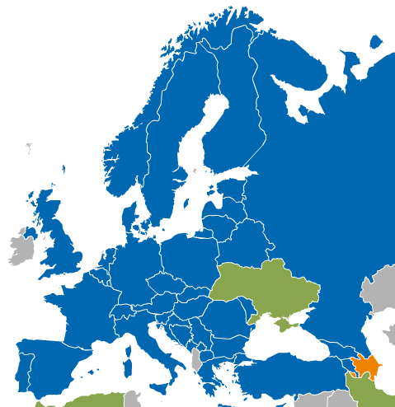
What is the EGI Federated Cloud?
The EGI Federated Cloud is federation of institutional private Clouds, offering Cloud Infrastructure as a Service to scientists in Europe and worldwide.
EGI Federated Cloud is based on:
Standards and validation: federation is based on common Open-Standards – OCCI, CDMI, OVF, GLUE, etc...
Heterogeneous implementation: no mandate on the cloud technology, the only condition is to expose the chosen interfaces and services.

Slide 20
AppDB - Appliances Marketplace
Web-based VM image catalogue with automatic deployment on the EGI Federated Cloud sites
Cloud VM image repository
Publish your image
Manage your VM images
Sharing
Automatic deployment on the cloud sites
Images automatically deployed on the cloud sites
Re-use images certified by EGI
Manage versions
Create private images
Automatic update
AppDB
Cloud Marketplace
Publish
image
Image deployed in cloud sites
Site 1
Site 2

Slide 21
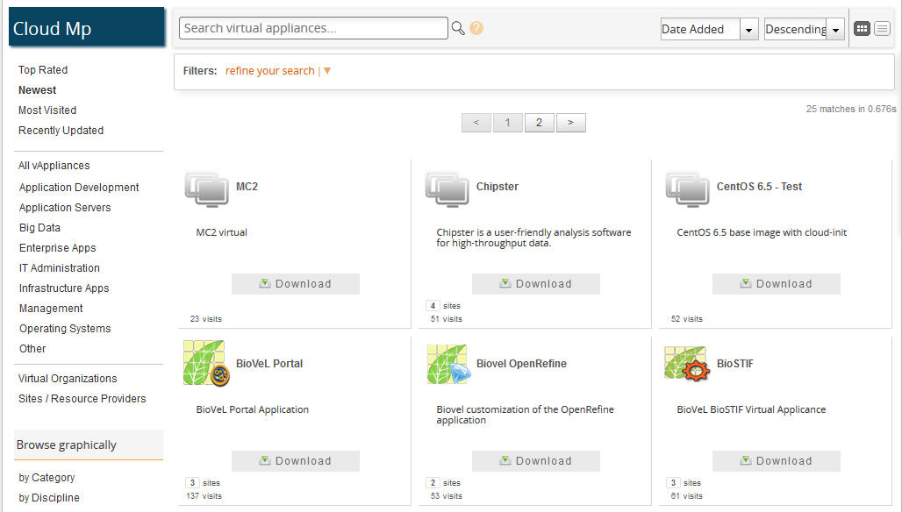
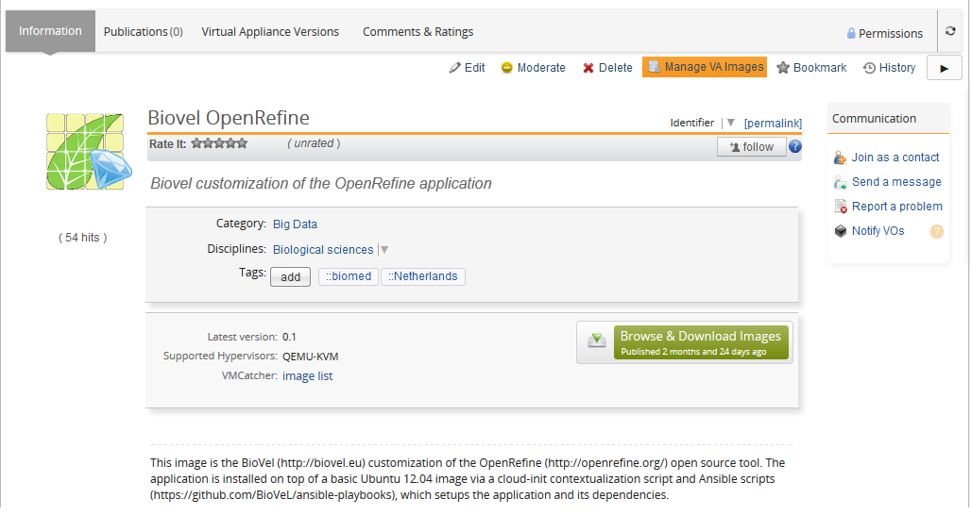
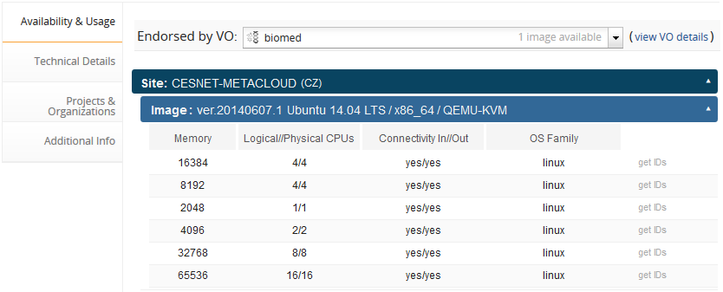
AppDB - Appliances Marketplace

Slide 22
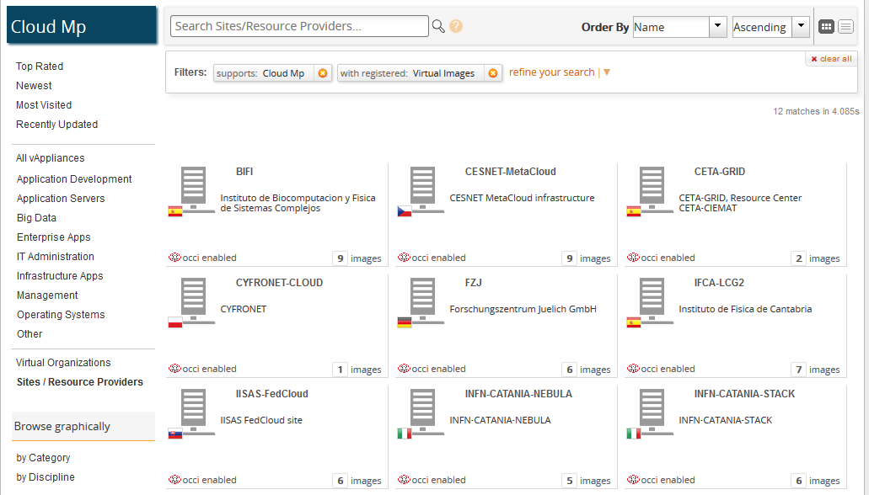
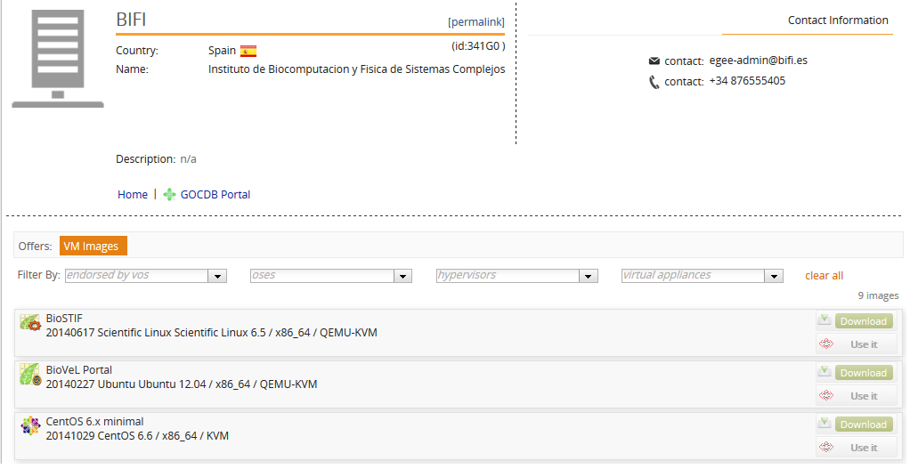
AppDB - Appliances Marketplace

