Slide 1
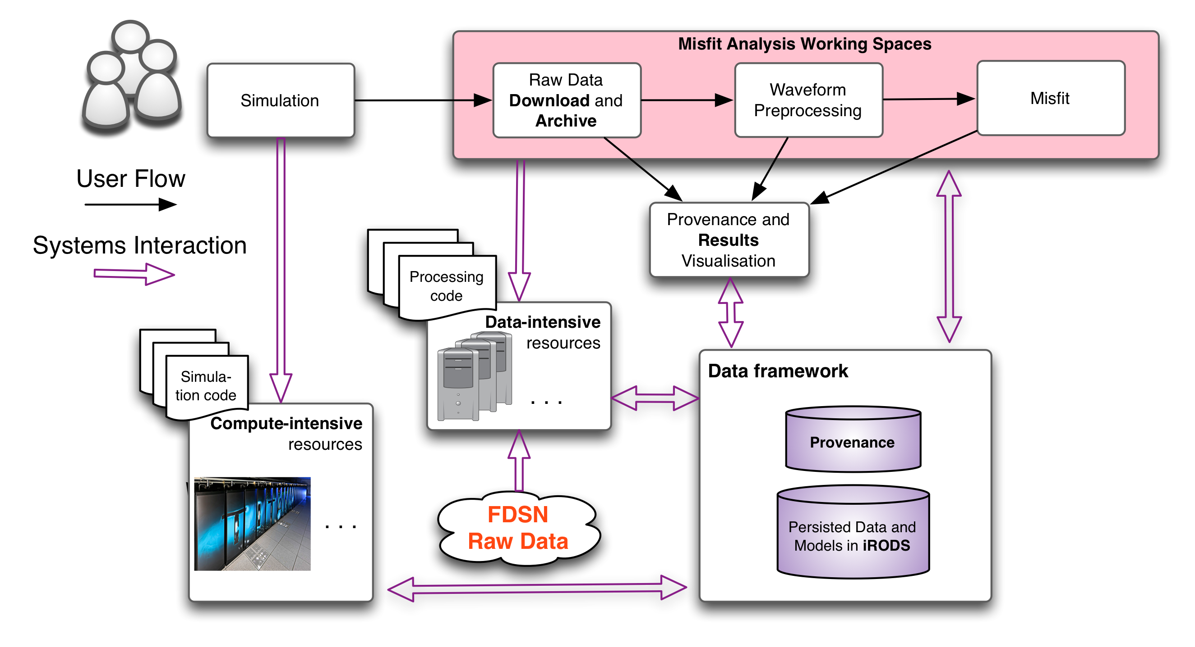
Computational use case Overview

