Slide 1
ELIXIR AAI
Michal Procházka, Mikael Linden,
EGI VC 15 March 2016

Slide 2
Goals of this meeting
How we harmonize development and deployment of the AAI infrastructure?
What will be benefits for ELIXIR to interconnect with EGI AAI?
What AAI components can be shared?

Slide 3
ELIXIR AAI history – where we are now
Use case gathering -- Autumn 2014
https://goo.gl/a1SYnD
Requirements and design – Spring 2015
Based on existing s/w and experience in the NREN community
https://goo.gl/NRxyZ6
Deployment starts – Autumn 2015 – EXCELERATE WP4.3.1
Part of ELIXIR Compute platform
First release -- August 2016
Until that ELIXIR AAI in pilot status
Key components up and running already

Slide 4
High level stuff: ELIXIR AAI strategy (DRAFT)
Covers
ELIXIR AAI under the responsibility of the hub
Delegation of common AAI components to other e-infrastructures
Relations to e-infrastructures (collaborate, make use of)
Relations to other BMS research infrastructure (common AAI, share gained knowledge)
ELIXIR AAI policies for end users, relying parties and AAI operators
Under community consultation right now

Slide 5
Design of ELIXIR AAI

Slide 6
ELIXIR AAI design
Relying services
EGA
eLearning
wiki
…
…
Cloud
Intranet
Data archive
ELIXIR AAI
Credential translation
Dataset authorisation management (REMS)
Step-up AuthN
ELIXIR Directory
Group/role mgmt (PERUN)
Bona fide management
ELIXIR Proxy IdP
Attribute self-management
External authentication (e-infrastructures)
eduGAIN IdPs
Common IdPs

Slide 7
ELIXIR identity
Relying services
EGA
wiki
…
…
…
Cloud
Intranet
Data archive
ELIXIR AAI
tommi@elixir-europe.org
34fak30r2h@elixir-europe.org (ELIXIR ID)
External authentication
nyronen@csc.fi (eduGAIN)
tommioffinland@google (Google ID)
0000-0002-3634-3756 (ORCID)

Slide 8
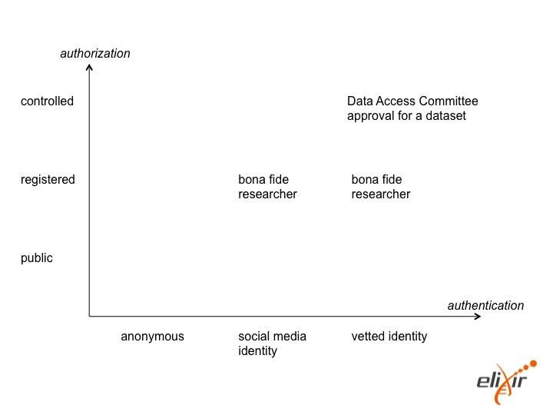
The dimensions of authentication and authorisation

Slide 9
The planned assurance levels for authentication
Strong
Face-to-face proof of identity and two factor authN
Step-up authentication
Possibly rely on external sources (e.g. eID)
Raised
Organisation-registed accounts, password authN
Log in with Home Organisation IdPs (eduGAIN)
Requires Home Organisation complying to a minimal assurance level
Basic (in place now)
Self-registrated accounts, password authN
Google, LinkedIn, ORCID authentication

Slide 10
ELIXIR AAI position
It is used by to community already
Users’ enrolment
Group and authorization management
Community is quite large
BBMRI would like to use the same approach as is used in ELIXIR
Uses validated and maintained components
Perun, REMS, OpenConext, CILogon, Kerberos, Shibboleth, VOMS
There is no own development, just deployment

Slide 11
Common BMS AAI
AARC2 project proposal has a pilot: BMS AAI
Gather use cases
Draw requirements and design
Have a pilot
Study implementation alternatives
For a Common AAI for the 11 BMS research infrastructures (in collaboration with the CORBEL project)
We can expect all those BMS to require the same AAI components

Slide 12
Perceived differences and gaps
ELIXIR AAI architecture is finalized with all the components required to do the AAI within the e-Infrastructure
Core components of ELIXIR AAI is operational
Design of EGI architecture is is not complete and list of used components is not fixed

Slide 13
User/group/VO management
ELIXIR has its own VO/group/user management system connected to the Proxy IdP directly
EGI relies on attribute authorities, it is not clear how the users will be registered to the attribute authorities and how the attribute authorities will manage additional user’s attributes

Slide 14
Authorization
ELIXIR has central component where authZ rules are defined
Services receive only relevant data, no data breach
Bona fide researcher defined
Connection with REMS for additional authZ management
In EGI AAI there isn’t clear who and where the authZ will be defined: globally? on VO level?
Proxy IdP doesn’t know the attribute values in advance, thus cannot filter them. AAs doesn’t know the target service so they cannot do filtering as well

Slide 15
Identity verification
ELIXIR can raise user’s LoA by
Managers/board approval (Perun and REMS)
Connection with ORCID and publications
Identity consolidation
EGI uses only external identities as is

Slide 16
Identity consolidation
ELIXIR consolidates users’ identities at system which do the VO/group/authZ management
Identity consolidation is done on Proxy IdP
It is not clear how this information will be published to the attribute authorities which are doing registration/management of the users

Slide 17
Common components
Perun system
At EGI works as an Attribute Authority
At ELIXIR does the whole user/group/vo management, including account linking, provisioning/deprovisioning
Can be outsourced
CILogon and other token translation components (can be outsourced)
VOMS (can be outsourced)
REMS (can be outsourced)
Proxy IdP
ELIXIR uses OpenConext components (maintained by SurfNet, used by SurfConext and delivers additional components on top of SimpleSAMLphp like OIC, step-up authN)
EGI uses OpenConext as well?

Slide 18
How to interconnect AAI infrastructures?
ELIXIR AAI should be one of many AAIs to connect to the EGI AAI, do not do proprietary interconnection
EUDAT, UNICORE, PRACE, …
BBMRI, CLARIN, DARIAH, ...
Keep it simple (avoid multiple WAYFs), but secure
Use shared components
Strong trust between AAI infrastructures and shared components – technical and political
E.g. Trusted CA at CILogon, accepted privacy policy for REMS or Perun

Slide 19
How we can harmonize work on AAI?
Share our design documents
ELIXIR AAI Requirements and Design Document (mostly align with the AARC Blue Print)
Share components
ELIXIR needs to know clear vision what the EGI AAI will deliver and what will be the quality of service
ELIXIR can then adopt technologies used in EGI, but cannot be alpha tester
Need to harmonize also policies
ELIXIR is currently developing policy documents for each of the AAI component
Privacy policy should be harmonized as well

