Slide 1
Strategic market analysis
for (defining)
sustainability potential
(after EDISON CSA ends)
T4.1 2nd Interim Report – AMS, May 19th, 2016

Slide 2
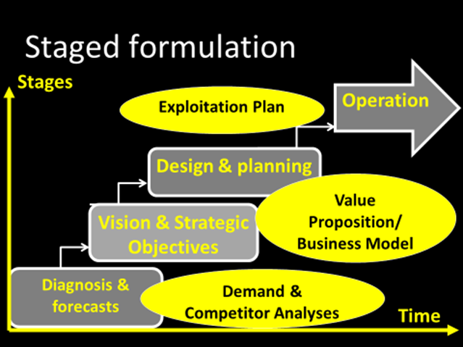

Slide 3
“Raw material”: Potential DS
DS “Producers”
- SUPPLY-
DS Employers
- DEMAND -
Fit for purpose
“Competitive product”: Skilled DS
Universities
Research
Infrastructures
Other Training Centres
Other
Research
Organisations
In-house training centres
Industry
Self-made DS channels
Public
Administration
Vital, professional & economic expectations
Value Propositions, ROI
Recruitment needs/Selection criteria
Gaps
DS professional market

Slide 4
EDISON: The Mission
Data
Scientist(s)
DS Employers:
- Research
- Industry
- Government
DS “Demand”
Education
Training
Certification
DS “Supply”

Slide 5
Windows of Opportunities
Needs in the Demand
Failures in the Supply
GAPS: NO FIT

Slide 6
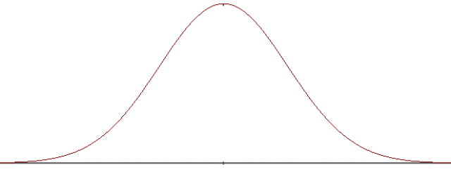
70.000.000
Telecom
Retailers
Banks/Insurance
Manufacturing
Defence/ Health
50K-200K€
70K-300K€
30K-100K€
200.000
2.000.000
Geeks´
Heavens
Researchers´
Heavens
Real worlds
Market Segments Windows

Slide 7
7 Main DS career differences
Traits | Business-Industry | Research
Driving force | Decision making | Technical support
Functions | Induce decisions | Support / bridge
Mobility | High, across employers | Up stipulated scale
Risk | prone | avoiding
Recruitment process | flexible | rigid
Training success: | Fast | Solid
1 Size does NOT fit All

Slide 9
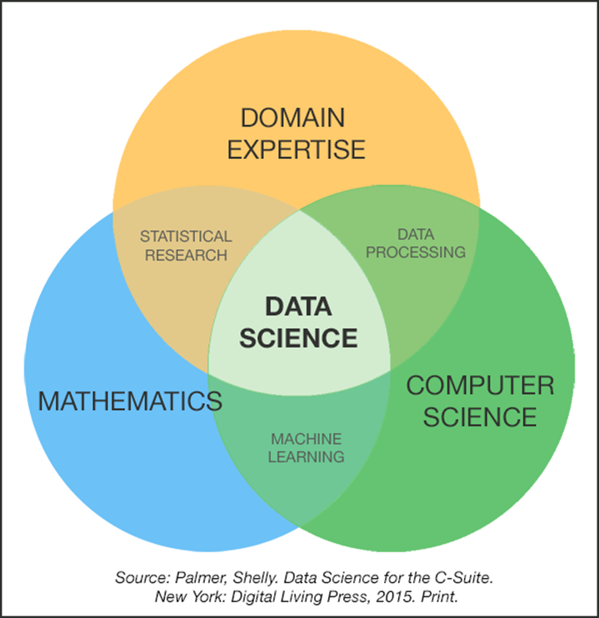
DS for Research infrastructures
Research project leaders recruit, not the organisation
What they recruit are proxies (unicorns don´t exist)
The need to retrain/train= adapt is 100% cases
Domain voc /ontology
Projects’ needs
Systems / methodologies
CS to Researchers
Domain to IT guys

Slide 10
Time-bound Window - Sense of Urgency
High in Business world
Low in Research
Public Admin: Not even aware
USA
EU

Slide 11
Product Window- DS Recruitment
Participation in the process
Closeness to required profile
+ CV/What they claim to know
+ Degrees, Certificates
Who actually gets the job
What problems they are able to solve
Social skills /empathy/team working
Mental stability, psychological profile
Ability to learn fast and adapt to local culture

Slide 12
How do you get DS trained?
2015 dataversity education L.L.C

