Slide 1
TSA1.6 for OMB
Torsten Antoni, KIT

Slide 2
Middleware specific Workflows
Various different workflows
DMSU workflow (January release)
DMSU 2nd level support
Tech Provider 3rd level support
Release announcement workflow (February release)
Tech Provider to SA2 and back
Bugs found in operations (February release)
From SA2 to Tech Provider and back
All workflows in one seperate instance

Slide 3
Report Generator
report generator remodeling (March release) New requirements
e.g. from Middleware groups
Focus on variability of the tool
Output only in further processable formats, e.g. xml (no graphics)

Slide 4
NGI Integration
Continuous integration of NGIs (ongoing)
Currently 28 NGIs in GGUS
20 as support unit (human interface)
8 with automatic interface
3 xGUS instances (DE, CH, AEGIS)
5 with local ticket system
Plan to have all NGIs connected by TF’11
Increase the rate of „proper“ interfaces
xGUS or regional Ticket System

Slide 5
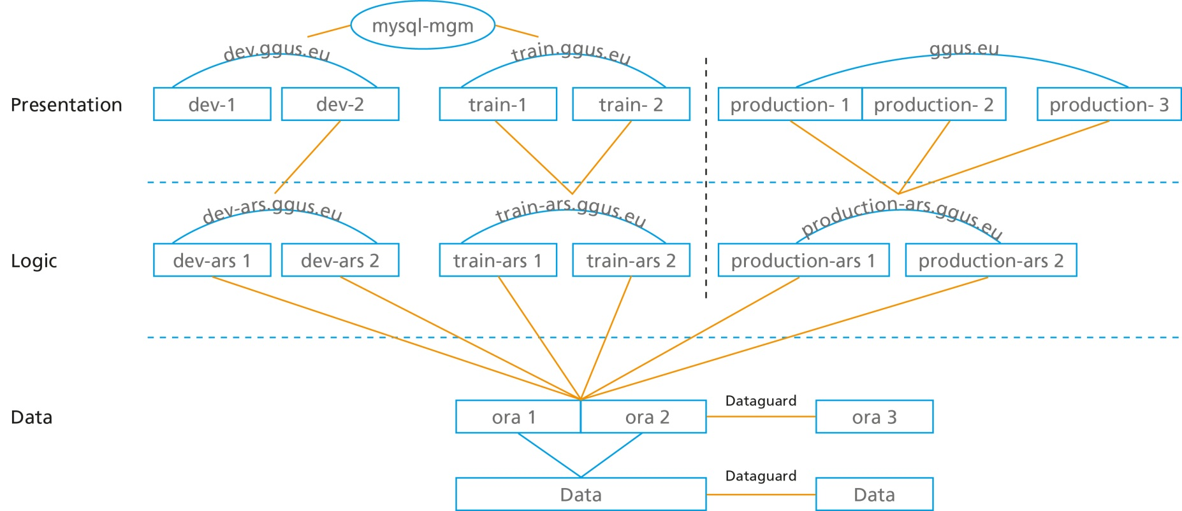
High Availability for GGUS
Data layer done
Logic and presentation layer first half of 2011 (no release date set yet)

Slide 6
MS417: EGI Helpdesk and the NGI Support Units
Due PM14 (End of June)
Internal review should start beginning of Mai
We need to start soon
Could be announced at OMB

Slide 7
Possible extension of GGUS use
Middleware workflow for non-EGI users or components
xGUS for extra-EGI projects regions
If funded or benefitting EGI

Slide 8
Clarification of requirements gathering workflows
„Too many cooks…“
OTAG discusses GGUS
USAG discusses GGUS
Tech Providers need to have a forum
Seperate xGUS requirements workflow?

