Slide 1
E-ScienceTalk PMB
E-ScienceTalk PMB Meeting Q3
27 January 2011
Telcon

Slide 2
WP1: Grid policy outreach
Progress
GridBriefing ‘Mapping the e-Infrastructure Landscape released at the e-Concertation meeting and online
e-Concertation feedback and report completed for the EC
Policy advisory group for e-ScienceTalk includes the e-IRG Board with additional advisors eg Silvana Muscella, Matti Heikkurinen, Dieter Kranzlmueller, Florida Estrella and Leif Laaksonen
MoU signed with e-IRGSP2/3
Took part in particle physics 6th Form seminar at QMUL to reach out to younger audiences
Completed policy engagement strategy deliverable
Blogged remotely from PRACE/LinkSCEEM Winter School, January

Slide 3
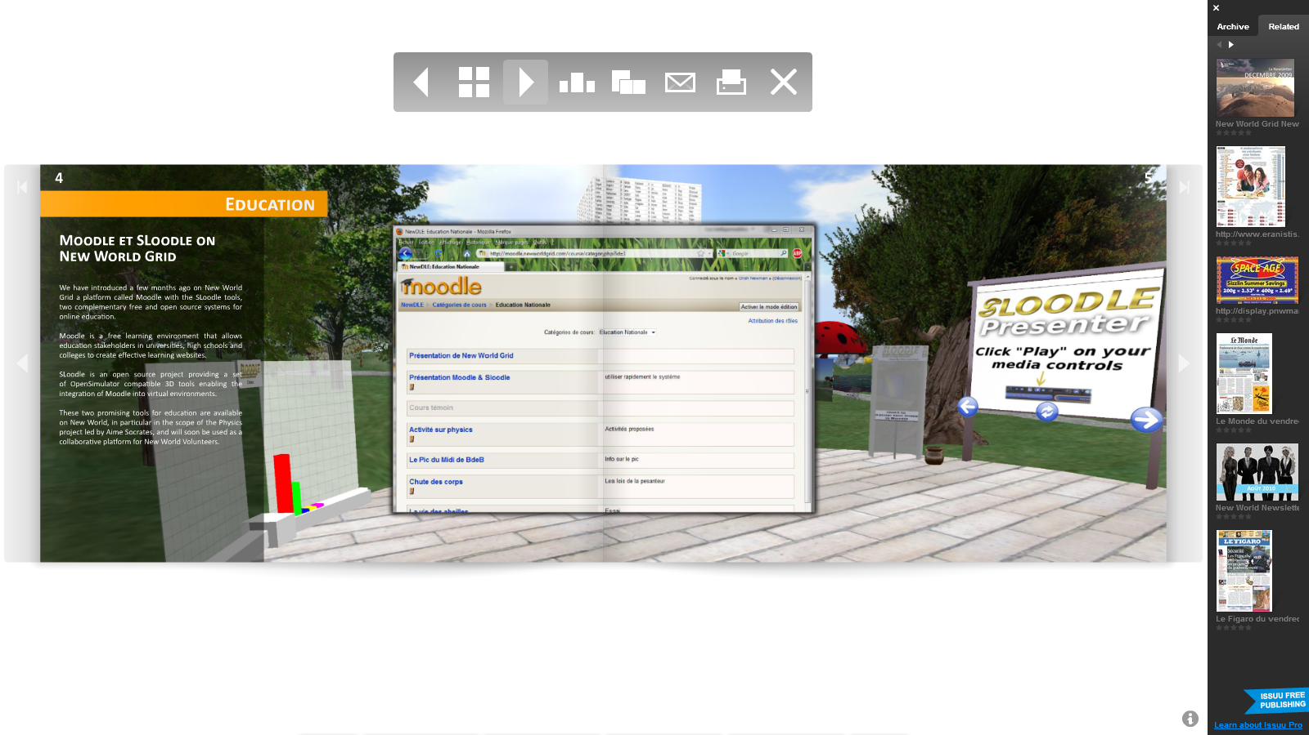
WP1: Grid policy outreach
Next steps
Supercomputing GridBriefing currently being designed
New name for the GridBriefings at the close of Year 1.
Working on making them more readable and searchable online.
Identifying policy events for later in the year eg eChallenges, October, Florence
Future topic ideas
International dimension of grids
eGovernment
Impact indicators
Digital Agenda for Europe
Next Framework programme

Slide 4
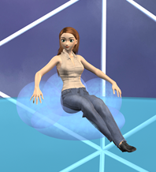
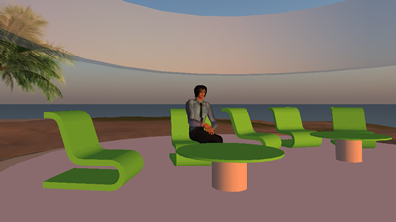
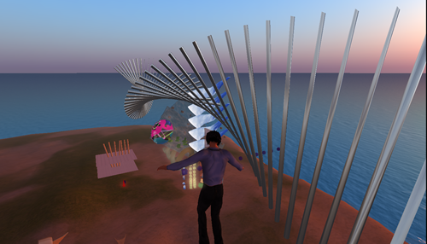
WP2: GridCafé, GridCast, GridGuide
Progress
e-ScienceTalk
Feeds included from iSGTW on to the home page
Working on a new CMS to drive all the websites – Drupal
GridCafé
French version of GridCafé launched in December
Russian translation worked on by intern at QMUL, testing the script in Drupal
Concept ideas for e-ScienceCity developing, along with the 3D GridCafe
Cleaned up references to old projects, now identifying new people profiles
GridCast
Mini GridCast at EUAfrica e-Infrastructures Meeting, 9-10 Dec, Helskinki (+poster, media sponsorship)
GridCast at PRACE/LinkSCEEM Winter School, 24-27 Jan, Nicosia
(5 bloggers)
GridGuide / RTM
More than 600 CE reports added, round trip enquiry time issues solved to show more jobs.

Slide 5
WP2: GridCafé, GridCast, GridGuide
Next steps
e-ScienceTalk
New leaflet and promotional materials eg pens, banner
Copyright notices – apply by the end of the first period
GridCafé
New translations for the GridCafé eg Chinese – ASGC working on this
Volunteer computing contributions from Citizen CyberScience (and EDGI)
Build the new e-Science landing area
Build a test version of the CloudLounge ready for the CloudScape III event in March
GridCast
Longer, more editorial posts – some of these have been tried out
Upcoming GridCasts at Cloudscape-III, ISGC, TERENA TF-CPR, EGI User Forum, PRACE/DEISA Symposium
Experiment more with longer videos, a ‘day in the life’, a conference overview, vox pops
GridGuide / RTM
Work on the USP – who is it for? NGIs being encouraged to add sites. NRENs?
Should we also include projects as well as individual sites?
Working with ATLAS to include their jobs as a new layer in RTM

Slide 6
WP3: iSGTW
Progress
New editor appointed, starts on 1 April 2011
New edition launched as the Digital Scientist as planned on 12 January 2011 using the new CMS.
Legal letter received on Friday 14 January
Now publishing as iSGTW from isgtw.org while we await legal advice from Fermi
First feedback gathered from CERN IT Dept, PMB, Board and EC
Any further PMB feedback?

Slide 7
WP3: iSGTW
Next steps
Implement changes to the site layout before it becomes too fixed
Decide whether to pursue using The Digital Scientist name
If not, identify a new name in collaboration with the PMB, Board and EC
Issues
Remaining development budget for changing to a new name
Funding a ‘due diligence’ check on a new name ($1-2000 per name)
Moving the ownership of the URL to Europe
Legal protection of iSGTW and the new name

Slide 8
WP4: Management
Progress
All pre-financing payments made to partners – EC very slow to authorise payments
Dissemination Plan submitted in PM2, Quality Plan and Policy Engagement Strategy in PM3
QR1 report submitted in PM4
Project timesheets moved to EasyTS
Presentations planned at ASSYST, Paris, 31 January and British Science Association Science Communication Conference, UK, 25 May
Costings for e-Concertation meetings now confirmed, working on an amendment to the DoW
Weekly meetings continuing with the project team, F2F held at CERN in December to discuss long term aims
Travel: invitations to Taiwan for ISGC, some costs will be met
MoU with e-IRGSP2/3 now signed, EUIndiaGrid ready to sign, other leads identified at the CHAIN Launch event

Slide 9
Q1 Effort
Overall effort achieved in Q1 in PMs: per work package
Work package | September | October | November | Total | Year plan | Linear Q plan | % achieved
WP1 | 1.2 | 1.6 | 1.1 | 3.9 | 46.0 | 4.2 | 92%
WP2 | 1.4 | 1.4 | 1.6 | 4.3 | 64.0 | 5.8 | 75%
WP3 | 1.4 | 2.2 | 2.2 | 5.7 | 52.0 | 4.7 | 121%
WP4-M | 0.6 | 0.5 | 0.7 | 1.7 | 17.0 | 1.5 | 113%
WP2-UNF | 0.0 | 0.0 | 0.0 | 0.0 | 8.0 | 0.7 | 0%
WP4-UNF | 0.0 | 0.0 | 0.1 | 0.1 | 5.0 | 0.5 | 18%
Total | 4.6 | 5.6 | 5.6 | 15.8 | 192.0 | 17.5 | 90%
Overall effort achieved in Q1 in PMs: per partner
Partner | September | October | November | Total | Year plan | Linear Q plan | % achieved
CERN | 1.1 | 2.2 | 2.2 | 5.5 | 67 | 6.1 | 90%
APO | 1.1 | 1.3 | 1.0 | 3.4 | 34 | 3.1 | 110%
QMUL | 1.2 | 1.0 | 1.1 | 3.3 | 47 | 4.3 | 80%
IMPERIAL | 0.6 | 0.6 | 0.6 | 1.8 | 26 | 2.4 | 80%
EGI.eu | 0.6 | 0.5 | 0.7 | 1.8 | 18 | 1.6 | 110%
Total | 4.6 | 5.6 | 5.6 | 15.8 | 192 | 17.5 | 90%

Slide 10
Expected spend profile
Partner | WP1 | WP2 | WP3 | WP4 | Total | 1st Year
EGI.eu |  |  |  | 187.694 | 187.694 | 68.252
QMUL | 223.513 | 56.858 | 40.627 |  | 320.998 | 116.727
APO | 28.088 | 154.882 | 28.088 |  | 211.057 | 76.748
Imperial |  | 114.181 |  |  | 114.181 | 41.520
CERN | 69.164 | 77.562 | 319.344 |  | 466.070 | 169.480
Total | 320.764 | 403.485 | 388.057 | 187.694 | 1.300.000 | 472.727
Overall EC contribution is 1.3million Euros

Slide 11
Estimated expenditure
Estimated personnel expenditure Q1 (in K euros)
Work package | Sept | Oct | Nov | Cumul Direct | Cumul Indirect | Cumul Eligible | Q1 Estimated Funding
WP1 | 6.130 | 7.913 | 5.423 | 19.466 | 3.893 | 23.359 | 20.829
WP2 | 7.540 | 7.695 | 8.448 | 23.683 | 4.737 | 28.420 | 25.341
WP3 | 7.971 | 12.957 | 13.479 | 34.407 | 6.881 | 41.288 | 36.815
WP4-M | 4.053 | 3.667 | 4.522 | 12.243 | 2.449 | 14.692 | 13.100
WP2-UNF | 0 | 0 | 0 | 0 | 0 | 0 | n/a
WP4-UNF | 0 | 0 | 830 | 830 | 166 | 996 | n/a
Total | 25.694 | 32.232 | 32.703 | 90.629 | 18.126 | 108.755 | 96.085

Slide 12
Deliverables and milestones tracking
Months | 1 | 2 | 3 | 4 | 5 | 6 | 7 | 8 | 9 | 10 | 11 | 12
WP1 Policy
T1.1 Policy |  | D1.2.1 | D1.1 |  | D1.2.2 |  |  | D1.2.3 |  |  | D1.2.4
T1.2 Impact |  |  |  |  |  |  |  |  |  |  | D1.3
T1.3 Events |  |  | MS1
WP2 GridCafé
T2.1 GridCafé
T2.2 GridGuide |  |  |  |  |  |  |  |  |  |  |  | D2.1
T2.3 GridCast |  | MS4 |  |  |  | MS4 |  |  |  | MS4
WP3 iSGTW
T3.1 Weekly | D3.1 cont. |  | D3.2 |  |  |  |  |  |  |  |  | D3.4.
T3.2 New media |  |  |  |  | MS7 |  |  |  | D3.3 |  | MS7
WP4 Mgmt
T4.1 | MS10 | D4.1 | D4.2 | MS10 |  | MS11 | MS10 |  |  | MS10 |  | D4.3 MS12
Complete
In preparation
Overdue

