Slide 1
Forest Fire Case Study (ID) DMCC Working Group, APAN42th , Hongkong 2016
Basuki Suhardiman
Directorate System and Information Technology , ITB

Slide 2
Outline
Background
Current conditions
Design Thinking (Concept)

Slide 3
Firewatch in Forestry
Iniatiatited by Ministry of Forestry in the early 2001
In 2009 collaboration between Indonesia and Australia (Landgate) for reducing the fire and hazard smoke
Ministry of Forestry , Ministry of Environment and Indonesia National Insitute of Aeronautics and Space (LAPAN)
Australia , LANDGATE
Deliver the Data from satellite through Network (Inherent/NREN in 2010 – 2012)
Ministry of National Education
In 2014
Burning from the Land in Sumatra and Kalimantan causes the smoke to other country
In 2015
Burning from the peatland effected half of the wolrd

Slide 4
Firewatch Initiatives
Ministry of Forestry and LAND-gate Australia
MODIS-Data from NASA
Collaboration Ministry Forestry with Ministry of Education (2010) for delivering the Hotspot information (Fire) through the Inherent (University of Palangkaraya and University of Riau )
In 2015, ITB initiatives again for firewatch
Data Analysis through satellite
Sosialize the environment impact through the social media (Facebook/twitter)
Prevent air filter system solution in classroom
In 2016
Prevent initiatives for building the near realtime model with Authomatic Weather System and Environment Sensor

Slide 5
Indofire (2010)
Collaboration Ministry of Forestry and LAND-gate Australia to monitor Hotspot in Forestry

Slide 6
MODIS Data –NASA
Wild fire on 2015
Source Data from MODIS Data- NASA
https://earthdata.nasa.gov/earth-observation-data/near-real-time/firms/active-fire-data
Get Updates every days
Needs to process with big capacity of computing
Get KML data using KML (google earth) and visualize in Google Earth
With the KML format , directly we can used the exact information where the fire’s came from

Slide 7
Google with KML’s data from MODIS NASA
Confidence level :100 %
https://earthdata.nasa.gov/earth-observation-data/near-real-time/firms/active-fire-data

Slide 8
Capture on 30-10-2015

Slide 9
Earth.nullschool.net
The Fire affected by the Wind direction and speed
The indicators :
COsc , Carbon Monoxide surface concentration
Wind directions and speed
a visualization of global weather conditions forecast by supercomputers updated every three hours
Good as a models
Need more precise informartion on the location affected
CO : 3424 ppbv

Slide 10
29-10-2015
10.09 WIB
15.57 WIB
CO : 10.954 ppbv
CO : 1599 ppbv
(south Sumatra)

Slide 11
30-10-2015
10.23 WIB
12.33 WIB
CO : 542 ppbv
CO : 421 ppbv

Slide 12
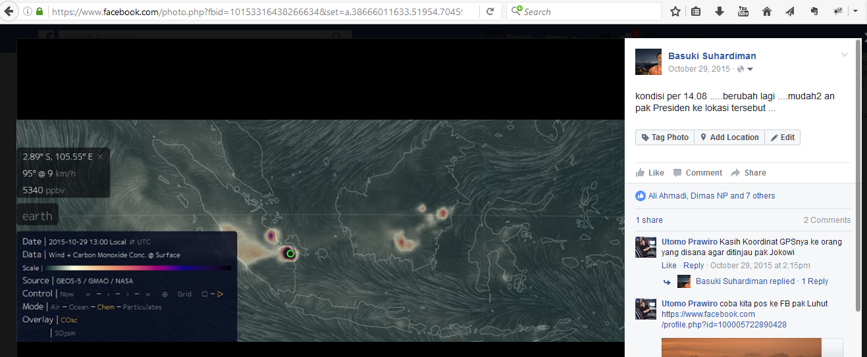
To socialize via Social Media
Every updated from http://Earth.nullschool.net
Captured the information and graph and put in Via Facebook

Slide 13
Installation for reduce Polution Index in Classroom
Zeily Nurachman ,
Department of Chemistry
ITB

Slide 14
Background
The smoke from wildfire in Sumatra and Kalimantan (peat land)
The effect of the fire in Foresty effected untill more than 300 km from the source
For example ; the source from the fire in South Sumatra and the effect of the smoke , CO and particulate matters (PM) until West Sumatra
When haze came , school dismissed the students. This dangeorus because they do not come to safe places
Several researcher from ITB initiatives to build safe class in class and building the haze protection system

Slide 15
Principle
TERBUKTI
(Proven)
Reduce air polution Index
MUDAH
(Simple)
Simple implementation and maintenance
Haze protection System
MURAH
(Cost effectiveness)
Cheap mateial , easy to install
EDUKASI
(Education)
The education’s media for pupil /students
MUMPUNI dan KONTINYU
(Reliable and Sustainable)
Can be used continuously after the smoke problem is finished
Notes:
.

Slide 16
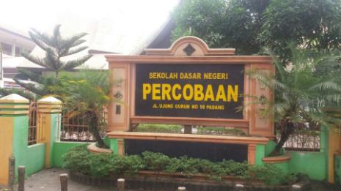
Trial
Location : SD Percobaan – Kota Padang
timeline : 27 – 28 Oktober 2015

Slide 17
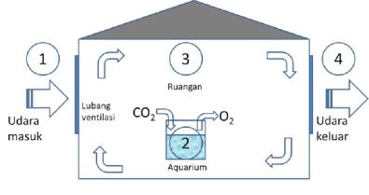
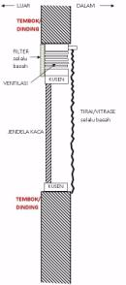
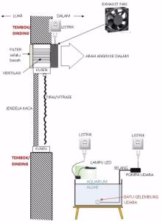
Installation system
Aquarium
Kipas Angin
Exhaust Fan
Tumbuhan
Air filter

Slide 18
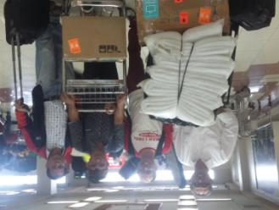
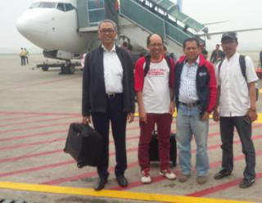
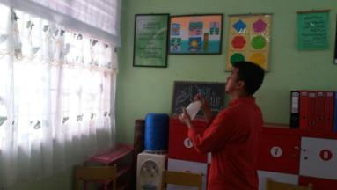
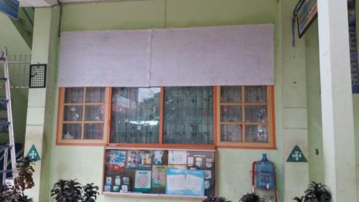

Slide 19
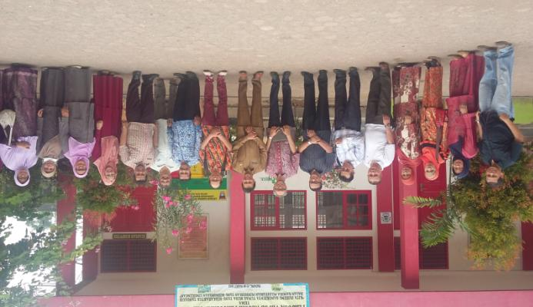
Results
Reduce Air Polution Index (PM)
Index on City (Padang) = 288
Index on the class room after installation = 78

Slide 20
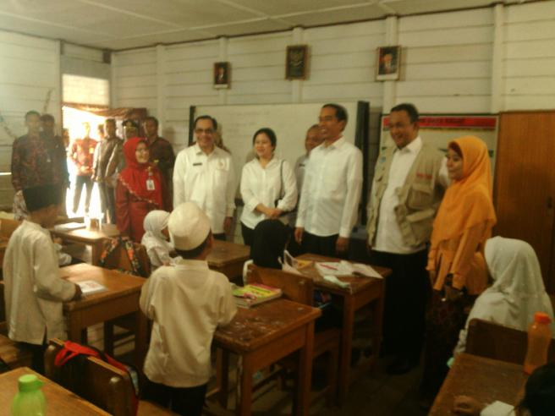
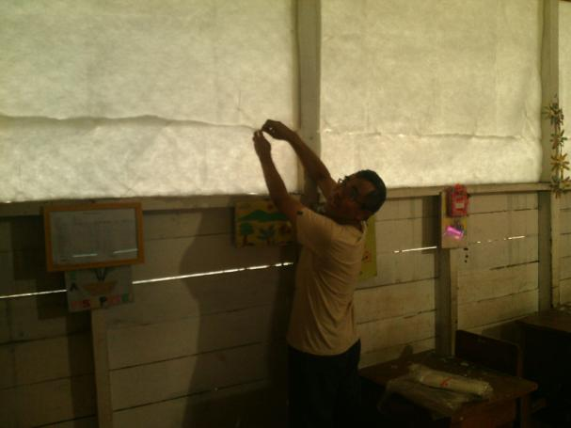
President visited to School

Slide 21
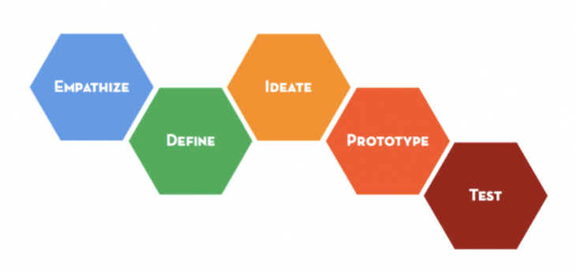
Concept (Design Thinking)
Focus on People and Environment
http://dschool.stanford.edu/

Slide 22
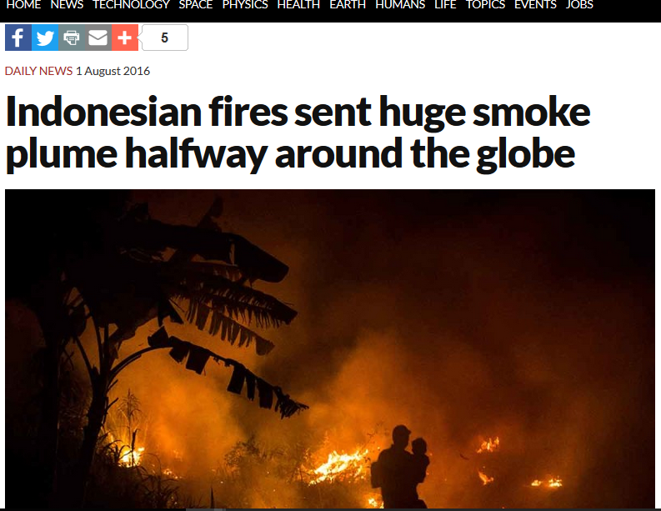
New Scientist (1 August 2016)
https://www.newscientist.com/article/2099496-indonesian-fires-sent-huge-smoke-plume-halfway-around-the-globe/?utm_medium=Social&utm_campaign=Echobox&utm_source=Facebook&utm_term=Autofeed&cmpid=SOC%7cNSNS%7c2016-Echobox#link_time=1470082665

Slide 23
Current Condition
http://fires.globalforestwatch.org/map/#activeLayers=viirsFires%2CactiveFires&activeBasemap=topo&x=112&y=-1&z=5

Slide 24
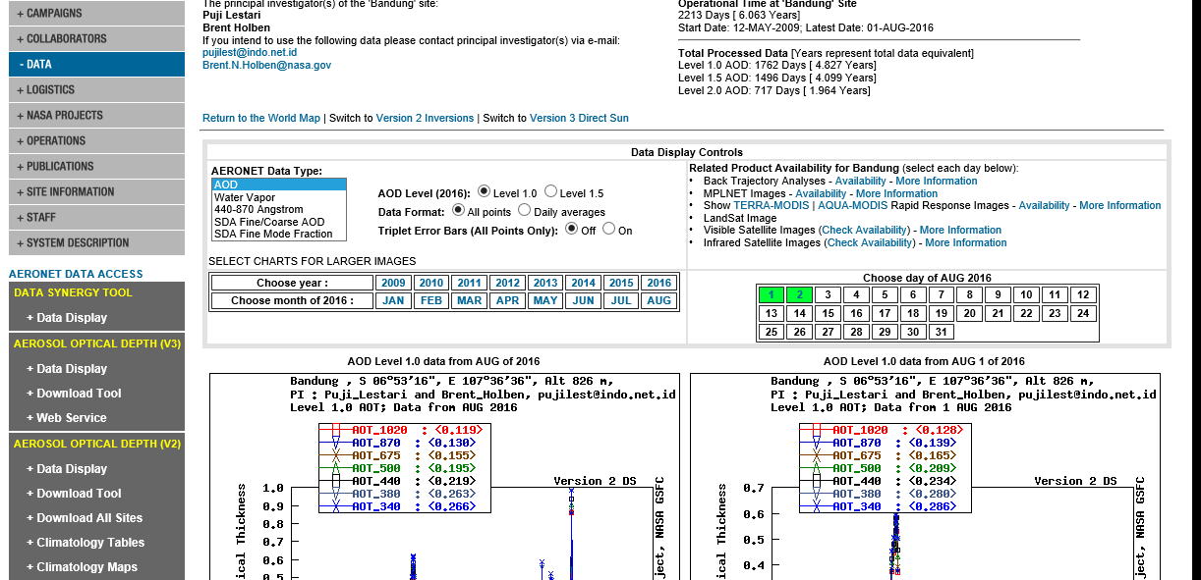
Aerosol Sensor in Indonesia (NASA)
Initiated by NASA
Collaboration with several institution (incl ITB)
Six Sensor
Bandung
Jakarta
Palangkaraya
Pekanbaru
Jambi
PM 10
http://aeronet.gsfc.nasa.gov/cgi-bin/type_one_station_opera_v2_new?site=Bandung&nachal=0&year=24&month=7&aero_water=0&level=1&if_day=0&if_err=0&place_code=10&year_or_month=0

Slide 25
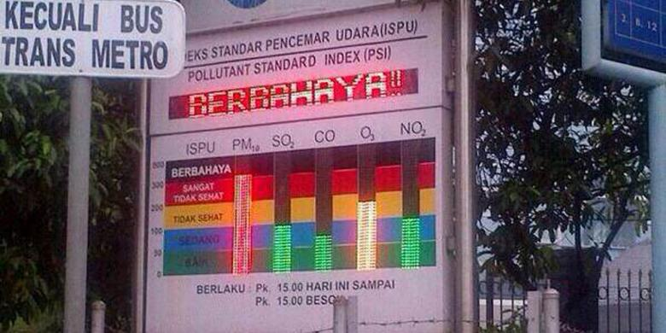
Environment Sensor
Environmental sensor with Polutant standard Index (PSI)
PM10
SO2
CO
NO2
Locally
Not connected to the Network and Sensor Network
Not connected to central database

Slide 26
Define
What we (Indonesia) need it ?
Automated Weather Station
Rainfall
Temperature
Humidity
Air quality Index and Polution Standard index measurements
NOx, SOx , CO , NH3 , O3 and PM 2.5 (10)
Sensors and sensors network
Prediction models
Socialize to peoples
https://en.wikipedia.org/wiki/Pollutant_Standards_Index

Slide 27
IDeate
By combining the satellite data with meteorological records, Field established that Indonesian fires often occur in association with the ultra-dry conditions in the region that accompany El Niño, a major cyclical weather system. These dry out the underlying peat to the point at which it can catch fire and can’t be extinguished until monsoon rains arrive months later. A next step might be to refine the predictions further by including the combined effects of high temperatures and low humidity on peat moisture, says Field.
He also found that less than 4 millimeters of rain per day during the annual dry season, from August to November – combined with El Niño conditions – seems to be a “tipping point” beyond which fires can to suddenly take off.
https://www.newscientist.com/article/2099496-indonesian-fires-sent-huge-smoke-plume-halfway-around-the-globe/?utm_medium=Social&utm_campaign=Echobox&utm_source=Facebook&utm_term=Autofeed&cmpid=SOC%7cNSNS%7c2016-Echobox#link_time=1470082665

Slide 28
IDeate
Build prototype for AWS+sensor base on Arduino
Board (I/O)
Communication
GSM/GPRS/Wifi
Ethernet
USB/Storage System
Sensors
Temperature
Wind speed
Wind direction
Humidity
Rainfall rate
CO
Build Polution Protection System in the School (classroom)
In areas where affected by
Put the AWS in the area with near forestry/ peatland

Slide 29
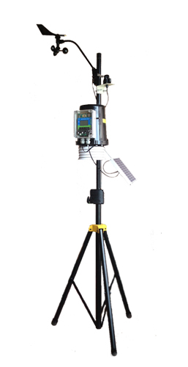
Prototype
Forestry (School)
GSM/GPRS Modul
TCP/IP
ITB
Web Server
For collecting data
And
Portal
Arduinno
Microcontroller
GPS modul
AWS
-Wind Direction
-Wind speed
-Temperature
Humidity
Rain fall
USB /Storage
CO sensor
And other sensors
Middle Ware
Network of Science Community
NASA/NOAA web server ,etc

Slide 30
Test
Put the AWS+ Sensor in School in some forestry areas (South Sumatra, Jambi , Pekanbaru and Central Kalimantan)
Combine the near realtime data measurement with satellite data and prediction model
Running as a live model
Get the feedback from the community

Slide 31
Main Challenges (Future)
Data sharing
Data are available only in web based information systems
Need to develop web services to make those data available to others
http://weather.meteo.itb.ac.id/aws.php is one example that have some of their data available to others using web service (by request)
Build the model for reduce impact on Disaster
Fire on Forestry / Land fires
CO/CO2 models
PM (Particulate Mattes 2.5 micron)
Build the Sensor Network
AWS (Automatic Weather Station)
Carbon Monoxide (CO)
Carbon Dioxide (CO2)
Particulate Matter
Simuation on Environment impact peoples

Slide 32
Community Engagement and Support
Government Support
Ministry of National Education
Ministry of Forestry and Environment
University Support
Weather Modelling
Sekolah Bebas Asap (Reduce pollution index in Classroom)
Community Support
Schools and Universities
Indonesia bebas asap (Smoke-Free Indonesia)
Notes:
Supporting activity to reduce the effects of smog caused by land fires

Slide 33
Thank You

