Slide 1
WLCG SOC WG
Ian Neilson
GridPP Security Officer

Slide 2
Background
Set up at March GDB after WLCG Workshop, Lisbon 2016
Jointly chaired -
David Crooks (Glasgow) and Liviu Valsan (CERN)
acknowledged for (almost) all slide content that follows !
http://indico.cern.ch/event/394782/
https://indico.cern.ch/event/394831/
Wikipedia SOC
An information security operations center (ISOC) is a dedicated site where enterprise information systems (web sites, applications, databases, data centers and servers, networks, desktops and other endpoints) are monitored, assessed, and defended.

Slide 3
Context
A need for external observability of systems & networks
Increasingly opaque execution environments
VMs, Containers
Increasing amount of security monitoring data being produced
+ reductions in manpower to cope with this
Identify tools available to WLCG sites of different sizes and provide appropriate guidance
Leverage data analytics and Big Data frameworks used within our communities to provide security alerting, traceability and forensics information

Slide 4
Scope I
Identify data that SOCs can / should provide
Both in terms of sources from which the SOC ingests data as well as necessary outputs
Identify necessary components of a SOC for typical WLCG sites of different sizes
Recognising that local needs will be likely to vary
Reference designs for SOCs of different sizes which could include installation guidance or appliances

Slide 5
Scope II
Identify key stakeholders to be considered in the deployment of a typical SOC, including but not be limited to:
Local sysadmins
Local security teams
Campus security teams
NGI security teams/officers
VO Security teams
Data protection / privacy and information sharing policies
Timeframe for delivery (differentiated between outcomes)

Slide 6
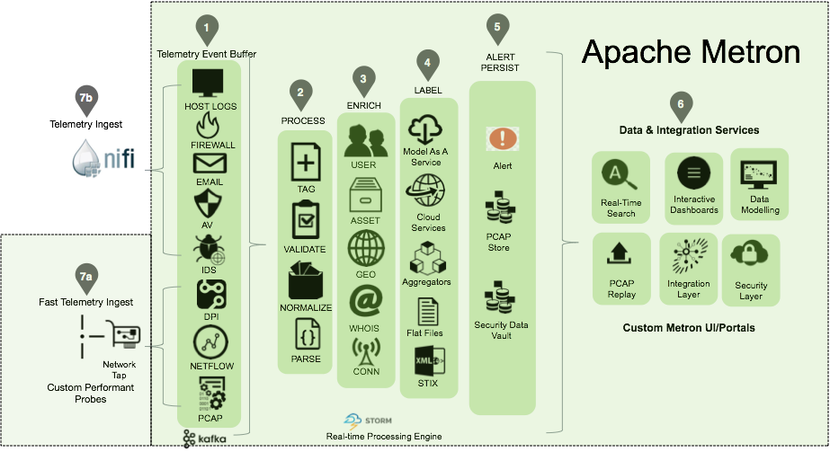
CERN SOC
CERN quite far advanced with custom campus SOC
Similar architecture/flow to OpenSOC -> now Apache Metron
Ingest monitoring data
Enrich with information (network/DNS/GeoIP)
Correlate with intelligence (e.g. MISP)
Store, index, alert, visualise.

Slide 7
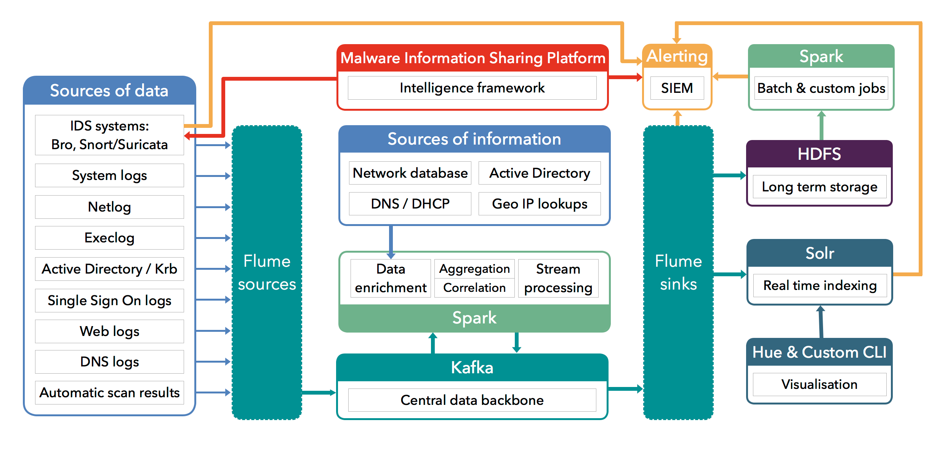
CERN SOC

Slide 8
Progress and Challenges
Metron and CERN SOCs
Large, complex (=? fragile) stacks
Applicable at campus level
Can components be used in isolation for smaller sites?
Can a SOC-in-a-box be created for easy deployment and use with less manpower?
WG starting “at each end”
Bro IDS and MISP could be used as minimal framework
Create a small peering of MISP instances (currently UK NGI-based)
Test instances running at Glasgow and RAL
To understand the tool and how it might be used
Challenge is probably not the tool but the human trust networks.
Configure Bro instances to gain experience

Slide 9
Thank You.

