Slide 1
EGI CSIRT Web Presence
Barbara Krasovec, Sophie Ferry, Ian Neilson

Slide 2
Objectives
https://rt.egi.eu/rt/Ticket/Display.html?id=10884
Improve image of CSIRT to outsiders
https://www.egi.eu/about/policy/groups/EGI_Computer_Security_Incident_Response_Team_EGI_CSIRT.html
isn’t very exciting
https://wiki.egi.eu/wiki/EGI_CSIRT:Main_Page
is ... a wiki mess
all the information (and more) is there but v. hard to navigate
Improve accessibility of information for insiders
Side effect to filter outdated wiki content

Slide 3
So Far ..
Not much concrete discussion ☹
Reviewed quite a few other CSIRT websites
us-cert.gov | cert.gov.uk | icic.gob.ar | csa.gov.sg | circl.lu | bsi.bund.de
jisc.ac.uk | surf.nl
“These site look all the same to me ! But yes, better than the wiki.” – S. Ferry
Talked briefly to Sara@EGI
but need to be further down the path to use her skills
Got a bit bogged down in naming/branding
e-csirt, wise-csirt, ….
?tbd

Slide 4
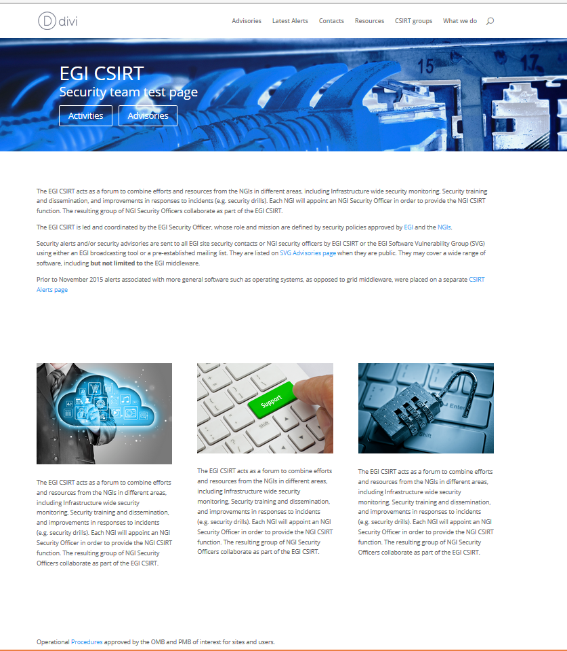
So far ..
However ☺
Barbara likes to webmaster the new site ☺ ☺
Got permission to host CSIRT pages at Arnes
“Provided we don’t need special themes and plugins”
Checked themes and recommends -
http://barbara.splet.arnes.si/vzorcna-stran/

Slide 5
Decisions
Overall structure
as Barbara suggests?
HEADER - CSIRT LOGO + main menu + 2 buttons (advisories and latest alerts)
SLIDE 1 - buttons/links to subpages (activities, CSIRT groups,
resources, contacts)
SLIDE 2 - 3 main descriptions/missions of CSIRT
SLIDE 3 - Latest advisories + alerts
FOOTER - Logos, Sponsors and Links
Public and private: how to handle
Start with glossy public of course!
Content
Pages on the public wiki (~50 excl. ~50 Alerts)
Pages on private wiki (too many)

