Slide 1
Orchestration & Container Management in EGI FedCloud
Enol Fernández
enol.fernandez@egi.eu

Slide 2
Containers
Containers provide virtualisation at the OS level
  Same kernel, isolated user-space
  Faster deployment, less overhead, easier migration…
App A
App B
App A
App B
containers
VMs
libs/bins
libs/bins
MONOLITHIC
SLOW TO BOOT
HEAVY OVERHEAD
libs/bins
libs/bins
Guest OS
Guest OS
Hypervisor
Docker Engine
Host OS
Host OS
Server
Server
Notes:
CONS:
Same kernel for every container, may not be valid for every application (not a problem for most cases)
Security? Not clear the implications for multi-tenancy (i.e. several users executing containers in the same host)

Slide 3
Containers
Containers provide virtualisation at the OS level
  Same kernel, isolated user-space
  Faster deployment, less overhead, easier migration…
App A
App B
App A
App B
containers
VMs
libs/bins
libs/bins
LIGHTWEIGHT ISOLATED PORTABLE EFFICIENT
libs/bins
libs/bins
Guest OS
Guest OS
Hypervisor
Docker Engine
Host OS
Host OS
Server
Server
Notes:
CONS:
Same kernel for every container, may not be valid for every application (not a problem for most cases)
Security? Not clear the implications for multi-tenancy (i.e. several users executing containers in the same host)
Containers are a solution to the problem of how to get software to run reliably when moved from one computing environment to another. This could be from a developer's laptop to a test environment, from a staging environment into production and perhaps from a physical machine in a data center to a virtual machine in a private or public cloud.

Slide 4
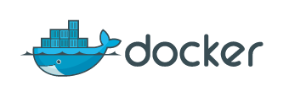
Docker
“Open-platform for building, shipping and running distributed applications”
Docker commoditizes containers
  Hides and automates container management process
  One-command-line deployment of applications
  Easy to move from development to production
  Provides ecosystem to create and share images

Slide 5
Managing Docker applications
Applications are usually composed of several containers linked together
Docker-compose allows defining and running multi-container applications.
  Define on a file the application’s services and dependencies
  Create/Start services with single command

Slide 6
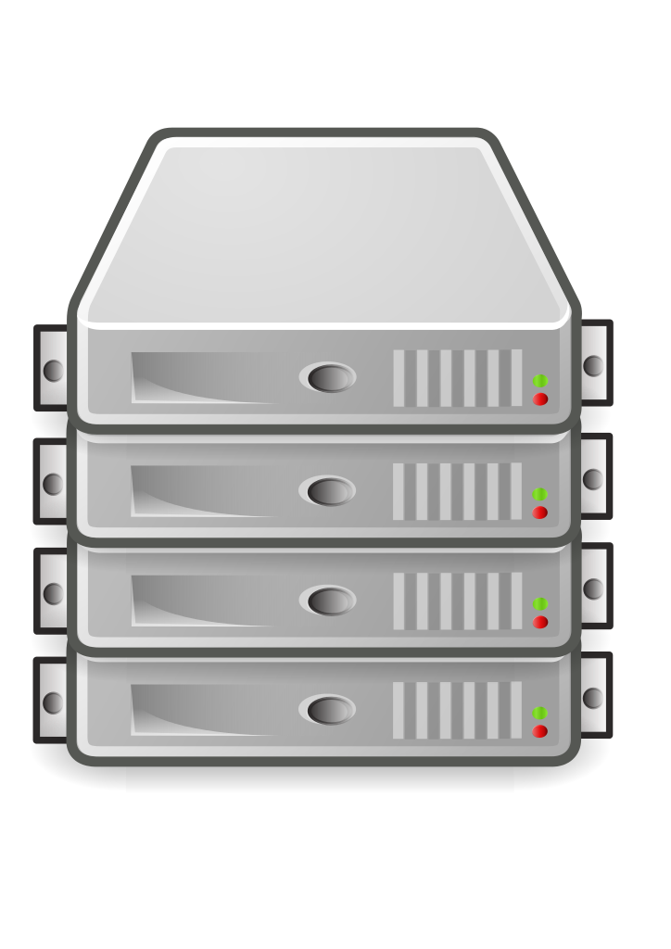
Container orchestration
App A
Container
Container
Container
Container
Container
Orchestrator
App B
Container
Container
Container
Container
Schedule containers to physical or virtual machines
Restart containers if they stop
Provide private container network
Scale up and down
Service discovery
Infrastructure
Notes:
Once the application needs to scale (i.e. run in more than one host) a container orchestrator is essential to manage the mapping of containers to available hosts.
That means they help you launch and manage clusters of containers. A container orchestrator is essential if you want to run containers at scale, since admins quickly reach the limitations of human abilities if they try to manage many containers manually using the Docker CLI. Swarm and Kubernetes automate most of the tasks involved in running containerized infrastructure, such as spinning up more containers in response to an increase in demand.

Slide 7
Kubernetes (I)
Kubernetes is an open-source platform for automating deployment, scaling, and operations of application containers across clusters of hosts, providing container-centric infrastructure.
Key concepts:
  Pod: group of one or more containers, shared storage and options to run the containers
  Deployment maintains the desired count of Pods all the time
  Service: logical set of Pods and a policy by which to access them.
    Exposed to the exterior of the Kubernetes cluster via mapping of ports and or Load Balancing
  Job: A job creates one or more pods and ensures that a specified number of them successfully terminate.
Notes:
Kubernetes is inspired from an internal Google project called Borg
100% Open source, written in Go
V1.5 releasedDec 2016
Declarative approach to deploying applications .
Kubernetes is comprised of a set of independent, composable control processes that continuously drive current state towards the provided desired state.
Pods are meant to be mortal, live and die according to the state of the cluster and the controllers managing them
Deployment use Replication Sets
NodePort: on top of having a cluster-internal IP, expose the service on a port on each node of the cluster (the same port on each node). You’ll be able to contact the service on any <NodeIP>:NodePort address.
LoadBalancer: on top of having a cluster-internal IP and exposing service on a NodePort also, ask the cloud provider for a load balancer which forwards to the Service exposed as a <NodeIP>:NodePort for each Node.
Jobs allow to do batch-like executions, but not designed to support closely-communicating parallel processes, as commonly found in scientific computing.

Slide 8
Kubernetes (II)
Image from:
http://www.slideshare.net/KasperNissen1/google-cloud-platform-and-kubernetes

Slide 9
Docker Swarm (I)
Docker Swarm provides native clustering capabilities to turn a group of Docker engines into a single, virtual Docker Engine.
Image taken from
http://www.slideshare.net/Docker/docker-swarmmikegoelzermvmeetup45minworkshop-02242016-1-58805924

Slide 10
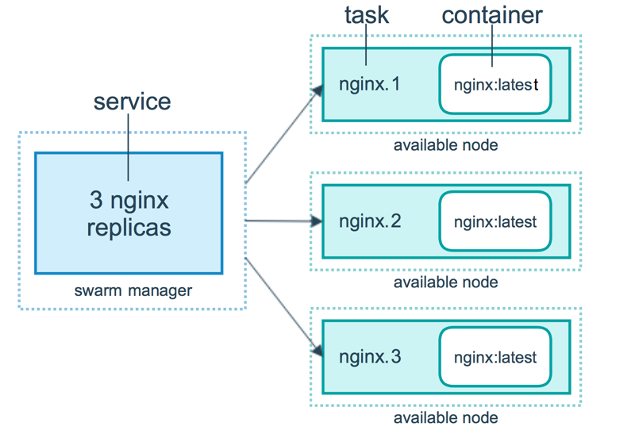
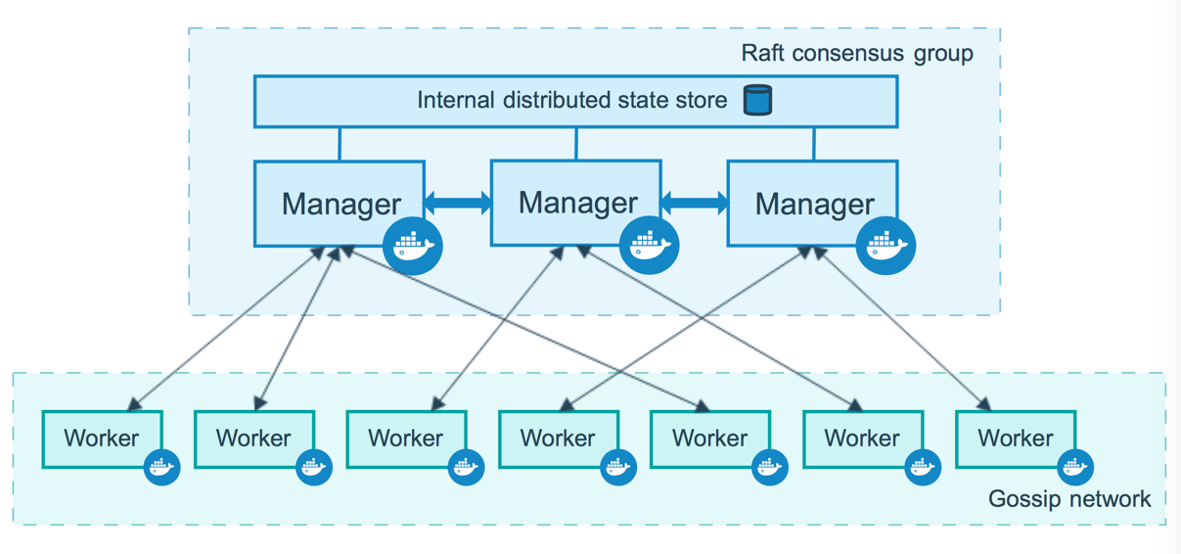
Docker Swarm (II)
SwarmMode introduced in Docker 1.12 (July 2016)
  Integrated with Docker Engine → simplified deployment
  New concepts similar to Kubernetes declarative model: services & tasks
Notes:
A service is the definition of the tasks to execute on the worker nodes. It is the central structure of the swarm system and the primary root of user interaction with the swarm.
When you create a service, you specify which container image to use and which commands to execute inside running containers.
In the replicated services model, the swarm manager distributes a specific number of replica tasks among the nodes based upon the scale you set in the desired state.
For global services, the swarm runs one task for the service on every available node in the cluster.
A task carries a Docker container and the commands to run inside the container. It is the atomic scheduling unit of swarm. Manager nodes assign tasks to worker nodes according to the number of replicas set in the service scale. Once a task is assigned to a node, it cannot move to another node. It can only run on the assigned node or fail.

Slide 11
Apache Mesos (I)
Apache Mesos abstracts CPU, memory, storage, and other compute resources away from machines (physical or virtual), enabling fault-tolerant and elastic distributed systems to easily be built and run effectively.
Images taken from
http://www.slideshare.net/tnachen/scale-your-docker-containers-with-mesos

Slide 12
Apache Mesos (II)
Marathon:
  Distributed init for long running services
  Start, stop, scale update apps
Chronos:
  Replacement for cron: scheduler for batch and one-off jobs
  Dependency job graph execution
Mesos is used in INDIGO-DataCloud for running user containers

Slide 13
Deploying the container orchestrators
All the tools require to be deployed on the infrastructure that they will manage
Initial effort on FedCloud with manual step-by-step guides
  Easily outdated
  Too complex for most users
Now moving into automated management:
  Infrastructure provisioning to manage the IaaS resources (e.g. IM, Terraform, SlipStream)
  Configuration management to deploy and configure the tools (e.g. Ansible, Puppet, Chef…)

Slide 14
IM – Infrastructure Manager
IM is a platform to deploy on demand customizable virtual computing infrastructures.
  Multiple VMs with multiple configurations.
Infrastructure-Agnostic
  OpenNebula, OpenStack, EC2, GCE, OCCI (FedCloud), FogBow, Docker, LibVirt.
Powered by Ansible to deploy configurations
  Repository with recipes for common deployments (e.g. Hadoop, Mesos, etc.)

Slide 15
Next steps in FedCloud
Develop/Adopt recipes for configuration management tools (mostly Ansible)
  Deploy Swarm, Kubernetes and Mesos
Ongoing Assessment of Infrastructure provisioning automation tools
Some features of the orchestrators rely on third-party services not yet available on FedCloud (e.g. Load Balancer Service type in Kubernetes)
  Ongoing investigation on how to support them

