Slide 1
OMB January 2016

Slide 2
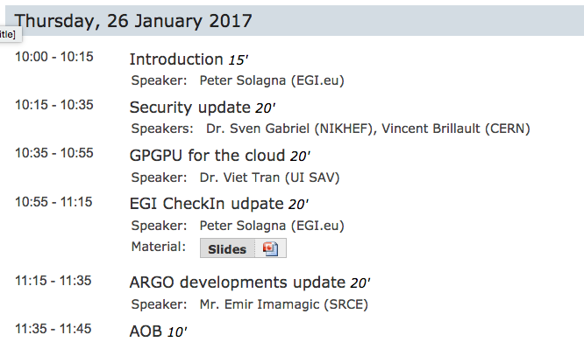

Slide 3
Policies approved
Policies approved by OMB in the previous months and officially endorsed by Executive Board
  eInfrastructure security policy
  Acceptable Authentication Assurance
  Processing of personal data
They will be replacing the previous versions

Slide 4
WebDav endpoints
New service type proposed to OMB: webdav
Should be used to register webdav interfaces in GOCDB for monitoring purposes
Please, provide feedback on the noc-managers ML by today COB, if any
WebDav monitoring probes are developed by the CERN data management team and will be deployed for testing in the coming days

Slide 5
Storage accounting
At the moment there are 10 sites publishing storage accounting data: see in the acc-portal
APEL team would like to have at least one site per NGI deploying the probes before planning a full deployment campaign
  Deployment has been reported to be easy and very low-effort for the site managers
  Instructions are here:https://wiki.egi.eu/wiki/APEL/Storage
  Sites still need to be manually authorized by the APEL team, but the process takes few iterations
EGI Operations will open a ticket for the other NGIs asking for volunteers sites
  Only for DPM/dCache SEs

Slide 6
UMD/CMD
UMD 4.4.0 (regular February release) under preparation
CMD-OS 1.0.0 (OpenStack Mitaka release) for CentOS7 and Ubuntu 14 released on December 16
  Keystone-VOMS 9.0.3
  ooi 0.3.2
  gridsite 2.3.3
  Cloud BDII Information provider 0.6.12
CMD for OpenNebula under preparation

Slide 7
EGI Conference May 2017
Next EGI event will be in Catania(IT) in the week 8-12 May 2017
It will be a joint event with the INDIGO Datacloud project
One session planned to discuss the roadmaps of the NGIs operations
  Joint double-session with the NGI Outreach teams

