Slide 1
CheckIn service status
Peter Solagna – EGI Foundation
Nicolas Liampotis - GRNET

Slide 2
Topics
Introduction and summary
What is available in production now
What is work in progress

Slide 3
Introduction
CheckIn is the new AAI platform for the EGI services and communities
Developed in the context of EGI-Engage, task JRA1.1, lead by GRNET
Integration of off-the-shelf products with some customisations
The work in EGI-Engage has been performed in close collaboration with the AARC project.
CheckIn is aligned with the architecture and best practices produced by AARC

Slide 4
Goals of CheckIn
Users should be able to access the EGI Services using the credentials they have from their Home Organizations using eduGAIN when possible
Institutional IdP must provide a unique non-reassignable ID
CheckIn will accept IdPs with different levels of assurance, and this information will be provided to the services in EGI
Access to the various services should be granted based on the VO/EGI roles the user have.
EGI Services should not have to deal with the complexity of multiple IdPs/Federations/Attribute

Slide 5
What does it mean for the EGI services?
Every EGI service should support for authentication:
X.509 IGTF credentials, or
CheckIn, or
Both (both it’s not mandatory)
Users will be identified within EGI by:
Certificate DN
Provided in the personal certificate
EGI UID
Created and stored in CheckIn
EGI UID and Certificate DN will be linked within CheckIn

Slide 6
EGI User Identifier
The EGI User ID:
personal - used by a single person (as opposed to shared user accounts)
persistent - used for an extended period of time across multiple sessions
non-reassignable - assigned exclusively to a specific person, and never reassigned to another individual
non-targeted - not intended for a specific relying party (or parties), i.e. should be shared
globally unique - unique beyond the namespace of the IdP and the namespace of the SP(s) with which the ID is shared
opaque - should (by itself) provide no information about the user, i.e. should be privacy-preserving

Slide 7
Production ready

Slide 8
Timeline
2015/06 Start of JRA1.1
2015/.. Architecture design
2015/12 First prototype with SAML IdPs and SAML SPs
2016/03 Release of the first alpha with SAML/OIDC IdPs and SAML SP
2016/04 Begin integration with ops/tools
2016/09 OIDC support for SPs
2017/02 Release as a beta service with full production support
2017/03 (beta) Access to fedcloud without a certificate

Slide 9
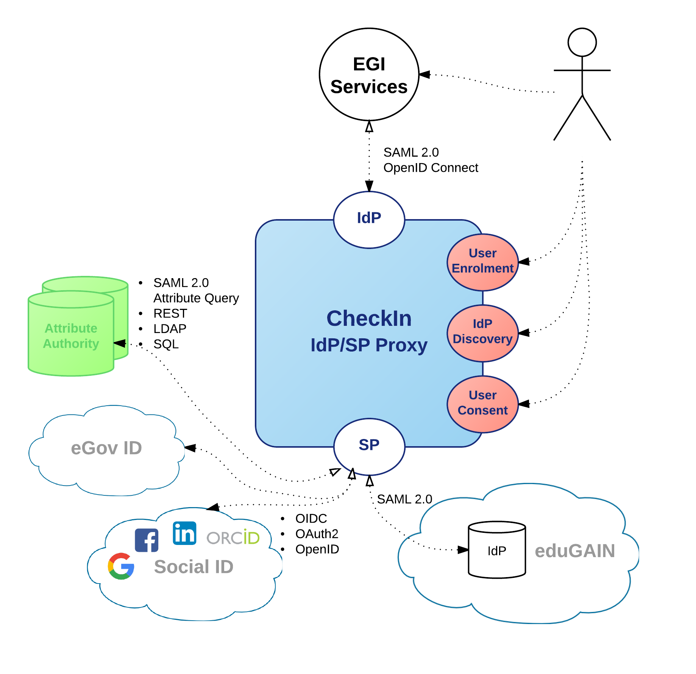
Architecture
EGI services will need to configure only the IdP-Proxy
CheckIn will integrate with IdPs and community specific AAI platform

Slide 10
Levels of Assurance
Level of confidence that the person who is authenticating is actually who they claim to be
Not all credentials are the same!
Examples:
Very high level of assurance: eID - e-Government ID.
High level of assurance with ID verification:
X509 certificates, many institutional IdP
Social media credentials:
Everyone with an email account can have one.
Use cases
allow an IdP to advertise those LoAs for which it is able to meet the associated requirements
allow an IdP to indicate the actual LoA in its responses
allow a SP to express its expectations for the LoA at which a user should be authenticated

Slide 11
Sources of attributes
CheckIn aggregates attributes from the following sources:
SAML attribute authorities and IdPs
OIDC IdPs
LDAP
Specific REST interface-based attribute authorities
All the relevant attributes to a service are provided in the authentication assertion released by CheckIn to the SP, including:
Attributes stored by CheckIn (e.g. EGI UID)
Attributes released by the user’s IdP
Attributes released by the attribute authorities (e.g. VO membership)
Sources of attributes integrated
Connection with GOCDB - DONE
Connection with Perun - DONE
Connection with COmanage – DONE

Slide 12
OpenID Connect Support
Service Providers can connect to the EGI AAI using OpenID Connect (OIDC) as an alternative to SAML2
EGI AAI OIDC Provider allows users to sign in using any of the supported backend authentication mechanisms, i.e institutional IdPs (eduGAIN) or Social Providers
Easy OIDC client registration through Client Management UI:
Obtain OAuth 2.0 credentials
Register one or more redirect URIs
Register required scopes (e.g. openid, profile, email)
PoC with cloud services under implementation

Slide 13
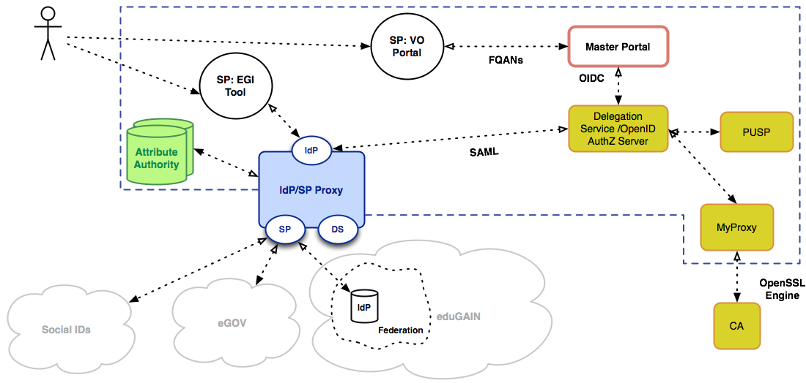
Online CA integration
RC Auth components

Slide 14
Status Integration with RC Auth (online CA)
Production RC Auth is now integrated with CheckIn
Users can retrieve X509 proxies by authenticating through CheckIn
So, can I submit grid jobs with my eduGAIN account?
Not yet ☹
RC Auth can be used only with VOs that are authorized
New version of LCMAPS that implement this condition for user authorization: http://repository.egi.eu/2016/11/23/lcmaps-plugins-1-7-1-2/
The whole process needs to be formalized

Slide 15
Policies
CheckIn: Acceptable Use Policy
CheckIn: Data protection policy
CheckIn is federated in eduGAIN and it is compliant with:
RnS
Sirtfi

Slide 16
Integration with other AAI infrastructures Partially WiP
ELIXIR:
Enabled interoperability with the new production ELIXIR AAI IdP Proxy
CheckIn will be integrated with the devel instance of the ELIXIR AAI IdP Proxy (available by end of Jan) to allow testing access to FedCloud
LToS:
CheckIn has been integrated as an IdP for LToS users, as the first VO to be fully accessible through CheckIn
CheckIn has developed a Unity connector to get LToS VO membership information and generate entitlements (supported use case: AppDB uses vm_operator role of LToS users for AuthZ)
EPOS:
Integrated as an IdP for EPOS users (still in the staging env but can be moved to production upon request)
In the future CheckIn will reuse the Unity connector (see LToS use case) to allow EPOS users to access EGI services
EUDAT:
CheckIn will be integrated as both an IdP and an SP with EUDAT B2ACCESS to support the following cross-infrastructure use cases: - EGI users accessing EUDAT (web and non-web) resources using their EGI CheckIn ID - EUDAT users accessing EGI (web and non-web) resources using their EUDAT
B2ACCESS ID
Both use cases to be implemented by end of 2017Q1 in the context of AARC

Slide 17
Work in progress

Slide 18
Transparent VO management (to do)
Translation of VO information into VOMS proxyes (from SAML/OIDC)
Provisioning of VOMS information through SAML and OIDC interfaces
X.509 Credentials
VOMS Service
SAML/OIDC Credentials
Attribute service
CheckIn

Slide 19
Translation of group information into VOMS proxy
Use case description
User does not have a personal certificate
User VO is not managed by a VOMS, but with a generic attribute management service
User needs to access X.509 based service
VOMS extensions are not provided directly by the Online CA
A pilot solution is being deployed in the context of AARC

Slide 20
Translation of VO information into VOMS proxy
Science Gateway
My Proxy
RC Auth
(Virtual Organization (SAML2)
CheckIn
VOMS

Slide 21
Provisioning of VOMS information through SAML and OIDC interfaces
Use case
Classic VOMS-based VO members need to access a SAML/OIDC service
VO membership should be translated into an entitlement included in the authentication assertion
Work in progress:
CheckIn can record the user DN as an alternative credential associated to the EGI UID
CheckIn can query the operations portal to get the list of VO users and add this information to the user profile

Slide 22
Other activities in progress
Provide user documentation/sample code for getting certificates through RCauth.eu
Integrate CheckIn with staging instance of ELIXIR IdP Proxy to test VO/entitlement-based access to FedCloud
Re-enable CheckIn integration with GGUS Helpdesk
Complete transition to entitlement-based access to GOCDB
Refine user enrollments flows
Provide UI for managing OIDC tokens for federated access to CLI tools/API clients
Provide user documentation/sample code for token-based access for CLI tools/API clients

