Slide 1
Introduction OMB June 2017
Peter Solagna – EGI Foundation
Senior Operations Manager

Slide 2
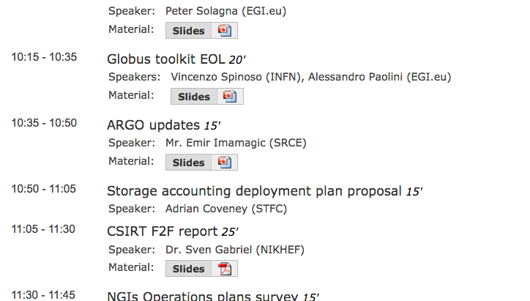
Agenda

Slide 3
Ops VO
With the ARGO monitoring the support for ops-based NGI Nagios is discontinued
Currently ops membership includes:
2 representatives per NGI
ARGO team members
EGI Operations representatives
EGI CSIRT members
~60 members
The proposal would be to reduce ops VO members
ARGO team
EGI Operations representatives
EGI CSIRT
NGI security officers or other representatives who requests access to the VO (standing the current ceiling of 2 members)
Are they needed?
A communication plan will be developed over the next months (e.g. until the end of the year) to allow a graceful transition to the post-ops infrastructure
dteam remains as the VO used for troubleshooting
Ops VO may be used also for authorizing access to some ops tools, this will be investigated to implement alternatives if necessary

Slide 4
Fedcloud quality of service
Cloud services are less mature than HTC ones
New cloud users may face more problems than in the grid
For example, the behavior and configuration of the sites is not uniform
Quality of support is more important for fedcloud sites
EGI Operations will follow up with fedcloud sites who are not following tickets in a timely manner
Contextually with the A/R report on a monthly basis
The suspension policy will not change (only A/R-based)

Slide 5
CMD Updates
CMD-OS 1.1.2 (C7/Xenial) is out
CentOS7 (bdii-infoprovider 0.7.0, rOCCI client 4.3.8, APEL SSM 2.1.7, Infrastructure Manager 1.5.1, Site BDII 1.2.1, ooi 1.1.1, keystone-VOMS 9.0.4, cASO 1.1.0)
Ubuntu Xenial (bdii-infoprovider 0.7.0, rOCCI client 4.3.8, Infrastructure Manager 1.5.1, ooi 1.1.1, keystone-VOMS 9.0.4, cASO 1.1.0
CMD-ONE dry run successful
including products for OpenNebula 5 for CentOS7 (Ubuntu not requested by FedCloud)
UMD 4.5 (June) in progress
WN and CREAM for C7
ARGUS 1.7.2
APEL, DynaFed, XROOTD, dCache, QCG, ARC

