Slide 1
Galaxy aaS (GaaS) in EGI
Giuseppe La Rocca giuseppe.larocca@egi.eu Technical Outreach Expert

Slide 2
The Galaxy platform in a nutshell
Galaxy is an open web-based platform for data-intensive biomedical research
It provides support to :
build multi-steps computational analyses
upload from user’s workstation, by URLs, and directly from many online resources
Some statistics:
90 public Galaxy servers around the world
5K tools that can be installed in any Galaxy site
44K commits on GitHub

Slide 3
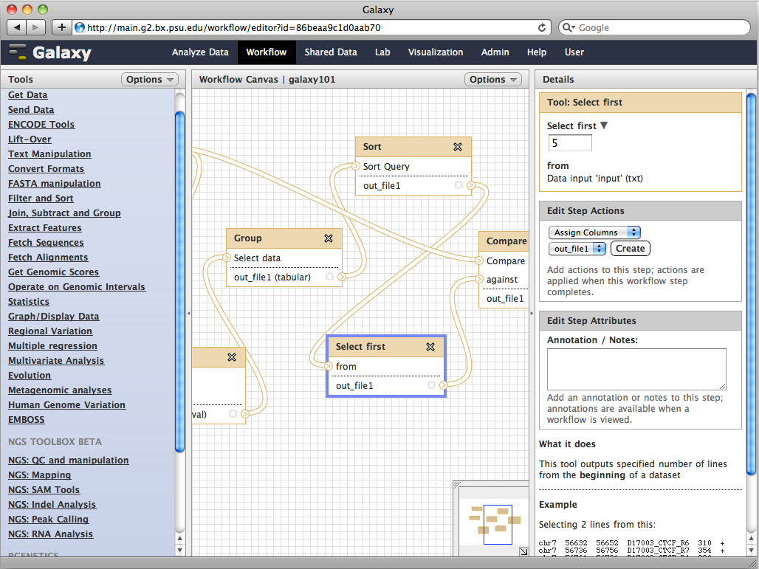
Galaxy as an EGI service: vision
Configure a catch-all service for biologists/researchers of different NGIs
Leverage on EGI resources for helping data-intensive research
Provide a transparent access to HPC resources to analyse their own data, reproduce workflows and share results

Slide 4
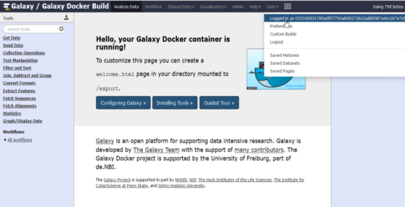
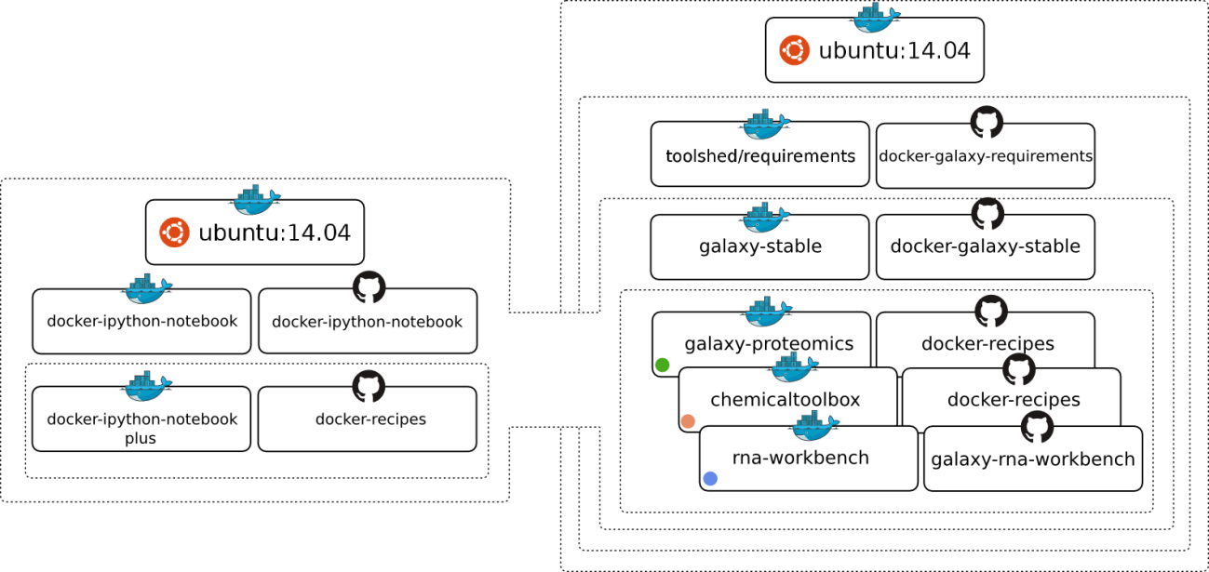
Galaxy service in EGI
Stable stand-alone Galaxy docker container + tools
EGI CheckIn
Front-end
proxy
Implements the auth module. Provide the USER_ID to Galaxy
With the $REMOTE_USER env. var
HPC cluster for running jobs

Slide 5
Where we are ?
An initial set up is available at INFN-CATANIA-STACK
A Galaxy docker container
A dockerfile.yml has been created to configure Apache with Shibboleth support
Docker-compose used to combine the two containers
Galaxy Endpoint: https://galaxy-docker.fedcloud-tf.fedcloud.eu
Access restricted only to members of the EGI Applications on Demand service

Slide 6
Requirements
Minimal setup:
1 VM with 8+ vCPU cores, 16+ GB of RAM, and 500GB of disk space
Python 2.7
Networking:
1 public IP with 80/443 ports accessible
Trusted host certificates (e.g. Let’s Encrypt CA)
Service registered in a DNS server
AAI:
Via the EGI Check-In service
Remote User Authentication + Shibboleth

Slide 7
Technical open issues
Integrating non-Shed tools into the container
Scaling of resources:
Compute:
Different cluster back-ends are supported
(e.g.: SLURM, Torque and SGE)
Galaxy can act as one job manager
Storage:
Different storage strategies and technologies are supported

Slide 8
Call for participation
Task force creation:
Identify a list of providers for supporting the development of the new service
Improve/Enhance the current architecture based on real users’ needs
Configure a dedicated HPC cluster for running jobs
Run pilot testing with the identified user community
Sign an SLA/OLAs with the providers interested to support the service

Slide 9
Links
The current configuration on GitHub:
https://github.com/glarocca/EGI-galaxy-docker
A Galaxy Docker image is available on GitHub developed by bjoern.gruening@gmail.com

