Slide 1
Update on the Community Security Policies
EGI OMB meeting 2 November 2017
David Kelsey (STFC/RAL)

Slide 2
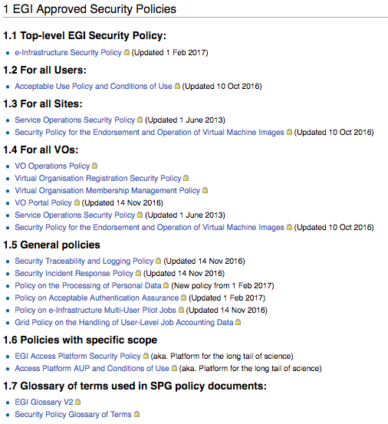
EGI security policies
These are being replaced

Slide 3
Joint Activity
EGI Security Policy Group – EGI-Engage
And
EU H2020 AARC2 project – NA3 - Policy and Best Practice Harmonisation
Community Engagement (task 3.4)
Recent meeting
10 October 2017 - Vidyo
To address all feedback received (Aug/Sep)

Slide 4
Old policy
VO Registration: https://documents.egi.eu/public/ShowDocument?docid=78
VO Operations: https://documents.egi.eu/public/ShowDocument?docid=77
VO Membership Management: https://documents.egi.eu/public/ShowDocument?docid=79

Slide 5
New Policy
EGI SPG Phase 2 – External Drafts
There are TWO new policy documents:
The Community Operations Security Policy - aimed at governing the relationship between Community and Infrastructure(s).
The Community Membership Management Policy is all about the Community managing itself and its Users.
EGI has already expressed the desire to see both documents being separate sections of one EGI policy document
But for now we will keep them separate.
Should we combine?

Slide 6
Community Operations Security Policy
https://docs.google.com/document/d/1TFE4T4hyFFrVKHyTjh4K8cJlrrvJGfpVvIvL4GCzYFM/edit#
This policy applies to the Community Manager and other designated Community management personnel. It places requirements on Communities and it governs their relationships with all Infrastructures with which they have a usage agreement.
Phase 2 – External draft
Invitations to comment went out (to a wide audience!) 26th July
Deadline for comment – 30th August 2017
Extended (to allow comment during Sep 2017)

Slide 7
Community Membership Management Policy
https://docs.google.com/document/d/1vPcAja1EyTp-kJPvJpwu3NSd8e1aVcytY3nSGthWNLU/edit#heading=h.4ww9eqfyuow1
This Policy applies to the Community Manager and other designated Community management personnel. It places requirements on Communities regarding eligibility, obligations and rights of their Users, and it governs their relationships with all Infrastructures with which they have a usage agreement.
Phase 2 – External draft
Invitations to comment went out (to a wide audience!) 26th July
Deadline for comment – 30th August 2017
Also extended to include September 2017

Slide 8
SPG/AARC2 NA3 meeting 10 Oct 2017
Discussed all feedback and responses (both docs)
Lots of useful comments and corrections (thanks!)
Major issue #1
“since the community definition is now much broader than a VO only, you can not apply the same rules!”
Answers
Allow for Communities with sub-groups
Acceptance of the AUP by Community members who act as responsible persons towards the Infrastructure
e.g. Person responsible for robot certificate of a portal

Slide 9
Review of feedback (2)
Major issue #2
Operations policy “reads like a contract” rather than a policy
“Indemnity belongs in a contract not in a policy”
Answers
Added more explanation of aims (Introductions)
Added more to the indemnity paragraph
Including “Without prejudice to provisions set forth in more specific agreements,…” and
“not to be used for any purpose which creates the possibility of personal injury, material loss, or the design of safety-critical products and clinical decision support, if they fail or malfunction”

Slide 10
Next steps
We have now addressed all issues
The documents are complete
Next steps
Does EGI want one policy or two?
Personally I prefer to keep them separate
Once decided, then transfer to standard EGI policy template and store in DOCDB
Seek formal approval
OMB, UCB, EB
Can we aim for adoption on 1st December 2017?

