Slide 1
OMB December 2017
Matthew Viljoen – EGI Foundation

Slide 2
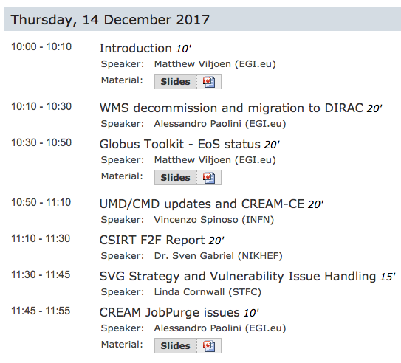
Agenda

Slide 3
Jupyter and Galaxy aaS
Aim: offer popular science apps/tools as a service via the EGI Marketplace:
Jupyter and Galaxy, as a service
Both now deployed at CESGA
check-in compatibility, create personal notebooks (Jupyter), interactive environment support (Galaxy)
Working on moving from alpha to beta
monitoring, accounting etc.
Interested in hosting a future service, or testing?
see NILS presentation: https://indico.egi.eu/indico/event/3539/

Slide 4
Strategy and Vulnerability Issue Handling
EGI SVG Strategy and Vulnerability Issue Handling procedure has been presented during the July OMB
Document: https://documents.egi.eu/secure/ShowDocument?docid=3145
New version final and old version now deprecated.

Slide 5
Storage accounting
Development instance of accounting portal shows the sites publishing accounting data:
http://accounting-devel.egi.eu/storage.php
Now only 39 sites not publishing
Two configuration issues uncovered during rollout
https://wiki.egi.eu/wiki/Agenda-2017-12-11#Storage_accounting_deployment
Current status here:
https://wiki.egi.eu/wiki/Storage_accounting_deployment

Slide 6
EOSC-hub Kickoff
Kickoff meeting with WP managers, task managers and invited experts 8-12 Jan ‘18
https://indico.egi.eu/indico/event/3548/overview
AHM possibly during February

Slide 7
EOSC-hub WPs overview
WP1 - Project Management & Coordination, Yannick Legre
T1.3 Risk & Quality Management, Service Management System & Continual Improvement, Malgorzata Krakowian
Service Planning
WP2 - Strategy & Business Development, Jarjut Andler
WP3 - Innovation Management & Engagement, Sara Garavelli
WP12 - Business Models & Procurement, Sergio Andreozzi
Service Integration, Management & Delivery
WP4 - Federated Service Management , Matthew Viljoen
WP10 - Technical Coordination. Giacinto Donvito
WP5 - Federation & Collaborative Services, Paul Weber
WP6 - Common Services, Johannes Reetz
WP7 - Thematic Services, Claudio Cacciari
WP13 - Access Provisioning, Malgorzata Krakowian
Service Adoption
WP11 - Training, Giuseppe La Rocca
WP8 - Competence Centres, Gergely Sipos
WP9 - Joint Digital Innovation Hub, Sy Holsinger
Latest DoA and GA: http://go.egi.eu/EOSC-hub-doa

Slide 8
January OMB
Next OMB on Jan 18th (or Feb 1st ?) at 10am CET

