Slide 1
Science Gateways, Workflows and Toolkits in the second INDIGO release
Marcin Plociennik
On behalf of INDIGO WP6 team
RIA-653549

Slide 2
WP6 services offered

Slide 3
List of the WP6 services
the Future Gateway
Liferay portlets
Ophidia analytics workflow
INDIGO Kepler module/actors
Open Mobile Toolkit
Orchent
Wattson

Slide 4
The FutureGateway

Slide 5
FutureGateway
A full framework to build Science Gateways:
It provides
Installation and maintenance tools
RESTful APIs to manage interaction with DCIs
Optionally a Liferay based web portal
A fully customizable environment to serve different community needs
Useful for
Create GUIs to seamlessly interact with different DCIs
Create interfaces for Web, Mobile and Desktop applications
5

Slide 6
FG in Electric Indigo
Fixed 13 Issuses coming from INDIGO 1st release
New features
PTV simulator service made now configurable
Automatic registration of new tokens (API user isolation)
User rights consistency during application installation
Deb package creation scripts (Ubuntu 14.04)
Implemented API calls on infrastructure management and use of their ids while installing applications
API support to application level files
Newly introduced in specs and do not deprecate previous ‘input_file’ approach
6

Slide 7
LiferayPlugIns
A collection of Liferay plugins to create Science Gateways based on INDIGO Software stack
Implement authentication using IAM
authorisation managed on the portal but can exploit IAM information (e.g. groups)
Token management for the FG REST APIs
the portal is the only endpoint registered in IAM and it is responsible to check tokens using the provided endpoints
Provide several basic portlets for any communities

Slide 8
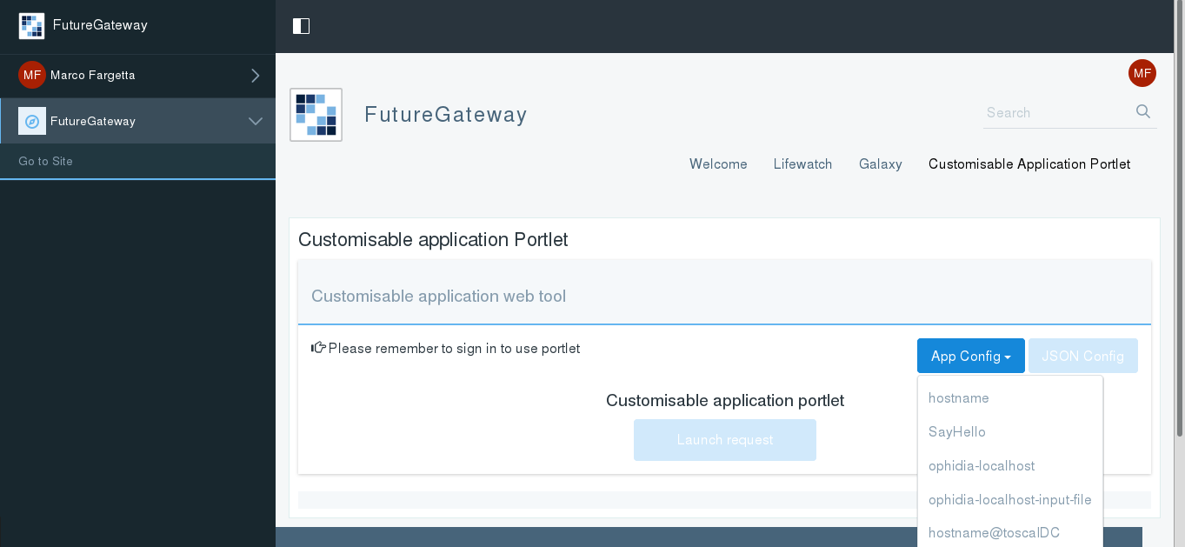
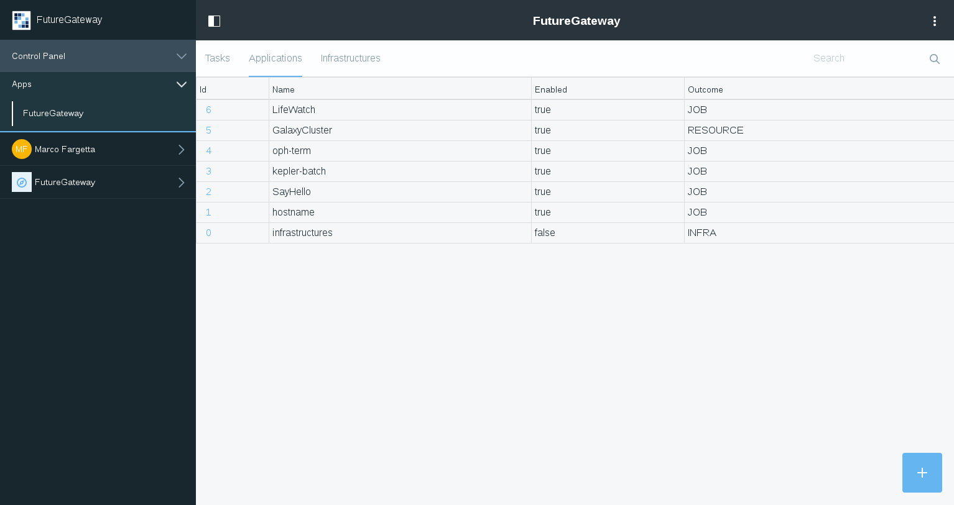
What new in Electric Indigo
A new interface for domain administrators
to manage applications for the community
to monitor activities performed through the portal
A new generic portlet to simplify the integration of new applications in the portal
administrators can adapt the UI to the related application at run-time through a json configuration file

Slide 9
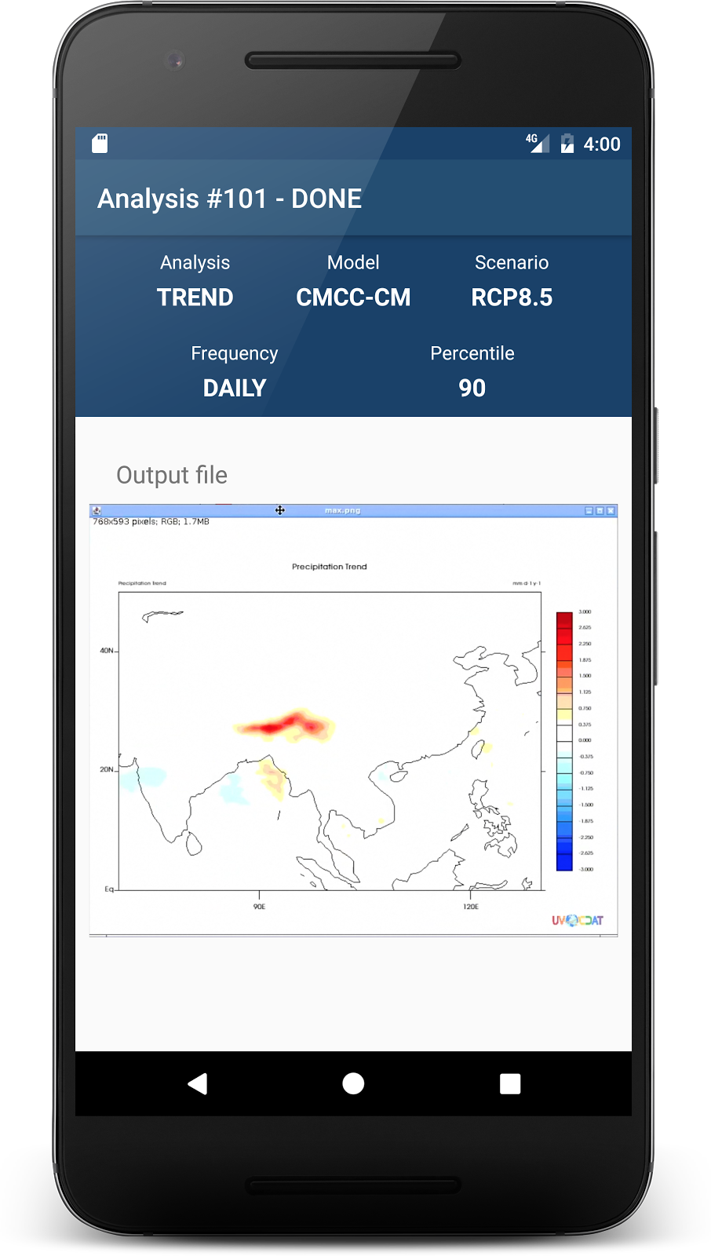
Open Mobile Toolkit
Indigo OMT is a set of libraries to give mobile programmers easier start to implement mobile applications based on INDIGO DataCloud API.
Basing on the existing FG API, library for
Android 2nd version and a sample applications which helps to show the features.
New iOS library and sample applications
Current version of the library handles exposed FG operations. The sample app shows these operations as well.
ENES app using the OMT presented on booth

Slide 10
Orchent, Wattson

Slide 11
Orchent
Hightlights INDIGO-2
complete new application
easy to use and well documented
command line client for the orchestrator
supports full API of orchestrator
creating deployments
updating and deleting them
listing all the deployments and resources
packages for Debian/Ubuntu/CentOs and Docker container

Slide 12
Wattson
Hightlights INDIGO-2
completely rewritten in go
easy to use with integrated help
command line client for WaTTs 1.0+ and 0.4 (from INDIGO-1)
supports full API of WaTTS
requesting and revoking credentials
advanced requests: request with parameter e.g. public ssh-key
listing services, provider and credentials
using environmental variables to make it easier for user
packages for Debian/Ubuntu/CentOs and Docker container

Slide 13
Scientific workflows and big data analytics

Slide 14
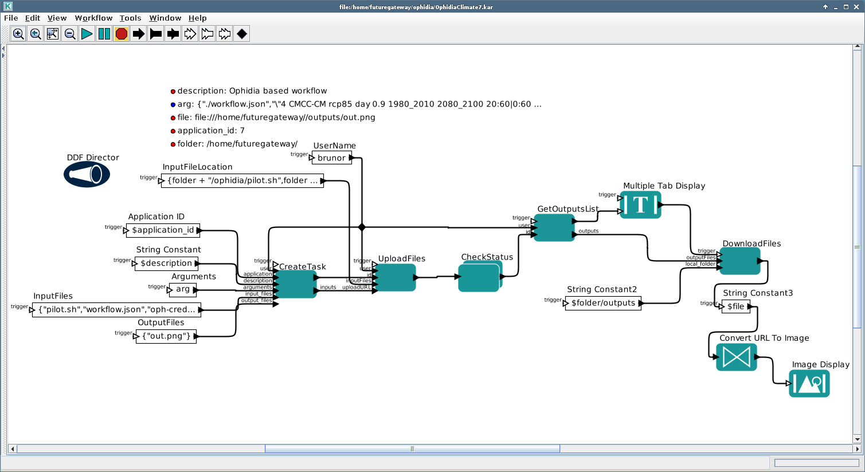
INDIGO module for Kepler
The Kepler scientific workflow system is an open source tool that enables creation, execution and sharing of workflows across a broad range of scientific and engineering disciplines.
INDIGO module based on the FutureGateway API
FutureGateway API client: https://github.com/indigo-dc/indigoclient
Kepler based actors: https://github.com/indigo-dc/indigokepler

Slide 15
New features in INDIGO Kepler
Added support for tasks’ Runtime Data:
General method of interaction between user ⇆ FutureGateway ⇆ task
In ENES: live monitoring of the computation process
The change required a switch of underlying HTTP library (Jersey does not support PATCH method). Unnoticable by end-users, but time-consuming and risky
Improved DevOps approach: automated integration tests configurable in runtime
15

Slide 16
New features in INDIGO Kepler
Created a new entity in the INDIGO ecosystem: kepler-batch
Components involved:
Ansible role: indigo-dc.kepler-batch
Docker image: indigodatacloudapps/kepler-batch
It is a non-gui & non-interactive Kepler installation
Whole scenario is configured at submission time: mobile UI (demo!), portlets
It is an INDIGO-based Workflows-as-a-Service
16

Slide 17
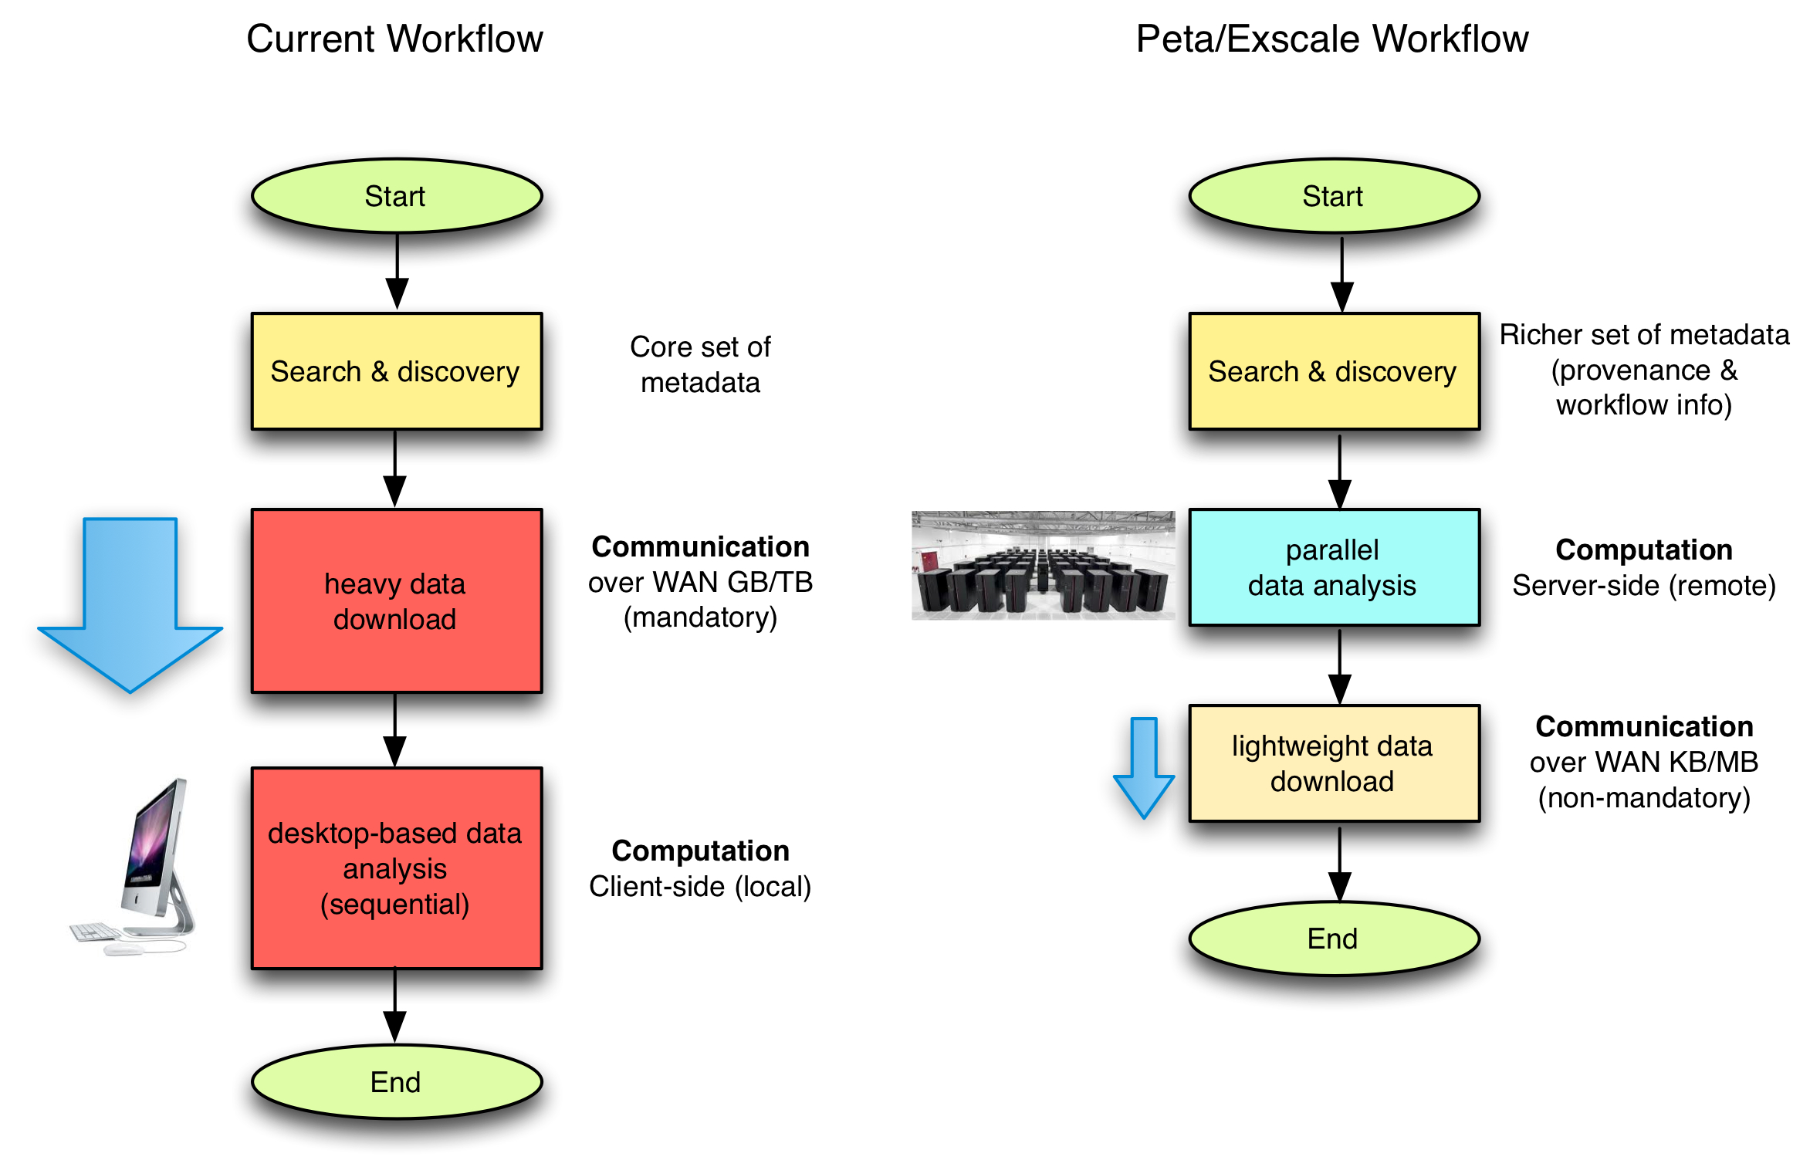
Ophidia
Big data stack for scientific data analysis
Specifically designed for eScience
It joins big data and HPC to address to address fast and big data analysis
it includes a native analytics workflow support to implement complex experiments
Extensible: simple API to support framework extensions like new operators and array-based primitives (currently 50+ operators and 100+ primitives provided)
Programmatic access via C and Python APIs

Slide 18
New features in Ophidia
Hightlights INDIGO-2
Analytics workflow interfaces
Interactive workflows: include operations involving user interaction, such as the ask for additional input parameters, sending requests to external modules, waiting for resources (datasets) during the execution
Interleaving workflows: interact with other concurrent or cooperative workflows
Bug fixing on the existing workflow interfaces as a result of the feedback from the case studies
Configurable base path for massive and interactive operations
Improvements and bug fixing
Bug fixing regarding Ophidia operators (e.g. IMPORT)
Max and min operations to OPH_INTERCUBE operator
Support for missing values to operators and primitives and support for base64-encoded dimensions
New watch command in the Ophidia terminal
Update regarding the dynamic and automated deployment of Ophidia according to the proposed Workflow as a Service model
Update of the work done (ansible roles) according to the latest release/updates

Slide 19
Ongoing work for Ophidia
Ongoing work, planned for the upcoming updates of the INDIGO-2 release
Finalization of the implementation of the IAM security support for Ophidia
Data analytics portlets to support the implementation of Science Gateways for data analysis (e.g. ENES)
New release of the PyOphidia Python class
task already completed. Ready for 1st update
New IMPORT operators to support different research communities
New IMPORT operators already implemented for LBT (FIT) and EMSO (SAC).
Task already completed. Ready for 1st update

Slide 20
Questions?

