Slide 1

Case Study and INDIGO solution for:
CMS Analysis Cluster On-Demand
Presented by Daniele Spiga
Daniele.Spiga@pg.infn.it
INDIGO SUMMIT
EGI-INDIGO workshop on community application support
Catania, 10th May 2017
RIA-653549

Slide 2
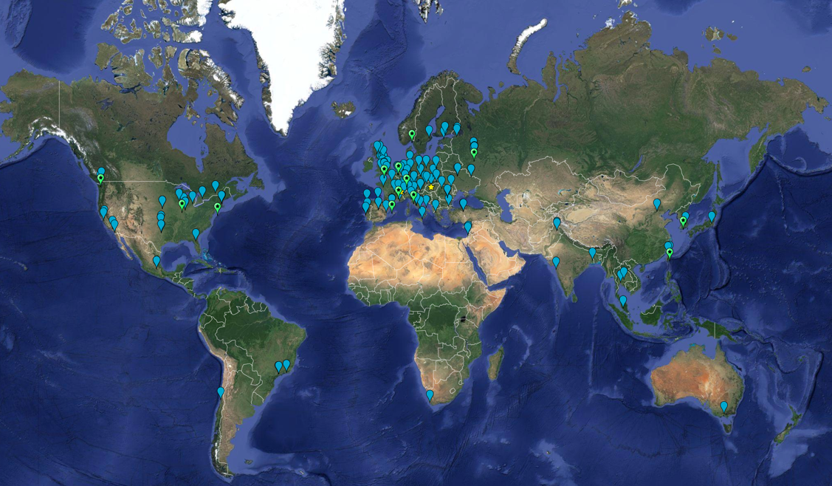
Worldwide computing
Worldwide Distributed Computing for LHC:
Summing up all the experiments, ~200 Sites
CPU = 3.6 MHS06 (~360000 cores)
Disk = 310 PB
Tape = 380 PB
Dr. Ian Bird
Future Challenges
CPU:
x60 from 2016
Raw data volume for LHC increases exponentially and with it processing and analysis load
Technology at ~20%/year will bring x6-10 in 10-11 years
Estimates of resource needs at HL-LHC x10 above what is realistic to expect from technology with reasonably constant cost

Slide 3
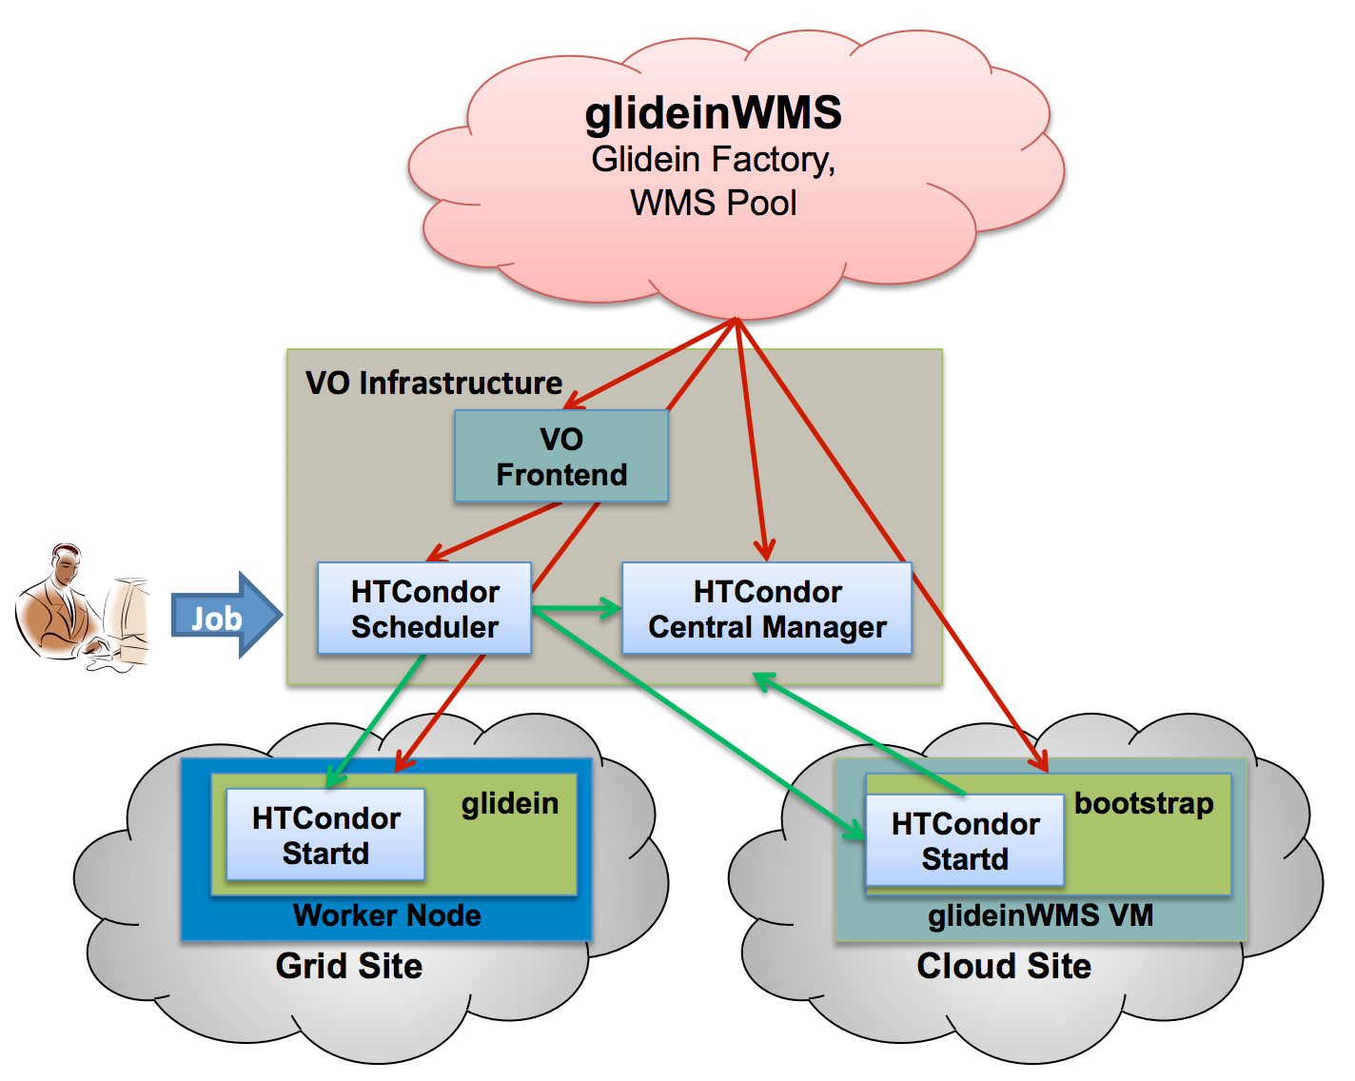
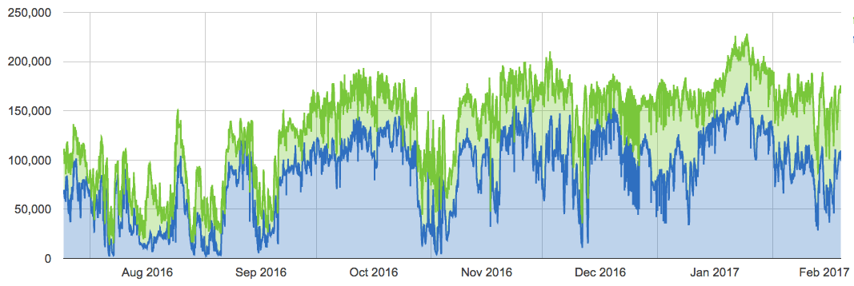


CMS: HTCondor Job Submission Infrastructure
HTCondor Global pool: jobs rate
Ephemeral CMS Site
Auto Register
HTCondor Startd
Docker container
VM
Generic Cloud

Slide 4
CMS-Dynamic On Demand Analysis Service
Research Community: High Energy Physics
  LHC Data Analysis
Objective of the use case
  To develop a solution for generating an on-demand, container based HTCondor cluster for CMS seamlessly integrating an existing HTCondor pool
    Requirements: Automate complex cluster setup; Configure multiple services; Securely auto-register resources with a HTCondor Pool.
Innovation challenges:
    The effective use of opportunistic resources, like general purposes campus facilities
    The dynamic extension of an already existing dedicated facility
    The user-friendly generation and management of computing cluster for LHC data analysis workflows

Slide 5


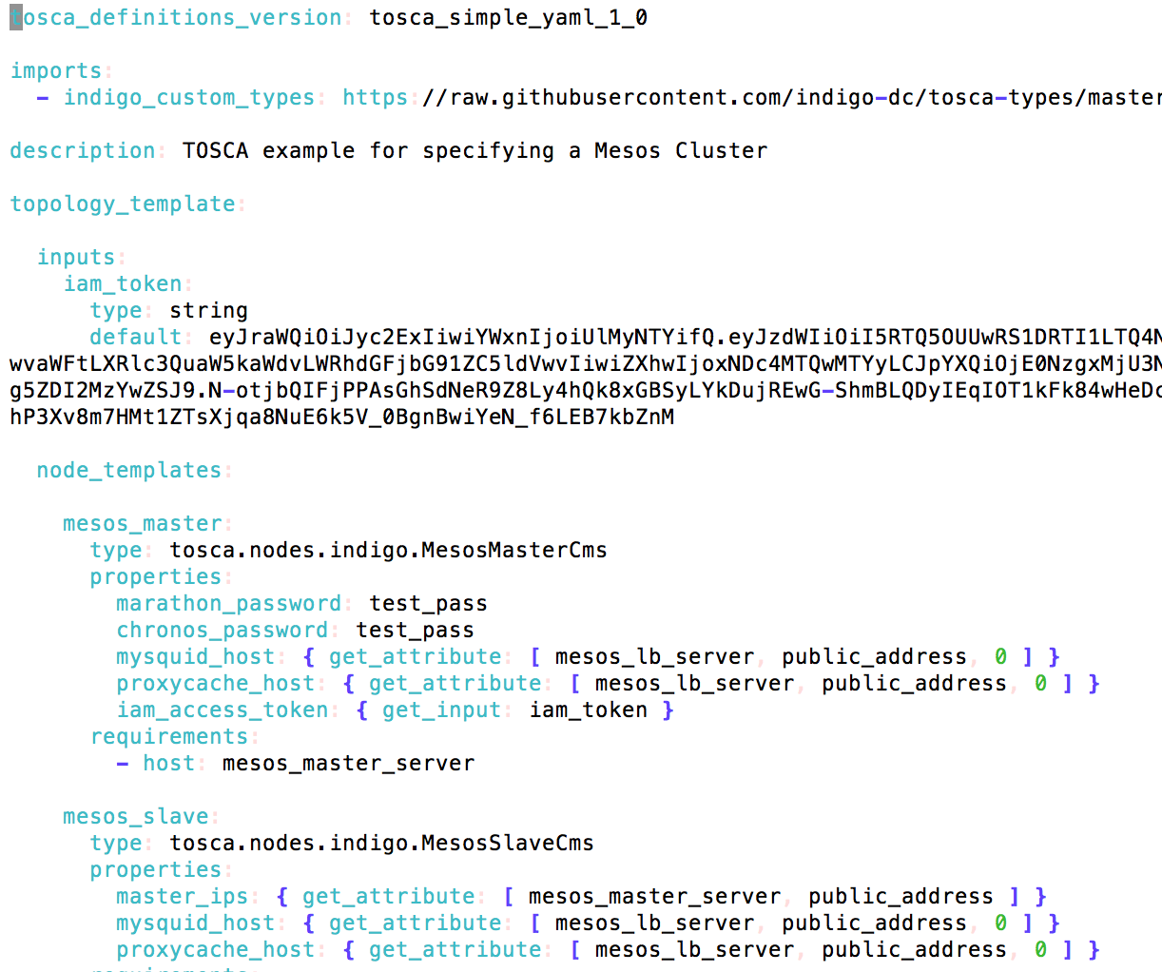







Scheme of the solution
TOSCA (+Ansible)
PaaS Orchestrator
Orchent
Jobs
CMS Physicists
IM
AuthN
Home IdP
HTCondor Global Pool of CMS
IAM
Auto-Register
Jobs
TTSCache
HTCondor
HTCondor
Load
Balancer
Squid Proxy
Slave
CVMFS
Slave
CVMFS
TTS
DATA I/O
X.509
Master
HTCondor
HTCondor
HTCondor
Slave
CMS
Distributed Storages
CVMFS

Slide 6
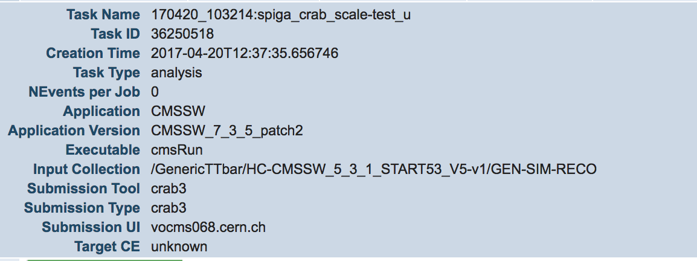
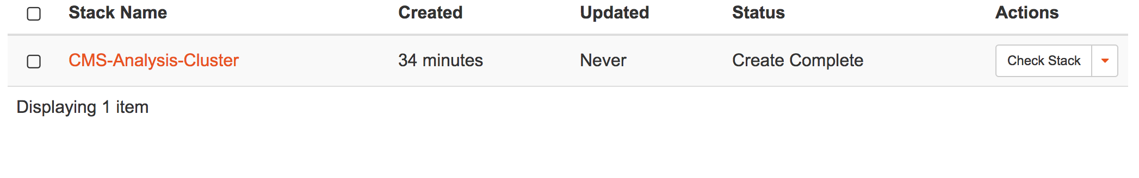
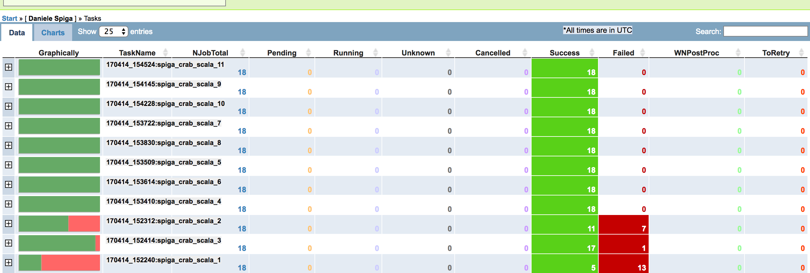
How an INDIGO solution is key for us:
Automation: TOSCA + Ansible
  A single YAML file allows to describe a complex setup leaving end-user just with the management of a trivial configuration file.
Real Analysis Jobs
Job Efficiency - 90 %
Mesos Marathon,
HTCondor
Squid proxy,
TTS Cache
CVMFS
CMS I/O Policies configuration
Diskless-site test

Slide 7
DEMO
https://www.youtube.com/watch?v=n_izqMAANgA

Slide 8
We are ready to share our experience!
https://www.indigo-datacloud.eu
Better Software for Better Science.

