Slide 1
The Copernicus Collaborative Ground Segment
Gioacchino Buscemi
European Space Agency
EGI Conference 2017 and INDIGO Summit 2017
Catania 09-12 May 2017

Slide 2


Before we start
Gioacchino Buscemi
European Space Agency (ESA)
ESRIN, Frascati, Italy
EOP Security Officer; ISO27001 Auditor
EOP Data Centre Manager
Responsible for EOP Networks, System (mm), EO Virtual Infrastructure and Cloud (mm)
Italian football (soccer) team supporter
gioacchino.buscemi@esa.int

Slide 3
Agenda
ESA Earth Observation environment
EOP Core Ground Ground Segments
  Dissemination, Processing, Archiving and Network
EOP Core Facilities
EOP Security
Copernicus : The space Components
ESA-EO Operated the Data Hub
ESA-EO the Collaborative Data Hub
ESA-EO the Collaborative Ground Segment
Conclusions

Slide 4
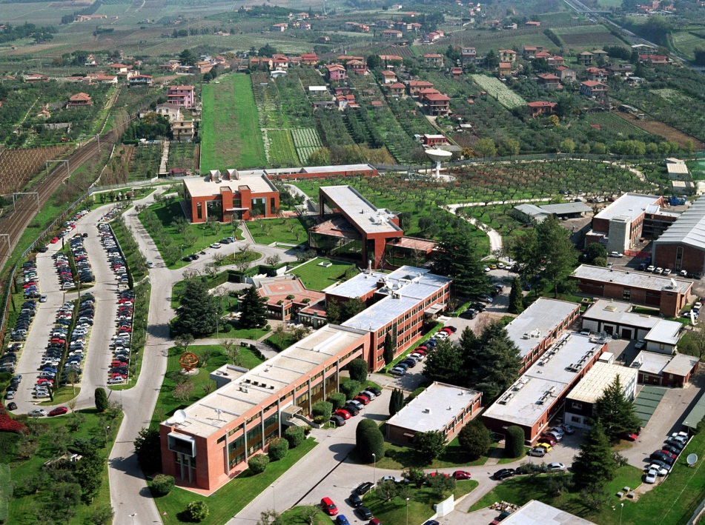
ESA’s eye on earth
ESRIN, in Frascati, Italy, is ESA’s center for Earth Observation where operations and exploitation of Earth Observation satellites are managed.
The world’s largest database
of environmental data for both Europe and Africa is managed from ESRIN.

Slide 5
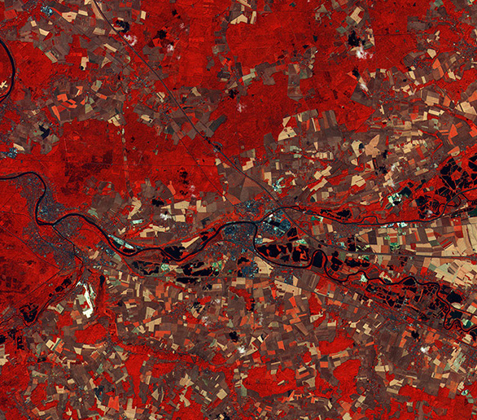
Pioneers in Earth observation
ESA has been dedicated to observing Earth from space ever since the launch of its first meteorological mission, Meteosat-1 in 1977.
ERS-1 (1991–2000) and ERS-2 (1995–2011) providing a wealth of invaluable data about Earth, its climate and changing environment.
Envisat (2002–12) the largest satellite ever built to monitor the environment, it provided continuous observation of Earth’s surface, atmosphere, oceans and ice caps.

Slide 6
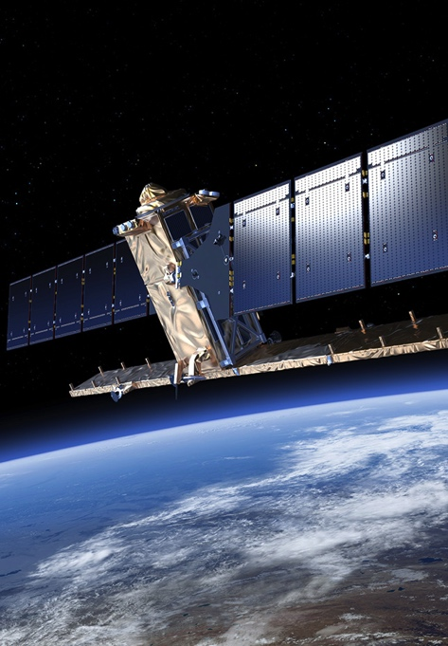
Global monitoring for a safer world
Copernicus: an Earth observation programme for global monitoring for environment and security.
Led by the European Commission in partnership with ESA and the European Environment Agency, and responding to Europe’s need for geo-spatial information services, it will provide autonomous and independent access to information for policy-makers, particularly for environment and security issues. ESA is implementing the space component: developing the Sentinel satellite series, its ground segment and coordinating data access.
ESA has started a Climate Change Initiative, for storage, production and assessment of essential climate data.

Slide 7
EO Missions Overview
earthcare
adm-aeolus
sentinel-3b
sentinel-5p
sentinel-2b
sentinel-1b
sentinel-3a
sentinel-2a
sentinel-1a
proba-v
swarm
cryosat
smos
proba-1
+ Third Party Missions
# of missions
sentinel-1b
sentinel-3a
sentinel-2a
sentinel-1a
proba-v
swarm
cryosat
smos
proba-1
Landsat, Aura OMI, Cosmo-Skymed, DEIMOS, GOSAT, RapidEye, Radarsat ….
+ development of PDGS for future missions
goce
envisat
ers-2
proba-1
goce
envisat
ers-2
ers-1
goce
envisat
ers-2
ers-1
ers-1
https://earth.esa.int/
http://www.copernicus.eu/

Slide 8
EO missions growth
The figure does not include the statistics for EO data distributed by partners (e.g. GOCE geoid through GFZ, Sentinel by Collaborative Ground Segment, EUMETSAT, etc.)
60000
A growing increase resulting from:
the increase in data offering,
the upgraded data access,
the open and free data policy,
the support to data exploitation
Sentinel missions
# of users
15000
ESA missions

Slide 9


ESA EO Core Ground Segments
Dissemination
Dissemination (Mix of Virtual and Physical resources):
Virtual Central Dissemination (DissHarm)
Copernicus Dissemination Platform (Pick-Up Point)
Local DMZ on remote sites
Multi-Mission Central Services
Copernicus Central Services
Internet
Pick-Up Point
Data Hub Portals
DissHarm
ELVIS
Dissemination Center
Processing Center
KSAT
e-GEOS
INTA
DLR
Airbus
UK
ESAC
Multi-Mission
MPLS Backbone
Copernicus
MPLS Over DWDM
EUMETSAT
SSC
CLS - B
Cloud Services
CNES
CNMCA
CLS - T
DAS
ESRIN
ACRI
Indra

Slide 10
ESA EO Core Ground Segments
Processing
Processing (Mix of Virtual and Physical resources):
Virtual Central Processing (ELVIS)
Mixed local physical servers and local virtual solutions
Private PaaS high performing infrastructure (Insourced ESA)
Interconnected Public Cloud
Multi-Mission Central Services
Copernicus Central Services
Internet
Pick-Up Point
Data Hub Portals
DissHarm
ELVIS
Dissemination Center
Processing Center
KSAT
e-GEOS
INTA
DLR
Airbus
UK
ESAC
Multi-Mission
MPLS Backbone
Copernicus
MPLS Over DWDM
EUMETSAT
SSC
CLS - B
Cloud Services
CNES
CNMCA
CLS - T
DAS
ESRIN
ACRI
Indra

Slide 11
ESA EO Core Ground Segments
Archiving
Archiving:
Local LTA at PACs
Data Archival Center (DAS)
Cold Backup
Multi-Mission Central Services
Copernicus Central Services
Internet
Pick-Up Point
Data Hub Portals
DissHarm
ELVIS
Dissemination Center
Processing Center
KSAT
e-GEOS
INTA
DLR
Airbus
UK
ESAC
Multi-Mission
MPLS Backbone
Copernicus
MPLS Over DWDM
EUMETSAT
SSC
CLS - B
Cloud Services
CNES
CNMCA
CLS - T
DAS
ESRIN
ACRI
Indra

Slide 12
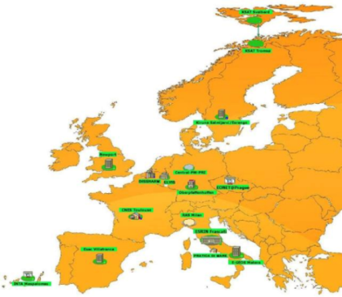
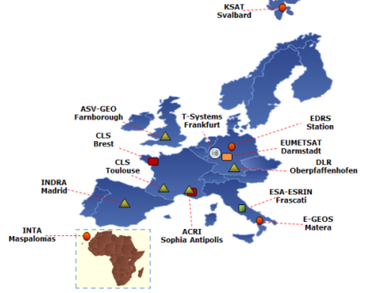
ESA EO Core Ground Segments
Network
Network
Two networks based on MPLS/DWDM up to 10 Gbps
Central Internet break-outs
LAN at remote sites with heterogeneous technologies and ownership
Multi-Mission Central Services
Copernicus Central Services
Internet
Pick-Up Point
Data Hub Portals
DissHarm
ELVIS
Dissemination Center
Processing Center
KSAT
e-GEOS
INTA
DLR
Airbus
UK
ESAC
Multi-Mission
MPLS Backbone
Copernicus
MPLS Over DWDM
EUMETSAT
SSC
CLS - B
Cloud Services
CNES
CNMCA
CLS - T
DAS
ESRIN
ACRI
Indra

Slide 13
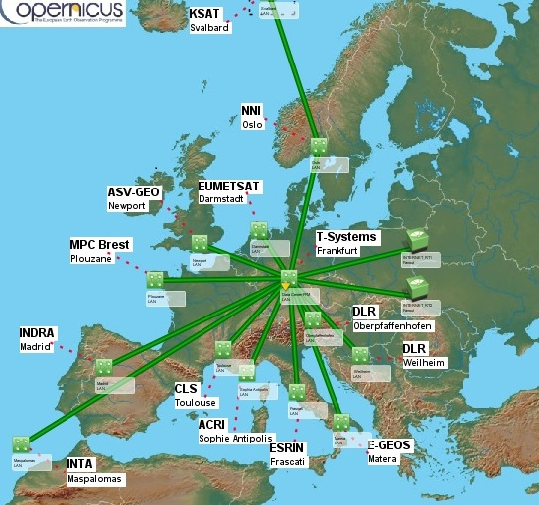
Copernicus Core Ground Segment
WAN Details
The Ground Segment
3 Core Ground Stations (CGS)
7 Processing and Archiving Centres (PAC)
3 Mission Performance Centres (MPC)
3 Payload Data Monitoring Centres (PDMC )
1 Marine Centres (Eumetsat)
1 Coordinated Data Access Service (CDS)
EDRS Receiving Station

Slide 14
EO Core facilities
Site | ACRI @ Luxemburg | ACRI @ S. Antipolis | Airbus @ Newport | Airbus @ Weilheim | CLS @ Brest | CLS @ Toulouse | CNES @ Toulouse | DLR @ Oberpfaffenhofen | E-GEOS @ Matera | ESAC | ESRIN | EUMETSAT @ Darmstadt | Indra @ Madrid | INTA @ Maspalomas | KSAT @ Svalbard | KSAT @ Tromsoe | SSC @ Kiruna
MM | 1 |  | 0,3 |  |  |  | 0,1 | 0,15 | 1 | 0,3 | 2 |  |  |  | 0,4 | 0,3 | 0,3
Copernicus |  | 1 | 10 | 1 | 1 | 1 |  | 10 | 10 |  | 1 | 1 | 10 | 1 | 2.5
Gb/s
Intranet combined capacity: 100 Gb/s
Internet access combined capacity: 45 Gb/s
Mission | Globe Coverage | Orbit # | BW
S 1A/B | 6 days | 175 | 2 x 280 Mb/s
S 2A/B | 5 days | 143 | 1 x 280 Mb/s
S 3A | 27 days | 385 | 2 x 280 Mb/s

Slide 15
EO Data Volume
Central Virtual Hub | Size
DataHuB | 8 PB, +1200CPU, 8+TB RAM, 70 VM
DISSHARM | 2.75 PB, +130CPU, +500 GB RAM, 33 VM
ELVIS | 2.5 PB, 250 CPU, 700 GB RAM, 80 VM
21 facilities spread over Europe
2 central hosting and dissemination facilities
Data volume | Data/Day
S1A+B | 16 TB
S2A | 800 GB
S3A | 420 GB
Swarm | 5 GB
Cryosat | 33 GB
Traffic | Volume/month
Copernicus Circulation | 1.25 PB
MM Circulation | 170 TB
Dissemination from DataHub | 1.98 PB
Dissemination from DISSHARM + Centres | 130 TB

Slide 16
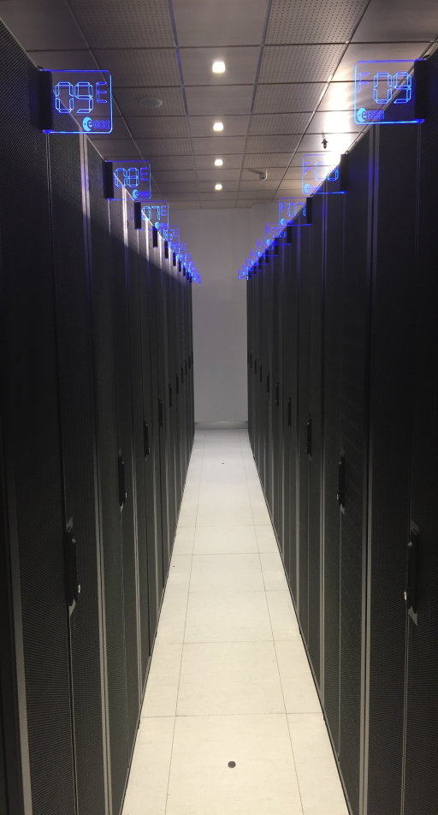
ESA EO - Security
ESA SECURITY DIRECTIVES
Physical Security
Information Protection
Personnel Security
INFOSEC
Business Continuity Management
EOP-G Security Framework
Security requirements
Secure operations management
Access control
SECOPS
User classification
EOP-G Security Framework
Two Security Operations Centres (SOCs)
Local Security Managers
Centralised Security Services (DDoS, F/W, IDS/IPS, AntiBot, Antispam, AntiVirus, URL Filtering)
Peripheral and distributed Security Services (F/W, IDS/IPS, end-system security)
Event Correlation (SIEM), Analytics
Secure code Analysis and development
Regular Patching
ISO 27001 as governance tool to manage security over a distributed, multi-actors and heterogeneous environment
Data classification
Disaster Recovery &
Business Continuity
Secure Operations &
Management
Network policy
Security
organization
Applications
Systems

Slide 17
EO Security Operations
Total number of logs lines collected from all security devices: 29 Trillions (2016)
Security events blocked: >1,6 Trillions attack attempts Blocked (SIEM+ Security measures 2016)
Security numbers | Total
# systems (DMZ + internal) | > 3700
# network devices | > 400
# logs collected every day | + 79.000.000.000
# attacks blocked every day | +4.300.000.000

Slide 18
EO Network and Security Services Summary
Two network with 21 Facilities and 3 Virtual sites (Data Hub, Dissharm, Elvis)
Near 41.000 Km of fibers only for Copernicus
Intranet combined capacity: 100 Gbps
Internet access combined capacity: 45 Gbps
Remote access :4 sites and more than 200 Mobile users
Number of deployed and managed devices: 400+
Number of security elements: 60+
Amount of data Circulated and disseminated per Month for Copernicus: 3.5+ Petabytes (2017)
Virtual dissemination & Processing facility for near 30 Missions and 13+ PB of on-line rolling
archive storage
Total number of logs lines collected from all security devices: 29 Trillions (2016)
Security events blocked:>1,6 Trillions attack attempts Blocked (SIEM+Security measures 2016)

Slide 19







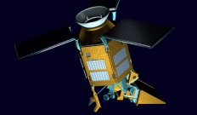
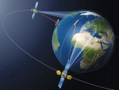






























Copernicus: The Space Components
Dedicated Missions
Sentinel-1
Sentinel-2
Sentinel-3
Sentinel-4
Sentinel-5P
EDRS
Acquisition Station
TT&C Station
Collaborative
Ground
Segment
Collaborative
Centre A
Contributing
Mission
CSC Coordinated
Data Access

Slide 20











ESA-EO Operated Data Hubs (1 of 2)
Open Access
Data Hub
Collaborative
Data Hub
International
Access Hub
Copernicus Services
Data Hub
Self Registration
13 Collaborative Users
5 Data Hub Relay Users
4 Users
166 Users
> 53,660 Users
No Rolling
Policy Applied
Node 1: 30 days
No Rolling Policy Applied
Node 2: 9 days
30 Days
Sentinel-1 NTC
Sentinel-1 NRT & NTC
Sentinel-1 NTC
Sentinel-1 NRT¹ & NTC
Sentinel-2 L1C
Sentinel-2 L1C
Sentinel-2 L1C
Sentinel-2 L1C
Sentinel-3 pre-ops
Max 2 Concurrent Downloads
Node 1: Max 10 downloads
No limits
Max 10 concurrent downloads
Node 2: No limits
NRT¹ via dedicated ftp

Slide 21
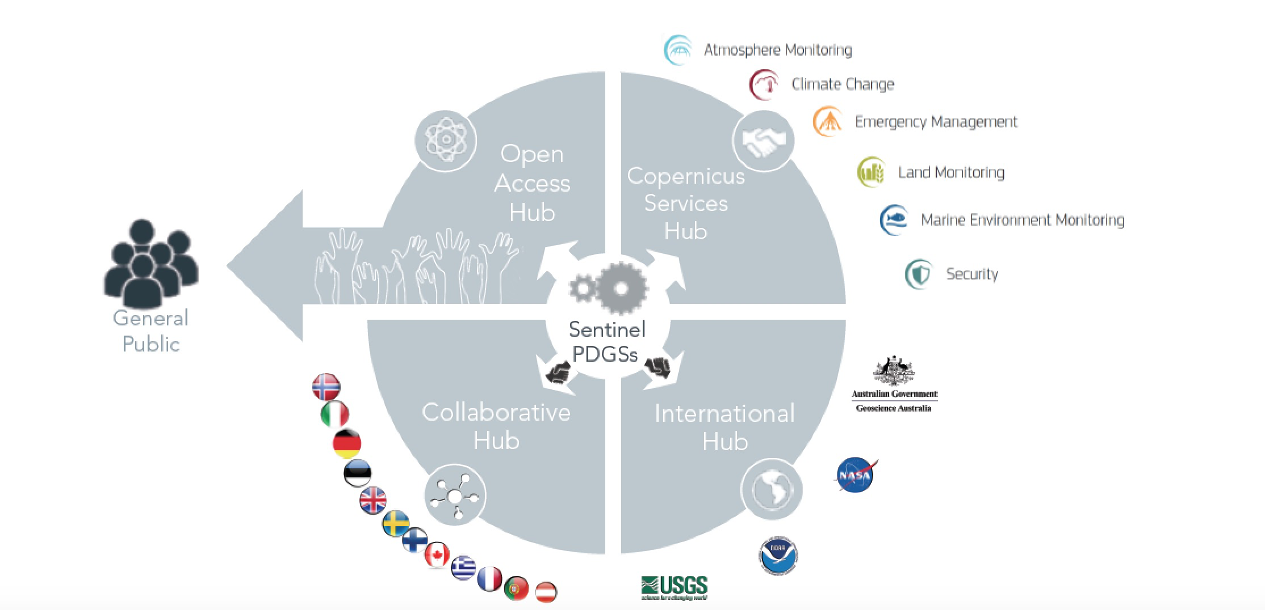
ESA-EO Operated Data Hubs (2 of 2)

Slide 22








ESA-EO Collaborative Hub
Use of Collaborative Hub and the
International Hub requires a technical
arrangement with ESA or an
international arrangement with the
European Commission.
The Collaborative Hub was initially
setup for ESA Member states participating
in the GMES program and later expanded
to all GMES/Copernicus participating states.
Partners retrieving data from the
Collaborative Hub and the International Hub
will redistribute the products from their own
platforms and data access points.
Node 2
Node 1
STFC
Member States mirror sites
Member States mirror sites
Member States mirror sites

Slide 23
The Collaborative Ground Segment (1 of 2)
Collaborative Ground Stations: acquisition of data in passive mode during core visibility.
Interconnection Agreement with specific partners (e.g. Industry).
The Collaborative Ground Segment provides:
  Complementary access to SENTINEL data and/or to specific data products or distribution channels.
  Complementary national and commercial services for the exploitation of Copernicus Sentinel data.
  Redistribution of Sentinel product.
  Creation of additional data sets or complementary products, such as regional datasets or higher level products.
  SENTINEL data exploitation in various areas.

Slide 24
The Collaborative Ground Segment (2 of 2)
A total of 12 Collaborative Ground Segment agreements have been signed with ESA.
69% of the Collaborative Ground Segment partners had opened their national mirror sites.
The European Commission and ESA have agreed with NASA, the National Oceanic and Atmospheric Administration (NOAA), the US Geological Survey (USGS) and Geoscience Australia (GA) to make Copernicus Sentinel data available to them via a dedicated access point, the International Hub.

Slide 25
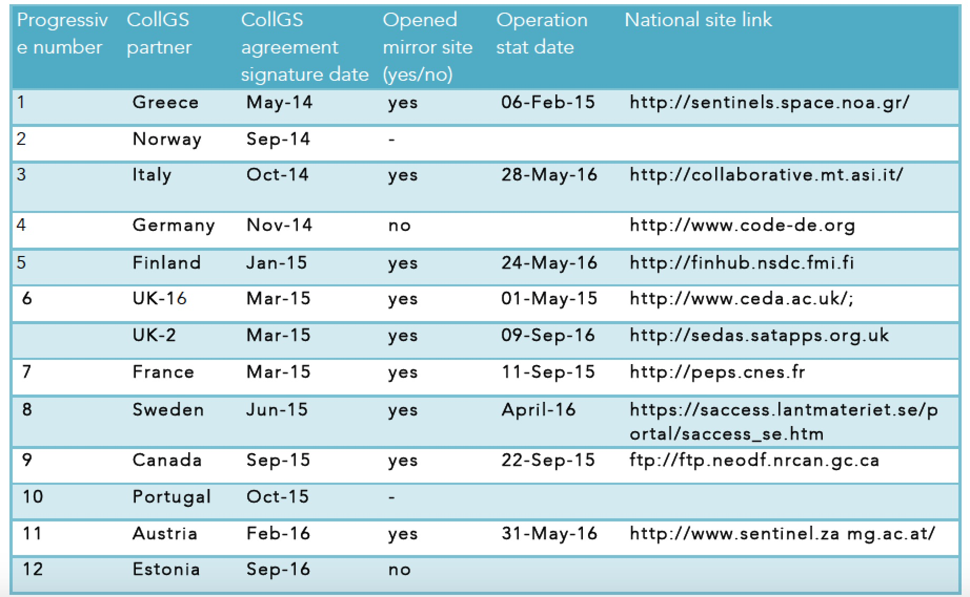
The Collaborative Ground Segment - mirror sites

Slide 26
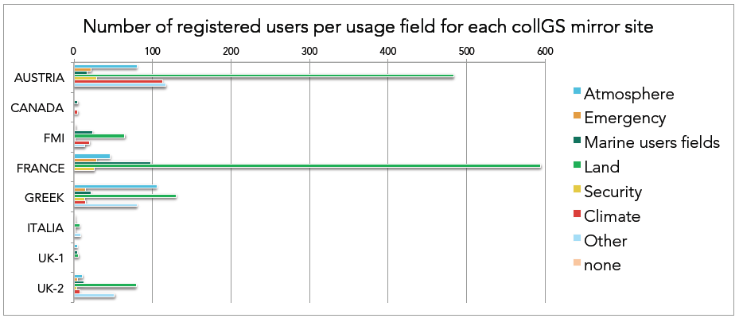
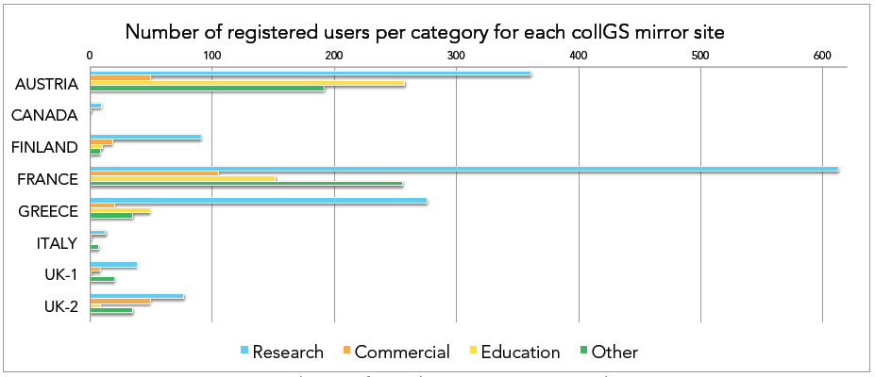
The Collaborative Ground Segment
User Distribution
Slovenian company Sinergise Laboratory for Geographical Information Systems, Ltd , and the Polish company CloudFerro sp. z o.o. opened its EO Cloud platform for Commercial use
LAND is the most common used fields
Research and Education are the most popular sites
A Considerable portion of data is used for Commercial use

Slide 27
Conclusions
Upgrade of the Core Front end to 40 Gbps for Academic users
Evaluation of federated Cloud Service Model
Introduction of a SDN (Software Defined Network)
Increased of security
  Microsecurity
  Intelligence and behavior analysis
  Copernicus Security Centre
  ISO 27001
Data Hub software enhancements (New DHuS version for Data Relays, Improved Synchronizers, Improved API for “catalogue view”, Geographic selection for Synchronizers, Remote retrieval of products outside relay cache)

Slide 28

Would you like to know more?
Visit www.esa.int

