Slide 1
A Marketplace prototype based on PrestaShop
Roksana Dobrzańska, Tomasz Szepieniec – ACC Cyfronet AGH

Slide 2
Main Guideline for Implementing MarketPlace
clear presentation of service offer for new users
build on intuitive on-line shop pattern
awareness of federation structure of providers
ready for extensions and various service delivery workflows

Slide 3
8 steps to ease your researcher life
-
marketplace.egi.eu

Slide 4
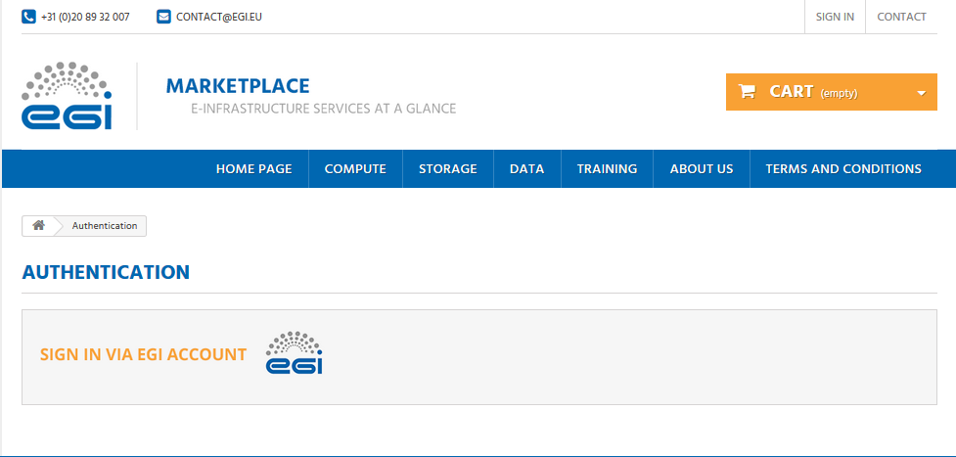
Step 1 - Sign In via EGI Account

Slide 5
Step 2 – Discover EGI Offer: Service Areas

Slide 6
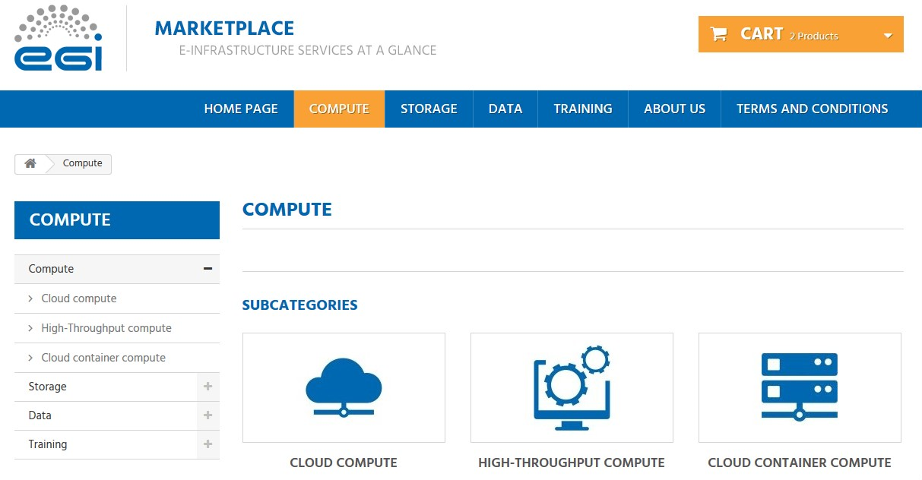
Step 2 – Discover EGI Offer: Services

Slide 7
Step 2 – Discover EGI Offer: Service Options

Slide 8
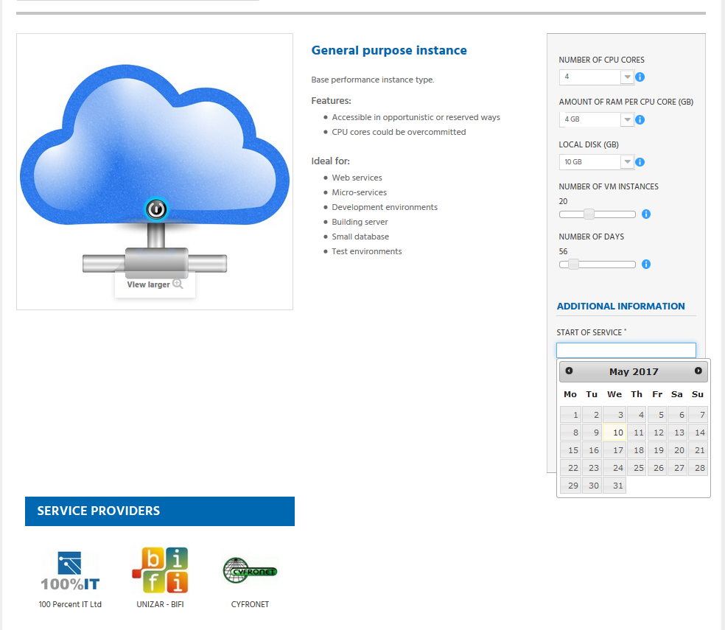
Step 3 – Fill In the Details

Slide 9
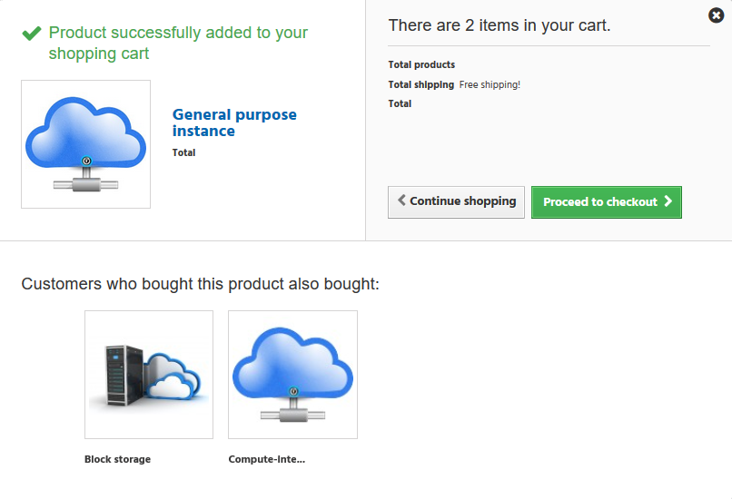
Step 4 – Proceed to Checkout

Slide 10
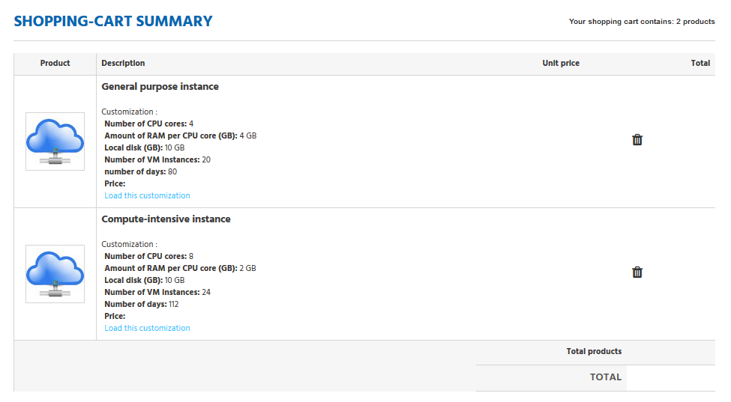
Step 5 – Double-Check Your Request

Slide 11
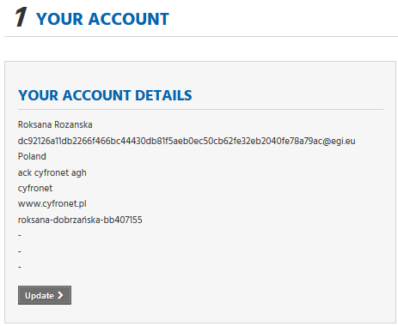
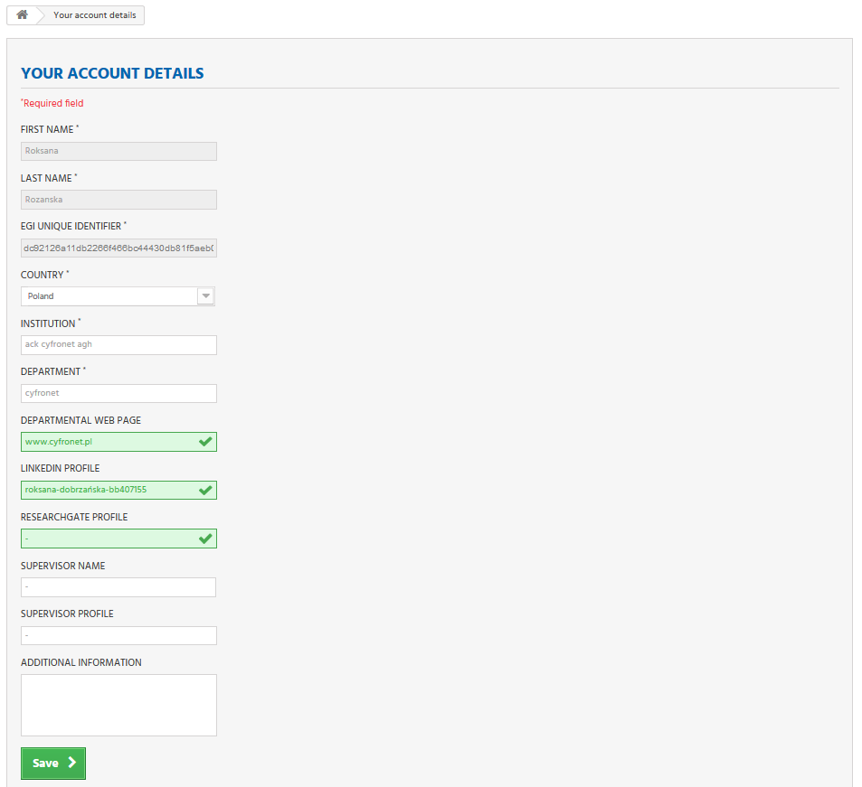
Step 6 – Fill In Affilliation Details

Slide 12
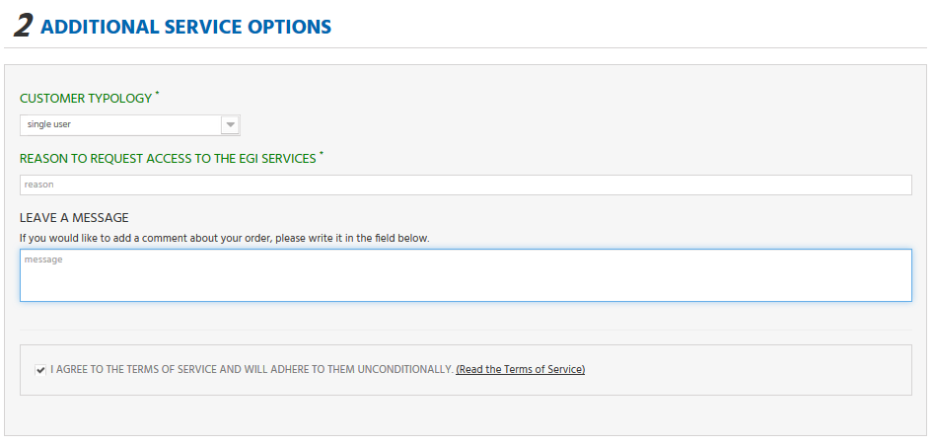
Step 7 – Choose Your EGI User Profile for the Order

Slide 13
Step 8 – Send the Request

Slide 14
DEMO
-
marketplace.egi.eu

