Slide 1

ONEDATA and
EGI DataHub
Lukasz Dutka

Slide 2
Before we start
Onedata
  software stack for distributed data management platform developed externally to EGI
EGI DataHub
  deployment of Onedata and ODP making existing large scale open data collection available in easy way for EGI Fedcloud users.

Slide 3


Slide 4
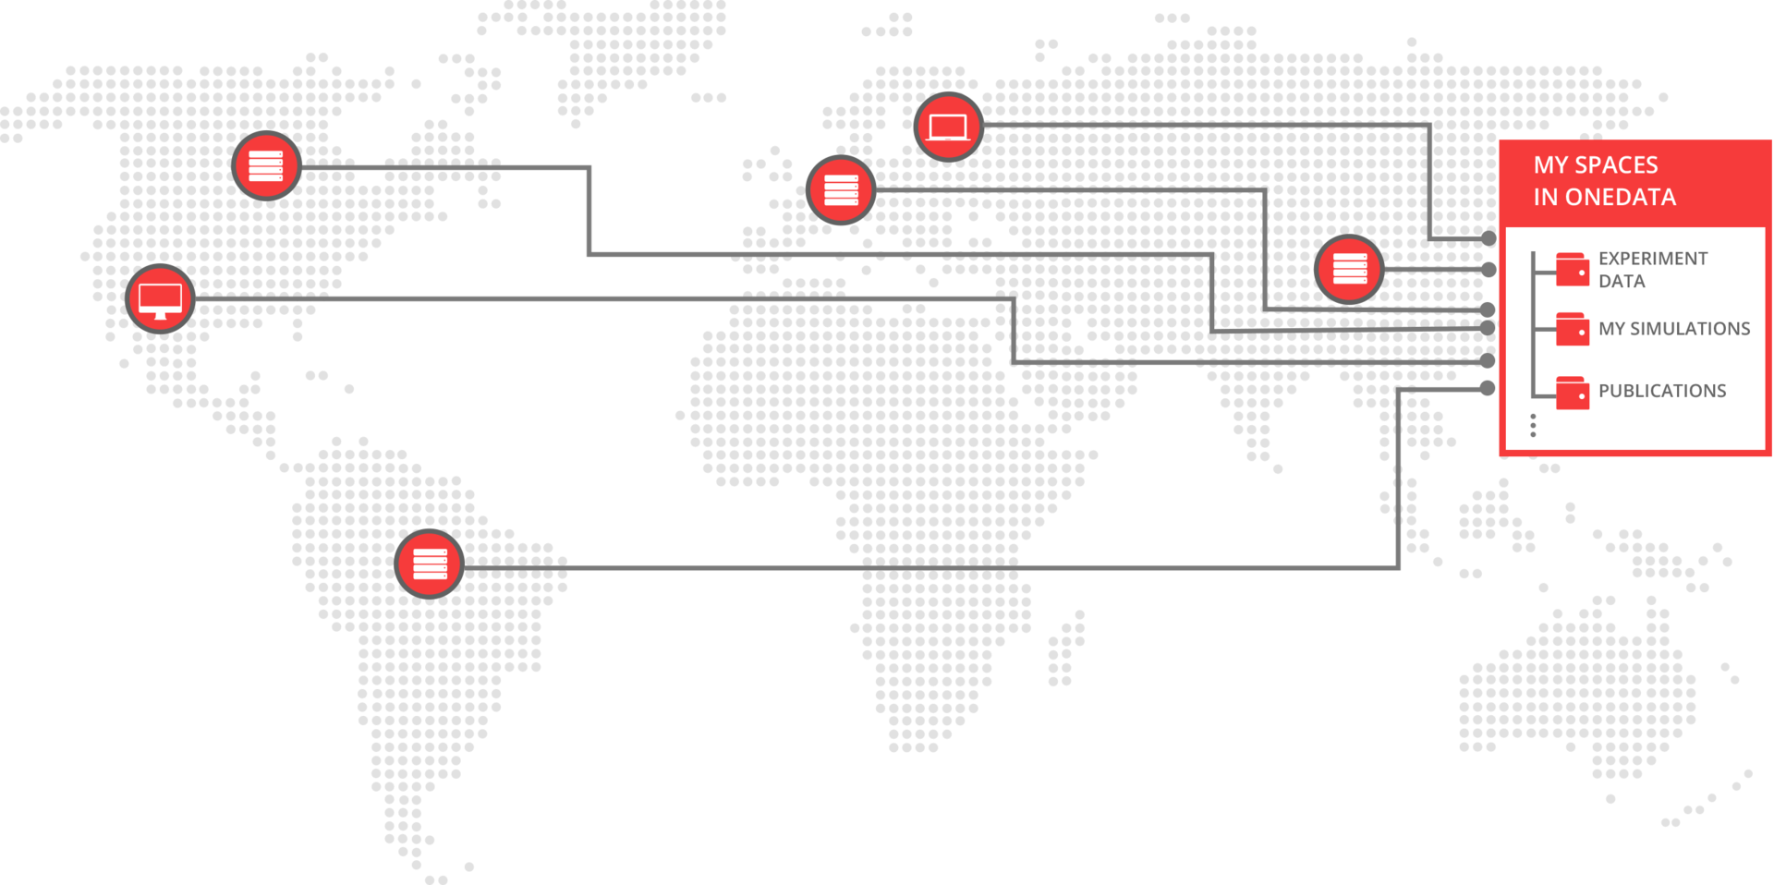
Onedata Big Picture

Slide 5









Onedata Spaces
User 1
User 2
User 3
Group
Is a kind of Virtual Directory with metadata
Is a kind of Virtual Directory with metadata
Each Space might be supported by many providers
P2P
P2P
ONEDATA Provider
ONEDATA Provider
ONEDATA Provider
ONEDATA Provider
Direct Access
Direct Access
Local Network Attached Storage
Storage
LustreFS
CephFS
Amazon S3
Private Resources
Active Repository Center 2
Active Repository Center 2
Private Resources

Slide 6
ONEWORLD

Slide 7




OPPORTUNITIES FOR LEGACY DATA
Space
Meteo
Space
Scans
Support with synching
to existing collection
Supported with synching
to existing collection
Support with local storage cache
Support with local storage cache
P2P Comm.
P2P Comm.
Metadata
Sync
Metadata
Sync
Access to
Meteo and Scans
as local data.
Meteo Cached
Access to
Meteo and Satellite
as local data.
Scans Cached
S3
Ceph
Meteo
(NFS)
Scans (Lustre)
Public Cloud
Private Cloud 1
Private Cloud 2
Private Cloud 3

Slide 8
Onedata Summary
Distributed and decentralized repositories
Pluggable architecture for various data types
Flexible data sharing and access control
Concept of “projects” called “data spaces”
Multiple interfaces for data access: CDMI, POSIX, REST, WebGUI, command line
High-throughput clients for larger data centres
Metadata management
Data migration and replication
Fine-grain ACL

Slide 9
EGI DataHub

Slide 10
EGI DataHub Role
Unified access to reference scientific data of public interest.
Host experimental or temporary scientific data and enable easy access to it by appropriate scientific applications.
Distributed platform for managing replicas of publicly available data collection available on EGI Infrastructure
Data here could mean datasets ­ a collection of data/files/filesets at a level of granularity considered useful to user communities.

Slide 11
Current Landscape
Public Data
Repository X
Public Data
Repository Y
Community Specific Data Discovery
Community Specific Data Discovery
AWS
S3
Existing Replica
Public Clouds
Private
Comp. Cloud
LUSTRE
S3
Ceph
NFS
EGI Resource Centres
EGI Resource Centres
Private Resources

Slide 12
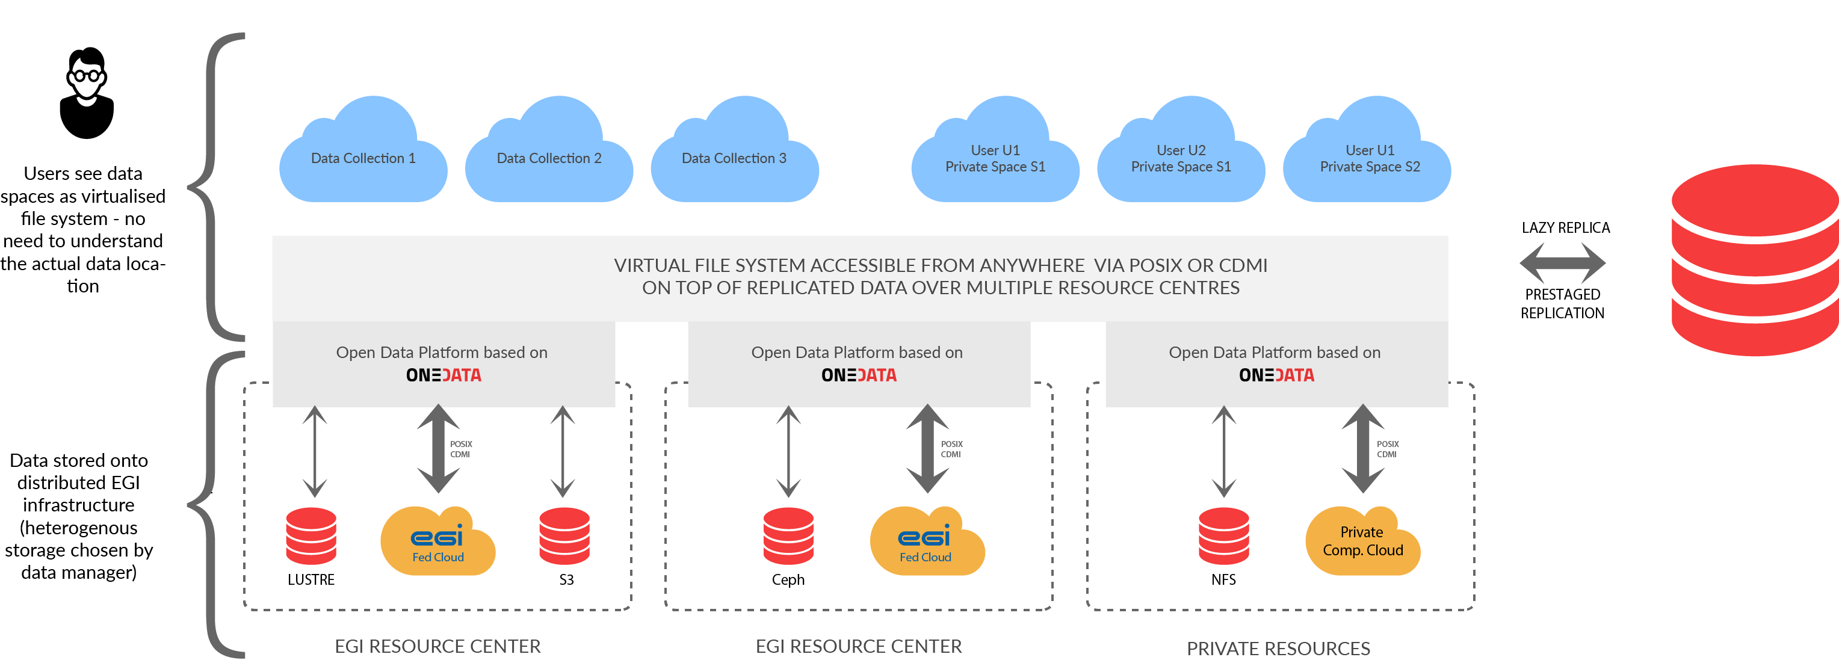
The Landscape Changed by DataHub

Slide 13
DataHub Processes / Use Cases
EGI.eu collects interest for data collections that should be available in DataHub
EGI.eu finds Resource Centres willing to support replica of the collections
EGI.eu and Data Providers negotiate technical means of replication data collection to the Resource Centers
Data Providers inform users about EGI replicas
Data Collections discoverable in AppDB
Users “link” collections of their interest in personal data hub space trough Data Providers JS widget or AppDB
Users can access data collections via POSIX virtual file system or HTTP requests on all EGI resources
Users can share their private resources in the same way as public collections

Slide 14
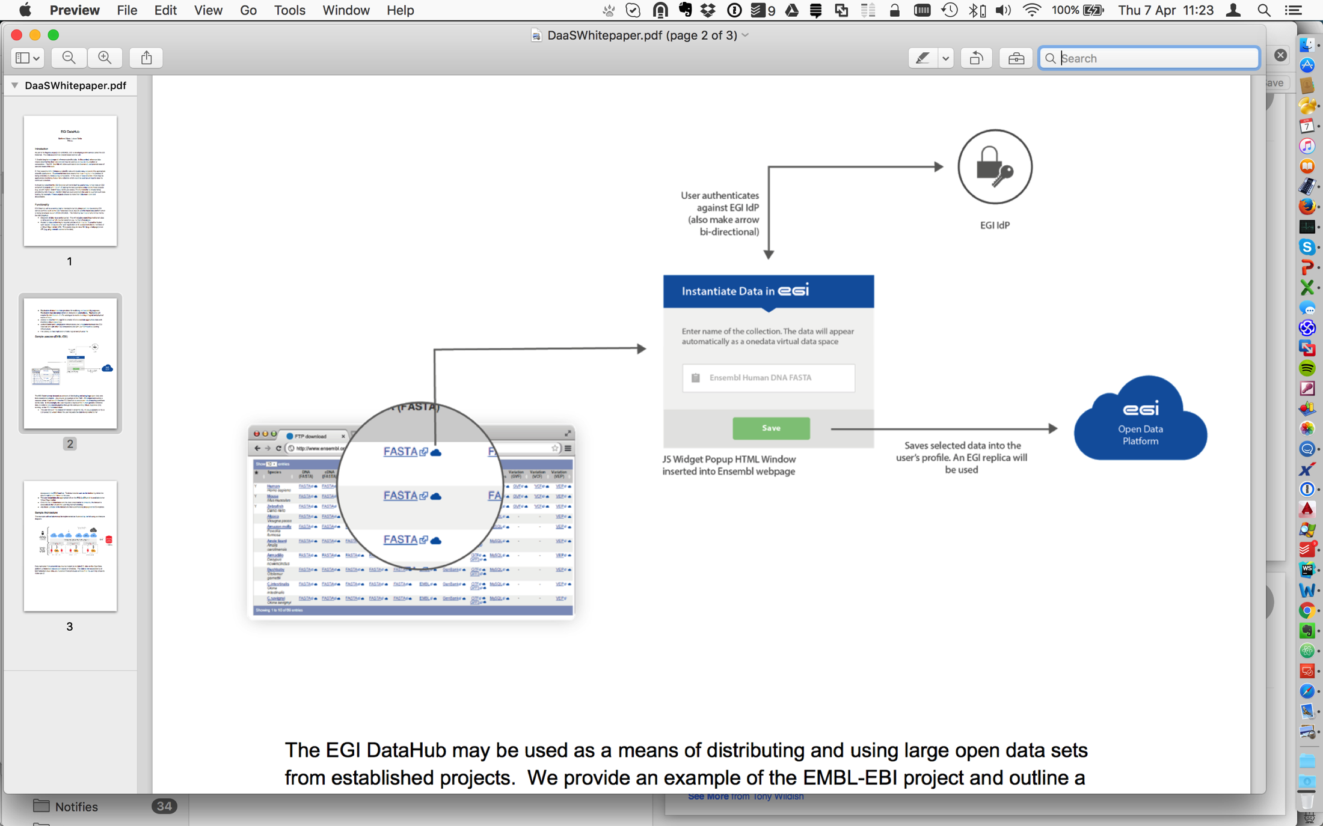
Concept of Data Widgets

Slide 15
Data Discovery Issues
DataHub is not to replace community specific data discovery mechanism
DataHub provides basic interface for access to metadata
DataHub provides interface for building added value discovery services running on top of EGI Cloud
Ideally DataHub should be integrated with existing discovery webpages using JS widget to enable direct “linking” selected data to make it available on cloud resources

