Slide 1
EOSC: an ecosystem of services
Luciano Gaido (gaido@to.infn.it)
INDIGO Summit 2017 – Catania, May 9-12 2017
RIA-653549

Slide 2
Outline
The context
EOSCpilot project
EOSC-hub proposal
Conclusions

Slide 3
Outline
The context
EOSCpilot project
EOSC-hub proposal
Conclusions

Slide 4
The context/1
The European Open Science Cloud is quite a vague concept
The Commission High Level Expert Group on the European Open Science Cloud was created in September 2015
They published the report “Realizing the European Open Science Cloud” on October 11, 2016
From the Executive summary:
“EOSC aims to accelerate and support the current transition to more effective Open Science and Open Innovation in the Digital Single Market. It should enable trusted access to services, systems and the re-use of shared scientific data across disciplinary, social and geographical borders... EOSC as a federated environment for scientific data sharing and re-use, based on existing and emerging elements in the Member States, with light-weight international guidance and governance and a large degree of freedom regarding practical implementation…. An important aspect of the EOSC is systematic and professional data management and long-term stewardship of scientific data assets and services in Europe and globally…”

Slide 5
The context/2
The first attempts to start building the EOSC are funded by the EC through two subsequent H2020 calls:
INFRADEV-04-2016
EOSCpilot project has been approved
EINFRA-12-2017
Call closed on march 29th 2017, evaluation of the proposals ongoing
Worth mentioning the EOSC-hub proposal jointly prepared by EGI, EUDAT and INDIGO
These are the grounds (at least our possible contribution) to the EOSC ecosystem.
Note that we have also submitted two proposals for the EINFRA-21-2017 call: DEEP-HybridDataCloud and eXtreme DataCloud (XDC).

Slide 6
The context/3
Our vision (shared with most relevant stakeholders) for the EOSC is that:
it should be an ecosystem of services provided by various different service providers
It should rely on the existing e-infrastructures → effort should be devoted to the integration/interoperability of their services
User needs should be driving the EOSC shaping
It should be continuously evolving and integrating new services and new technologies as soon as they become available, are production-ready (TRL8+) AND are requested by users

Slide 7
Outline
The context
EOSCpilot project
EOSC-hub proposal
Conclusions

Slide 8
EOSCpilot project in a nuthsell
Budget: about 10 M€
Coordinator: STFC
Duration: 1.1.2017 – 31.12.2018
33 partners, 15 third parties (plus one unfunded partner) of which 13 are also participating to INDIGO-DataCloud:
STFC, CEA, CERN, CNR, CNRS, CYFRONET, DESY, EGI Foundation, INAF, INFN, INGV, KIT, PSNC
https://eoscpilot.eu

Slide 9
EOSCpilot objectives
The EOSCpilot represents a first step towards the development of the European Open Science Cloud.
It will:
Design and trial a stakeholder-driven governance framework
Contribute to the development of European open science policy and best practice;
Develop demonstrators of integrated services and infrastructures in a number of scientific domains, showcasing interoperability and its benefits;
Engage with a broad range of stakeholders, crossing borders and communities, to build trust and skills

Slide 10
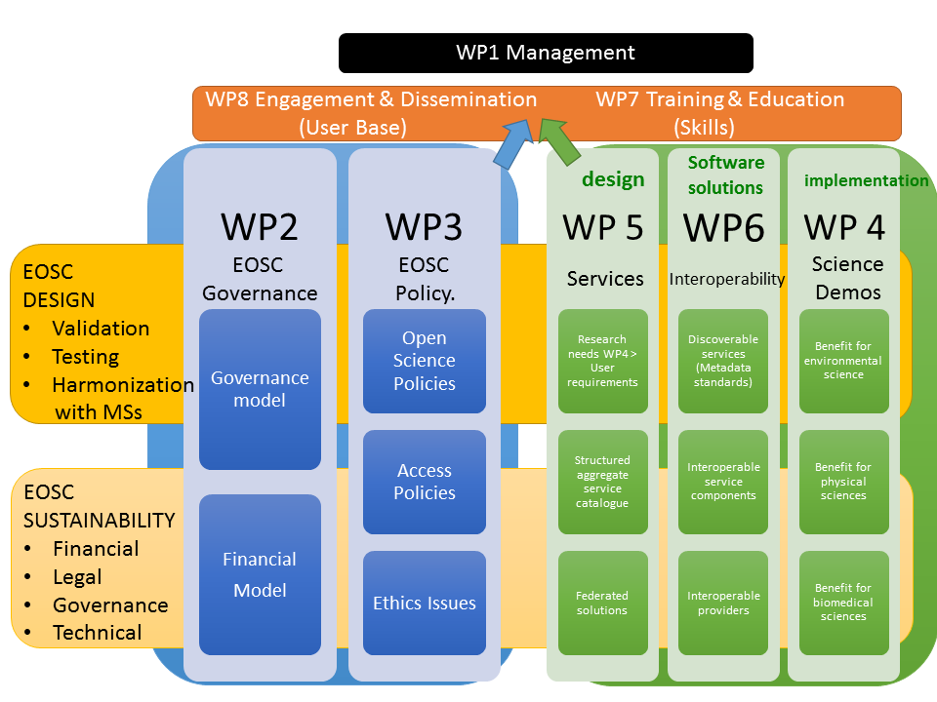
EOSCpilot WP structure

Slide 11
EOSCpilot expected output
governance framework (rules of engagement, business plan, ...),
15 science demonstrators
federated service management framework
interoperability demonstrators
identification of training needs
open innovation platform for industry engagement
workshops for engagement of different stakeholders

Slide 12
EOSCpilot science demonstrators
5 already selected:
PanCancer Analysis of Whole genomes (EMBL): Sensitive genomic data for cancer patient health care
ENVRI Radiative Forcing Integration (ICOS ERIC + ACTRIS + DKRZ + IPSL): Integration of heterogeneous climate data sources
Research with Photons & Neutrons (DESY, ESFR, XFEL, ESS, EMBL, ILL): Exploitation of data from analytical facilities
WLCG (CERN): Large-scale long-term data preservation and reuse of physics data
TEXTCROWD (Univ. of Florence): Collaborative semantic enrichment of text-based datasets –TEXTCROWD
10 more demonstrators being selected through an open call (review of the proposals is currently ongoing)

Slide 13
EOSCpilot Interoperability WP (WP6)
Objectives:
Research and Data Interoperability: data & services to be findable, accessible, interoperable and reusable (FAIR)
Infrastructure interoperability: facilitate the most adequate infrastructures for the treatment of extensive amounts of data. Demonstrate with multi-infrastructure, multi-community pilots
Key Output:
The design of a future EOSC based on federated interoperable services meeting the needs of the thematic research domains and wider user base
Tasks:
T6.1: gap analysis & interoperability architecture [CNRS lead]
T6.2: EOSC Research and Data interoperability [ELIXIR lead]
T6.3: Interoperability pilots [INFN lead]

Slide 14
EOSCpilot T6.3 - Interoperability pilots
Validation regarding:
AAI requirements for both e-infrastructures and scientific communities solutions offered by INDIGO- DataCloud, ELIXIR AAI, EUDAT B2ACCESS and AARC
Resource brokering solutions - spanning multiple infrastructures and user communities and aimed for high-level resource discoverability and addressability
Accessibility - EOSC local, Grid, HPC and Cloud resources accessible by multiple communities
Data accessibility – through personal resources, scientific portals, CLI
Interoperability - underlying distributed storage systems with the EOSC platform services; services and tools - as those provided by the EUDAT service suite and INDIGO-DataCloud toolbox

Slide 15
Outline
The context
EOSCpilot project
EOSC-hub proposal
Conclusions

Slide 16
EOSC-hub proposal in a nutshell
Joint EGI, EUDAT and INDIGO proposal
Integrating and managing services for the European Open Science Cloud
Call: EINFRA-12-2017 (Data and Distributed Computing e-infrastructures for Open Science), topic a: Secure and agile data and distributed computing e-infrastructure
Budget: 30 M€
Coordinator: EGI Foundation (EGI.eu)
Participants: 74 beneficiaries (plus 20 linked third-parties) from 36 countries
Duration: 36 months

Slide 17
EOSC-hub Objectives
Simplify access to a broad portfolio of products, resources and services provided by different actors through an open service catalogue
Remove fragmentation of service provisioning and access to digital services
Increase innovation capacity of digital Infrastructures
Consolidate digital infrastructures by
Expanding capacities and capabilities
Improving discoverability, access, interoperability and sharing , across research communities and countries
Extend access to integrated compute, storage, data and software to new user groups including high-education and industry, increase the user base
Expand human capacity (consolidate/expand a distributed network of experts and service operators at local/national level)

Slide 18
EOSC-hub Service architecture
Community Support services
Thematic
Service
Thematic
Service
Thematic
Service
Thematic
Service
Thematic
Service
Thematic
Service
Federation Services
AAI,
Accounting,
Monitoring,
Operations, Security Coord.
Added Value Services
Compute, Data, Software
Management and Preservation
Open
Collab.
Platforms
Application Repository,
Configuration Management,
Marketplace
Basic Infrastructure
Compute and Storage
Common services

Slide 19
EOSC-hub Project structure

Slide 20
EOSC-hub Engagement with research communities
Thematic Service Providers
Interested in providing a thematic production service as part of EINFRA-12 and the future EOSC
Early adopters
Interested in piloting common services, using and advancing cross-infrastructure usage for the benefit of their research community and beyond
Organized through “competence centers” bringing together e-Infrastructure providers and relevant research organizations and technology providers/experts
Both have already been selected via an open call, but an additional call is expected during the project (about 0.5 M€ earmarked)
Notes:
Distributed across 3 slides

Slide 21
EOSC-hub Thematic Services
60 proposals received, 9 selected:
CLARIN (European Research Infrastructure for Language Resources and Technology)
DODAS (CMS)
ECAS (climate studies)
GEOSS (Global Earth Observation System of Systems)
OPENCoasts (On-demand Operational Coastal Circulation Forecast Service)
WeNMR (Worldwide e-Infrastructure for Nuclear Magnetic Resonance and structural biology)
DARIAH (Digital Research Infrastructure for the Arts and Humanities)
LifeWatch
EO Pillar (Earth Observation)

Slide 22
EOSC-hub Early Adopters/Competence Centers
The Competence Centre is driven by well established and mature research infrastructure or international collaboration requiring advanced and integrated data and computing services.
In the Competence Centre early adopters test, adapt, and integrate the digital capabilities they need to pursue they research, with the support of e-Infrastructure and technology experts.
The Competence Centre will:
Run Proof of Concepts
Conduct Pilots
Prepare the production environment
Define appropriate business models to sustain the solutions after the end of the project
Notes:
Distributed across 3 slides

Slide 23
EOSC-hub Competence Centers
Out of 51 proposals received, 7 Competence Centres have been selected:
Elixir → Lead Partner: EMBL-EBI
Fusion → Lead Partner: CCFE
Marine → Lead Partner: IFREMER
EISCAT_3D → Lead Partner: EISCAT
EPOS-ORFEUS → Lead Partner: SURFsara
Radio Astronomy Competence Center (RACC) →Lead Partner: ASTRON
ICOS → Lead Partner: SNIC
Disaster Mitigation Competence Centre Plus (DMCC+) → Lead Partner: ASGC, unfunded
Notes:
Distributed across 3 slides

Slide 24
EOSC-hub Involvement of Industries
Organized through Business Pilots:
relevant to EGI participants with a national business programme and have activities of pan-European impact/interest
designed to foster innovation between e-Infrastructures and the private sector through building an ecosystem of SMEs, large industries, startups, researchers, accelerators, and investors to become active business partners of e-Infrastructures as customers and/or service providers. These initial pilots will serve as early demonstrators of the project’s Joint Digital Innovation Hub (DIH).
Selected via an open call at proposal preparation
Notes:
Distributed across 3 slides

Slide 25
EOSC-hub Business Pilots
6 proposals selected, out of 31 received:
CyberHAB (Water body management sector)
Sports Smart Video Analysis (Sports sector)
Bot Mitigation Engine (Business sector)
ACTION Seaport (Local coastal authorities)
Space Weather Data Services for the future DRACO Observatory (Climate sector)
Furniture Enterprise Analytics - DataFurn (Furniture industry sector)
Two transversal activities will support these pilots, an OpenLab and the commercialization support.
Notes:
Distributed across 3 slides

Slide 26
EOSC-hub: INDIGO contribution/1
Some INDIGO-DataCloud services are already been selected during the proposal preparation → their maintenance and support are part of the project. They are:
WATTS (WP5)
IAM (WP6)
Onedata (WP6)
Advanced IaaS Services (WP6)
Infrastructure Manager (WP6)
PaaS + Orchestrator (WP6)
Web Frontend Services (WP6)
Udocker (WP6)
They will be part of the EOSC-hub service catalogue (together with the EGI and EUDAT services).
Other INDIGO services could become part of the SC in the future, if requested by users
Notes:
Distributed across 3 slides

Slide 27
EOSC-hub: INDIGO contribution/2
Many INDIGO partners will contribute to important project activities:
definition of policies and governance of the EOSC
stakeholders engagement
technical coordination (which includes the definition of the technical roadmap, and the evolution of the service catalogue)
contribution to the external liaison
support and training
Notes:
Distributed across 3 slides

Slide 28
Outline
The context
EOSCpilot project
EOSC-hub proposal
Conclusions

Slide 29
Conclusions/1
The EOSC landscape is starting to be shaped now and it is a big challenge due to:
the pre-existing fragmentation of e-infrastructures, services, projects
the great number of actors (often with different agendas)
the current fragmentation of funding streams
However:
the EOSCpilot project has already started defining the first pilot implementation of the EOSC
there is the common feeling that the EOSC should be ‘flexible’ and evolve over time, including new services, resources and addressing the needs of more and more user communities
Notes:
Distributed across 3 slides

Slide 30
Conclusions/2
the project(s) which will be approved in the EINFRA-12a call will be a big step further
the projects which will be approved in the EINFRA-21 will hopefully provide new services relevant to the user communities → possible candidates to be included in the EOSC service catalogue
INDIGO-DataCloud and its partners (including the user communities and industries involved) can contribute to the EOSC by:
exploiting the INDIGO services in all possible environments
supporting the research communities to understand and adopt our services
continuing to foster innovation
Notes:
Distributed across 3 slides

Slide 31
Thanks!

