Slide 1
Population Imaging Use Case - EuroBioImaging
Ignacio Blanquer
Ferrán Borreguero
Universitat Politècnica de València

Slide 2
Medical Imaging Biobanks
Description
Resource needs
SW dependencies
Data Request
Access Request
Evaluate
BIMCV (an EuroBioImaging ESFRI node) manages a population database from an area of 5 Million people.
BIMCV will receive applications for projects
E.g. Training a set of models for the automatic segmentation of bone tissues in osteoporotic women of an age above 70, including sound control subjects.
BIMCV will provide research data for those projects and a infrastructure to process them
However, BIMCV has limited resources to deal with the computations of the different pilots.
BIMCV is seeking for a model to provide services rather than data and implementing a closer follow-up of the activities.
Scientific & Technical Committee
External subproj. team
Data request
Updated SW deps & resource needs
Data Manager
SW deps
Customised Volume
Resource needs
SW image
Tech. Manager
Brokering
Deploy
Mount
Provision
Regional PACS
Infrastructure
ceib.san.gva.es/bimcv

Slide 3
User Stories
US#1777: I will need to store data permanently.
US#1771: I will need convenient access to this storage.
US#1756: I will need to protect access to data to selected users.
US#1774: I need remote access to the data produced without downloading it all.
US#1753: I will need to run legacy applications that use POSIX filesystems.
End-User / Application developer
US#1765: My executions will involve high-throughput jobs. I will need that the amount of resources to dynamically fit the workload.
US#1762: I will need to compose and customize processing workflows with my own parameters and tools.
US#1768: I need direct access to the terminal of the processing resources.

Slide 4
Use Case Requirements
EB#1 Persistent (but medium-term) data storage volumes with standard POSIX file access.
EB#2 ACL in the access to data.
EB#3 Execution of data-driven and computing-intensive workflows.
EB#4 Availability of customised software.
EB#5 Deployment of own software.
EB#6 Resources adaptation to workload.
EB#7 Terminal access to the resources.
EB#8 Online access to data.
EB#9 Management of users and groups.
EB#10 Long-term availability of results.
EB#11 Provenance and repeatability of experiments.
TOSCA
SLURM

Slide 5
Image Processing integration
Overview
Onedata
/upload
Cluster
web service
api
/apply
Virtual Machine
Radiologist
slurm
/create

Slide 6
Medical Imaging Biobanks – Elastic batch queue
Adds the complexity of deploying an elastic batch queue
New TOSCA: https://github.com/indigo-dc/tosca-types/blob/master/examples/eubiosteo_server.yaml
Deals with both VM for the nodes of the batch queue and containers for the execution of the biomarkers
Skips the need of running Docker under privileged mode.
Addresses the need of respecting IPR of users’ code by injecting it on generic containers.
Uses ONEData volumes for both images and software code.
Runs jobs on a batch queue submitted through a web service.

Slide 7
Data volume integration
slurm
mount
Virtual Machine
No privileges required on Docker
ubuntu 16

Slide 8
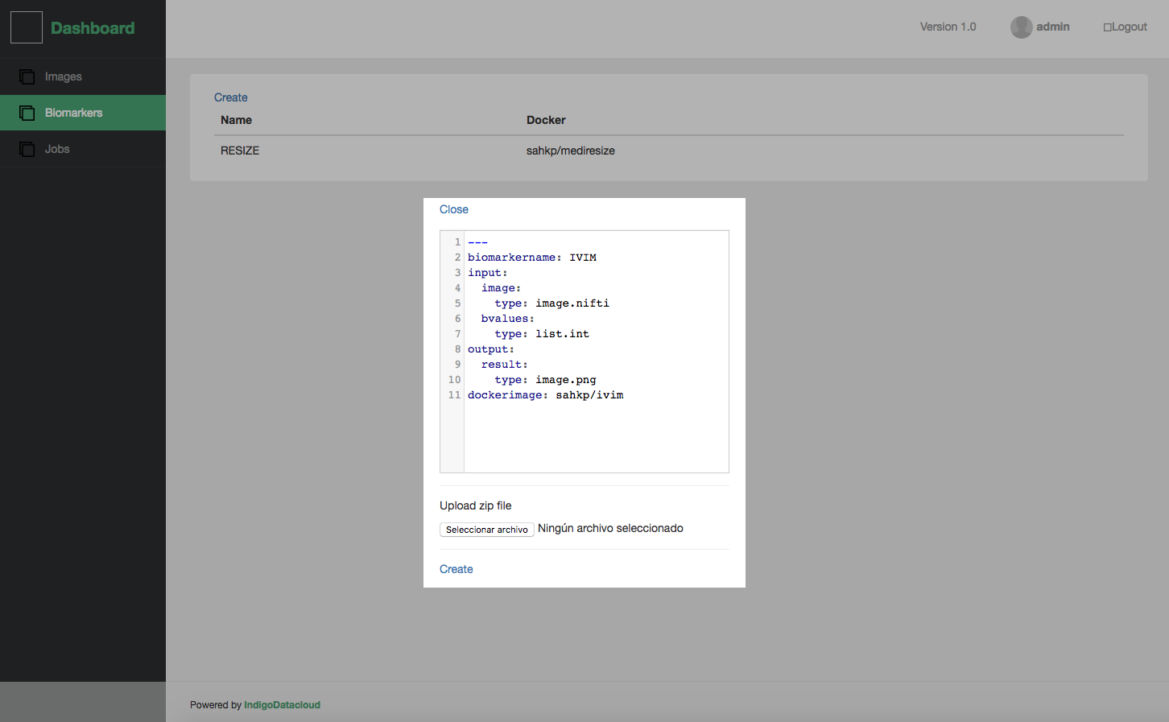
Medical Imaging Biobanks – architecture
HIS
Proj Volume
Ansible Galaxy
GitHub
Extract
1
Ansible Recipe
Proj. Volume
gitHub DockerHub
Galaxy
Ansible Play Role
…/indigo-dc/ansible-role-eubiosteo
Verification
Annotation
Anonymization
Upload
Research Repository
includes
Image Data Bank
calls
OneData
Docker Hub
Dockerfile
.../indigo-dc/eubiosteo
Extract
Nifty & Health Metadata
Proj. Volume
Own containers
Automated Docker Built image
Own Images
trigger
Data Manager
Local
Disk
IaaS
mount
pull
Define
3
Processing code
Terms of Usage
Orchestrator
Deploy
WN
WN
Front/end
Generic INDIGO components
Project Technical Manager
Submit
4
Web Portal
End-users
…/tosca-types/ …/eubiosteo_server.yaml
TOSCA
EUBIOSTEO INDIGO pilot
2
OneData
Project Director

Slide 9
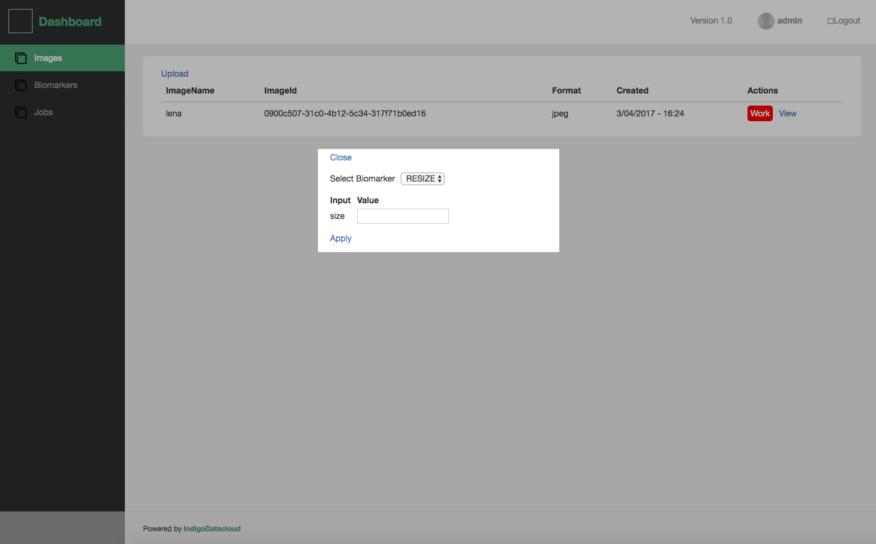
Web interface

Slide 10
Conclusions
Despite that EUBIOSTEO use case is tailored for Medical Imaging, it shares many general requirements with most of the applications
INDIGO-DC offers BIMCV
Availability of an efficient batch queue.
Convenient & secure access to Remote Volumes accessible through POSIX.
Convenient integration of user-specific code, including IPR restrictions.
Availability of a comprehensive endpoint to interact with.
Single sign-on, integrated deployment, QoS.
It constitutes the access model and application delivery pattern for the BIM-CV node.

Slide 11
We are ready to share our experience!
https://www.indigo-datacloud.eu
Better Software for Better Science.

