Slide 1
Presentation
European e-Infrastructure Services Gateway
EGI Conference 2017 & INDIGO Summit 2017 Catania (Italy)

Slide 2
what is eInfraCentral?
Coordination and Support Action (CSA) (INFRASUPP-03-2016 - H2020)
9 organisations, including 5 major e-infrastructures
Period: January 2017 – June 2019 (30 month)
1

Slide 3
eInfraCentral relation to H2020
INFRASUPP-03-2016 call foresees two CSAs for policy development:
Support the e-IRG secretariat to collect …
Dissemination and collaboration activities for information sharing among projects and stakeholders, through the development of a web-portal.
2

Slide 4
what is eInfraCentral ?
e-Infrastructures address the needs of European researchers for digital services in terms of networking, computing and data management
1

Slide 5
the context (1/2)
In the context of the European Open Science (EOS) agenda there is a need to:
capitalise on past e-infrastructure investments and develop an e-infrastructure commons
2

Slide 6
the context (2/2)
To be able to promote EOS, a number of obstacles need be addressed, like:
service accessibility, interoperability and fragmentation, comprehensibility and clarity + inconsistent use of key performance indicators (KPIs) for assessing added value
2

Slide 7
mission
Ensure that by 2020 a broader/ more varied set of users (including industry) benefits from European e-infrastructures
A common approach to defining and monitoring e-infrastructures services will increase the uptake
Enhance understanding of where improvements can be made in delivering e-infrastructure services
2

Slide 8
three core objectives (1/2)
Structure an open and guided discussion between e-infrastructures to consensually define a common catalogue for their services.
Develop a single-entry point (the eInfraCentral portal) for end users to browse the service catalogue, and enhance the monitoring of key performance indicators (KPIs).
2

Slide 9
three core objectives (2/2)
Draw policy and sustainability lessons for the future development of a European e-infrastructure ‘market place’ as an extension of the common service catalogue and portal so that it includes a much broader range of e-infrastructures and services.
2

Slide 10
key highlights 1/2
A co-design process that will involve funders (the EC, etc.), the (e-)research infrastructure community and a representative user groups.
On-going user interaction that will guide the design and development of the eInfraCentral portal that will take place in two phases:
fast prototyping -“Beta”(August 2017); and
a full release of a complete web portal, dashboard and collaborative e-tools (April 2019).
2

Slide 11
key highlights 2/2
Service catalogue alignment will be facilitated by drawing on experience of developing FitSM standards* to develop a standardised service portfolio definition.
2
FitSM is a free and lightweight standards family aimed at facilitating service management in IT service provision, including federated scenarios - http://fitsm.itemo.org.

Slide 12
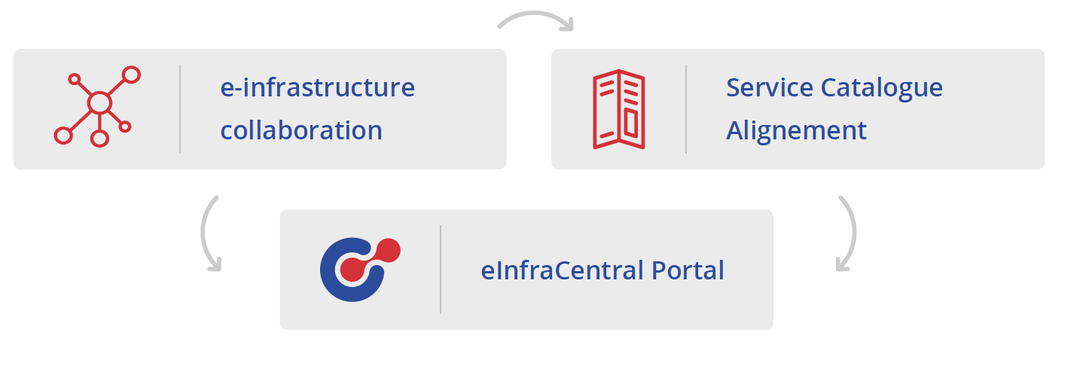
work packages
The core work of the eInfraCentral project is structured around three main activities that are interlinked:
2

Slide 13
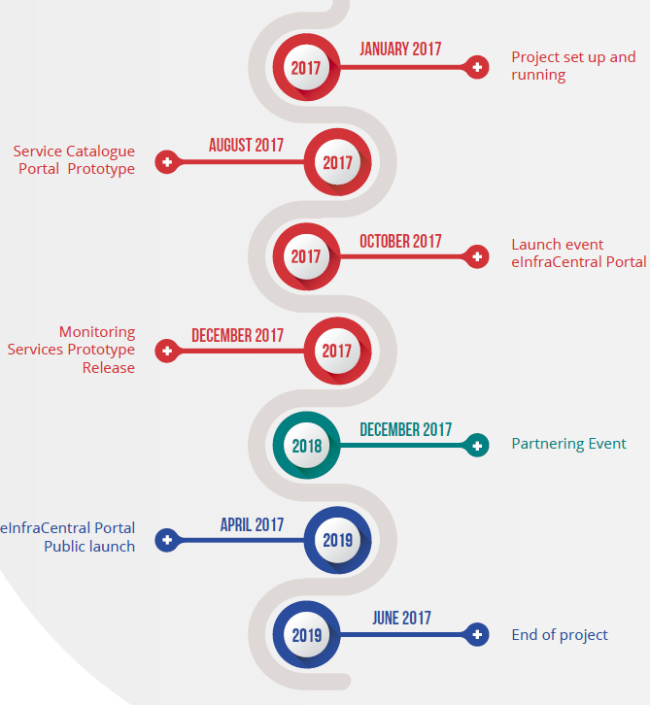
timeline
2

Slide 14
Thank you for your attention!
This project has received funding from the European Union’s Horizon 2020 research and innovation programme under grant agreement No 731049

