Slide 1
Procurement activities in the EOSC-hub Project Proposal
Sergio Andreozzi
Strategy and Policy Manager, EGI Foundation

Slide 2
What is the EOSC-hub project proposal?
Context: H2020 Call E-INFRA12.a
“Secure and agile data and distributed computing e-infrastructures: fostering the integration of a secure, permanent, on-demand service-driven, privacy-compliant and sustainable e-infrastructure incorporating distributed databases, computing resources and software.”
https://ec.europa.eu/research/participants/portal/desktop/en/opportunities/h2020/topics/einfra-12-2017.html
EOSC-hub
Project proposal submitted on 29 March 2017
Budget: 30M Euro
Duration: 3 years

Slide 3
EOSC-hub Project Consortium
User communities and Research Infrastructures
selected via open calls during proposal preparation phase, they provide Thematic Services (at TRL 8) for the EOSC-hub service catalogue and use cases for the Competence Centres.
Technology Providers
bring expertise and technologies fostering the integration of services into the EOSC-hub service catalogue and contribute to its evolution.
Service Providers and national e-Infrastructure representatives
bring resources to the federated e-Infrastructure, operate and provide access to the resources and services for the benefit of consumers.
SMEs/industries
they are involved mainly in the context of the Joint Digital Innovation Hub that is designed to stimulate innovation and knowledge transfer between e-Infrastructures and the private sector.

Slide 4
EOSC-hub Mission
Mobilises providers from
EGI Federation, EUDAT CDI, INDIGO-DataCloud and major research e-infrastructures
offering services, software and data for advanced data-driven research and innovation
Develop the integration and management system of the European Open Science Cloud (the ”EOSC hub”)
acting as a single entry point for all stakeholders

Slide 5
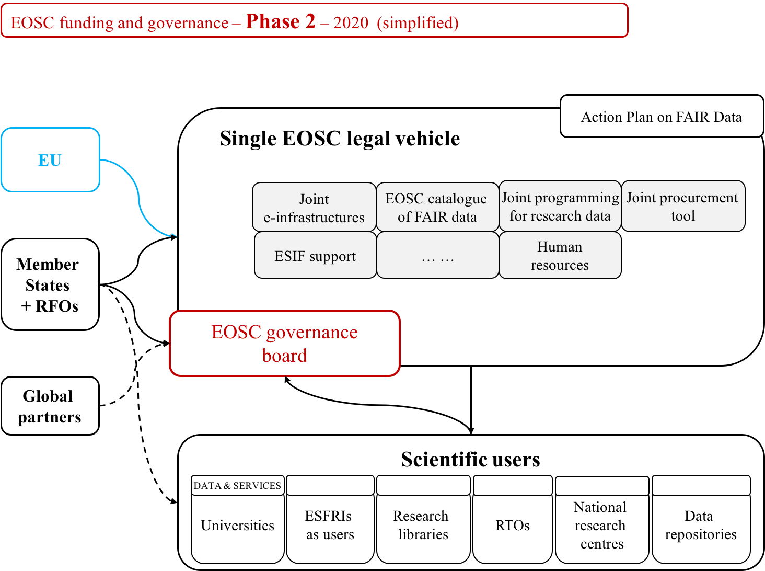
EOSC governance and functions (slide from EC)
Slide courtesy of J. C. Burgelman presented at RDA event, 4 April 2017

Slide 6
EOSC-hub: procurement activities Three main phases
Analysis
requirements from different stakeholders are collected with regards to needs for types of services, demand assessment, procurement constraints, funding models; a number of business models will be developed to support the selected cases
Procurement and purchasing framework design and validation:
development of a procurement and purchasing frameworks able to satisfy the selected cases from the analysis phase; the frameworks will be validated by pilot procurement actions from interested buyers identified during the analysis phase
Evaluation and roadmap
evaluation of the experience and definition of a roadmap for future activities

Slide 7
EOSC-hub Procurement Expected output
Demand assessment
Validated business models
Definition and validation of procurement and purchase framework(s)
Evaluation and roadmap

Slide 8
EOSC-hub: Procurement Activities Expected benefits
Develop the know-how and prototype procurement and purchasing framework that reduces the barriers, risks and administrative cost to purchase digital services for research

Slide 9
EOSC-hub Procurement Activity Partners
EGI Foundation
Role of federator, developed pay for use business models
CERN
Experience from HNSciCloud and cloud procurements
GEANT
Experience with IaaS Cloud Procurement framework
SurfSARA
Link to EOSCpilot activities
FZJ
Experience of large national organisation

Slide 10
Summary
Simplify cross-border procurement is an emerging need and an essential building block for the future EOSC
The EOSC-hub project proposal bring together partners with key expertise and aim to take the activities forward
If positively evaluated, it will contribute to increase the know-how and tools to facilitate purchasing activities of research communities

