Slide 1





FUSION CC
(TBC – Corona)
Marcin Plociennik
For
Rob Akers, Ian Collier, Shaun de Witt, Björn Hagemeier,
Frederic Imbeaux

Slide 2
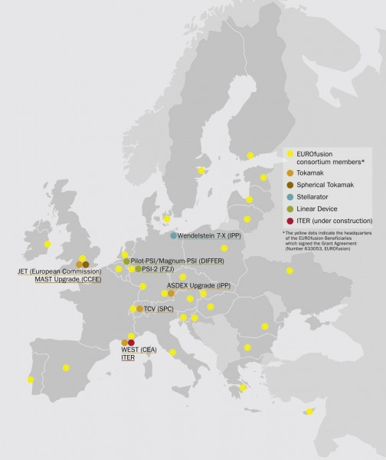

Fusion in Europe
Tokamaks
  JET, ASDEX-Upgrade, MAST-Upgrade, TCV, WEST
Stellerator
  Wendelstein 7-X
Linear Accelerators
  Pilot-PSI, Magnum-PSI
Research Groups
  Many,,,

Slide 3
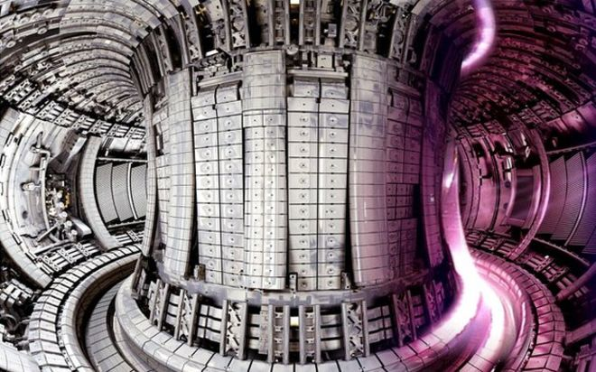
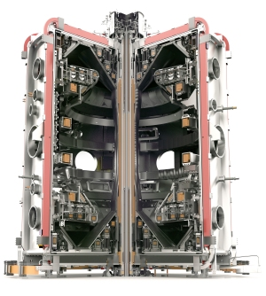
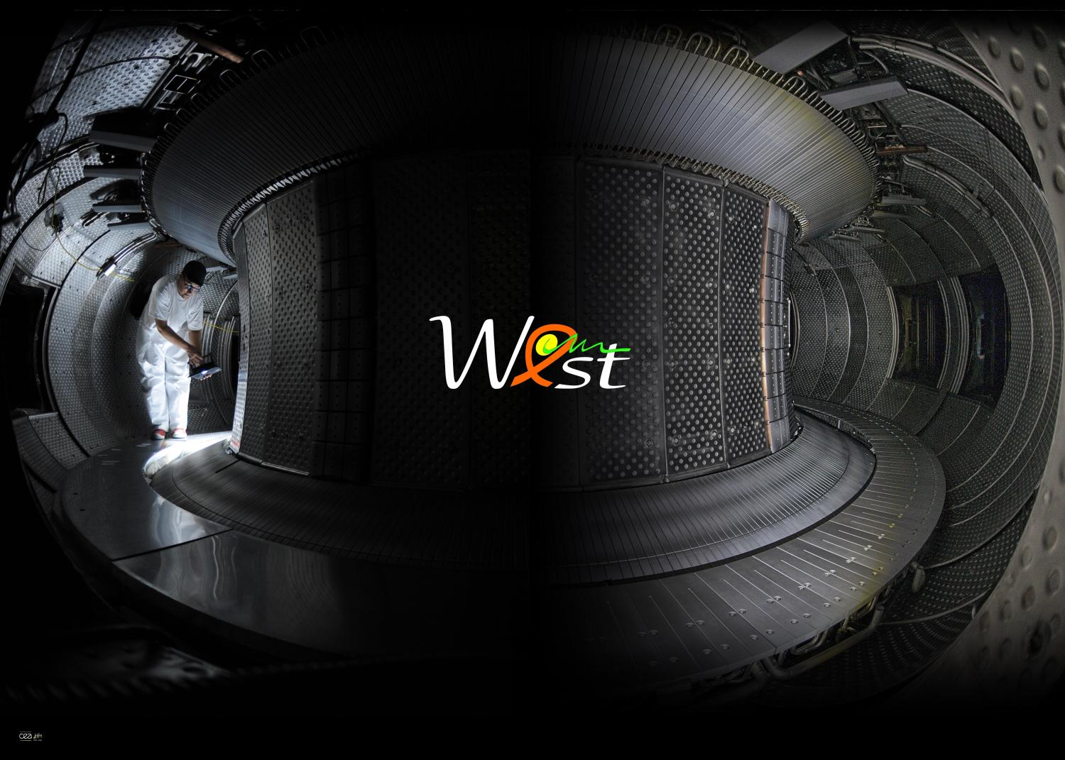
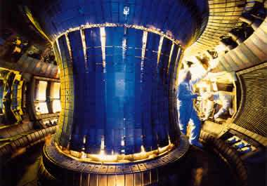
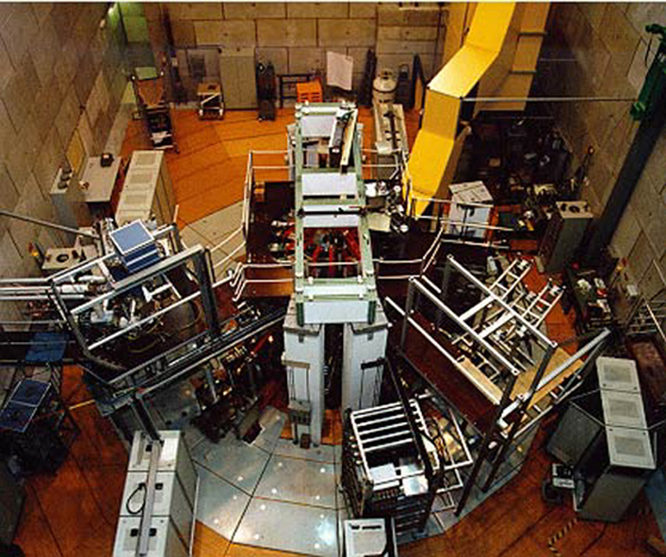
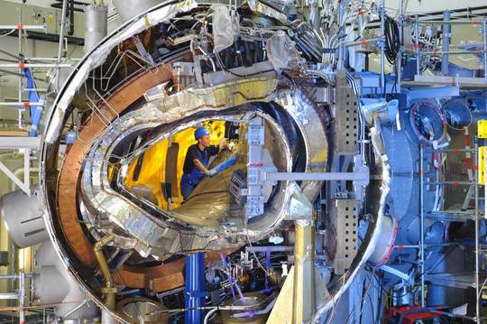
Fusion in Europe
MAST-Upgrade
WEST
Joint European Torus (JET)
ASDEX-Upgrade
TCV
Wendelstein 7-X

Slide 4
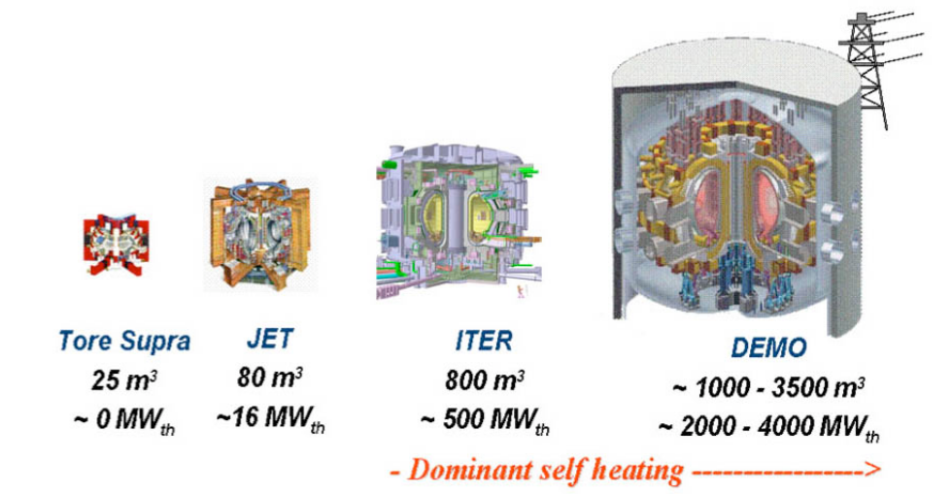
Future of Fusion

Slide 5
The Future of Fusion Data
Exponential Growth
Long Periods between Increments
Take Home Message
  ITER will generate more data in 1 day than all the other European Tokamaks have ever produced!
Notes:
Last two are projections – ITER based on latest I have and DEMO is just pure extrapolation. Colour meant to indicate uncetainty

Slide 6
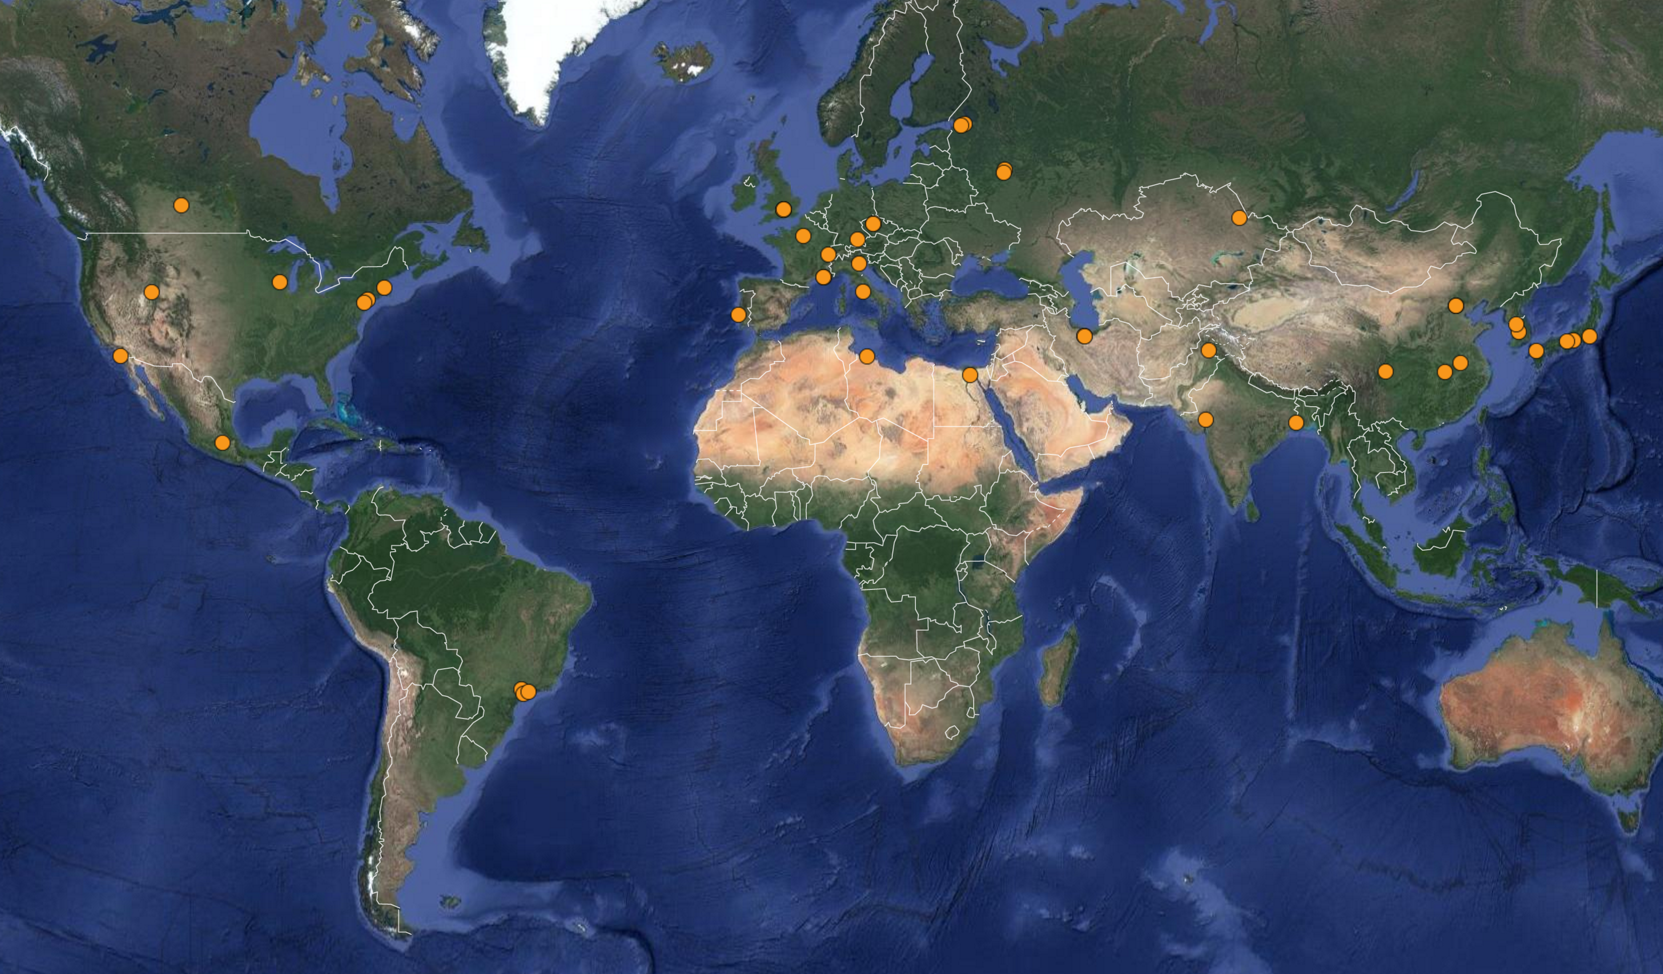
Part of a Global Community
Note: This only shows tokamaks
Much useful information at http://www.tokamak.info/

Slide 7
Problem Summary (Data)
Fusion Experiments operate as Islands
  Getting remote access is a bit like making a phone call in the 1930’s
  Sometimes it’s easier to go to the data – but that can be difficult and expensive
  Local Standards (at worst) but two main ways of accessing data
    HDF5 (open standard, widely used, self describing)
    MDSPlus (open source, optimised for fusion, bridges for reading HDF5 files)
    UDA provides abstraction (another standard?)
ITER Data may be federated geographically
  Islands won’t work any more
© xkcd
Notes:
Need to make clear that each site does it’s own data management and generally does it well
Isolation is both historic (nuclear data) and political (IPR and commercialisation issues)
Even where data is open – it is often difficult to work out what the data is, who to contact to get access, what format it’s in and how to interpret it
Getting site access can be difficult (nuclear again), and accessing compute is non trivial (often two phase authentication) with no federated AAI

Slide 8
What we would like…
Data still stored at islands
  Automated Data Replication
  Federated and Optimised Data Access (bridging the islands)
  Ability to ’prestage’ data to HPC
Data Abstraction
  Access any data in a well defined format
  Without the need for code recompilation
  Using something like OpenDDL (bridging the formats)
Why?
  Analyse any data, anywhere, anytime (AAA)
  Test UDA at scale
What’s Missing?
  Federated AAI, data placement rules
http://openddl.org/
Notes:
AAA is very similar to CMS AAA – except CMS have homogeneous data format/model (ROOT) – fusion doesn’t

Slide 9
Problem Summary (Compute)
Same Island Problem
  Sites have local compute facilities (some dedicated some shared) – but these limit aspirations (next slide)
  CINECA hosts MARCONI supercomputer
  But there is a whole ocean of computing resources out there
    Or should I say cloud???
But
  Porting codes between computing systems is too difficult as well as making sure all necessary dependencies are available
  Researchers always have more interesting things to do than port code
Image courtesy of NASA

Slide 10
Compute and Storage Demand
 | Current Demand (2016-17) |  |  |  | Projected Demand (2018-19)
Discipline | Peak cores | Monthly Average | Peak Memory | Data | Peak cores | Monthly Average | Peak Memory | Data
neutronics | 256 | 300 | 32GB | 1TB/y | 512 | 600 | 128GB | 2TB/y
Materials | 1000 | 1000 | 4GB | 18TB/y | 2400 | 2000 | 8GB | 36TB/y
Virtual Engineering | 4000 | 60 | 4GB | 2TB/y | 8000 | 600 | 8GB | 8TB/y
Uncertainty Quantification | 1000 | 100 | variable |  | 5000 | 500 | variable | 100Tb/y
Analytics & ML | 4 | 4 | 12GB | 1GB/y | 500 | 500 | 32GB | 100GB/y
Data Processing | 400 | 400 | 4GB | 1.5TB/y | 1000 | 1000 | 4 | 1.5TB/y
Edge, SoL & Divertor Physics | 2048 | variable | variable | 50GB/y | 4096 | variable | variable | 250GB/y
CCFE Survey 2016

Slide 11
What we would like…
Scalable computing in run-up to ITER
  IaaS
Not be limited to local compute
  PaaS, Orchestration
Easy to deploy and run on any infrastructure
  Containerisation
Five Rs – Register, Review, Reference, Run, Repeat
Notes:
Register – containerised applications/workflows should have identifiers and versioning,
Review – Is it trustworthy enough to run on my site, who else has used it
Reference – Have others used it, give identifier in published work
Run – Do the work
Repeat – Able to rerun by anyone, anywhere

Slide 12
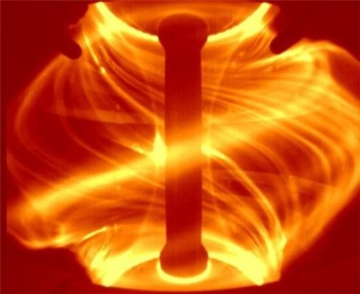
Simple (but Sad) Story 1
Cecile wants to investigate the impact of neutral current density on Edge Localised Modes
Difficult
  Different access policies
  Little public metadata
  Non-trivial and varied access methods
  No single well defined metadata standard
  No federated access
  …
But well(-ish) defined access ‘API’
  Experiment:pulse/x/y/z/foo
Credit: CCFE

Slide 13
Data Access Storyboard
Jane is based at site A but she has got time to run an experiment at site B.
  Site security prevents Jane taking away data from B, but she can access it remotely with the right security set-up, which she can do while at B.
Jane needs to use code back at A to analyse the data since she needs site licensed code.
But she also want to use the same code to analyse data from her local experiment.
  She will need to handle different access mechanisms and different data formats
But UDA will abstract this information to allow more unified access to data regardless of format

Slide 14
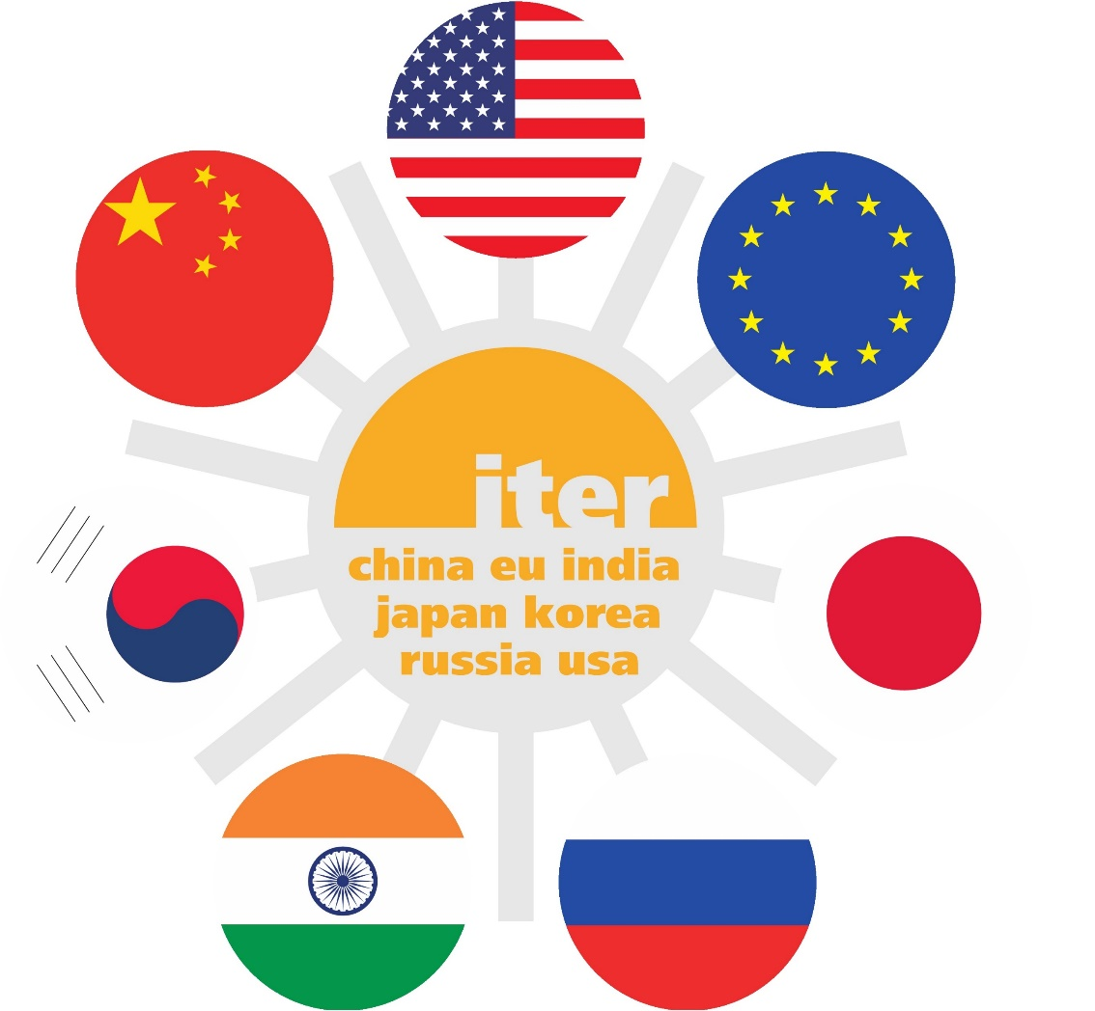
Data Distribution Story
ITER is an international experiment
Considering Data Distribution for security and analysis
Also need to move data from storage to supercomputer
  And/Or store data close to compute
Can we demonstrate B2SAFE to do the replication
  Can we define rules flexibly
  How secure will it make data
  Can we integrate into UDA

Slide 15
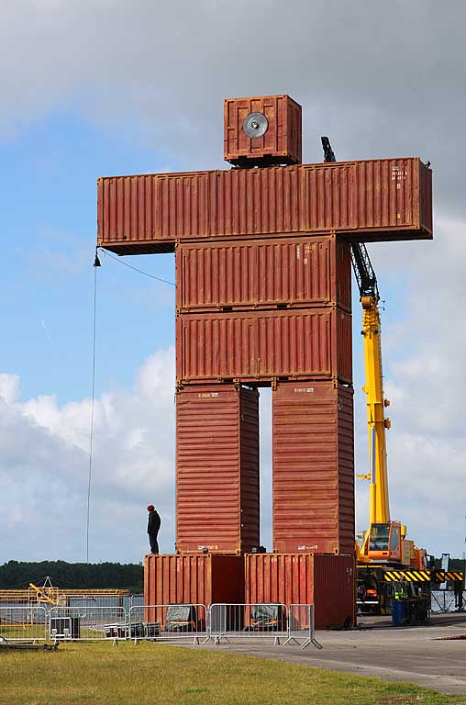
Compute Storyboard
George has developed a new algorithm for analysis of the plasma equilibrium state. It promises to reduce running time and can give near-realtime feedback due to its scalability.
  Tested to scale (1000 cores) on local hardware
  But needs to scale out to many cores
Could apply for time on PRACE, but needs to use for immediate contract. Another fusion site has 4000 cores currently not being used
  Why not use these resources
But who to talk to and how to get necessary software and dependencies installed
  Sounds like a job for containerisation and could interfaces

