Slide 1
Interaction with resource providers: selection, SLA, support
Giuseppe La Rocca giuseppe.larocca@egi.eu Technical Outreach Expert
Małgorzata Krakowian malgorzata.krakowian@egi.eu Quality and Risk Manager, Service Level Management Manager

Slide 2
Agenda
Introduction about the EGI SLA negotiation process
Benefits
The process workflow
The EGI SLA document content
EGI SLA status report (2016-2017)
Links

Slide 3
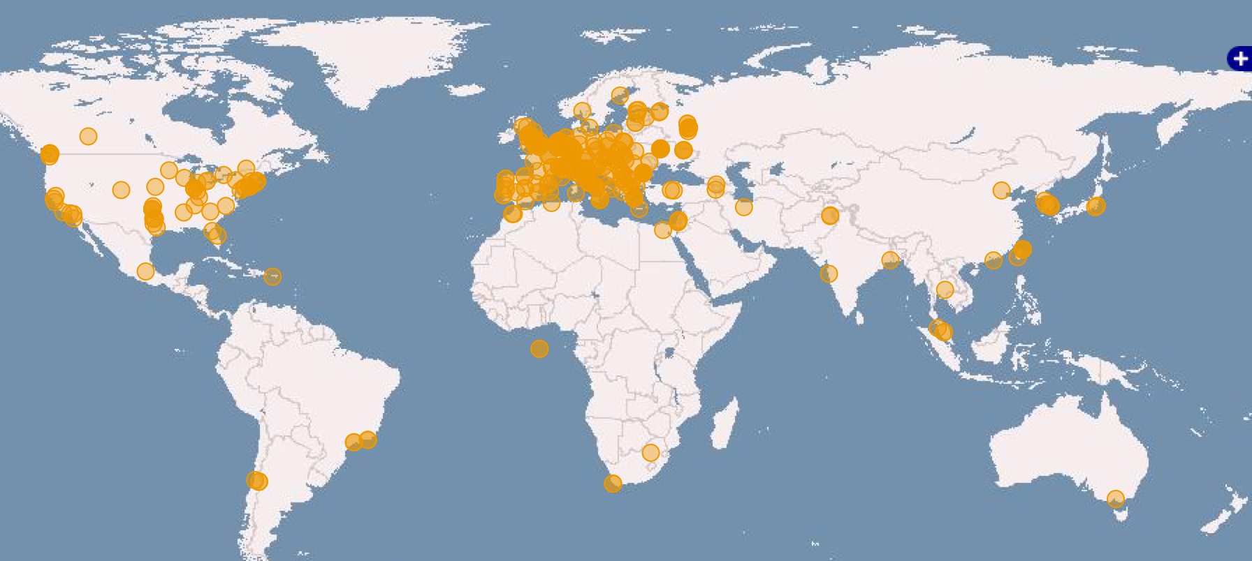
EGI federated infrastructure
Russia
Ukraine
Canada
USA
Asia
Pacific
775,000 CPU Cores
310 PB of disk and 270PB of tape storage
24 Cloud providers
325 resource providers
50,000 users
+4,000 research papers
Latin America
Africa
Arabia

Slide 4
From opportunities to operational setups
Opportunity
Customer support case
Operation
User story (business case)
Potential EGI services
Community footprint
NGI support
Cost-value analysis
Detailed technical requirements
Sw. devel. &integration
SLA – OLAs
Service satisfaction review interviews (3/6/12 months)
Improvement suggestions
Publications, users
Capacity plan updates
Helpdesk; Complaints
Customer relationship management
Business development
Service Level Management
Notes:
NGIs support is critical in all the three stages:
Willingness to support Opportunities
Contribute with technologies and effort
High quality operations (IT and staff)

Slide 5
The EGI SLA negotiation process
The purpose of EGI SLA negotiation process is to create a reliable, centralized communication channel between the Customer and the Providers to agree on the services, their levels and the types of support.
EGI VO SLAs are NOT legal contracts but, as agreements, they outline the clear intentions to collaborate and support research activities.
The process is facilitated by
Council surveys, broadcasting tool for sites, MLs
EGI Foundation is acting as a Broker
Finds and arranges resources from the EGI Federation that ‘fit on purpose’

Slide 6
Value Propositions
For research communities (the Customer):
Better communication and clarity on expectations
Increased confidence that services will be delivered
Easier future planning of research activities
For resource providers:
Direct communication with user communities and clarity on expectations
Clear responsibilities and rules/policies concerning usage of the resources
Recognition and greater visibility to role of the provider by requiring an explicit acknowledgment
For EGI Foundation:
Promoting the EGI service value with funding agencies and policy makers at national and European level
Being seen as mature partner
Ensuring a foundation of a control process to what is being delivered in the EGI Federation

Slide 7
Establishing Agreements

Slide 8
How does the process works ?
Customer
Broker
Providers
Broker
Customer
Send request for service (*)
Matchmaking
Proposes support
Sign OLA with provider & SLA with Customer
Agrees or Reject the VO SLA (**)
(*) Fill the request form https://www.egi.eu/request-service/
(**) The SLA will be reviewed every 12 months
Free-at-the-point-of-use model ➔ EGI Foundation is looking for free resources leveraging on the interest of the Providers to support cutting-edge research according to their national roadmap.
Pay-for-use model ➔ EGI Foundation will facilitate the process by putting together the Customer and the Providers which could satisfy the demand. The agreement and the contract will be signed between the Customer and the Providers.

Slide 9
EGI VO SLA document content

Slide 10
EGI VO SLA
Having clearly defined service levels and responsibilities ensuring mutually agreement expectations, comprising:
Scope and description of service
Service hours and exceptions
Support (Incidents and service requests handling)
Service level targets
Limitations and constraints
Communication, reporting and escalation
Information Security
Responsibilities (both provider and customer)
Review

Slide 11
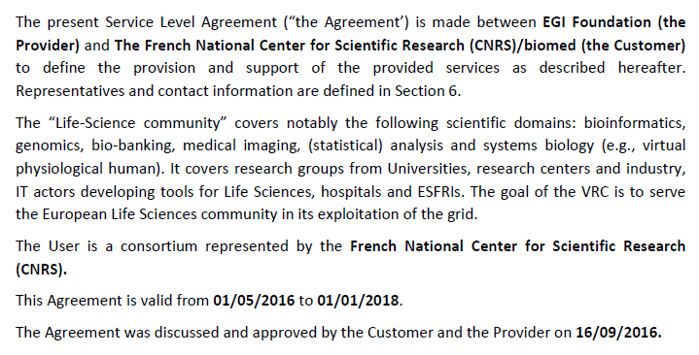
Scope and description of service

Slide 12
Service description
EGI available services are here: www.egi.eu/services/

Slide 13
Service hours and exceptions
Support

Slide 14
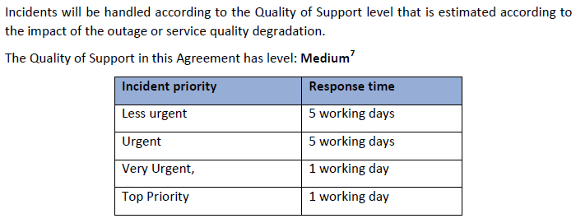
Incidents and service request handling
Service Level Target
Availability, Reliability are based on Ops VO results
85% => 90%
90% => 95%

Slide 15
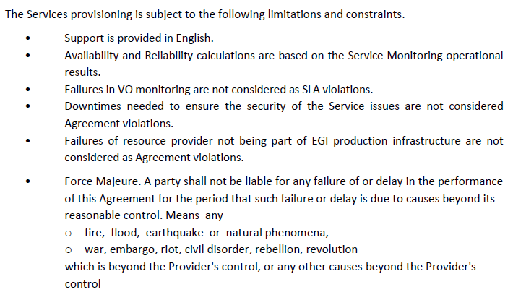
Limitation and constraints

Slide 16
Communication, reporting
All reports shall follow pre-defined templates

Slide 17
Escalation
Information Security and Data protection

Slide 18
Responsibilities
Manage the resource allocation process
Coordinate service delivery
Monitor the service delivery in order to measure the fulfilment of the agreed service level targets and will report to Customer
Manage the Customer complaints and disputes
Broker
Acknowledge EGI Foundation and providers in the scientific publications benefiting from the Service
Must not cause any legal violation and the use must be consistent with the Acceptable Use Policy of the Service
Customer
Adheres to all applicable operational and security policies
Enabling monitoring of Service in order to measure the fulfilment of the agreed service level targets.
Can introduce changes in how the Service is offered, in which case the Provider will promptly inform the Customer
Providers

Slide 19
Review, extensions and termination

Slide 20
SLA status report https://ww.egi.eu/federation/committed-resources/
Customer | Start | End | Service Type
BioISI | Aug. 2016 | Jan. 2018 | Cloud Compute
NBIS/BILS | Dec. 2015 | Dec. 2017 | Cloud Compute
DARIAH | Apr. 2016 | Sept. 2017 | Cloud Compute
DRIHM | Jan. 2016 | Jan. 2018 | High-Througput
D4Science | Sept. 2016 | Dec. 2017 | Cloud Compute
EMSODEV | Sept. 2016 | Dec. 2017 | Cloud Compute
EXTraS | May 2016 | May 2017 | Cloud Compute
LSGC | May 2016 | Jan. 2018 | High-Throughput, Cloud Compute
MoBrain | Jan. 2016 | Jan. 2018 | High-Throughput, Cloud Compute
Peachnote | Apr 2016 | Sept. 2017 | Cloud Compute, Online Storage
Terradue | Jan. 2016 | Jan. 2018 | Cloud Compute
11 SLAs agreed
1 MoU signed
30 providers from 16 countries

Slide 21
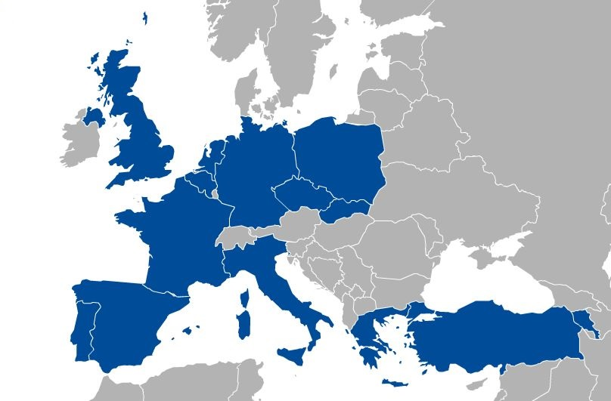
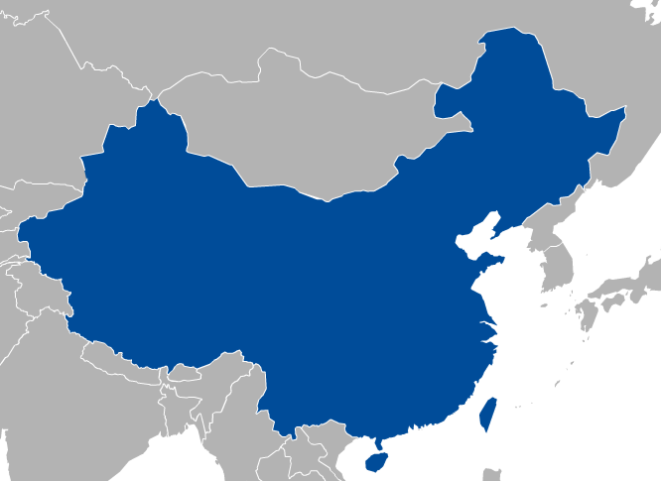
SLA status report https://ww.egi.eu/federation/committed-resources/

Slide 22
Links
EGI SLA/OLA Framework:
https://wiki.egi.eu/wiki/EGI_OLA_SLA_framework
EGI VO SLA and OLA templates
https://documents.egi.eu/public/ShowDocument?docid=2371
EGI SLA/OLA status:
https://docs.google.com/spreadsheets/d/1dQNJhMhYqMLHNVHRL4CsqwU0kaJ-lhgNq2ZJwTLy5UQ/edit#gid=828416905
SLA mailing-list: sla@mailman.egi.eu

