Slide 1
GPGPU computing support on HTC
Marco Verlato
INFN-Padova
EGI Conference/INDIGO summit 2017
Catania, Italy, 9-12 May 2017

Slide 2
Layout
Introduction
CREAM-CE
Job submission
Information system
Accounting
Applications use-cases

Slide 3
Introduction/1
EGI infrastructure supported through H2020 project EGI-Engage, from March 2015 until August 2017 → new EU projects are in preparation
Dedicated task for “Providing a new accelerated computing platform”
Accelerated computing:
GPGPU (General-Purpose computing on Graphical Processing Units)
NVIDIA GPU/Tesla/GRID, AMD Radeon/FirePro, Intel HD Graphics,...
Intel Many Integrated Core (MIC) Architecture
Xeon Phi Coprocessor
Specialized PCIe cards with accelerators
DSP (Digital Signal Processors)
FPGA (Field Programmable Gate Array)

Slide 4
Introduction/2
Main goals:
To implement the support in the information system
both software and hardware info at site level must be published/discoverable
OGF GLUE standard based information system structure must be extended
To extend the HTC and Cloud middleware support for co-processors
to provide a transparent and uniform way to allocate these resources together with CPU cores efficiently to the users
Requirements and use-cases from user communities were collected at various EGI events:
EGI Conference 2015: http://bit.ly/Lisbon-GPU-Session
EGI Community Forum 2015: http://bit.ly/Bari-GPU-Session
EGI Conference 2016: http://bit.ly/Amsterdam-GPU-Session

Slide 5
Introduction/3
Activity driven by the user communities
Grouped in EGI-Engage as Competence Centers:
LifeWatch: to capture and address the requirements of Biodiversity and Ecosystems research communities
Deploy GPU based e-Infrastructure services supporting data management, processing and modelling for Ecological Observatories
IC-DLT: Image Classification Deep Learning Tool
MoBrain: to Serve Translational Research from Molecule to Brain
Deploy portals for biomolecular simulations leveraging GPU resources
AMBER and GROMACS Molecular Dynamics packages
PowerFit: exhaustive search in Cryo-EM density
DisVis: visualisation and quantification of the accessible interaction space of distance restrained binary biomolecular complexes, determined for example by using CXMS technique
Linked with several older and new EU projects involving the Bio-NMR community

Slide 6
Introduction/4
Some requirements from applications:
Need of GPU resources for development and testing
One job per GPU (AMBER)
CPUs must be powerful to match the GPU
CPU is still doing some work (e.g. bonded interactions)
Discoverable within the e-infrastructure (e.g. JDL requirement)
Preferably containing GPU type (GTX vs K-series, AMD vs NVIDIA)
AMD GPUs not supported by MD code (yet)
Double-precision only supported by Tesla cards
GPU Cloud solution, if used, should allow for transparent and automated submission
Software and compiler support on sites providing GPU resources (CUDA, OpenCL)

Slide 7
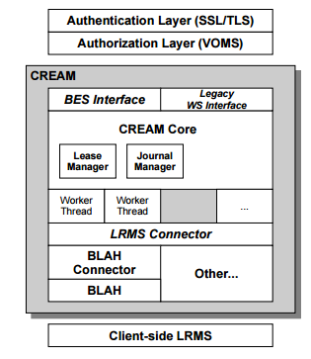
CREAM-CE
Starting from previous work of EGI Virtual Team (2012) and GPGPU Working Group (2013-2014)
CREAM-CE is the most popular grid interface (Computing Element) to a number of LRMSes (Torque, LSF, Slurm, SGE, HTCondor) since many years in EGI
Most recent versions of these LRMSes do support natively GPUs (and MIC cards), i.e. servers hosting these cards can be selected by specifying LRMS directives
CREAM must be enabled to publish this information and support these directives

Slide 8
Work plan
Indentifying the relevant GPU/MIC related parameters
supported by the different LRMSes, and abstract them
to significant JDL attributes
Implementing the needed changes in CREAM
Core and and BLAH components
Extending the GLUE 2.1 schema draft with
accelerator information
Writing the info-providers according to
extended GLUE 2.1 draft specifications
Testing and certification of the prototype
Releasing a CREAM update with full
GPU/MIC support

Slide 9
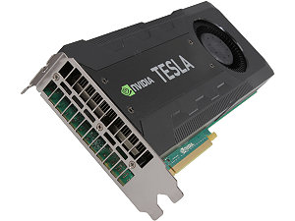
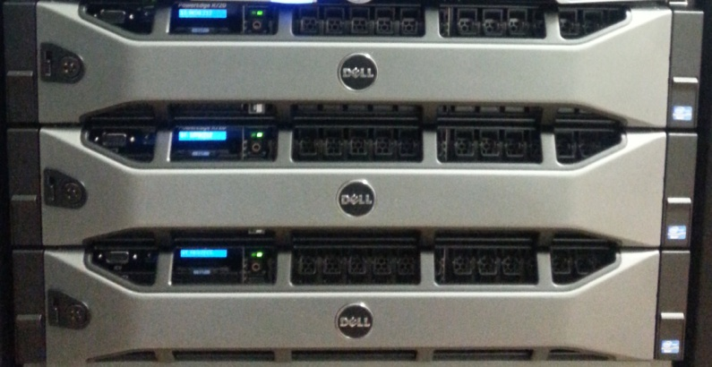
Implementing job submission/1
Testbed setup at CIRMMP
3 nodes 2x Intel Xeon E5-2620v2
2 NVIDIA Tesla K20m GPUs per node
Torque 4.2.10 (source compiled with NVML libs) + Maui 3.3.1
AMBER application installed with CUDA
First step:
Starting by testing local job submission with the different GPGPU supported options, e.g. with Torque/pbs_sched:
$ qsub -l nodes=1:gpus=1 job.sh
$ qsub -l nodes=1:gpus=1 job.sh
…and with Torque/Maui:
$ qsub -l nodes=1 -W x='GRES:gpu@1' job.sh

Slide 10
Implementing job submission/2
Second step:
defining the new JDL attribute GPUNumber
implementing it in CREAM Core and BLAH components
the first GPGPU-enabled CREAM prototype working on top of the CIRMMP Torque/Maui cluster was implemented in December 2015
Third step:
Looking at GPU and MIC supported options for the HTCondor, LSF, Slurm and SGE
Two additional JDL useful attributes identified and implemented:
GPUModel: for selecting the servers with a given model of GPU card
e.g. GPUModel=“teslaK80”
MICNumber: for selecting the servers with the given number of MIC cards

Slide 11
Implementing job submission/3
A CREAM/HTCondor prototype supporting both GPUs and MIC cards was successfully implemented and tested at GRIF/LLR data centre in March 2016 (thanks to A. Sartirana)
A CREAM/SGE prototype supporting GPUs was successfully implemented and tested at Queen Mary data centre in April 2016 (thanks to D. Traynor)
A CREAM/Slurm prototype supporting GPUs was successfully implemented and tested at ARNES data centre in April 2016 (thanks to B. Krasovec)
A CREAM/LSF prototype supporting GPUs was successfully implemented and tested at INFN-CNAF data centre in July 2016 (thanks to S. Dal Pra)
A CREAM/Slurm prototype supporting GPUs was successfully implemented and tested at Queen Mary data centre in August 2016 (thanks again to D. Traynor)
With Slurm Version 16.05 which supports the GPUModel specification

Slide 12
Example of submission to Slurm CE
User job JDL:
[
executable = "disvis.sh";
arguments = "10.0 2";
stdoutput = "out.txt";
stderror = "err.txt";
inputSandbox = { "disvis.sh" ,"O14250.pdb" , "Q9UT97.pdb" , "restraints.dat" };
outputsandboxbasedesturi = "gsiftp://localhost";
outputsandbox = { "out.txt" , "err.txt" , "results.tgz"};
GPUNumber=2;
GPUModel="teslaK80";
]
Definitions in Slurm gres.conf and slurm.conf configuration files:
NodeName=cn456 Name=gpu Type=teslaK40c File=/dev/nvidia0
NodeName=cn290 Name=gpu Type=teslaK80 File=/dev/nvidia[0-3]
NodeName=cn456 CPUs=8 Gres=gpu:teslaK40c:1 RealMemory=11902 Sockets=1 CoresPerSocket=4…
NodeName=cn290 CPUs=32 Gres=gpu:teslaK80:4 RealMemory=128935 Sockets=2 CoresPerSocket=8…
On the worker node:
$ lspci | grep NVIDIA
0a:00.0 3D controller: NVIDIA Corporation GK210GL [Tesla K80] (rev a1)
0b:00.0 3D controller: NVIDIA Corporation GK210GL [Tesla K80] (rev a1)
86:00.0 3D controller: NVIDIA Corporation GK210GL [Tesla K80] (rev a1)
87:00.0 3D controller: NVIDIA Corporation GK210GL [Tesla K80] (rev a1)
$ echo $CUDA_VISIBLE_DEVICES
0,1

Slide 13
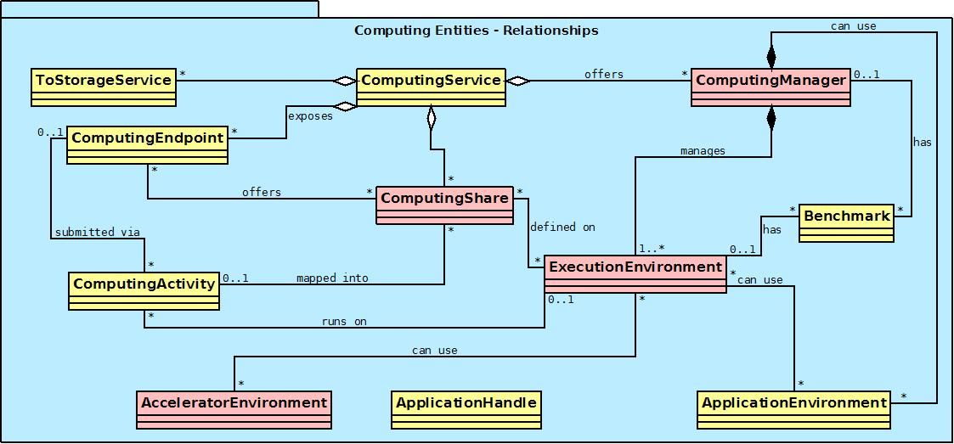
Info system: GLUE2.1 Draft
ExecutionEnvironment class: represents a set of homogeneous WNs
Is usually defined statically during the deployment of the service
These WNs however can host different types/models of accelerators
AcceleratorEnvironment class: represents a set of homogeneous accelerator devices
Can be associated to one or more Execution Environments
New attributes:
PhysicalAccelerators
Vendor
Type
Model
Memory
ClockSpeed
Driver info are
in the Application
Environment
Notes:
GLUE2.1 draft as starting point for Accelerator-aware infoprovider
Static info-provider based on GLUE2.1 AcceleratorEnvironment
class
New attributes: PhysicalAccelerators, Vendor, Type, Model, Memory, ClockSpeed
Info can be obtained in Torque e.g. from pbsnodes command
Driver info available in the ApplicationEnvironment

Slide 14
Info system: static info
Example of GLUE2.1 static info publication:
$ ldapsearch -x -LLL -h cegpu.cerm.unifi.it -p 2170 -b o=glue (objectClass=GLUE2AcceleratorEnvironment)
GLUE2AcceleratorEnvironmentMemory: 5120
GLUE2AcceleratorEnvironmentID: tesla.cegpu.cerm.unifi.it
GLUE2AcceleratorEnvironmentModel: Tesla K20m
objectClass: GLUE2Entity
objectClass: GLUE2AcceleratorEnvironment
GLUE2EntityCreationTime: 2015-05-04T16:31:18Z
GLUE2AcceleratorEnvironmentExecutionEnvironmentForeignKey: cegpu.cerm.unifi.it
GLUE2AcceleratorEnvironmentVendor: NVIDIA
GLUE2AcceleratorEnvironmentPhysicalAccelerators: 2
GLUE2AcceleratorEnvironmentType: GPU
GLUE2EntityName: tesla.cegpu.cerm.unifi.it
GLUE2AcceleratorEnvironmentLogicalAccelerators: 2
GLUE2AcceleratorEnvironmentClockSpeed: 706
$ ldapsearch -x -LLL -h cegpu.cerm.unifi.it -p 2170 -b o=glue
(&(objectClass=GLUE2ApplicationEnvironment)(GLUE2EntityName=nvidia-driver))
GLUE2ApplicationEnvironmentAppName: nvidia-driver
GLUE2ApplicationEnvironmentDescription: NVidia driver for CUDA
GLUE2ApplicationEnvironmentExecutionEnvironmentForeignKey: cegpu.cerm.unifi.it
GLUE2ApplicationEnvironmentID: nvidia-driver
GLUE2ApplicationEnvironmentAppVersion: 352.93
GLUE2EntityCreationTime: 2015-05-04T16:31:18Z
GLUE2ApplicationEnvironmentComputingManagerForeignKey: cegpu.cerm.unifi.it_ComputingElement_Manager
GLUE2EntityName: nvidia-driver
$ ldapsearch -x -LLL -h cegpu.cerm.unifi.it -p 2170 -b o=glue (&(objectClass=GLUE2ExecutionEnvironment)
(GLUE2EntityName=cegpu.cerm.unifi.it))
GLUE2ExecutionEnvironmentCPUModel: Xeon
[…]
GLUE2ExecutionEnvironmentAcceleratorEnvironmentForeignKey: tesla.cegpu.cerm.unifi.it
GLUE2ExecutionEnvironmentApplicationEnvironmentForeignKey: nvidia-driver

Slide 15
Info system: dynamic info
For dynamic info-providers, new attributes in GLUE2.1 draft for existing class were defined:
ComputingManager class (the LRMS)
TotalPhysicalAccelerators, TotalAcceleratorSlots, UsedAcceleratorSlots
ComputingShare class (the batch queue)
MaxAcceleratorSlotsPerJob, FreeAcceleratorSlots, UsedAcceleratorSlots
$ ldapsearch -x -h cegpu.cerm.unifi.it -p 2170 -b o=glue objectClass=GLUE2ComputingShare
[…]
GLUE2EntityOtherInfo: CREAMCEId=cegpu.cerm.unifi.it:8443/cream-pbs-batch
GLUE2ComputingShareMaxAcceleratorSlotsPerJob: GPU:4
GLUE2ComputingShareUsedAcceleratorSlots: GPU:1
GLUE2ComputingShareFreeAcceleratorSlots: GPU:3
[…]

Slide 16
Accounting
CREAM Accounting sensors, mainly relying on LRMS logs, were in the past developed by the APEL team
APEL team has been involved in the GPU accounting discussion
Batch systems should report GPU usage attributable to the job in the batch logs. APEL would then parse the logs files to retrieve the data.
Unfortunately job accounting records of Torque, LSF and other LRMSes do not contain GPU usage info ☹
NVML allows to enable per-process accounting of GPU usage using Linux PID, but not LRMS integration yet, e.g.:
$ nvidia-smi --query-accounted-apps=pid,gpu_serial,gpu_name,gpu_utilization,time --format=csv
pid, gpu_serial, gpu_name, gpu_utilization [%], time [ms]
44984, 0324713033232, Tesla K20m, 96 %, 43562 ms
44983, 0324713033232, Tesla K20m, 96 %, 43591 ms
44984, 0324713033096, Tesla K20m, 10 %, 43493 ms
44983, 0324713033096, Tesla K20m, 10 %, 43519 ms

Slide 17
Summary
The CREAM GPU-enabled prototype was tested at 5 sites
LRMSes: Torque, LSF, HTCondor, Slurm, and SGE LRMSes
3 new JDL attributes defined: GPUNumber, GPUModel, MICNumber
At 3 sites the prototype is run in “production”: QMUL and ARNES (Slurm) and CIRMMP (Torque/Maui)
New classes and attributes describing accelerators proposed and included in GLUE2.1 draft after discussion with the OGF WG
A major release of CREAM is almost ready
with GPU/MIC support for most LRMSes
with the GLUE2.1 draft prototype as information system
future official approval of GLUE 2.1 would occur after the specification is revised based on prototype lessons learned
with new Puppet module for the CE site with support for GPU/MIC and GLUE 2.1
on CentOS7, in order to be included in UMD-4 release

Slide 18
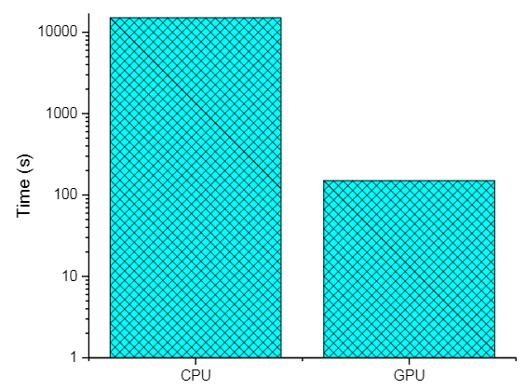
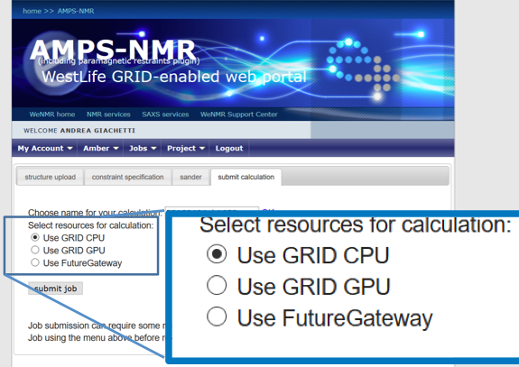
Application use-cases: AMBER
Restrained (rMD) Energy Minimization on NMR Structures
Free MD simulations of ferritin
a)
~100x gain
b)
94-150x gain
4.7x gain
Dynamic power strongly reduced:
8% of the 64 core Opteron server

Slide 19
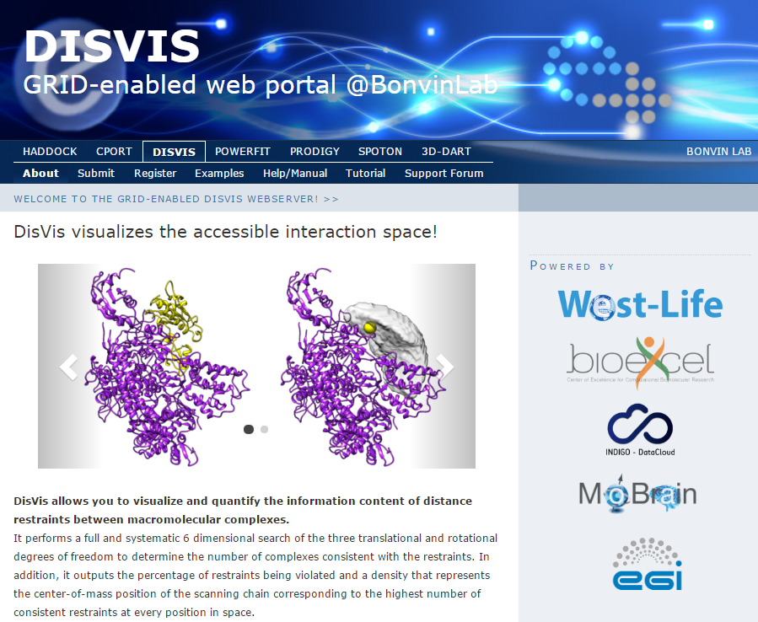
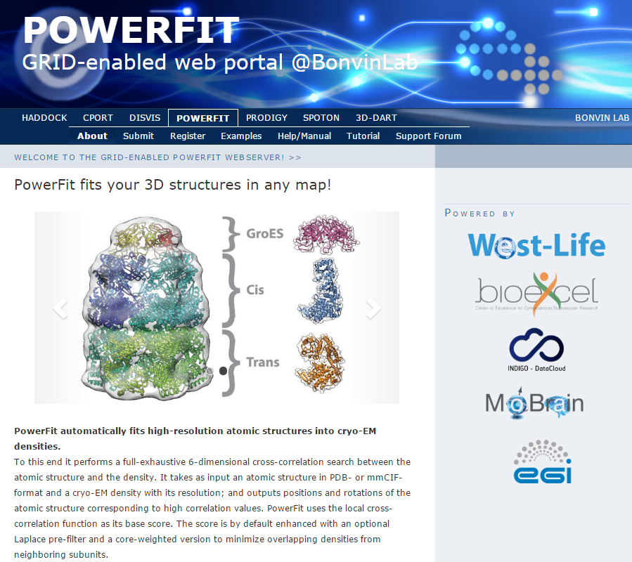
Application use-cases: DisVis and PowerFit
See more in the next talk of Zeynep

Slide 20
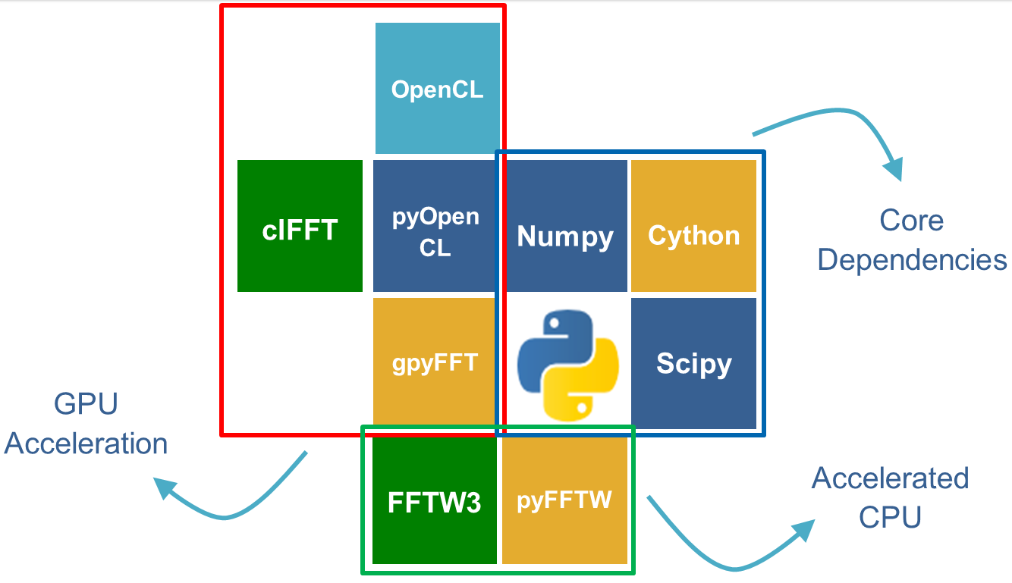
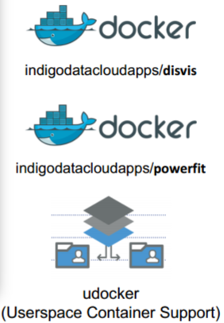
DisVis and PowerFit on EGI platforms
Application requirements:
Solution for grid and cloud computing:
Docker containers built with proper libraries and OpenCL support:
Docker engine not required on grid WNs: use udocker tool to run docker containers in user space (https://github.com/indigo-dc/udocker)

Slide 21
disvis.sh job example
Driver identification
#!/bin/sh
version=$(nvidia-smi | awk '/Driver Version/ {print $6}')
export WDIR=`pwd`
git clone https://github.com/indigo-dc/udocker
cd udocker
image=/cvmfs/wenmr.egi.eu/BCBR/DisVis/disvis-nvdrv_$version.tar
[ -f $image ] && ./udocker load -i $image
[ -f $image ] || ./udocker pull indigodatacloudapps/disvis:nvdrv_$version
rnd=$RANDOM
./udocker create --name=disvis-$rnd indigodatacloudapps/disvis:nvdrv_$version
mkdir $WDIR/out
./udocker run –-hostenv --volume=$WDIR:/home disvis-$rnd disvis \
/home/O14250.pdb /home/Q9UT97.pdb /home/restraints.dat -g -a $1 –vs $2 \
-d /home/out
./udocker.py rm disvis-$rnd
./udocker.py rmi indigodatacloudapps/disvis:nvdrv_$version
cd $WDIR
tar zcvf results.tgz out/
Install udocker tool
Load/Pull DisVis image
Create the container
Run the container
executing DisVis

Slide 22
Links and credits
https://wiki.egi.eu/wiki/GPGPU-CREAM
https://mobrain.egi.eu/technical
http://about.west-life.eu/ Support/Doc/EGI-Platforms menu
HTC/GPU dev. team
Paolo Andreetto (INFN)
David Rebatto (INFN)
Marco Verlato (INFN)
Lisa Zangrando (INFN)
Andrea Giachetti (CIRMMP)
Antonio Rosato (CIRMMP)
Acknowledgments
Barbara Krasovic (ARNES)
Stefano Dal Pra (INFN)
Daniel Traynor (QMUL)
Andrea Sartirana (CNRS-IN2P3)
Alexandre Bonvin (Univ. of Utrecht)
Zeynep Kurkcuoglu (Univ. of Utrecht)
Jörg Schaarschmidt (Univ. of Utrecht)
Mikael Trellet (Univ. of Utrecht)
Mario David (LIP)

