Slide 1
INDIGO Data Ingestion
Fernando Aguilar, IFCA-CSIC
INDIGO-DataCloud WP2
aguilarf@ifca.unican.es
RIA-653549

Slide 2
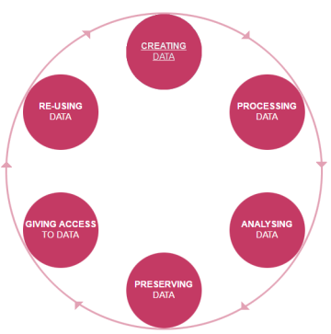
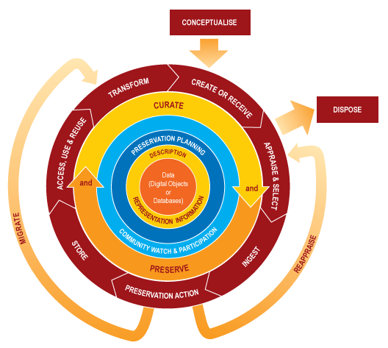
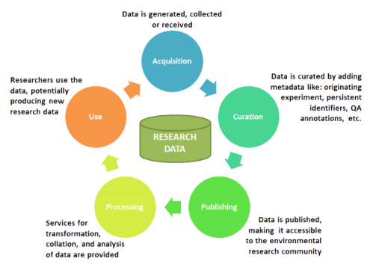
INDIGO Data Ingestion
Deliverables: D2.11, D2.7
Data Life Cycle Analysis
Roles, Data Levels, Metadata
ENVRI
RDA
NASA
Metadata Standards.

Slide 3
Data Management in the Cloud
Session in last RDA Plenary: EUDAT, EGI, INDIGO.
Different Cloud-based data management approaches.
Conclusions:
Interest in assuring FAIR(+R).
Different paths to achieve.
Not close to implementation in production.

Slide 4
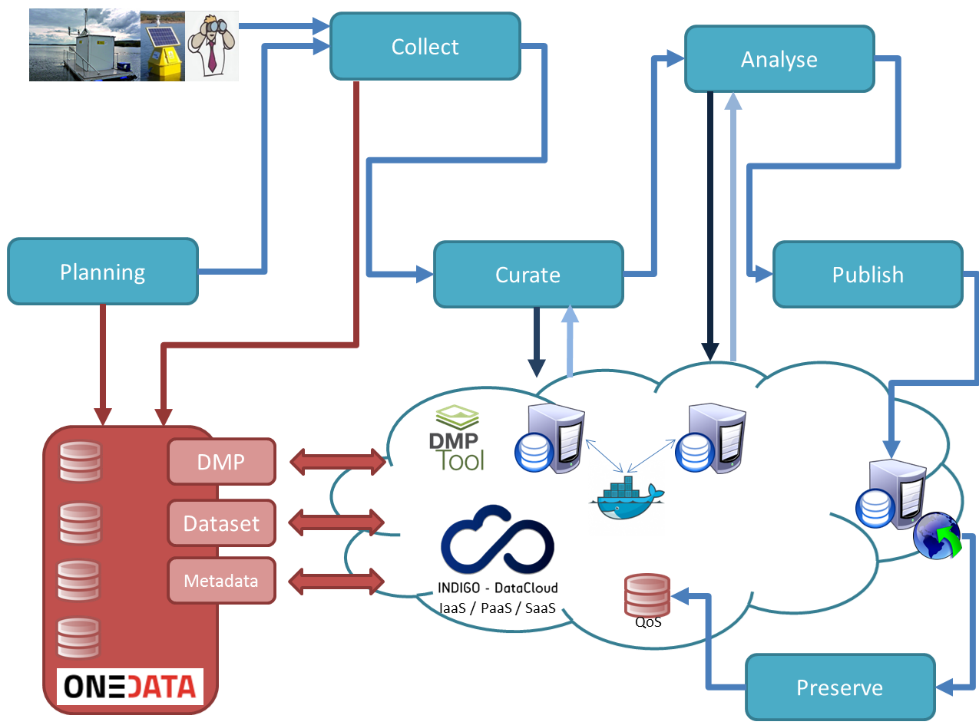
INDIGO Data Life Cycle (“6S”)
Stage 1: Plan: DMP
Stage 2: Collect: process of getting data
Stage 3: Curate: actions performed over the data.
Stage 4: Analyse: also called “Process”, given the data an added.
Stage 5: Ingest (& Publish): including other steps like “Access”, “Use” or “Re-use”, in this stage, data is normally associated to metadata, has a persistent identifier and is published in an accessible repository or catalogue, under a format that makes it useful for further re-use.
Stage 6: Preserve: "store" both data and analysis for long-term. Licenses and methods need to be taken into account.

Slide 5
The concept of “Data Levels”
Dataset Level | Format and Definition | Associated Metadata | Other metadata/links
Raw data | SQL tables, real time update (IoT-like) | SQL scheme, names of parameters (following EML) | Instruments description (OGC) Platform location (GPS)
Processed data | SQL tables, consolidated backup | SQL scheme, matching EML definitions | Definition of specific derived variables like, PAR (Photosynthetic Active Radiation), depth (from Press), etc.
Curated data | SQL tables, revised for spikes, outliers, out-of-range data, etc. | SQL scheme, matching EML definitions | Errors deleted.
Ingested data | CSV, R / Excel ready to be used, associated basic scripts | Included in DOI of published dataset. Associated EML file. | Published in catalogue.
Derived Data | NetCDF, HDF, Model proprietary format. | NetCDF or HDF metadata. Associated EML File. Included in DOI. | Data derived from models (Delft3D) or other analysis tools.
Data Level | Short Name | Description
Level 0 | RAW | Acquired raw data.
Level 1 | CALIBRATED | Calibrated camera data.
Level 2 | RECONSTRUCTED | Reconstructed shower parameters (such as energy, direction, particle ID).
Level 3 | REDUCED | Sets of selected events with associated instrumental response characterizations needed for science analysis.
Level 4 | SCIENCE | High Level binned data products (such as spectra, sky maps, or light curves).
Level 5 | OBSERVATORY | Legacy observatory data (such as survey sky maps or source catalog).
Data Levels for Algae Bloom
Data Levels for CTA

Slide 6
INDIGO Data Management Solutions
OneData
Distributed storage solution to access, store and publish data.
IAM. OneClient, OneProvider, OneZone.
Metadata Management. Web-API Access. File System, Extended and Custom Attributes.
Storage QoS (Quality of Service)
Get or add information about a storage element characteristic such as type of media, location or latency.
Can be combined with SLA.
Works with CDMI, Amazon S3, etc. The endpoint is public and reachable by REST API.
Integration
Integration of the information provided by a sites QoS endpoint into OneData will allow users to identify (and modify if available) the storage qualities via the OneData client.

Slide 7
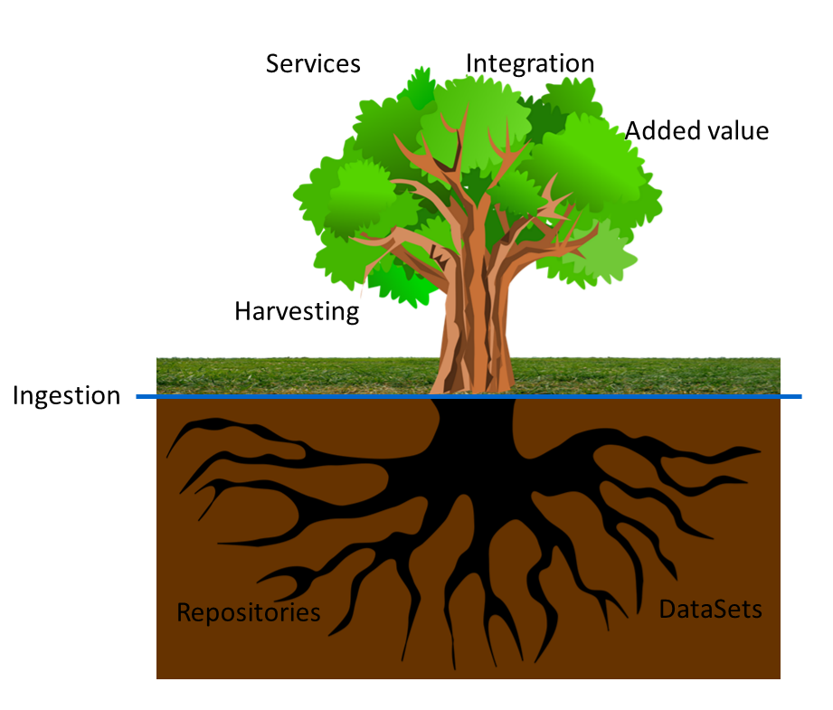
INDIGO Data Ingestion: The Arbor metaphor
“Data Ingestion as the process that ends with the data being ready for sharing/(re-)use, following the usual community requirements”

Slide 8
INDIGO Data Ingestion: The Arbor metaphor
“Data Ingestion as the process that ends with the data being ready for sharing/(re-)use, following the usual community requirements”
FAIR
+ Reproducibility
+ Security/Legal

Slide 9
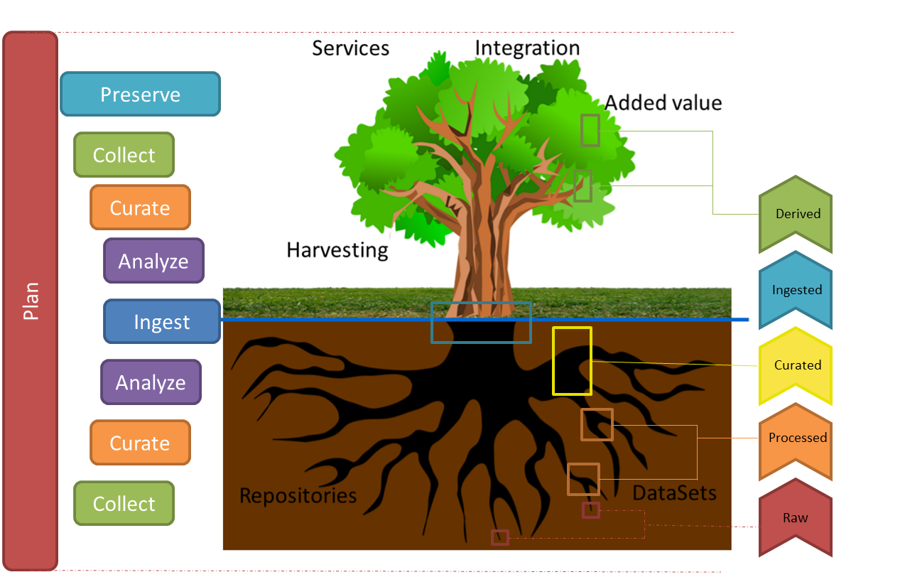
INDIGO Data Ingestion: The Arbor metaphor

Slide 10
INDIGO Data Integrity Test
STAGE | Definition of the Integrity Test components | INDIGO-DataCloud Solution
1. PLAN | Check DMP Existence | Manual
 | Next gen: Machine Actionable DMPs | Automatic linking (not implemented)
2. COLLECT | DataSet existence | EML – Onedata
 | DataSet Integrity (checksum)
3. CURATE | Qc/Qa description OK | EML – Onedata
 | Curating, Quality Software (optional)
4. ANALYSE | Parameters description OK | EML – Onedata
 | Processable Check: Validation
5. INGEST | Check all previous stages OK | EML – Onedata
 | Assign PID/DOI
 | Assure Open Protocol (OAI-PMH) | Supported by Onedata (Data Provider role)
6. PRESERVE | License Definition | EML – Onedata
 | Preservation details | QoS - Onedata

Slide 11
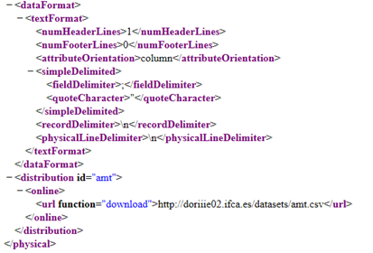
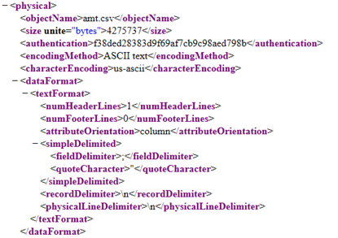
Example: Collect
EML Physical Module

Slide 12
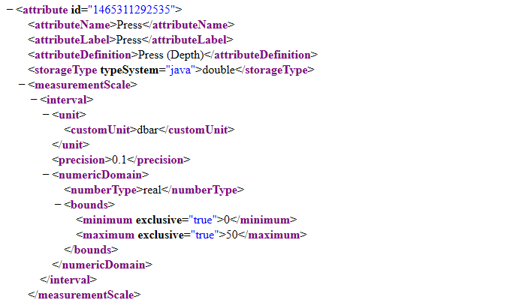
Example: Analyse

Slide 13
Thank you!
Fernando Aguilar, IFCA-CSIC
aguilarf@ifca.unican.es

