Slide 1

Onedata Platform for
Unified Data Access and MGMT. in Distributed hybrid Cloud
Presented by: Dr. Lukasz Dutka

Slide 2
DATA IN MULTI-CLOUD ENVIRONMENTS

Slide 3
PROBLEMS ADDRESED BY ONEDATA PLATFORM
Multi-protocol transparent access to data “[…] but we want POSIX”
Heterogeneity of storage technologies
Replica Management
Easy Data Sharing without Borders
Metadata Management Integrated with Data Management Platform
Flexible authentication and authorization
Easy integration using API with external services
High-throughput data processing
Lock-in data collection available only locally on NFS/GPFS/Lustre available in multicloud
1
2
3
4
5
6
7
8
9

Slide 4
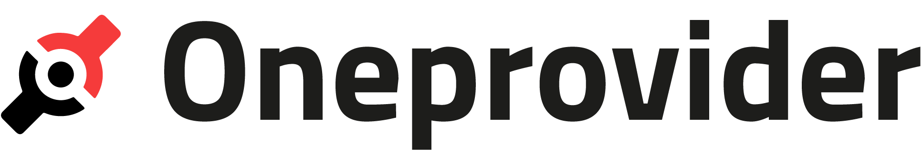




ONEDATA SYSTEM ARCHITECTURE
DS.
3
FUSE Client
Oneclient
Data Space 1
HTTP GUI
REST / CDMI
Onezone
FUSE Client
FUSE Client
P2P
Data Space 2
HTTP GUI
REST / CDMI
FUSE Client

Slide 5
ONEDATA SYSTEM ARCHITECTURE
FUSE Client
Oneclient
Onezone
POSIX
Ceph
S3
Swift
SAML
(in prep.)
HTTP GUI
REST
Entry
GUI
POSIX
OIDC
REST APIs
WebDAV
(in prep.)
FUSE Client
OAI-PMH
CDMI
FUSE Client
Data Mgmt. GUI
Kademila DHT
HTTP GUI
REST
REST APIs
FTP / SFTP
(in prep.)
FUSE Client

Slide 6
DEMO

Slide 7


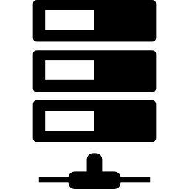
OPPORTUNITIES FOR LEGACY DATA
Space
Meteo
Space
Scans
Support with synching
to existing collection
Supported with synching
to existing collection
Support with local storage cache
Support with local storage cache
P2P Comm.
P2P Comm.
Metadata
Sync
Metadata
Sync
Access to
Meteo and Scans
as local data.
Meteo Cached
Access to
Meteo and Satellite
as local data.
Scans Cached
S3
Ceph
Meteo
(NFS)
Scans (Lustre)
Public Cloud
Private Cloud 1
Private Cloud 2
Private Cloud 3

Slide 8
QUESTIONS?
Please visit:
www.onedata.org

Slide 9
BACKUP SLIDES

Slide 10
PROBLEM 1: MULTI-PROTOCOL TRANSPARENT ACCESS TO DATA IN MULTI-CLOUD ENVIRONMENTS
Thanks to Onedata now you can:
Transparent access your data and create new one in multi-cloud environments
Care less about data locality, all your data are accessible wherever you go
Use many protocols to access the same data

Slide 11
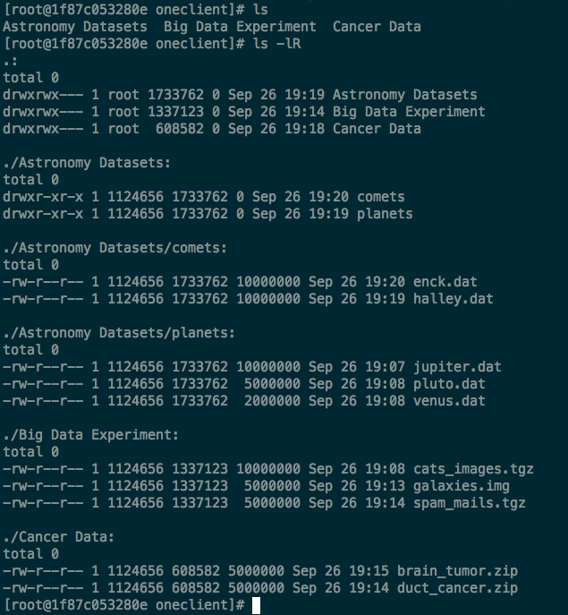
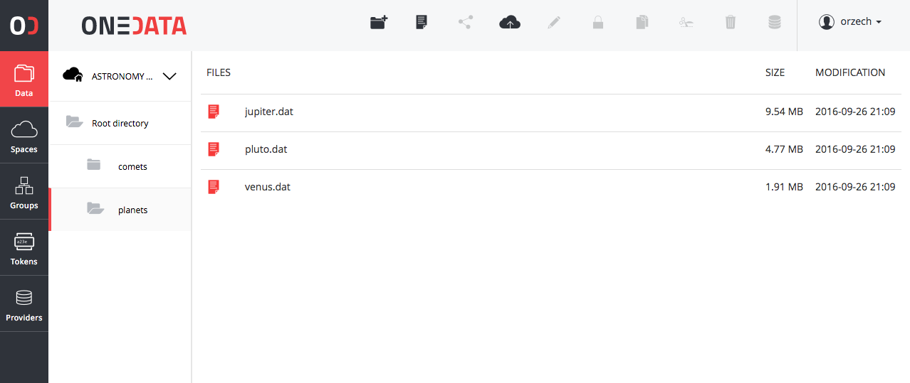
[…] BUT WE WANT POSIX
Support for most of the POSIX operations on virtual file system.
All data accessible trough in a form of unified file system mountable on VM, Grid, VM

Slide 12
PROBLEM 2: Heterogeneity of storage technologies
Thanks to Onedata now you can:
Use the same data access protocols (up to your choice) wherever you go
Pass-through problems of selection right storage technology to data centres operators
Avoid cloud vendor locking

Slide 13
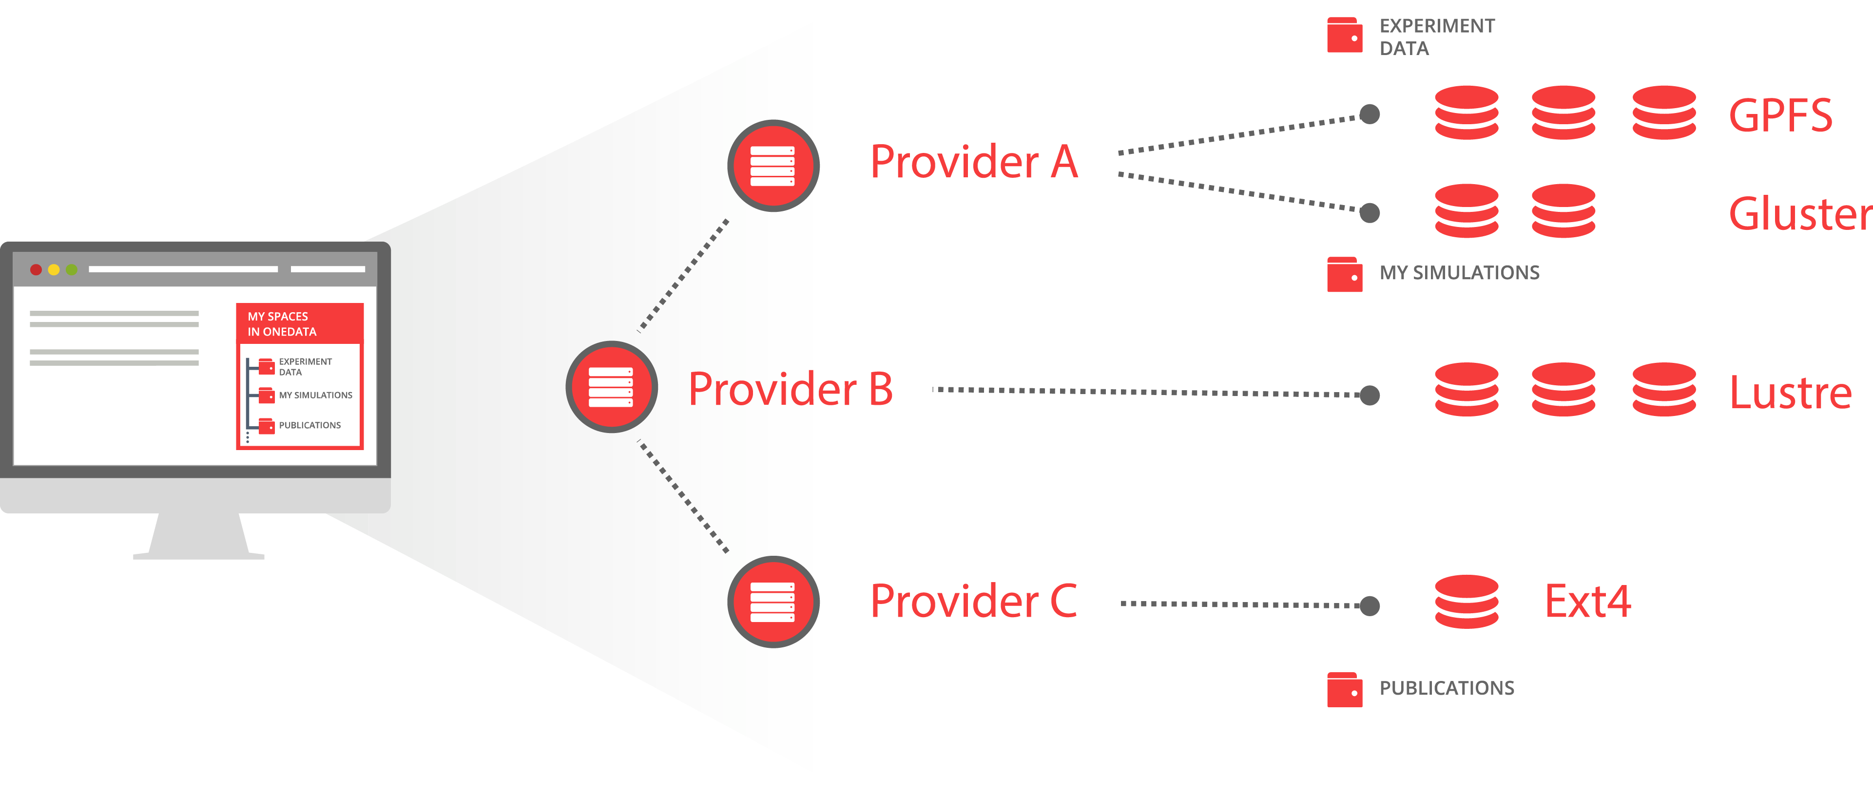
Different types of storages virtualized
S3
POSIX
Ceph
OpenStack Swift

Slide 14

CDMI HTTP ACCESS
Operations | Capabilities
Basic object GET PUT DELETE | cdmi_dataobjects, cdmi_read_value, cdmi_modify_value, cdmi_delete_dataobject
Basic container GET PUT DELETE | cdmi_list_children, cdmi_create_container, cdmi_delete_container
Metadata (container&dataobject) | cdmi_read_metadata, cdmi_modify_metadata, cdmi_size, cdmi_(atime|mtime|ctime)
Access control lists (rwx) | cdmi_acl
Big folders | cdmi_list_children_range
File System Export (FUSE client) | -
Move and copy | cdmi_(move|copy)_(container|dataobject)
Big files | cdmi_read_value_range, cdmi_modify_value_range
Access by ObjectID | cdmi_object_access_by_ID

Slide 15
PROBLEM 3: REPLICA MANAGEMENT
Thanks to Onedata now you can:
Replicate files on demand and on the fly without any additional effort
Migrate data between sites on demand with simple API interface
Easily check location of your data trough GUI or API

Slide 16
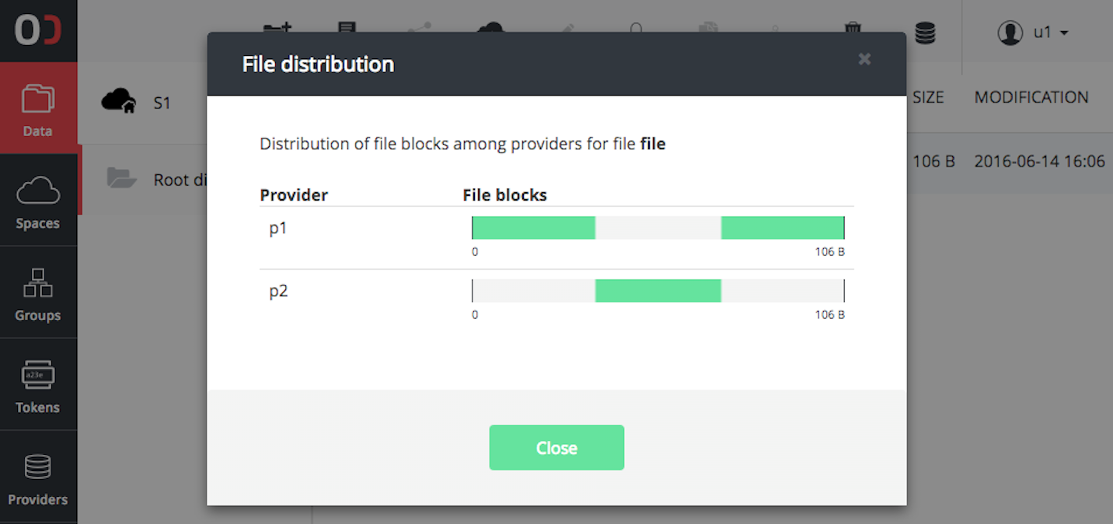
Replicas Management SIMPLIFIED
Manage files not Replicas
Files distribution level between locations is level below to the file structure
Replicas management on a chunk basis
Missing chunks delivered on the fly
API for replica management for pre-staging and implementing external data policy management

Slide 17
PROBLEM 6: FLEXIBLE AUTHENTICATION AND AUTHORIZATION
Thanks to Onedata now you can:
Control who knows about your data
Control who can access data on a single file level

Slide 18
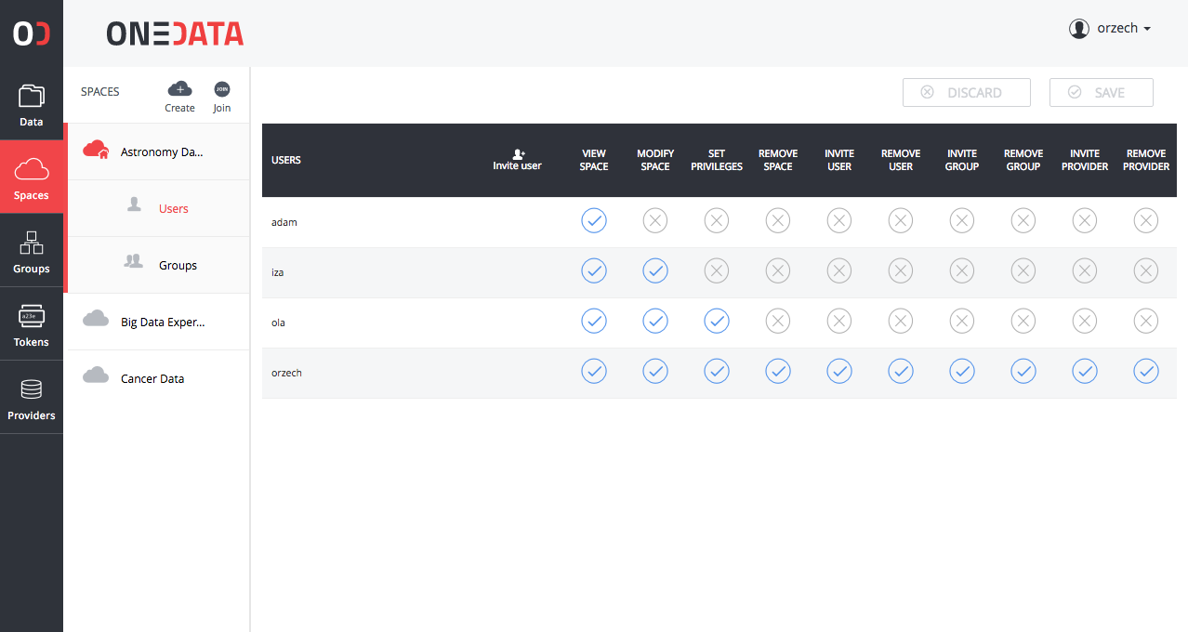
authentication and authorization
Integrated with Indigo IAM
Pluggable methods of authentication per zone
Multi level of access control
ACL on files and directories
Group management
Token based authentication (macaroons)
X.509 in prep.

Slide 19
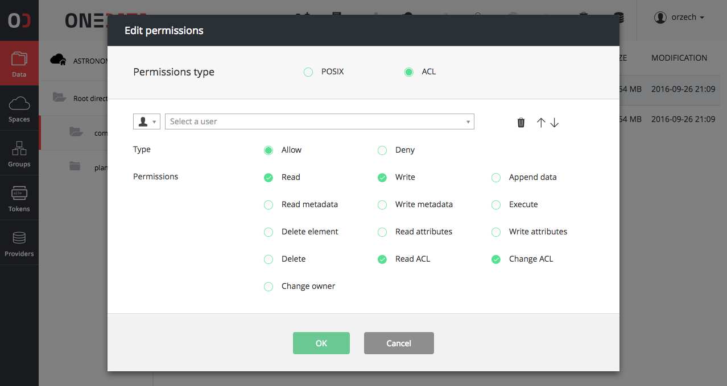
authentication and authorization
Integrated with Indigo IAM
Pluggable methods of authentication per zone
Multi level of access control
ACL on files and directories
Group management
Token based authentication (macaroons)
X.509 in prep.

Slide 20
PROBLEM 5: METADATA MANAGEMENT INTEGRATED WITH
DATA MANAGEMENT PLATFORM
Thanks to Onedata now you can:
Work with data and metadata in one system – avoiding problems of consistency
Monitor metadata data changes trough API in order to feed external custom systems

Slide 21
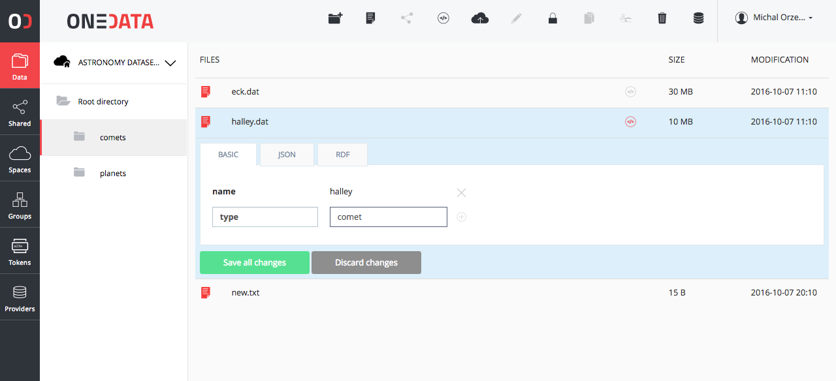
Integrated metadata managment
All files and directories could have a custom user metadata
API for metadata management
API for data discovery based on metadata
Virtual Folders based on metadata tags

Slide 22
PROBLEM 7: EASY INTEGRATION USING API WITH EXTERNAL TOOLS
Thanks to Onedata now you can:
Integrate external tools using rich API interfaces with data management platform building more complex environment for data processing

Slide 23
RICH COLLECTION OF APIs
APIs for all operations
Flexible permission checking for APIs
APIs for full eventually consistent integration with external systems
API fully described using Swagger for generation of clients based on API specification
Easy to use simple command line clients for REST API

Slide 24



PROBLEM 8: High-throughput processing
Protocols CDMI
Protocols S3
Protocols POSIX VFS
P2P
Control,
Remote Data Access
CDMI API
Storage Access
P2P
Direct Access
if possible
P2P
Parallel Processing Nodes using POSIX oneclient, CDMI or REST
Ceph
S3
SWIFT
Lustre

Slide 25
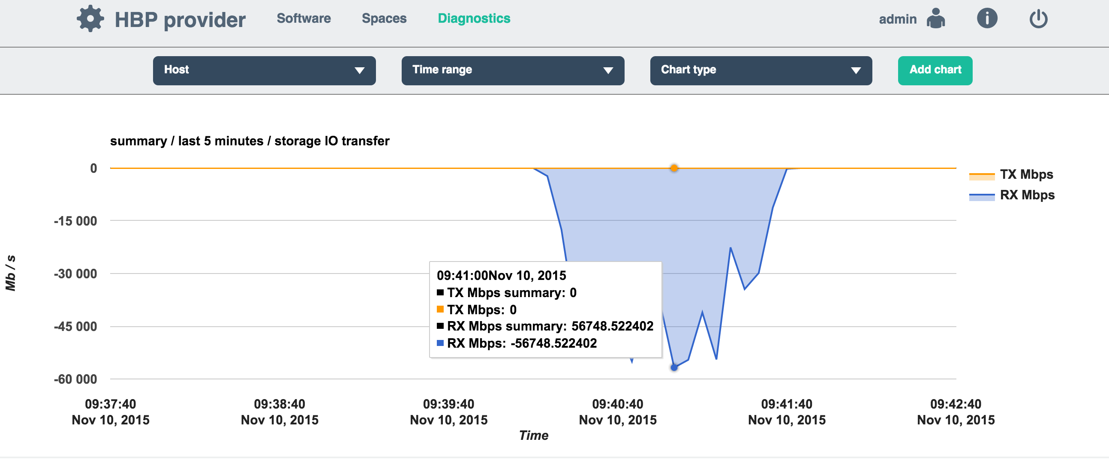
THROUPUT TESTS
55Gbit/s
On single node
5 parallel streams

Slide 26
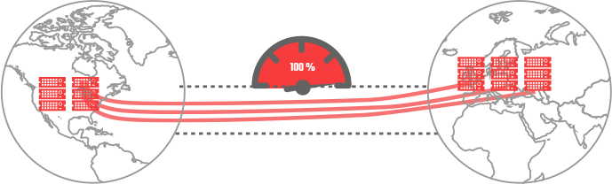
High-throughput transfers
Distributed Priority Queue
For cluster to cluster transfers
WAN
Transfer started by:
User in GUI
API-s
Policy
Access to Rmt. Data
Block-based transfer:
Remote Data Access on the fly
Pre-staging
Data Migration
Data Replication

