Slide 1
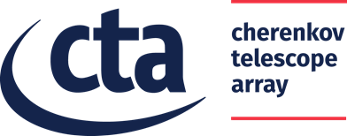
Case Study and INDIGO solution for: Distributed Archive System for the Cherenkov Telescope Array: Metadata management
Presented by Eva Sciacca
INAF, Astrophysical Observatory of Catania, Italy
eva.sciacca@oact.inaf.it
INDIGO SUMMIT
EGI-INDIGO workshop on community application support
Catania, 10th May 2017
RIA-653549

Slide 2
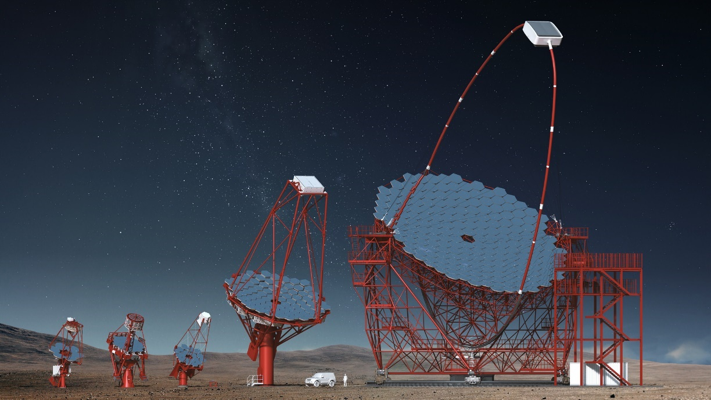
Cherenkov Telescope Array https://cta-observatory.org
WHO: the CTA Consortium consists of more than 1,200 scientists and engineers from 210 institutes in 32 countries and has become a truly global (ESFRI) project.
OUR AIM: One of the major technological challenge is related to the data-handling and archiving of the huge amount of data (from 20 to 100 PB/year) coming from the observatory facilities.​​
WHAT: CTA is the worldwide project for the future of Very High Energy gamma-ray astronomy.
~20 telescopes for the North-site (Canarie) ~100 telescopes for the South-site (Chile)

Slide 3
Requirements analysis for the CTA case study
Easily handle and manage huge amount of data
OneData, IAM
Effective Long Term storage (avoid silent corruption in long­‐term storage systems)
OneData, Zabbix
Distributed Storage
OneData
End user data retrival: customized queries
OneData, File Transfer Services

Slide 4
Architecture

Slide 5
INDIGO-OneData
OneData is a key component in our solution:
It virtualizes storage systems provided by storage resource providers distributed globally.
A single huge data center was not feasible for the amount of data expected for CTA and it is not easy to manage and maintain.
A Distributed Archive lower costs respect to a single huge data center, is easily scalable and distributing data and meta-data offers a disaster recovery free solution.

Slide 6
Running the Demo
The test infrastructure has been setup using VirtualBox Virtual Machines and Docker containers.
Demo datasets coming from the ASTRI project are uploaded to the CTA OneZone within a space supported by the two providers.
The ingested data are enriched with Metadata thanks to the Cloud Data Management Interface (CDMI) or, alternatively, the REST API can be used.
Metadata queries are performed using REST-API and indexing functions (associated to the Space) on pre-defined extended attributes (Metadata).
The CouchBase database (embedded in OneData) can be used alternatively to query and retrieve the metadata using Elastic Search engines (e.g. N1QL) or common MapReduce functions using the standard CouchBase console and the SDK from the client side. This will enable versatile access to the whole CTA dataset to higher level application frameworks and end-users analysis tools.

Slide 7
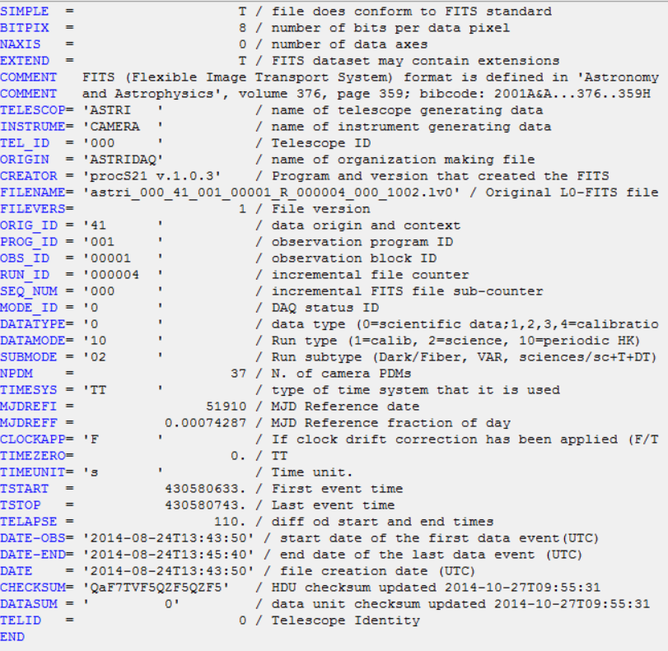
Metadata

Slide 8
Metadata management and Ingestion
ENDPOINT : https://oneprovider_host:8443/cdmi
curl -k --tlsv1.2 -H "X-Auth-Token: $TOKEN" -H $CDMI_VSN_HEADER -H "Accept: application/cdmi-object" -X GET "$ENDPOINT/$DATAPATH?metadata"
Read Metadata
Sample Metadata Ingestion
curl -k --tlsv1.2 -H "X-Auth-Token: $TOKEN" -H $CDMI_VSN_HEADER -H 'Accept: application/cdmi-object'
-d '{"metadata" : {“PROGRAM_ID" : “001"}}' -X PUT "$ENDPOINT/$DATAPATH?metadata"

Slide 9
Metadata Query
function(meta) {
if(meta['PROGRAM_ID']) {
return meta['PROGRAM_ID'];
}
return null;
}
Sample indexing function
PROGRAM_ID_index.js
Associate indexing function to a space
curl --tlsv1.2 -X POST -H "X-Auth-Token: $TOKEN“ -H
'Content-type: application/javascript' –d @PROGRAM_ID_index.js "https://$HOST:8443/api/v3/oneprovider/index?space_id=$SPACE_ID&name=PROGRAM_ID_index"
Query using a REST-API call
curl -v -k --tlsv1.2 -Ss -H "X-Auth-Token: $TOKEN"
-X GET "https://$HOST:8443/api/v3/oneprovider/query-index/$INDEX_ID?key=\"001\"&stale=false"

Slide 10
See the demo

Slide 11
Issues and Future Works
Improve Metadata query: possibility to performe more complex queries.
Test OneData roles and data permissions (through connection with an Authentication and Authorization Infrastructure)
Data is proprietary for a fixed period, then it becomes public.
Test of the replication policies between providers.
Automatic Metadata ingestion (from file FITS headers)
Prototype deployment of the CTA Archive in 3 sites (INAF-Catania, INAF-Rome, ASDC) to enable CTA users to test it.
Prototype deployment with Data-Grid functionalities for CTA specific users (simulation & pipelines)
A look forward to Cloud-Services to be ready for CTA Workload Management System (DIRAC) migration from the DataGrid Environment to the Cloud Paradigm.

Slide 12
References
CTA web page: http://www.cta-observatory.org/
ASTRI web page: http://www.brera.inaf.it/astri/
YouTube demo: https://youtu.be/TbmJn1bIizE
OneData documentation: https://onedata.org/docs/index.html
OneData @ docker hub: https://hub.docker.com/u/onedata/

Slide 13
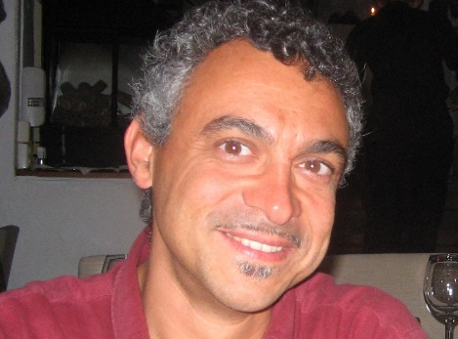
We are ready to share our experience!
eva.sciacca@oact.inaf.it
stefano.gallozzi@oa-roma.inaf.it
alessandro.costa@oact.inaf.it
angelo.antonelli@oa-roma.inaf.it
https://www.indigo-datacloud.eu
Better Software for Better Science.

