Slide 1
Case Study and INDIGO solution for: Amber NMR service
Presented by Andrea Giachetti
CIRMMP (Italy)
giachetti@cerm.unifi.it
INDIGO SUMMIT
EGI-INDIGO workshop on community application support
Catania, 10th May 2017
RIA-653549

Slide 2
Molecular dynamics simulations
Because no experimental technique can be applied to the investigation of all atoms/groups in a protein, computer simulations are needed to obtain a complete picture
MD simulations are based on the integration of classical equations of motion (variation of position, velocity and acceleration) over small intervals of time ∆t (constant acceleration, linear motion). At each time step the system energy and forces over atoms are re-evaluated.
For protein MD simulations ∆t = 1-2 fs. So for 1 μs of simulation, 1 billion steps are needed.
Calculations require several days and generate 10’s Gb

Slide 3
Ion escape from a protein nanocage
OUTSIDE
C3 CHANNEL SECTION
CAGE

Slide 4
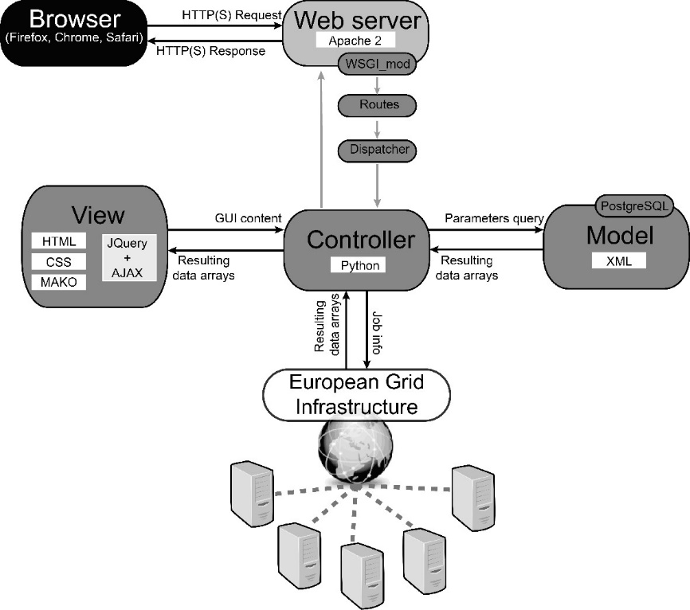
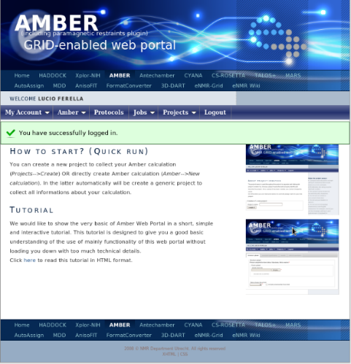
Structure of our current portal for short MD calculations
Bioinformatics, 27, 2384-2390 (2011). A Grid-enabled web portal for NMR structure refinement with AMBER. Bertini I, Case DA, Ferella L, Giachetti A, Rosato A.

Slide 5
Changes implemented in the portal using INDIGO solutions
New users can exploit the INDIGO IAM to log in the portal. On the first login, a new account is automatically created.
For the time being, calculations are dispatched to the grid using CREAM.
We successfully demonstrated the use of a previous version of the FutureGateway as an alternative way to dispatch jobs.

Slide 6
Building a cloud-based web server for MD analysis
The AmberTools software package for MD was implemented as a container for Docker
We additionally implemented the Oneclient application in the Docker image. This enables the server to access MD trajectory files directly on the cloud storage system
We achieved job submission using the INDIGO Orchestrator

Slide 7
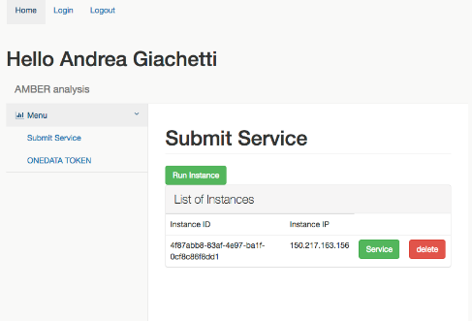
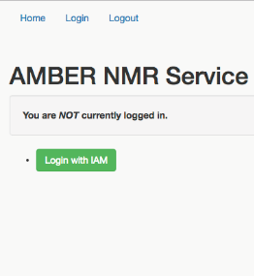
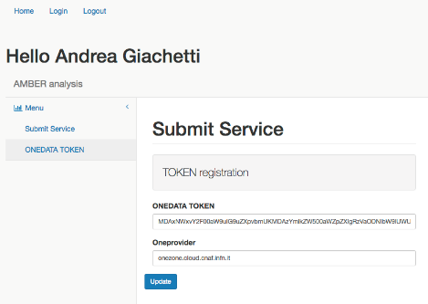
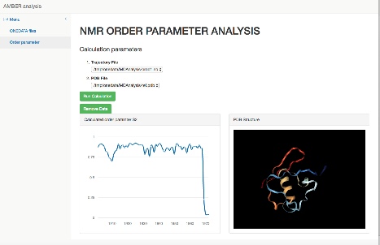
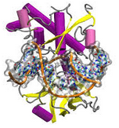
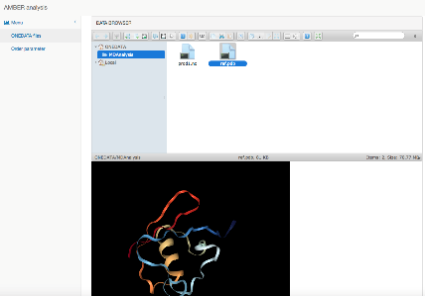
Scheme of the solution
IAM
Submission Instance to local Openstack
CIRMMP SERVER
ONEDATA token
AMBER
CLOUD CONTAINER
Creation of webserver that performs calculation
Creation of docker container
AMBER
WEB CLIENT
WEB SERVER

Slide 8
Building a cloud-based web server for MD analysis
The container further includes
A data browser, so the container can be accessed via your web browser (i.e. no need to use the Onedata web interface in another tab).
A viewer for macromolecular structures (NGL, a highly memory-efficient and scalable WebGL-based viewer)
We then instantiate the VM using specifications in YAML.
This is compatible with the PaaS Orchestrator of INDIGO. It works also on a local OpenStack private cloud.

Slide 9
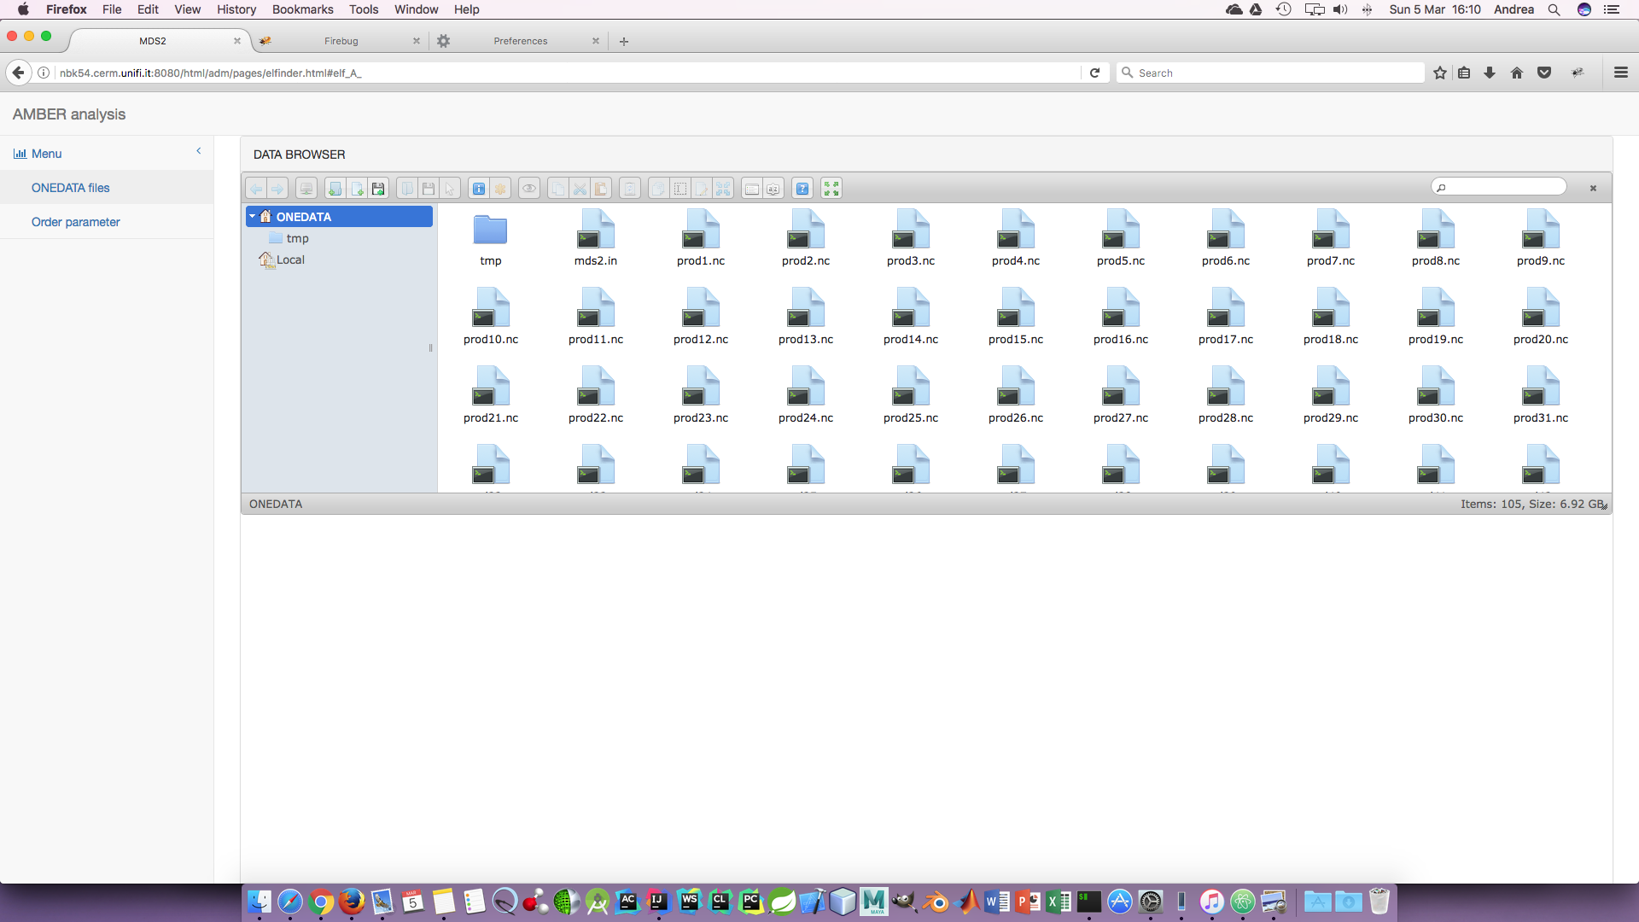
How it looks

Slide 10
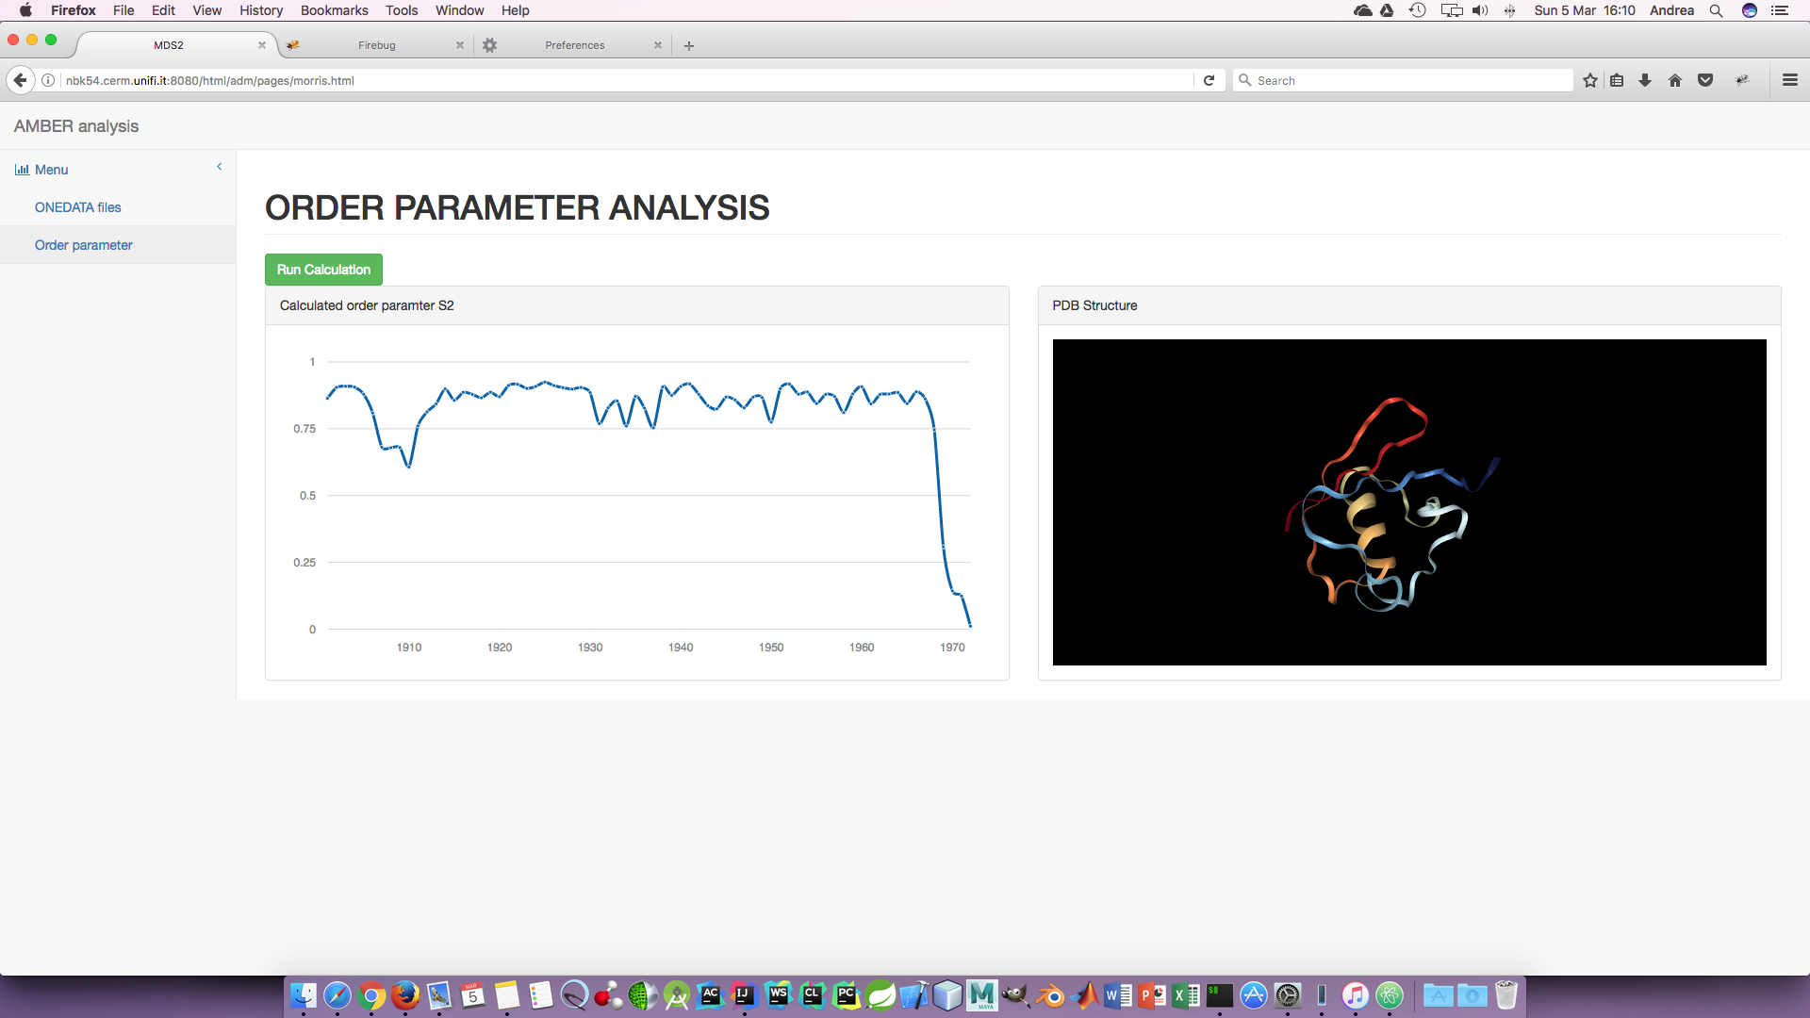
Display of the results of MD analysis

Slide 11
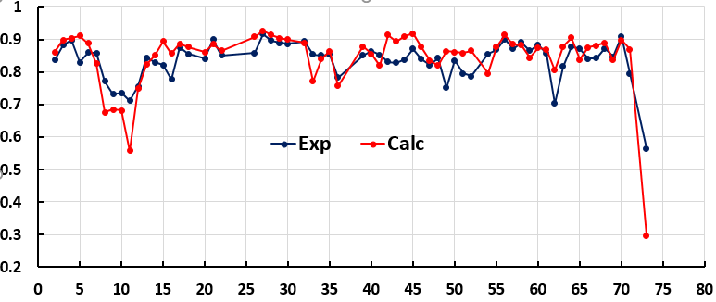
MD vs. NMR-derived dynamics
IRED analysis of a 1 μs simulation of ubiquitin, compared to order parameters derived from experimental data
S²
Residue
Pearson coefficient Exp-Calc = 0.82
Prompers, J. J., & Bruschweiler, R., 2002, J. Am. Chem. Soc., 124(16), 4522–4534.
Tjandra et al., J. Am. Chem. Soc., 1995, 117 (50), pp 12562–12566

Slide 12
Infrastructure to compute MD simulations
Presently:
GPGPU-based using the HTC infrastructure of EGI
Next
Dockerized version for GPGPU VMs
Computing MD simulations is much more efficient on GPGPUs: see https://documents.egi.eu/public/ShowDocument?docid=2774
Instead, MD analysis does not require GPGPUs
Link to the video of the demo: https://drive.google.com/file/d/0B6bQjDVrpSSnYkRfZ3F6WnVQdEE/view

Slide 13
Thank you for your attention!
People involved:
Davide Sala
Antonio Rosato
Financial support:
Italian Ministry of University
Regione Toscana
European Commission

