Slide 1
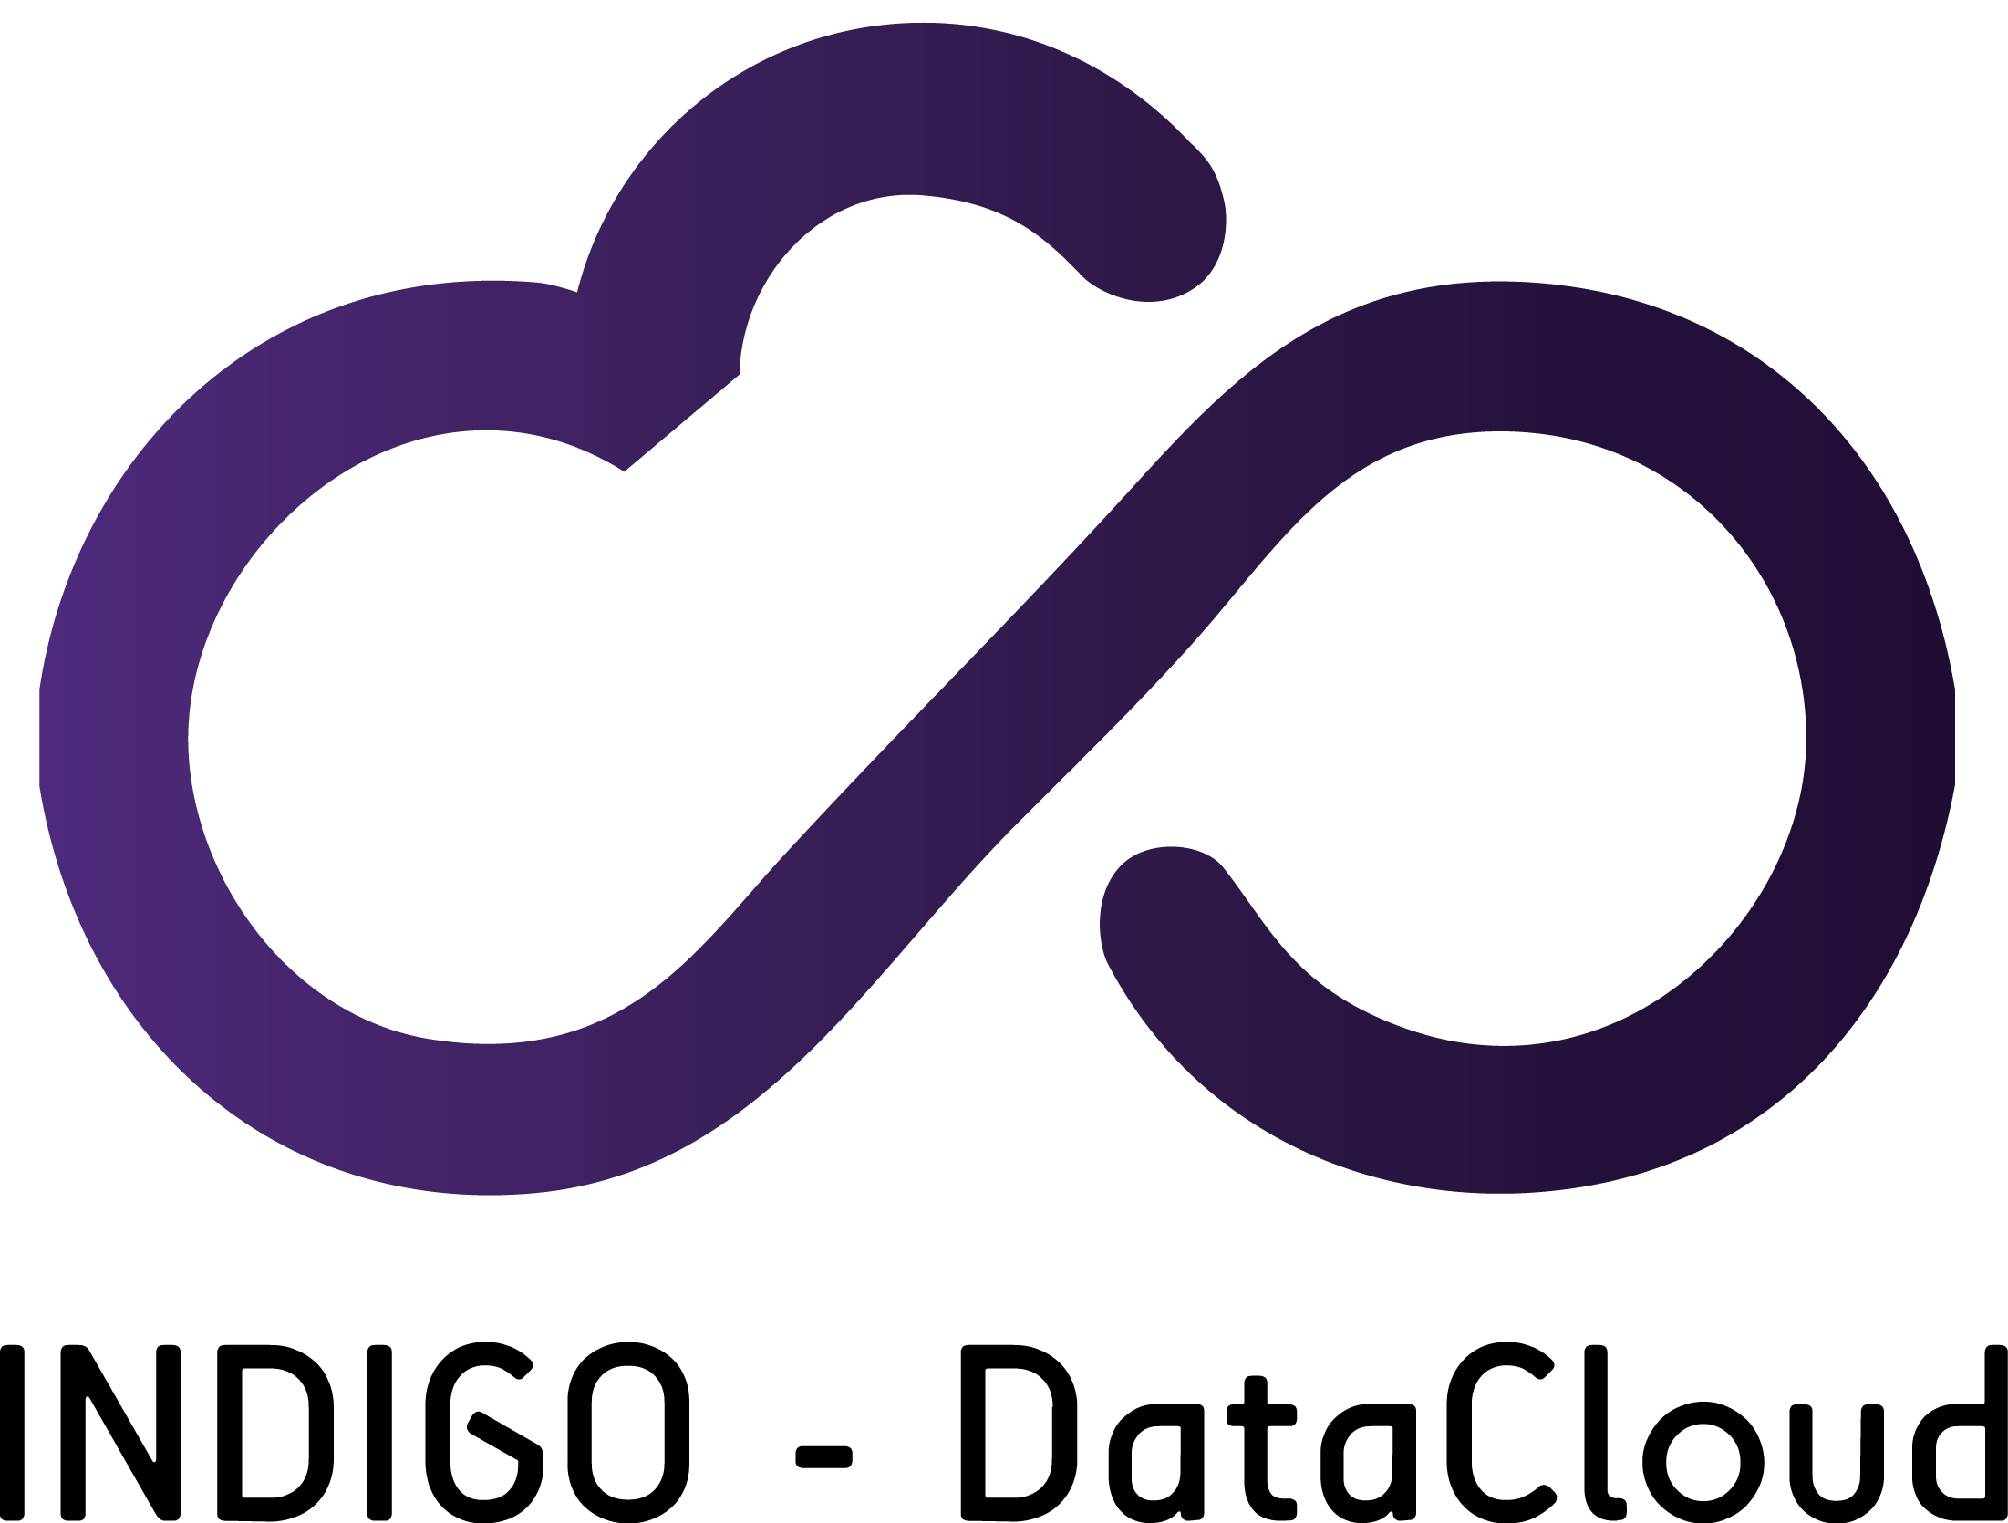

INDIGO Use Cases:
PaaS services for Computing and Storage
Giacinto Donvito (INFN)
RIA-653549
INDIGO-DataCloud is co-founded by the
Horizon 2020Framework Programme

Slide 2
Implementation approach
Rely on standards
µService approach
Modularity
  Pick the services you really need for your use-case
  And build your own platform based on your needs
Each layer has clear interfaces and could be exploited directly by the end users
The Authentication/Authorization is based on the concept of “Delegation”
  Each service could decide autonomously about the authorization
  Each service is requested exploiting the real end-user credential

Slide 3
Implementation approach
Automation based on orchestrating resources
  This is done at different level (IaaS/PaaS/SaaS)
Open:
  Not only Open Source,
  But the possibility to plug-in any supported services/protocols/resources in order to build the needed infrastructure
  Both private and public cloud resources could be part of the same INDIGO deployment
You can build your own (private) infrastructure or provide a multi-tenant solution for your users.
  Depending on your goal

Slide 4
The high level view of the Architecture
This is the INDIGO-DataCloud General Architecture*
*: see details in http://arxiv.org/abs/1603.09536 or in https://www.indigo-datacloud.eu/documents-deliverables

Slide 5


A web portal that uses a batch system to run applications - Overview
WP6
2) Deploy TOSCA with Vanilla VM / Container
Future Gateway API Server
User
WP5
6)Access Web Portal
1) Stage Data
Orchestrator
Other PaaS Core Services
IM
OneZone
WP4
TOSCA
Cloud Sites
TOSCA
Virtual Elastic LRMS Cluster
Clues
IM
Heat
Galaxy
5) Mount
WN
…
WN
WN
Front-End
Public IP
Provider
OpenNebula
OpenStack

Slide 6
Mesos PaaS solution exploiting INDIGO platform
WP6
2) Deploy TOSCA with Vanilla VM / Container
Future Gateway API Server
User
1) Stage Data
WP5
6) Access Mesos Services
Orchestrator
Other PaaS Core Services
Provider
IM
5) Mount
WP4
Virtual Elastic Mesos
Cluster
Public IP
4) Install / Configure
Cloud Site
IM
Heat
Chronos/Marathon
Clues
Workers
…
Workers
Mesos Masters
OpenNebula
OpenStack

Slide 7
A dynamic cluster to run applications – INDIGO Services
TOSCA Template to describe the user service
Future Gateway to “configure and submit” TOSCA Template in an easy way
Orchestrator + PaaS Core services + CloudProviderRanker + SLAM/QoS:
  To find the available IaaS
  That are correctly working
  That has SLA with the given user
  And supports the hw+sw requirements
  That hosts the required data
Infrastructure Manager at the PaaS level in case the IaaS do not supports native TOSCA enabled orchestrator
IaaS Orchestrator (Heat/IM) supporting TOSCA
Onedata for shared and distributed data access
CLUES for driving the automatic resource provisioning based on the usage

Slide 8
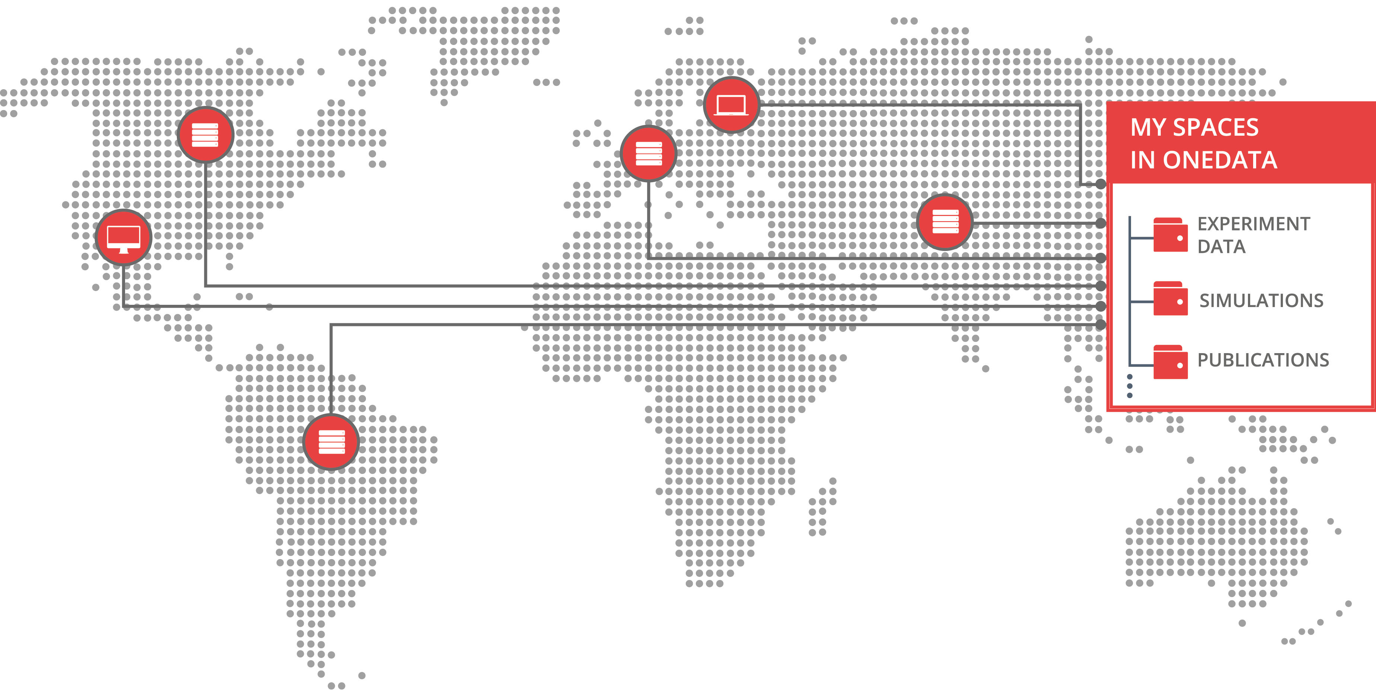
DATA IN MULTI-CLOUD ENVIRONMENTS

Slide 9
PROBLEMS ADDRESED BY ONEDATA FOR
INDIGO DataCloud PaaS
Multi-protocol transparent access to data “[…] but we want POSIX”
Heterogeneity of storage technologies
Replica Management
Easy Data Sharing without Borders
Metadata Management Integrated with Data Management Platform
Flexible authentication and authorization
Easy integration using API with external services
1
2
3
4
5
6
7

Slide 10
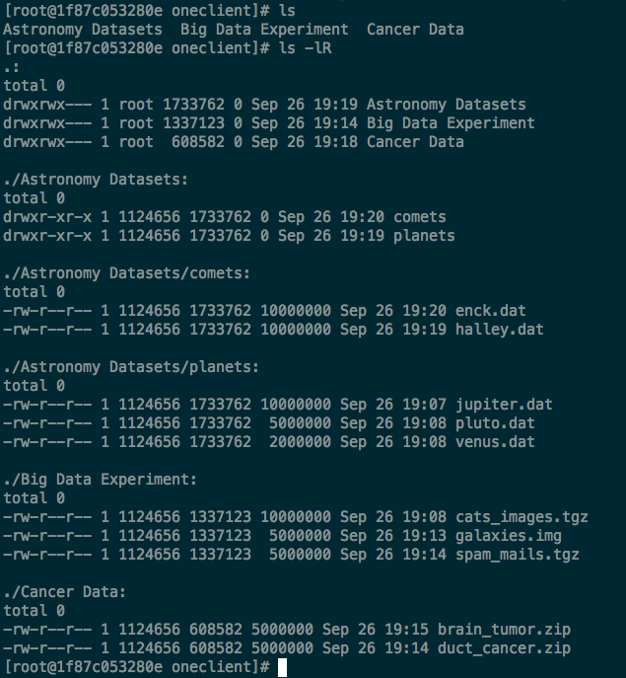
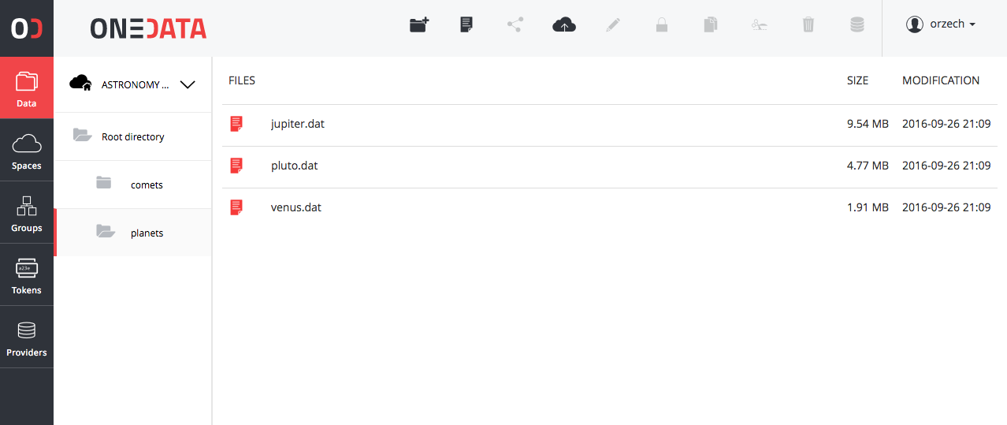
[…] BUT WE WANT POSIX
Support for most of the POSIX operations on virtual file system.
All data accessible trough in a form of unified file system mountable on VM, Grid, VM

Slide 11



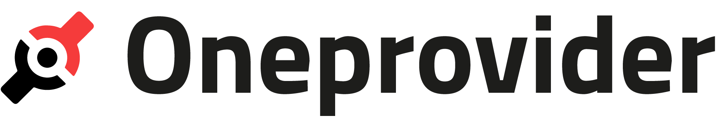

PROTOCOL HANDLERS (PLUGINS)
FUSE Client
Oneclient
Onezone
POSIX
Entry
GUI
CDMI
HTTP GUI REST
Data Mgmt. GUI
FUSE Client
Kademlia
DHT (in prep.)
FUSE Client
REST APIs
FTP / SFTP
(in prep.)
HTTP GUI REST
WebDAV
(in prep.)
FUSE Client

Slide 12
PROBLEM 2: Heterogeneity of storage technologies
Thanks to INDIGO-DataCloud now you can:
Use the same data access protocols (up to your choice) wherever you go
Pass-through problems of selection right storage technology to data centres operators
Avoid cloud vendor locking

Slide 13
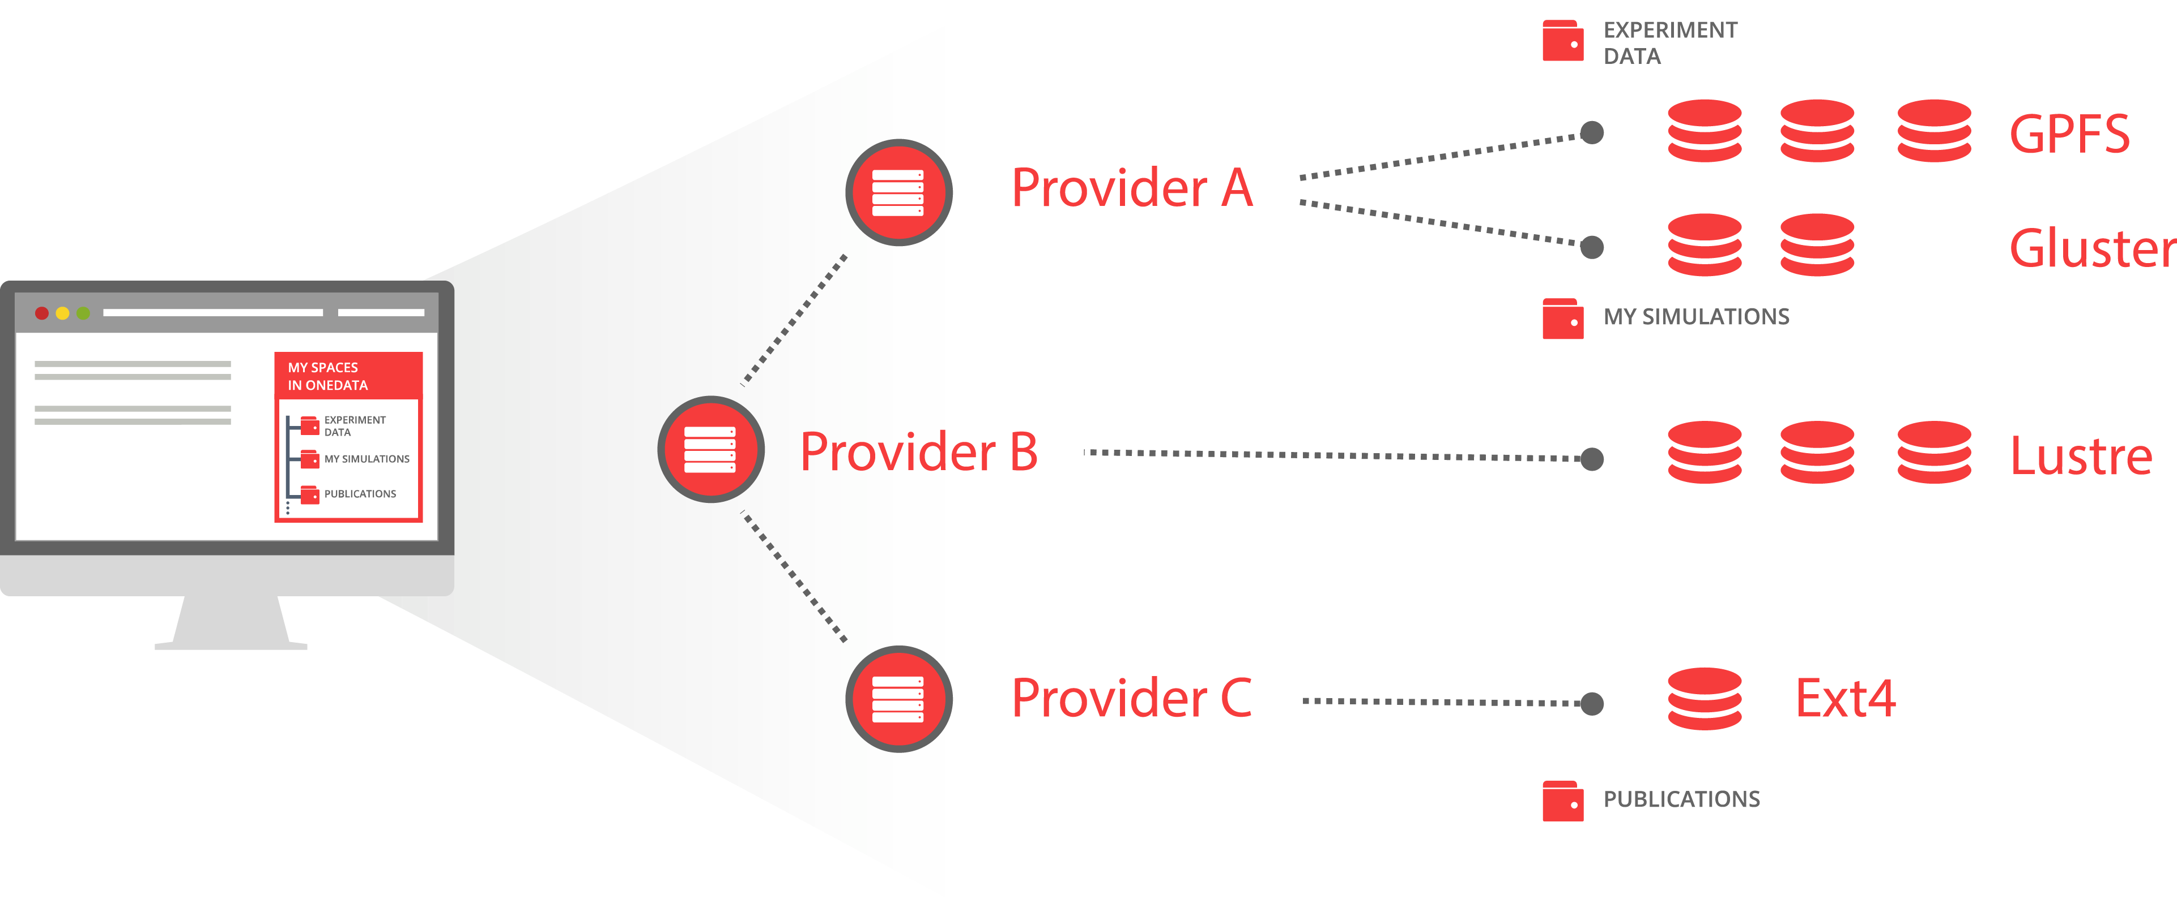
Different types of storages virtualized
S3
POSIX
Ceph
OpenStack Swift

Slide 14
STORAGE SYSTEMS DRIVERS (PLUGINS)
FUSE Client
Oneclient
Onezone
POSIX
Ceph
S3
Swift
Entry
GUI
GridFTP
(in. Prep)
HTTP GUI REST
FUSE Client
Kademlia
DHT (in prep.)
FUSE Client
HTTP GUI REST
FUSE Client

Slide 15
PROBLEM 3: REPLICA MANAGEMENT
Thanks to INDIGO-DataCloud now you can:
Replicate files on demand and on the fly without any additional effort
Migrate data between sites on demand with simple API interface
Easily check location of your data trough GUI or API

Slide 16
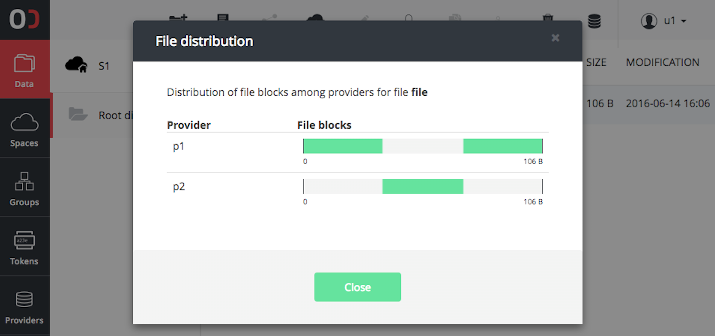
Replicas Management SIMPLIFIED
Manage files not Replicas
Files distribution level between locations is level below to the file structure
Replicas management on a chunk basis
Missing chunks delivered on the fly
API for replica management for pre-staging and implementing external data policy management

Slide 17
PROBLEM 4: EASY DATA SHARING WITHOUT BORDERS
Thanks to INDIGO-DataCloud now you can:
Share large scale data collection with other communities
Enable your data to be shared in cross-federation scenarios
Bring your data and tools as building blocks to European Open Science Cloud

Slide 18
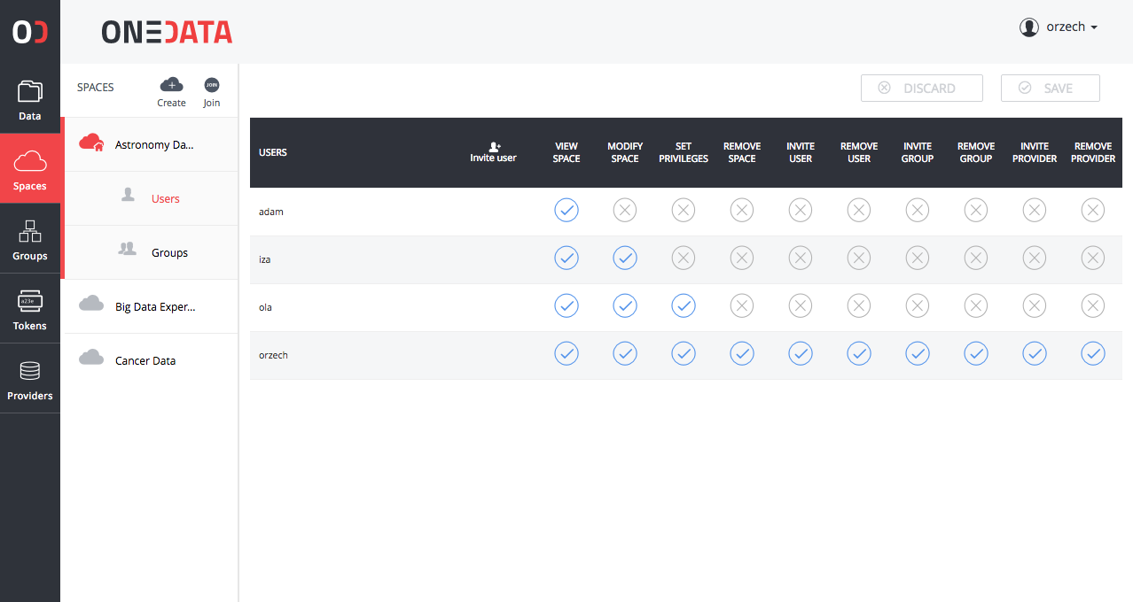
SHARING WITHOUT BORDERS
Team-sharing
  For groups
  For individuals
  Using tokens
Cross-community data sharing
Instant and ad-hoc data sharing
Thanks to effort supported by EGI Engage:
  Open Data Publication
  Handles (DOI) support
  OAI-PMH

Slide 19
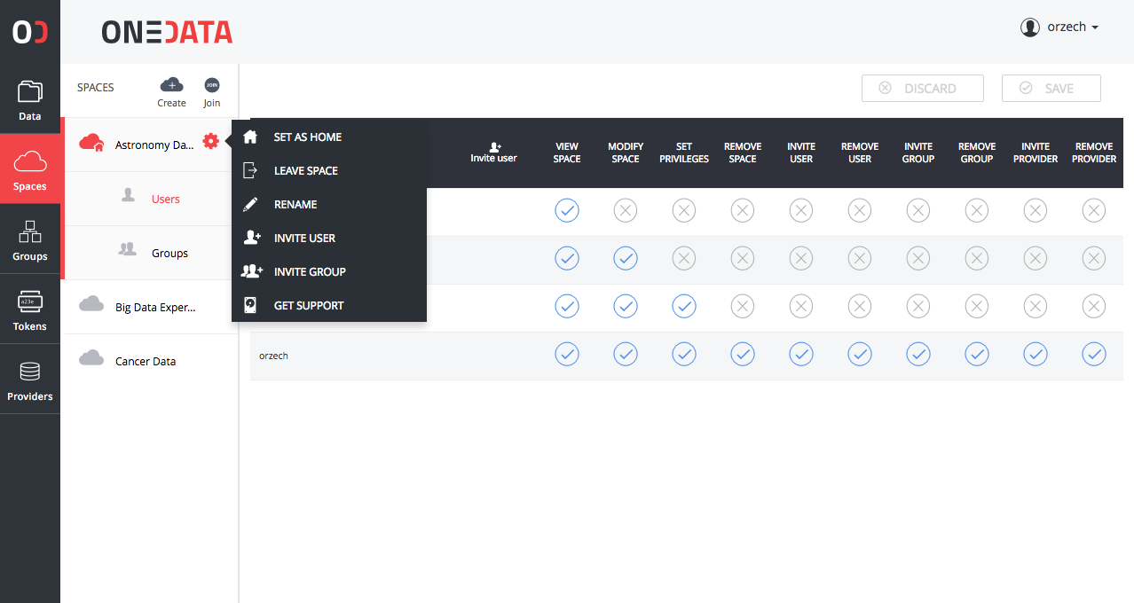
SHARING WITHOUT BORDERS
Team-sharing
  For groups
  For individuals
  Using tokens
Cross-community data sharing
Instant and ad-hoc data sharing
Thanks to effort supported by EGI Engage:
  Open Data Publication
  Handles (DOI) support
  OAI-PMH

Slide 20
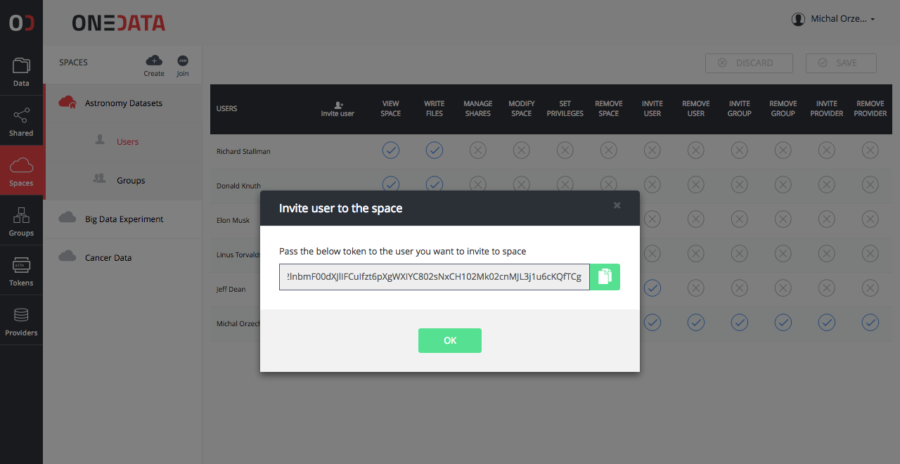
SHARING WITHOUT BORDERS
Team-sharing
  For groups
  For individuals
  Using tokens
Cross-community data sharing
Instant and ad-hoc data sharing
Thanks to effort supported by EGI Engage:
  Open Data Publication
  Handles (DOI) support
  OAI-PMH

Slide 21
PROBLEM 5: METADATA MANAGEMENT INTEGRATED WITH
DATA MANAGEMENT PLATFORM
Thanks to INDIGO-DataCloud now you can:
Work with data and metadata in one system – avoiding problems of consistency
Monitor metadata data changes trough API in order to feed external custom systems

Slide 22
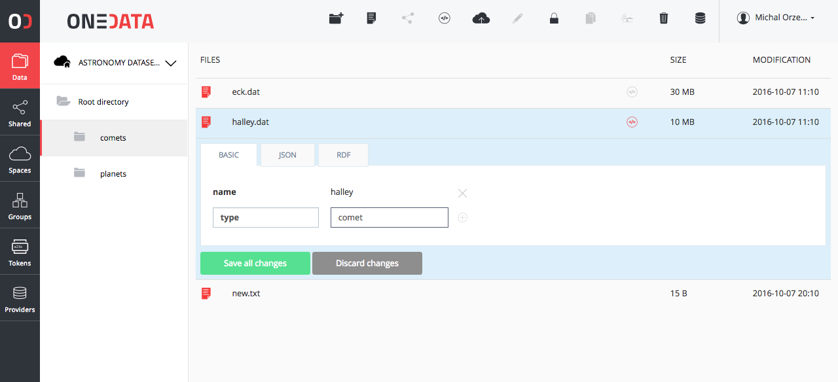
Integrated metadata managment
All files and directories could have a custom user metadata
API for metadata management
API for data discovery based on metadata
Virtual Folders based on metadata tags

Slide 23
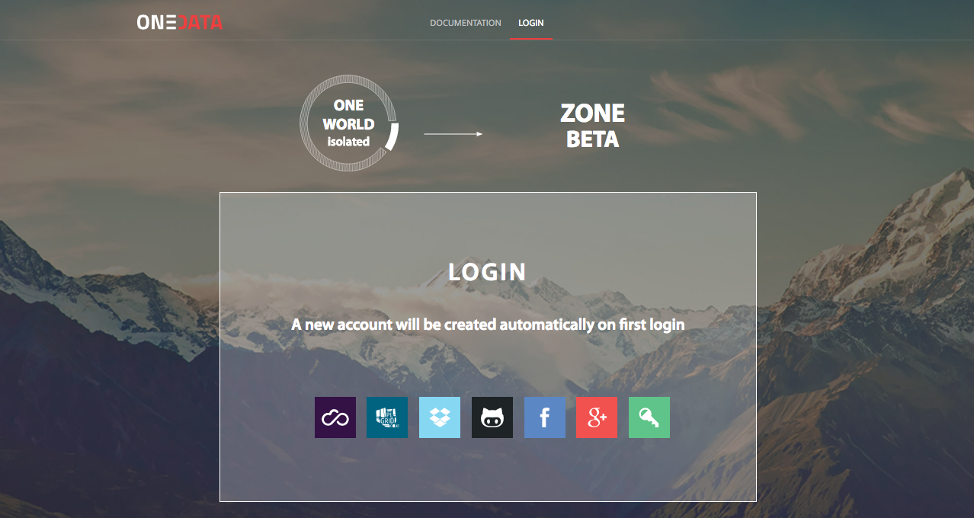
authentication and authorization
Integrated with Indigo IAM
Pluggable methods of authentication per zone
Multi level of access control
ACL on files and directories
Group management
Token based authentication (macaroons)
X.509 in prep.

Slide 24
authentication and authorization
Integrated with Indigo IAM
Pluggable methods of authentication per zone
Multi level of access control
ACL on files and directories
Group management
Token based authentication (macaroons)
X.509 in prep.

Slide 25
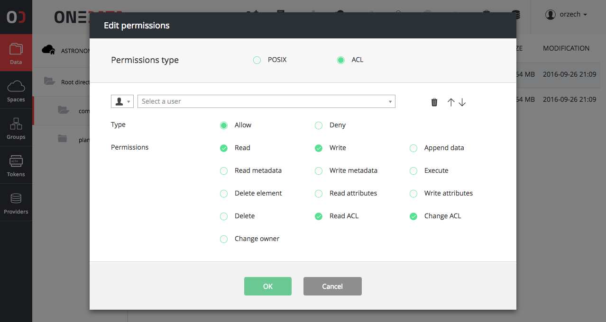
authentication and authorization
Integrated with Indigo IAM
Pluggable methods of authentication per zone
Multi level of access control
ACL on files and directories
Group management
Token based authentication (macaroons)
X.509 in prep.

Slide 26
PROBLEM 7: EASY INTEGRATION USING API WITH EXTERNAL TOOLS
Thanks to INDIGO-DataCloud now you can:
Integrate external tools using rich API interfaces with data management platform building morecomplex environment for data processing

Slide 27
RICH COLLECTION OF APIs
APIs for all operations
Flexible permission checking for APIs
APIs for full eventually consistent integration with external systems
API fully described using Swagger for generation of clients based on API specification
Easy to use simple command line clients for REST API

