Slide 1
Marketplace Update
Dean Flanders
SwiNG / FMI

Slide 2
Update
Working last few months developing the test system
http://egi.science-it.ch
http://marketplace.egi.eu
Recent initiated pilots:
Pilot initiated with Paul Scherrer Institute (PSI) for technology park implementation
Pilot initiated with Thermo Fisher Scientific
Pilot initiated with BioImaging Center in Bordeaux
France Bioimaging
Recent Presentations / Awards
S-Labs Award nomination

Slide 3
EGI Marketplace Prototype (PrestaShop)

Slide 4
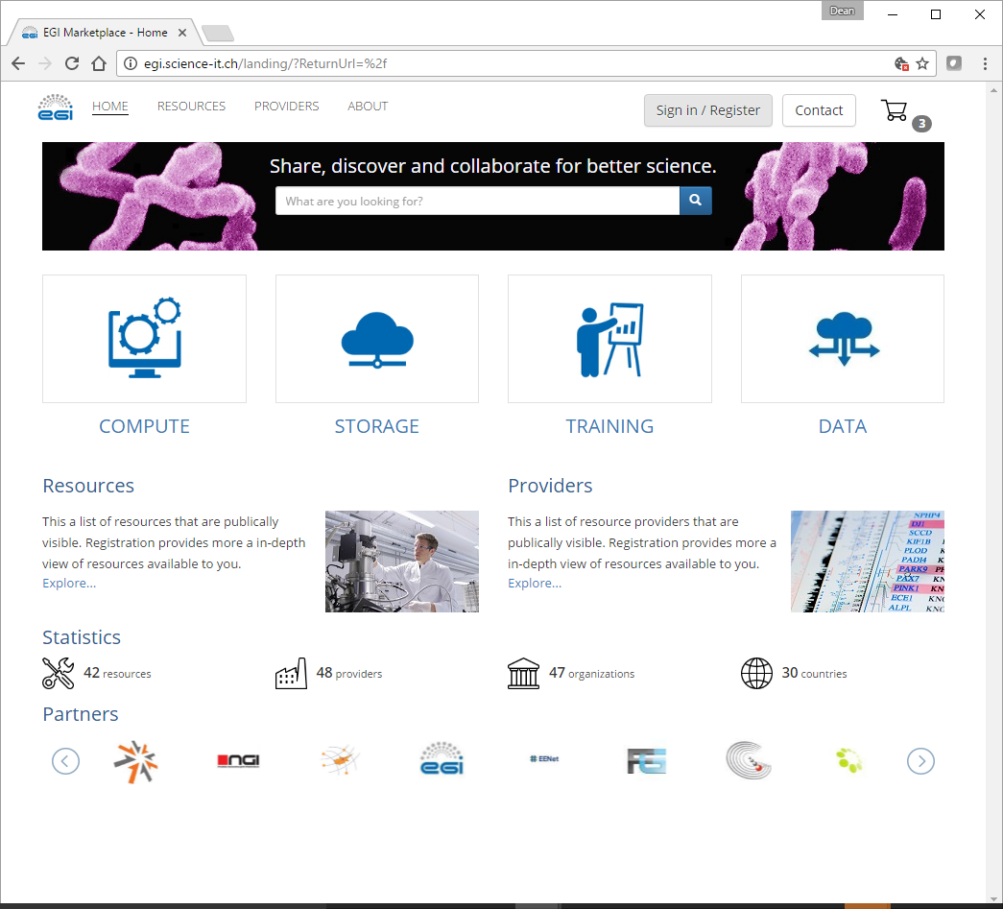
EGI Marketplace Prototype (Open IRIS)

Slide 5
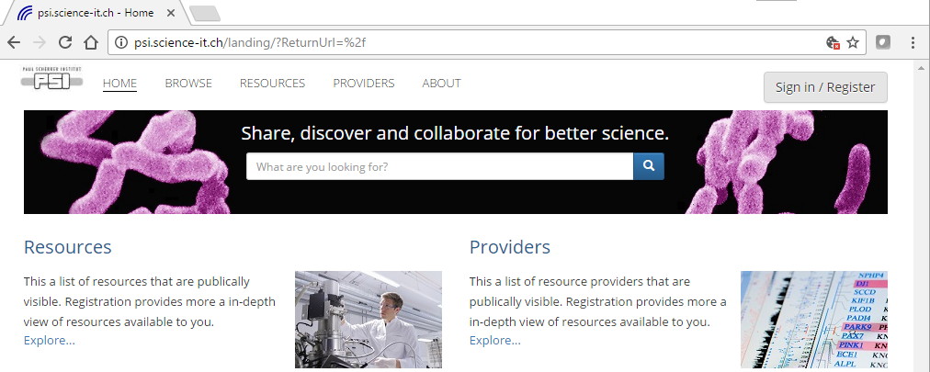
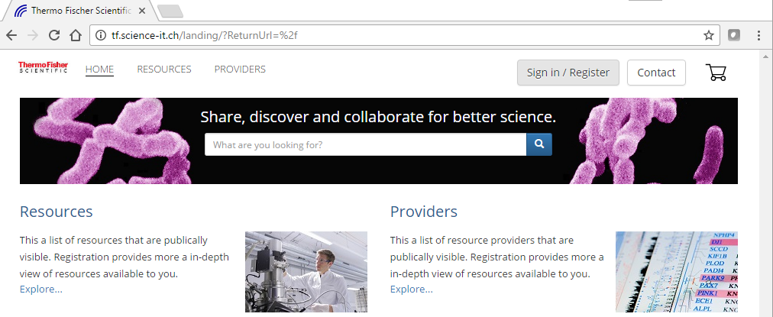
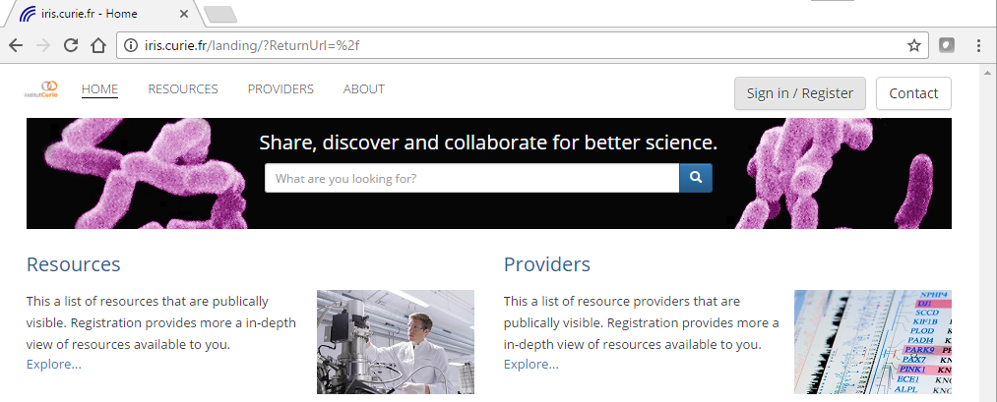
Open IRIS Pilot Use Cases

Slide 6
Statistics from the Current Usage of Overall Platform
The Open IRIS platform that is based on has the following statistics:
3400 users -> 4000 users
984 resources registered -> 1167 resources
154 resource providers -> 182 resource providers
119 registered organizations -> 150 organizationn
Over 40,000 resource usage requests in the past 6 months -> 29,000 resource usage requests in 3 months

