Slide 1
EGI Change Management (CHM) for Software Development An Introduction
Matthew Viljoen
2 Feb 2017

Slide 2
Contents
Why is CHM and why bother?
What if I already have my own CHM?
The policy, scope and process
Calculating risk and the Request for Change
Implementation
I have a change – what do I do?

Slide 3
EGI Change Management Process (CHM)
You will interact with CHM mainly when
You want to propose a change to IT services
As Service Owner – assess change risk
Process Owner
Tiziana Ferrari
Process Manager
Matthew Viljoen
Objective
The goal of this process is to ensure changes to CIs are planned, approved, implemented and reviewed in a controlled manner to avoid adverse impact of changes to services or the customers receiving services.
CI = Configuration Item

Slide 4
What is EGI CHM and why bother?
A lightweight process based on peer review of changes which helps to ensure:
changes are well thought through, planned and
risks are understood (and mitigated against)
Some benefits:
Improve quality of service for end users
Continuous improvement for EGI
Helps coordination of dependent service delivery
Spreads know-how, prevents “islands of knowledge”
Collective responsibility of major decisions

Slide 5
What if I already have my own CHM?
EGI CHM is a central process, and is not intended to replace/duplicate your own CHM.
For ISO20k, all in EGI federation needs to follow a CHM – not specified where.
Need to follow central CHM requirements (existence of CAB to review high risk changes, record, review changes and their implementation date
Exceptions (still need to use central EGI CHM)…
high risk changes potentially affecting other EGI services (e.g. changes to API)
major software development changes
Let EGI CHM Process Manager know if this affects you

Slide 6
The policy, scope and process
All ‘high risk’ changes are under scope (or lower risk changes that would benefit by the process) affecting production services listed in the EGI Service Catalogue
Changes are assessed and approved by the Change Advisory Board (CAB) prior to implementation.
A Request for Change (RfC) is filled in for each normal change (standard series of questions)
Recurrent changes may be classified as standard changes or pre-approved changes, not needing explicit approval by CAB on subsequent occasions
Emergency changes may be applied without prior assessment and approval (but they need to be recorded and reviewed)

Slide 7
What types of changes?
Production service delivery changes (upgrades, migration of hardware, DBs)
Now considering extending EGI CHM changes to service software development. Benefits for developers:
assistance with assessing major new functionality requests from users (significant development effort required)
help to push back ‘unreasonable’ new functionality requests
discussion/requesting of resource required for development.
Only high risk changes (major new functionality that requires significant development time. Changes to APIs)
Low risk changes (not requiring CHM approval) are: new functionality where there is no risk of development 'side-effects'. Minor changes to the UI.)

Slide 8
Calculation of Risk
Risk level = Likelihood x Impact
LIKELIHOOD
IMPACT
Rating | Description
1 | Unlikely
2 | Possible
3 | Likely
4 | Almost Certain
Rating | Description
1 | Minor light impact on project
2 | Moderate some impact, not too significant
3 | Major unacceptable reduction of quality
4 | Catastrophic detrimental to whole organization
Risks level:
=<4 can be approved by the Service Owner
>4 needs to be assessed by the CAB
Any change of Impact = Catastrophic need to be assessed by the SSB
see: https://wiki.egi.eu/wiki/File:IMS-RMGuideline-060117-1020-4791.pdf for more details

Slide 9
Normal change workflow
Step # | Responsible | Action
1 | Change Owner | Fills in RfC and creates ticket in RT
2 | Service Owner | Assesses level of risk. If risk =<4, approves the change which may then proceed
3 | CAB | If risk >4, assesses change and approves it.
4 | Change Owner | If appropriate, signs off the change by informing stakeholders
5 | Change Implementer | Implements the change
6 | CAB | Reviews and closes the change
https://confluence.egi.eu/display/IMS/CHM1+Manage+changes+including+emergency+changes

Slide 10
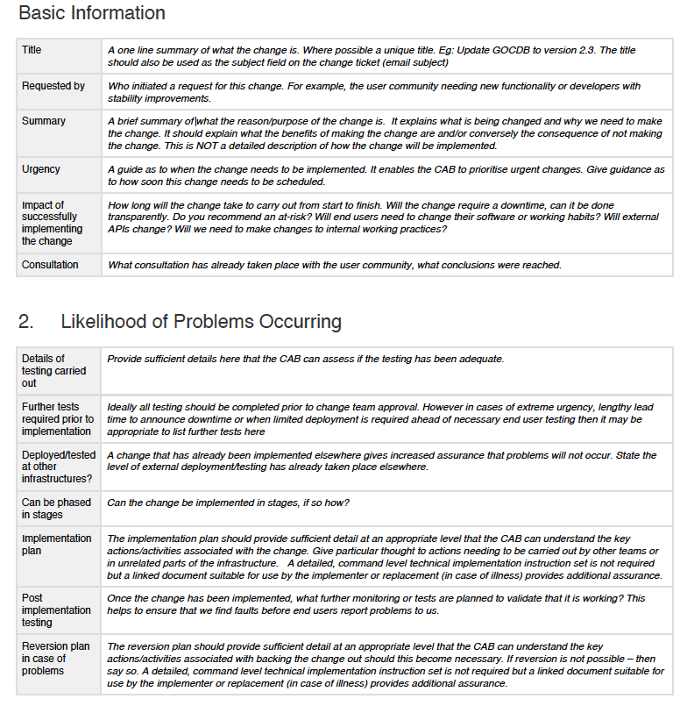
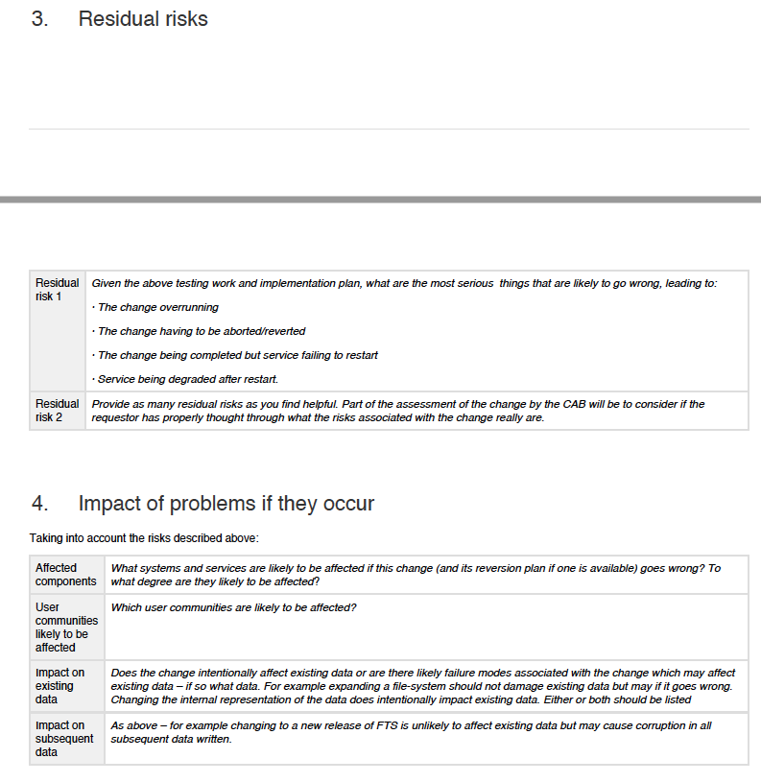
The Request for Change (RfC)

Slide 11
Implementation and links
CHM homepage on the wiki (documentation, policy etc.)
https://wiki.egi.eu/wiki/EGI_Change_Management
New queue for CHM in RT with custom fields (risk, status, date). New RfCs should be submitted to:
change-mgmnt@rt.egi.eu
Service
CAB exists. Initial membership:
Matthew Viljoen (Chair)
Peter Solagna
Tiziana Ferrari
Gergely Sipos
Diego Scardaci
Vincenzo Spinoso
Alessandro Paolini
CAB can meet up monthly, or on-demand to assess changes. Change owner present to introduce change
CAB should be agile, including other experts if helpful

Slide 12
I have a change – what do I need to do?
Change owner:
Download and complete RfC from
https://wiki.egi.eu/wiki/EGI_Change_Management
2. Submit RfCs to:
change-mgmnt@rt.egi.eu
Service owner:
3. Logon to https://rt.egi.eu and open ticket in change-mgmnt queue and scores the risk
4. CAB convenes where change owner presents RfCs. Change is discussed and considered for approval.

