Slide 1
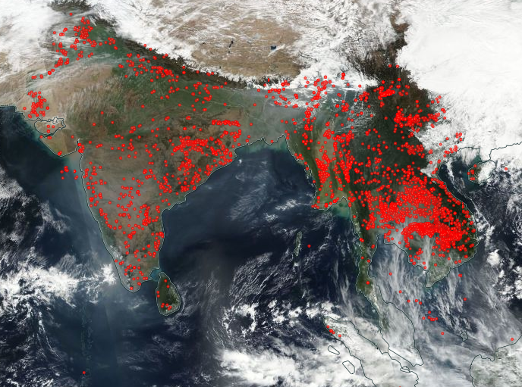
Early Warning System by Forecast Fire Danger Rating System of Thailand and Upper ASEAN and Forest Fire Control in Thailand
Veerachai Tanpipat, D.Eng.
veerachai@haii.or.th &
iamtanpipat@hotmail.com
https://worldview.earthdata.nasa.gov/
Disaster Mitigation Workshop at APAN43 on 15-16 Feb 2017

Slide 2
Contents
What is Early Warning System for Forest Fire?
What is Fire Danger Rating System (FDRS)
Global Fire Early Warning System
ASEAN FDRS System
Forecast Thailand and Upper ASEAN FDRS
6 things that Forest Fire Information System needs to include
Forest Fire Decision Supporting and Management System (FFDSMS)
Conclusions and Challenges
Disaster Mitigation Workshop at APAN43 on 15-16 Feb 2017

Slide 3
Early Warning System for Forest Fire or Wildland Fire (EWS-Fire) is a system that will allow forest fire managers and related people to mitigate fire-related problems, to know fire fuel conditions, to reduce fire suppression costs and to enhance more efficient fire control. Forest and land management agencies, as well as land owners and communities, require early warning of extreme fire danger conditions that lead to uncontrolled wildfires.
Source: Global Fire EWS--http://www.fire.uni-freiburg.de/gwfews/index.html & de Groot et al., 2010

Slide 4
Wagner, V., 1987
Fire danger rating (FDR) is a mature science and has long been used as a tool to indicate the potential of fire start, spread and impact. Fire danger rating is the systematic assessment of fire risk and potential impact, and it is the cornerstone of contemporary fire control and management program.
Source: Global Fire EWS--http://www.fire.uni-freiburg.de/gwfews/index.html & de Groot et al., 2010

Slide 5
Fire Danger Rating System (FDRS):
  Use weather data at noon as inputs (Van Wager, 1987, Lee et al. 2002, Amiro et al., 2004, de Groot et al., 2006, Taylor and Alexander, 2006 and FAO, 2006)
  Temperature
  Humidity
  Wind Speed
  Amount of 24 Hours Precipitation
  CFFDRS software can be downloaded at http://www.lakestatesfiresci.net/SciLibrary/FireDanger.htm and http://rpackages.ianhowson.com/cran/cffdrs/man/fwi.html

Slide 6
Fire Danger Rating information is used for many operational reasons:
to determine suppression resource levels (fire fighters, equipment, helicopters, fixed wing air tankers), mobilization, and strategic prepositioning;
to define safe and acceptable prescribed burn prescription criteria;
to establish fire management budgets based on long-term fire danger statistics; and
to justify increased funding during times of wildfire disaster.
Source: Global Fire EWS--http://www.fire.uni-freiburg.de/gwfews/index.html & de Groot et al., 2010

Slide 7
FDRS History
  Began in U.S. in 1919; Canada in 1925; Russia in 1949
  In Canada began with field data collection of how trees were responded to fire
    Have a system in used in 1960
    in 1987 Van Wagner developed into a better easy to use system
Source: Wildfire Hazards, Risks, and Disasters, Ch. 11 Wildland Fire Danger Rating and Early Warning Systems, William J. de Groot, B. Michael Wotton, Michael D. Flannigan 2015

Slide 8
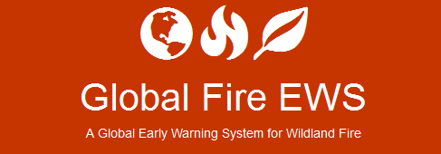
new longer term predictions of fire danger based on advanced numerical weather models
common global fire danger metrics to support international fire management cooperation, including resource-sharing during times of fire disaster
a fire danger rating system for the many countries that do not have a national system in place
Source: Global Fire EWS--http://www.fire.uni-freiburg.de/gwfews/index.html & de Groot et al., 2010

Slide 9
1. Long-term early warning products (or seasonal forecasts) provide an indication of anticipated global trends in fire danger over the course of the upcoming fire season.
2. Medium-term early warning products (1-2 weeks) provide information for large-scale tactical decision-making that requires 'spool-up' time to implement fire management action plans such as arranging the transfer of helicopters, fixed-wing air tankers, or fire fighters and equipment across international borders.
Source: Global Fire EWS--http://www.fire.uni-freiburg.de/gwfews/index.html & de Groot et al., 2010

Slide 10
3. Short-term of 1-5 days provides information for strategic decision-making, such as pre-positioning suppression resources in the most critical areas to most effectively control new fires and contain on-going fires.
Fire danger is calculated with Global Forecast System data from the U.S. National Centers for Environmental Prediction (NCEP) or The European Centre for Medium-Range Weather Forecasts (ECMWF).
Source: Global Fire EWS--http://www.fire.uni-freiburg.de/gwfews/index.html & de Groot et al., 2010

Slide 11
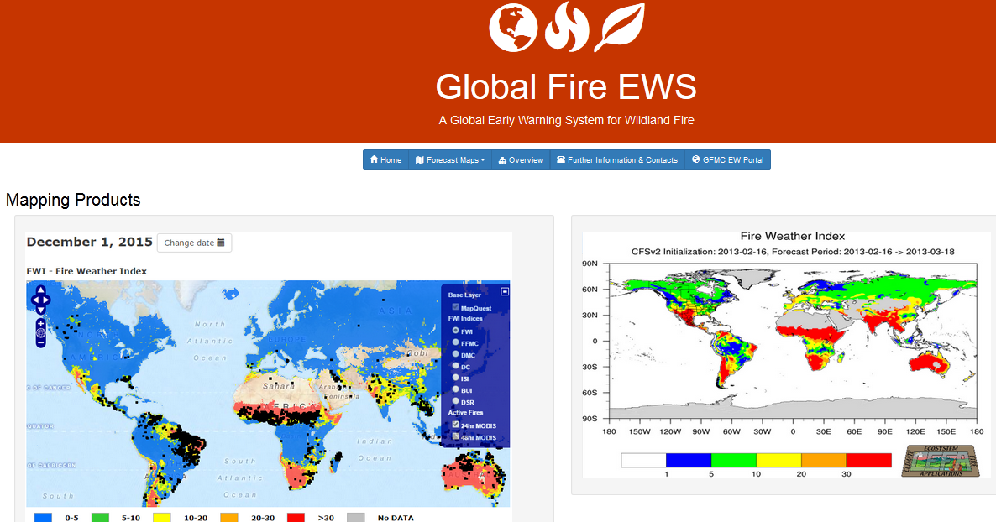
Forecast fire danger provides early warning of future trends in fire potential, allowing fire managers to plan/implement fire control strategies in advance.
Source: http://www.fire.uni-freiburg.de/gwfews/index.html

Slide 12
ASEAN FDRS History
  El Nino 1997-8 caused severe smoke and haze problem in Indonesia and neighboring countries
  ASEAN signed agreement in 2002
  2002-2005 System Development through Canadian Forest Service support
  2006 started running the system at Malaysian Meteorological Department

Slide 13
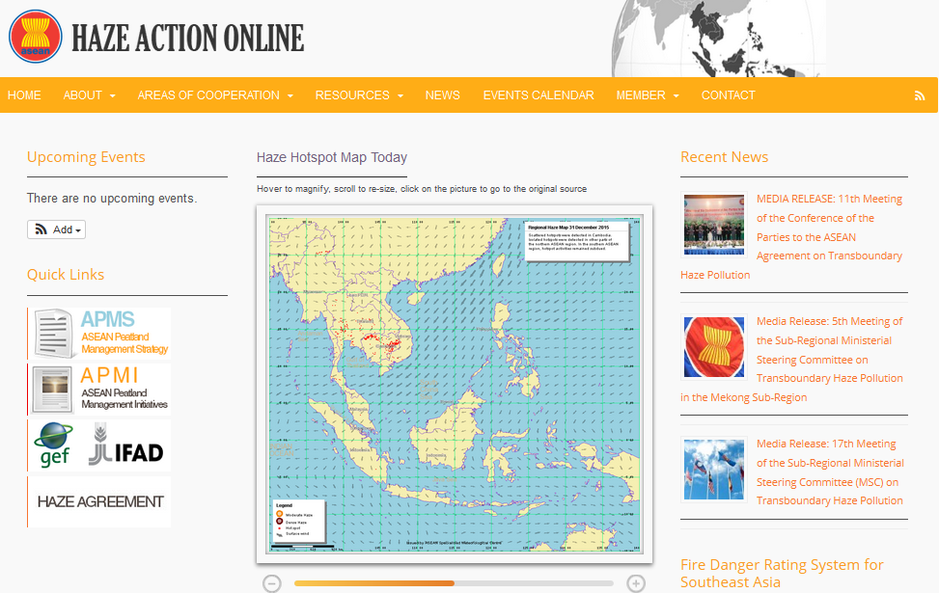
ASEAN System by Malaysian Meteorological Department
Source: http://haze.asean.org/#

Slide 14
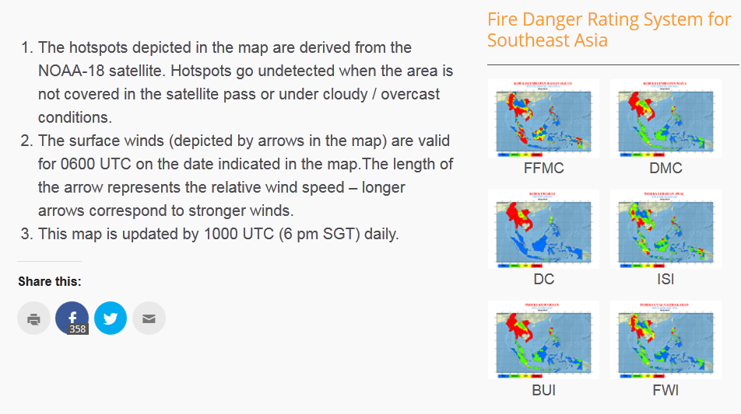
ASEAN System by Malaysian Meteorological Department
Source: http://haze.asean.org/#

Slide 15
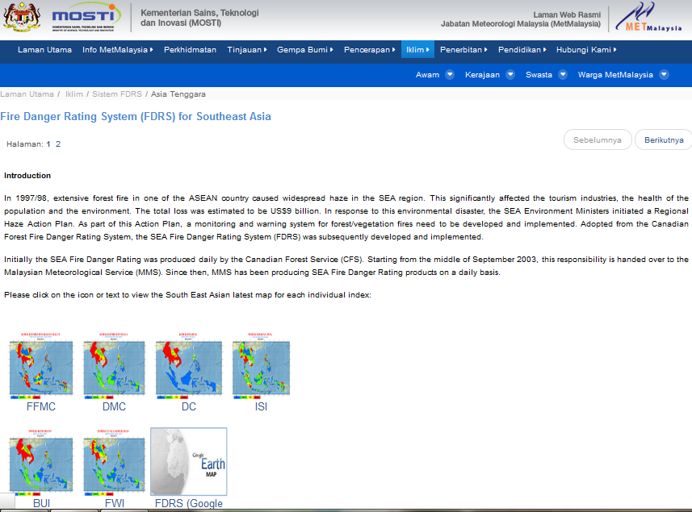
ASEAN System by Malaysian Meteorological Department
Source: http://www.met.gov.my/web/metmalaysia/climate/fdrs/southeastasia

Slide 16
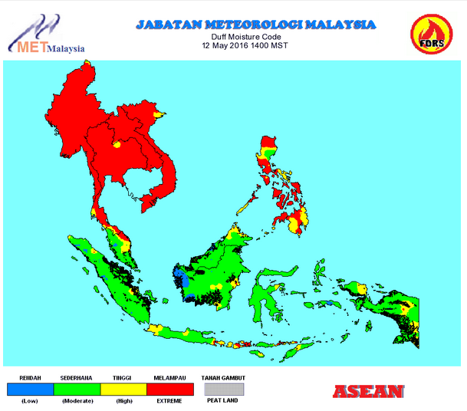
ASEAN System
Source: http://www.met.gov.my/web/metmalaysia/climate/fdrs/southeastasia

Slide 17
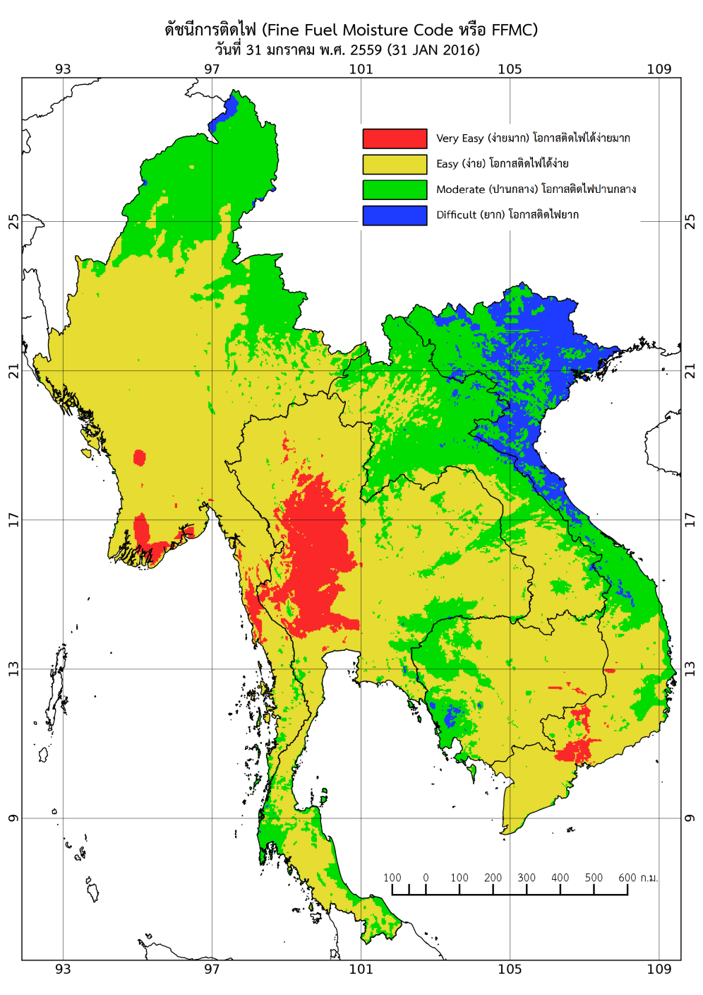
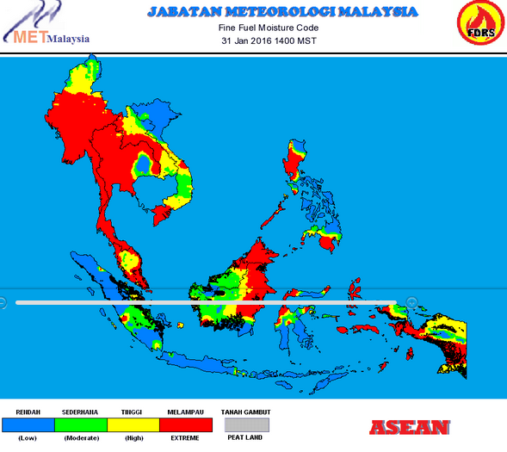
Differences
http://haze.asean.org/fire-danger-rating-system-fdrs-for-southeast-asia/
http://www2.dnp.go.th/gis/FDRS/FDRS.php

Slide 18
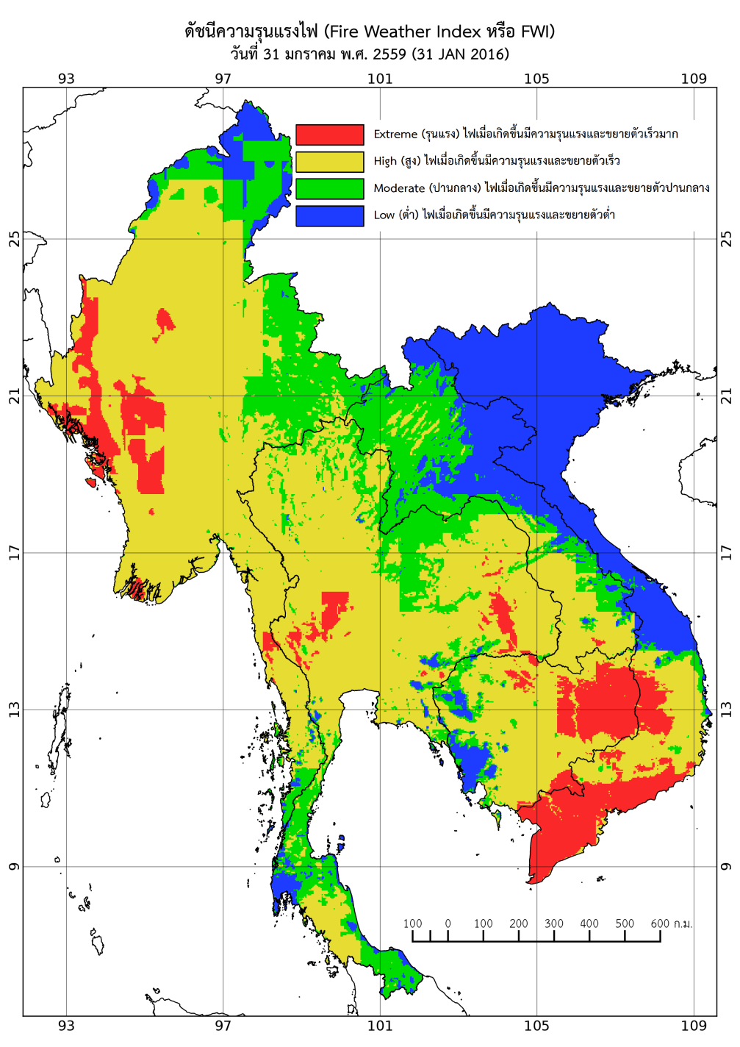
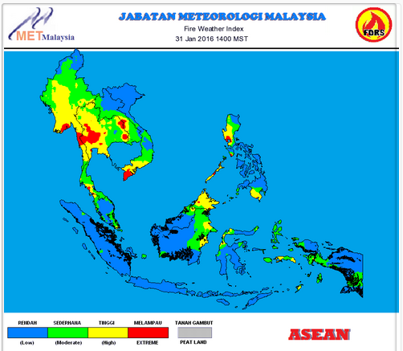
Differences
http://haze.asean.org/fire-danger-rating-system-fdrs-for-southeast-asia/
http://www2.dnp.go.th/gis/FDRS/FDRS.php

Slide 19
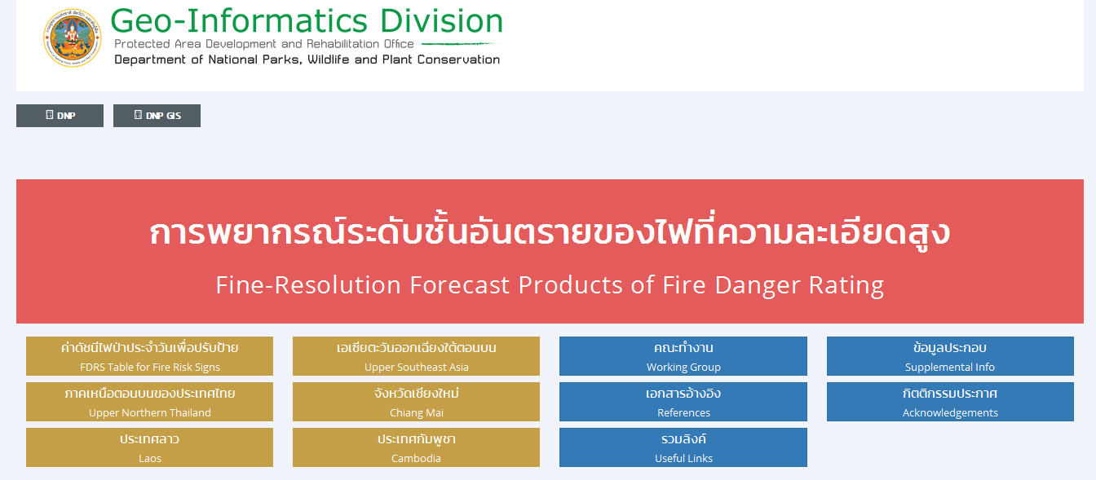

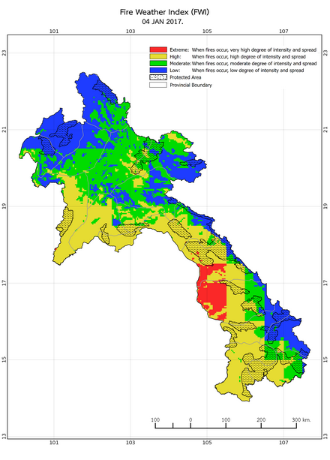
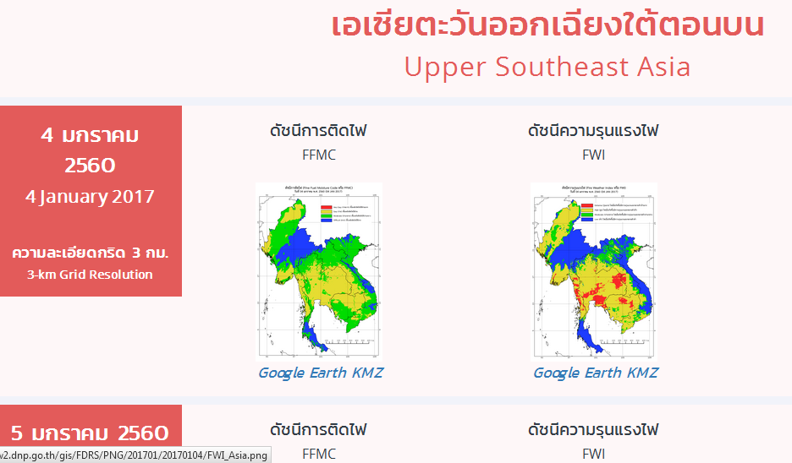
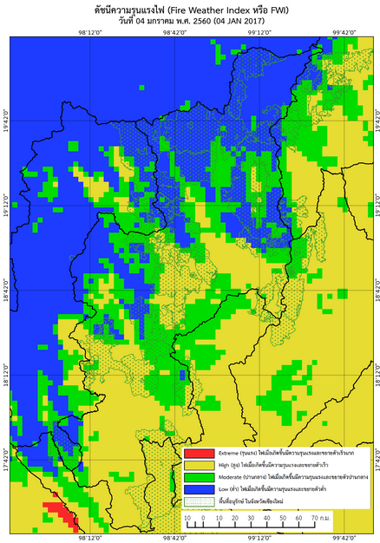
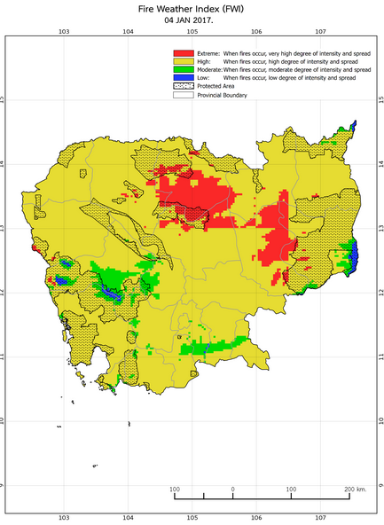
Source: http://www2.dnp.go.th/gis/FDRS/FDRS.php
http://www2.dnp.go.th/gis/FDRS/FDRS.html
Manomaiphiboon, K., Tanpipat, V., Nhuchaiya, P., Jaroonrattanapak, N., 2015

Slide 20
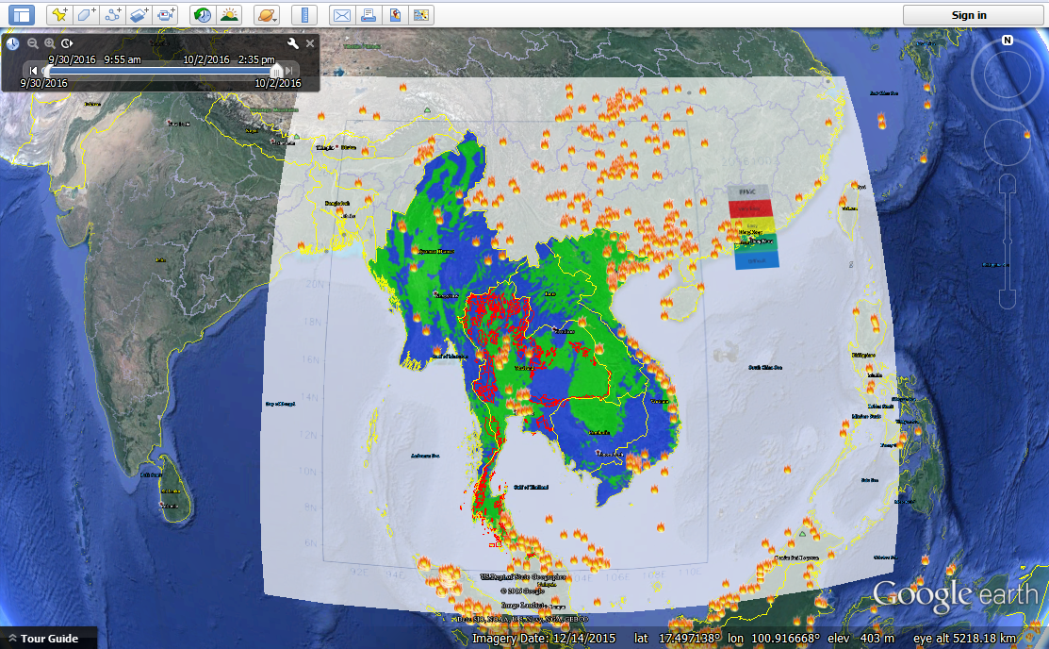
Combining forecasted fire danger maps with historical fire hotspots will indicate critical areas where serious fire problem will occur if current fire activity persists.

Slide 21
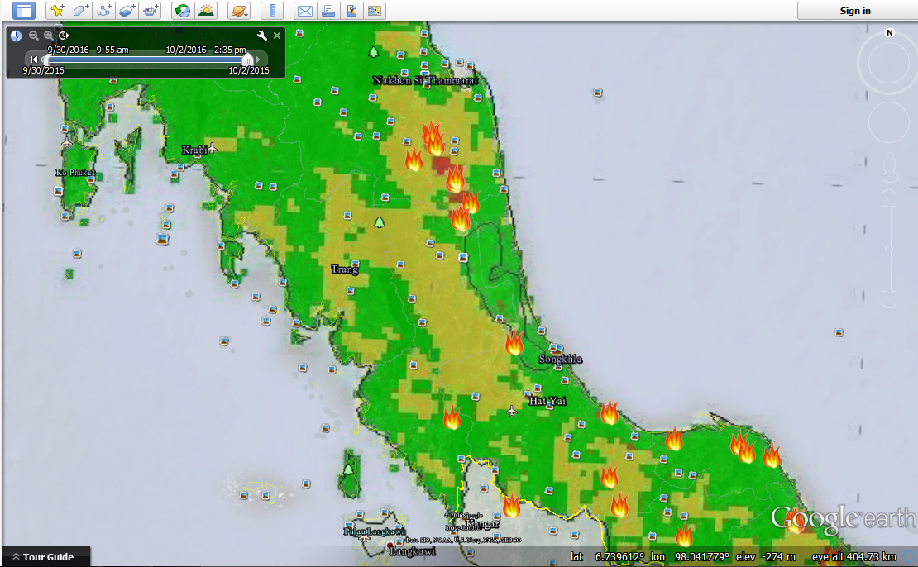
Using FWI with fire hotspots on Google Earth
2 October 2016

Slide 22
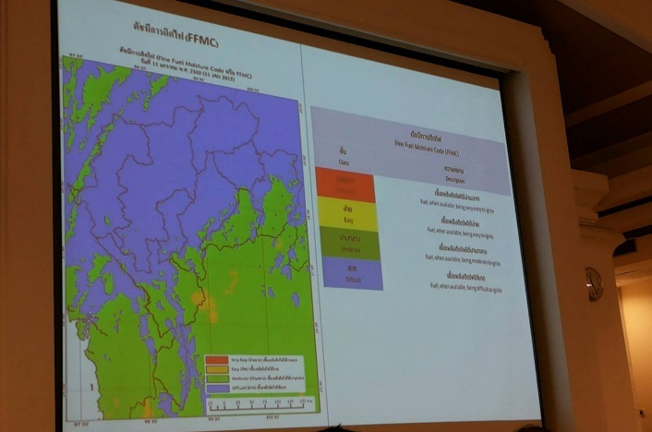
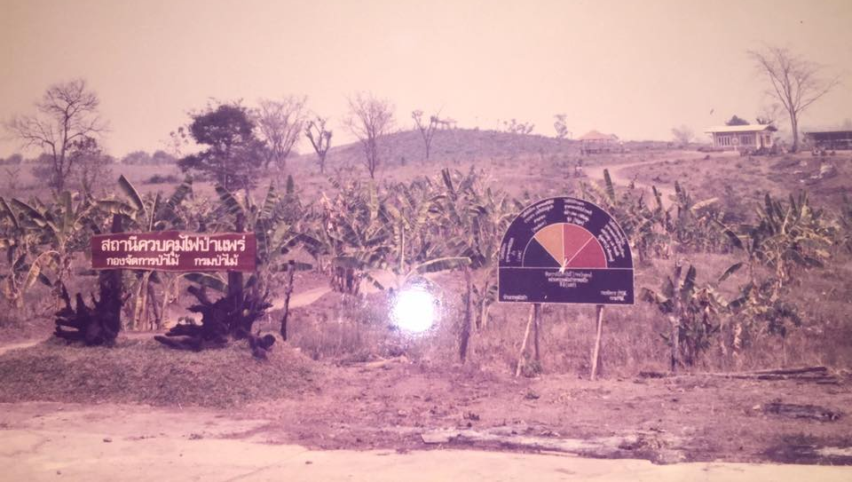
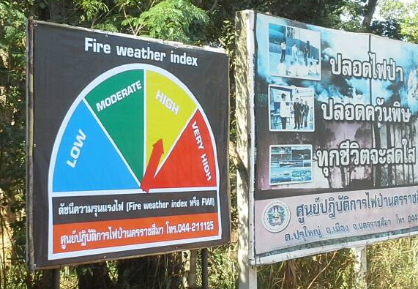
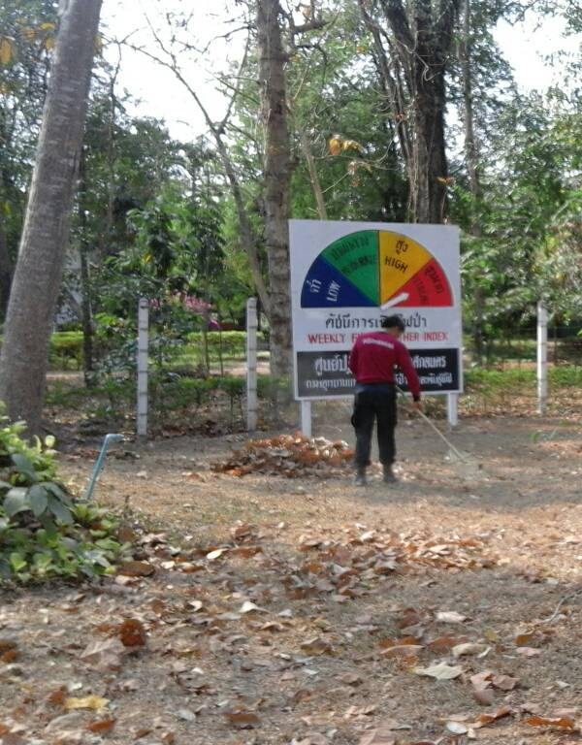
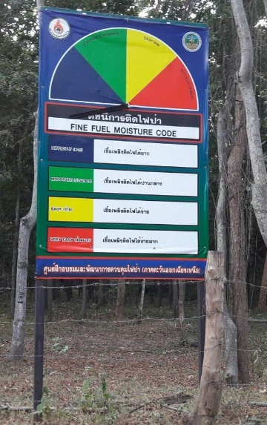
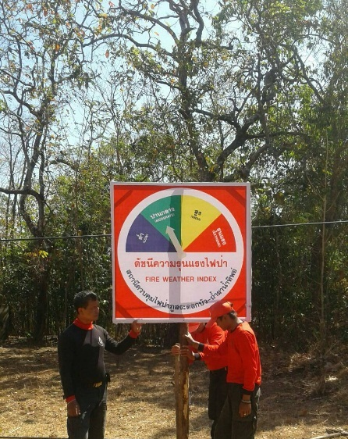
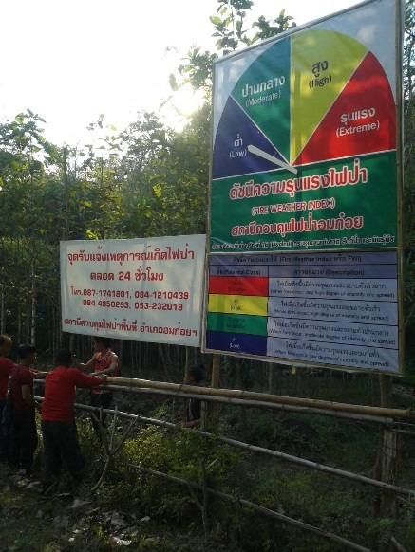
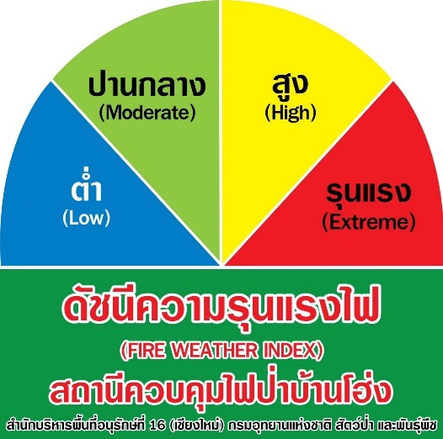
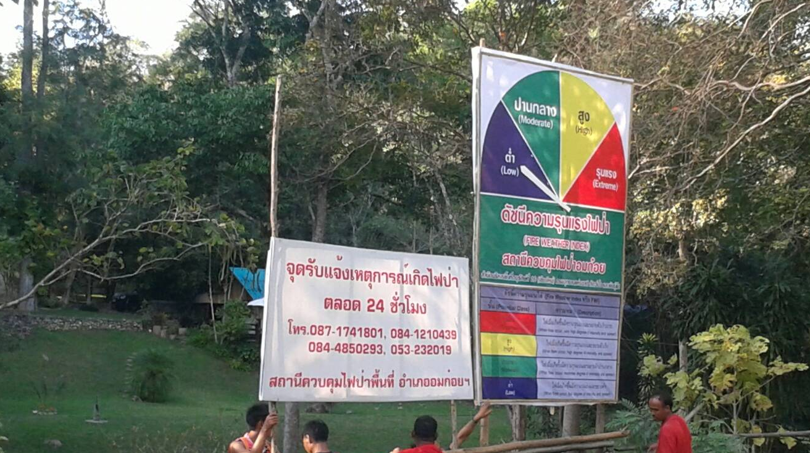
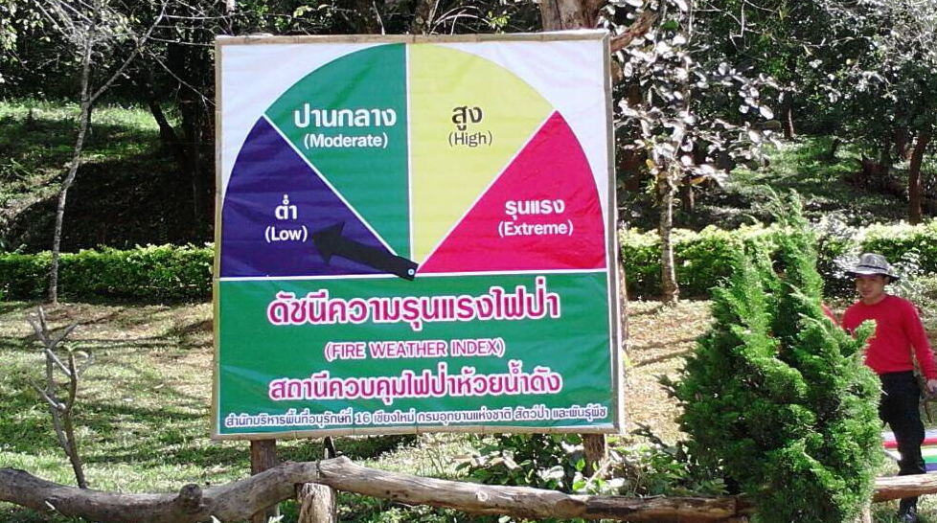
สกลนคร

Slide 23
What we need to cover in order to deal with Natural Disasters, especially forest fires?
6 Basic steps you have to do:
Prevention
Monitoring
Prediction (Forecasting, Modeling)
Warning
Response
Recovery, Assessment, Mitigation

Slide 24
What we need to cover in order to deal with Natural Disasters, especially forest fires?
Prevention
  Rising Awareness through
    Public Relation and Propaganda
    Training
    Fire break activities with locals
  Community Based Fire Management (CBFiM)
  Etc.

Slide 25
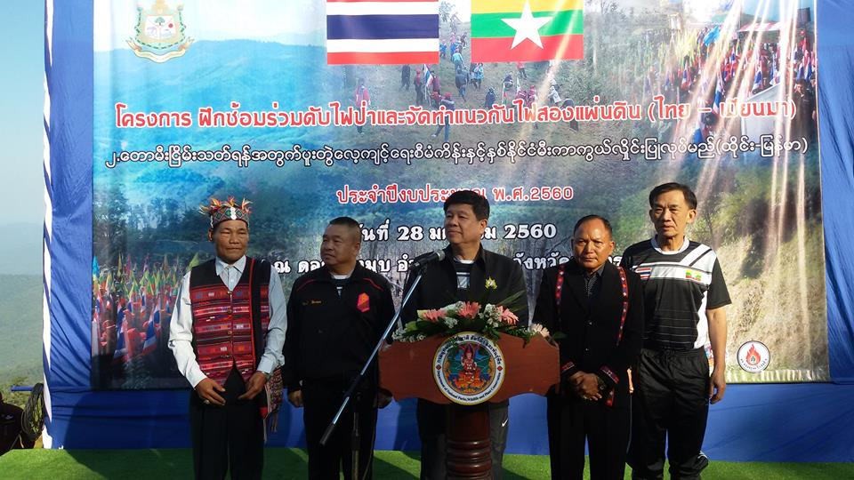
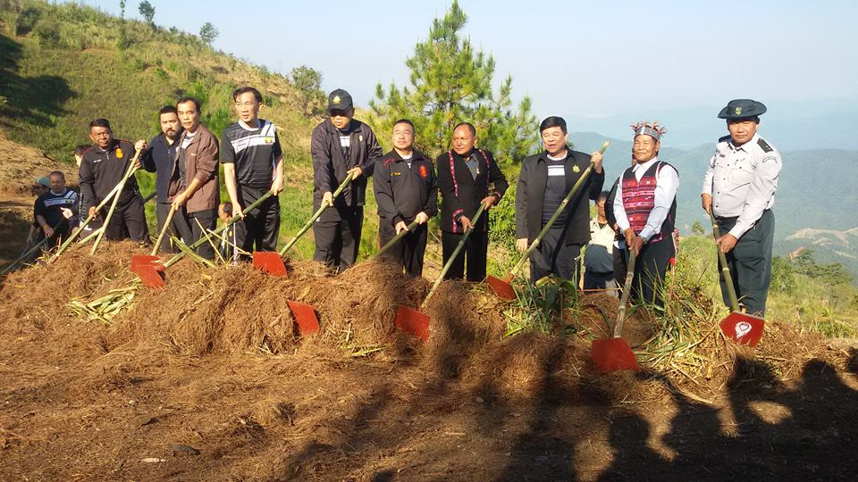
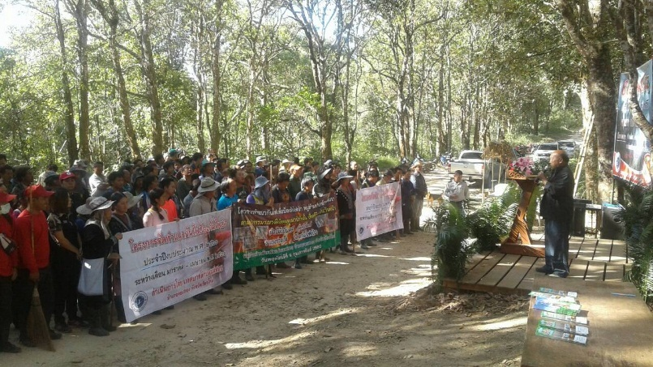
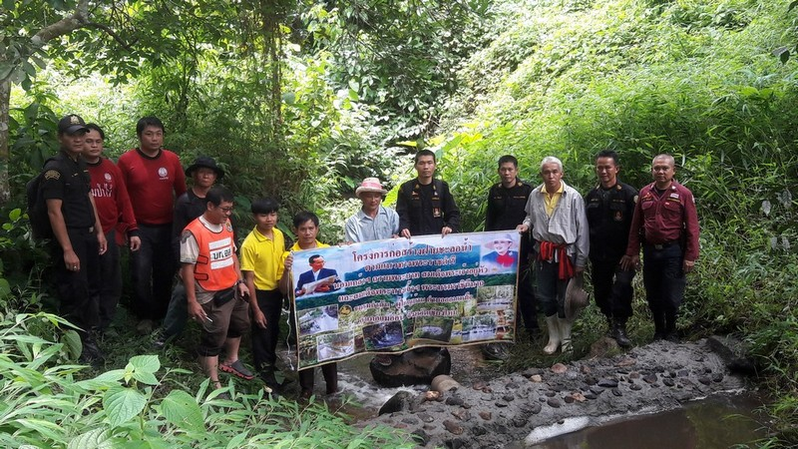
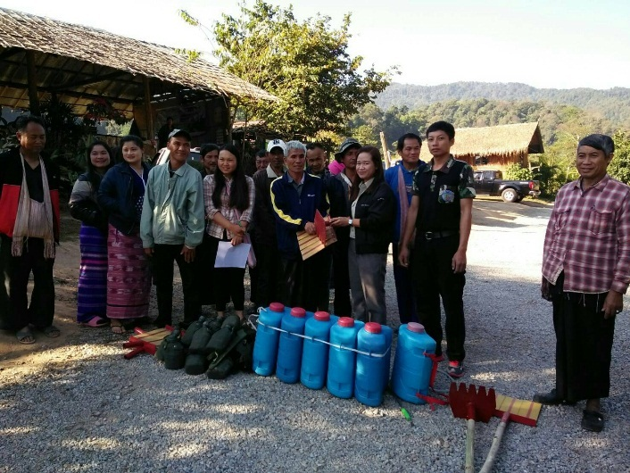
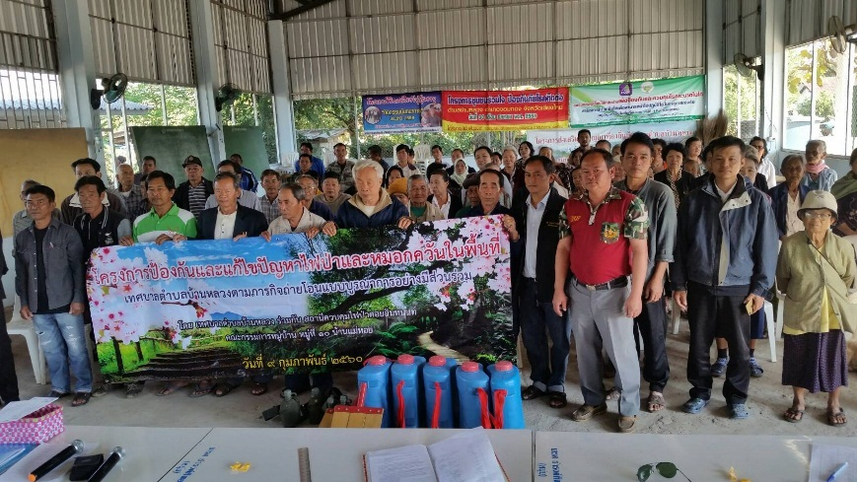
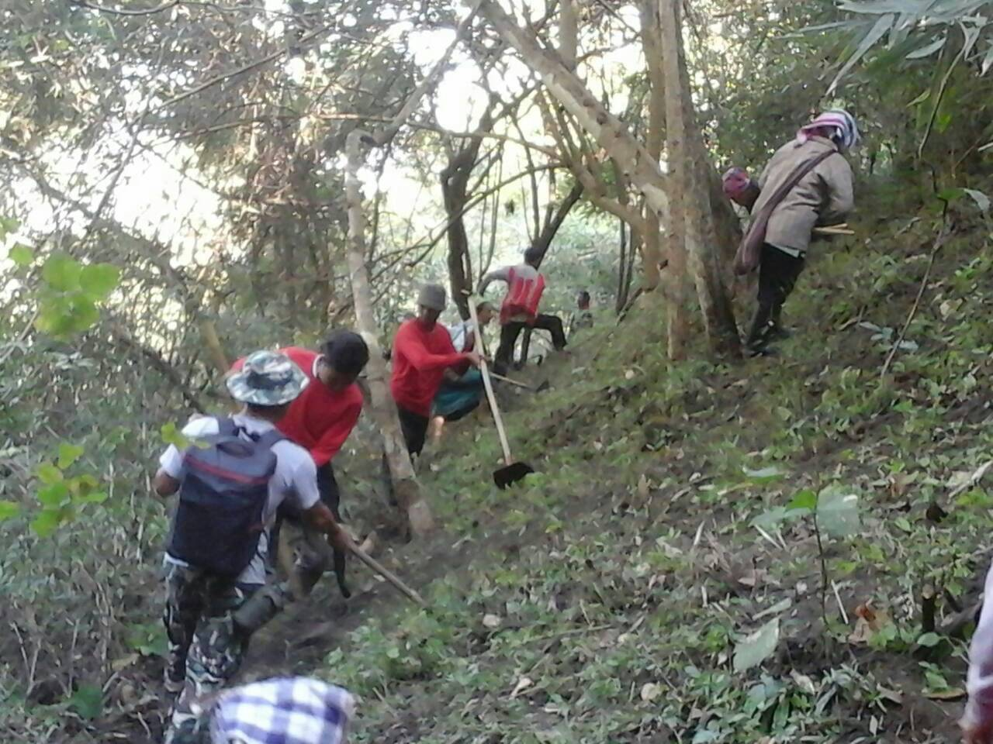
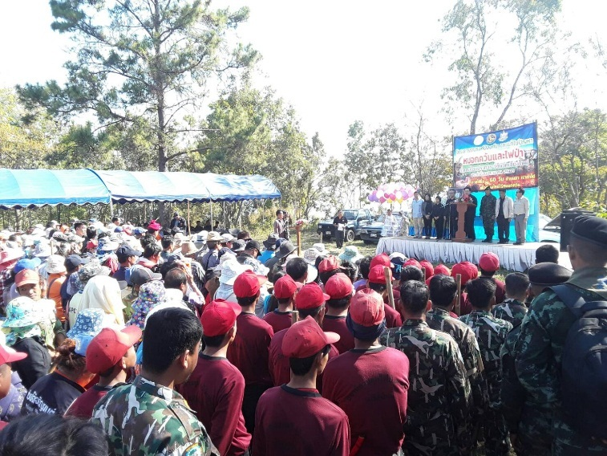
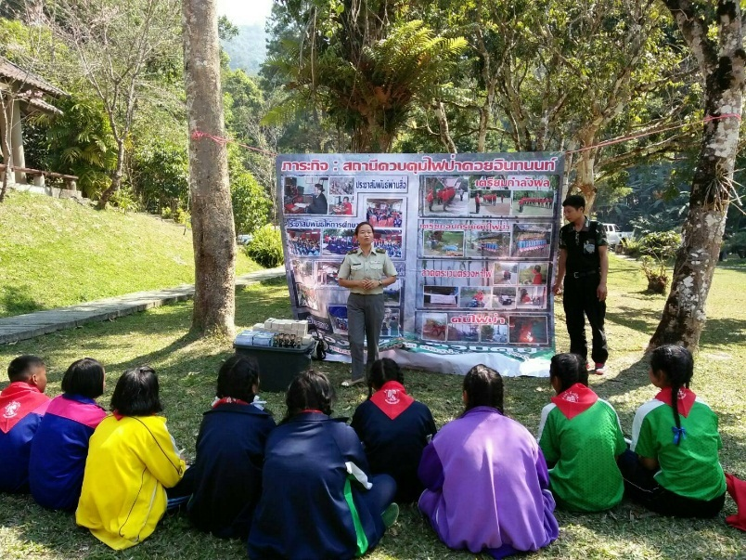
Prevention

Slide 26

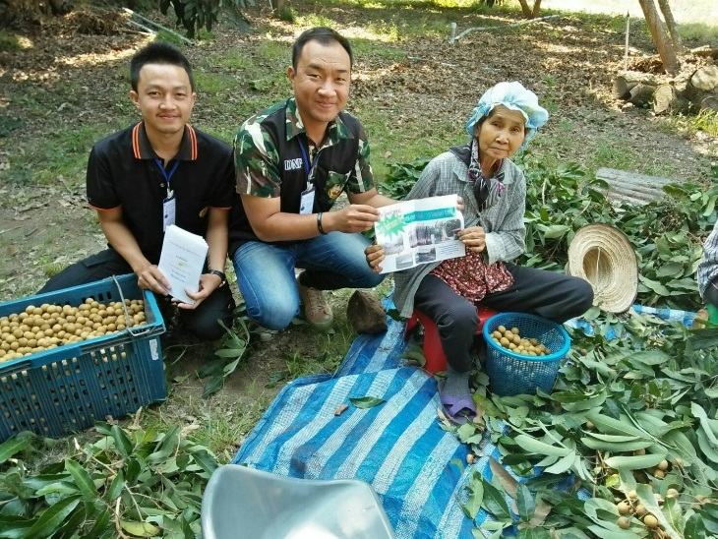

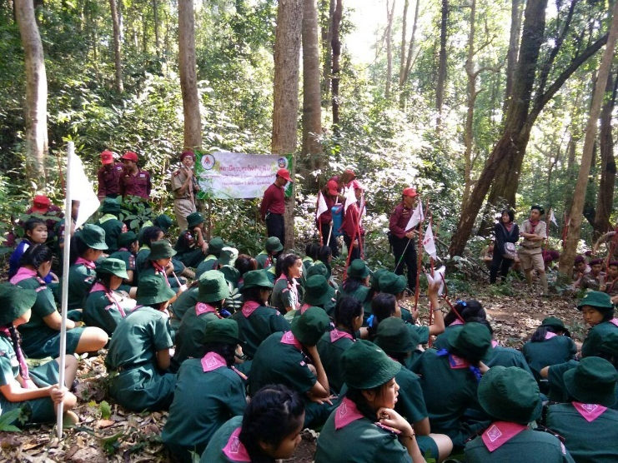
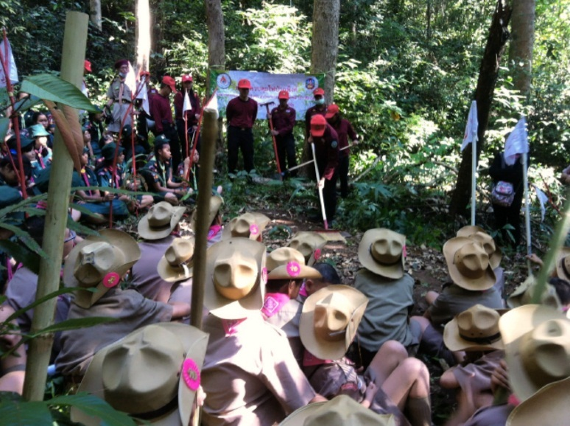
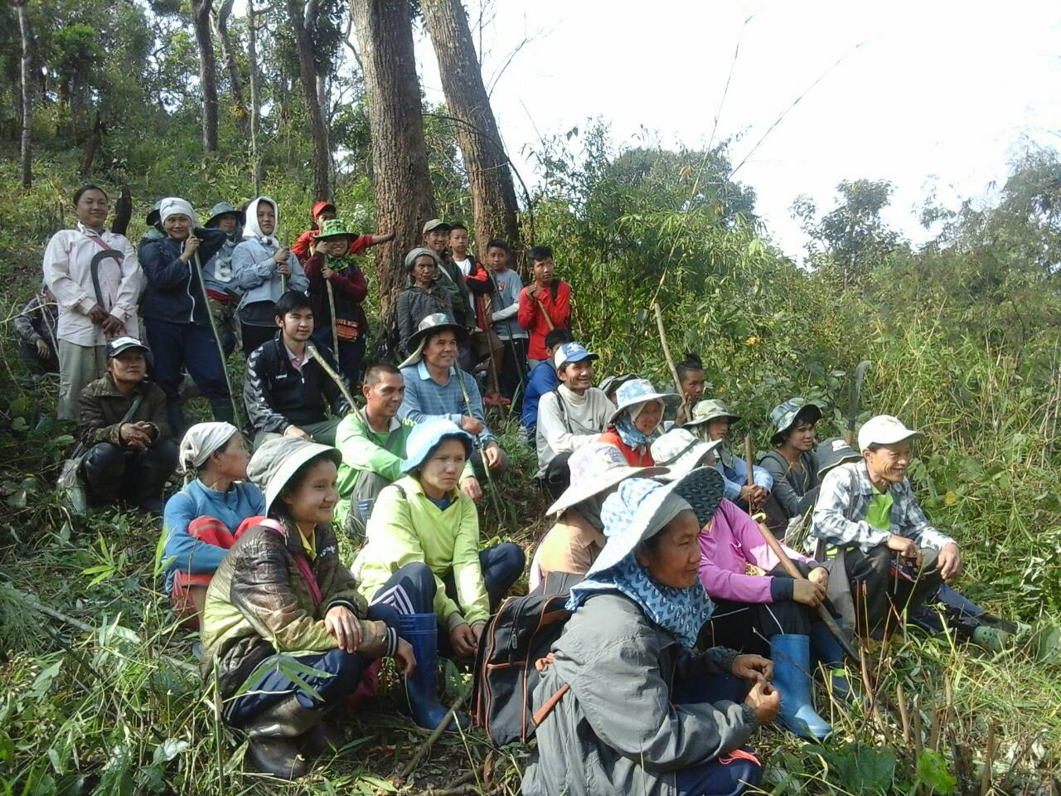
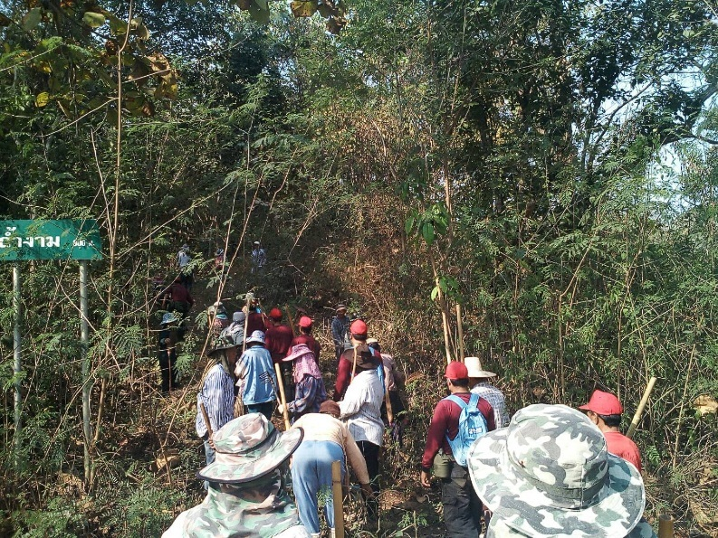
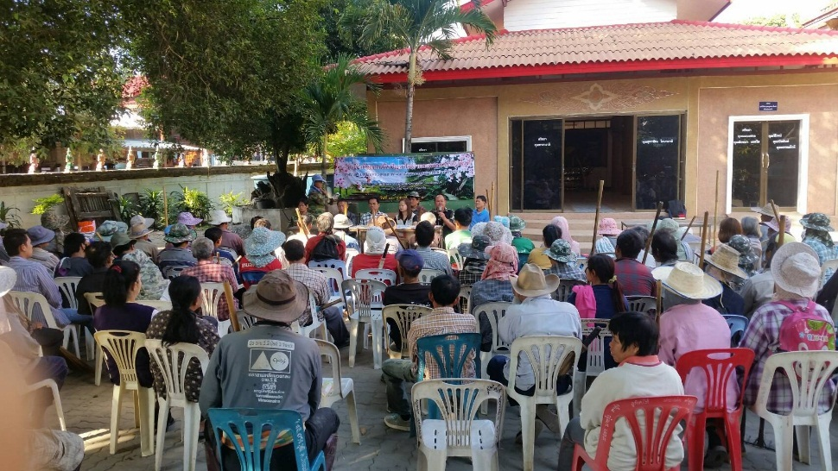
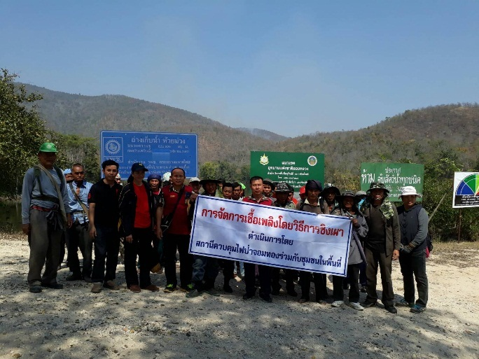
Prevention

Slide 27
What we need to cover in order to deal with Natural Disasters, especially forest fires?
Monitoring
  Watch-out tower, different vehicles (car, SUV, motorcycle, and bicycle), helicopters, fixed wings, EOS, UAV (unmanned aircraft vehicle), CCTV with both visible and thermal infrared camera
  Public Network
  Etc.

Slide 28
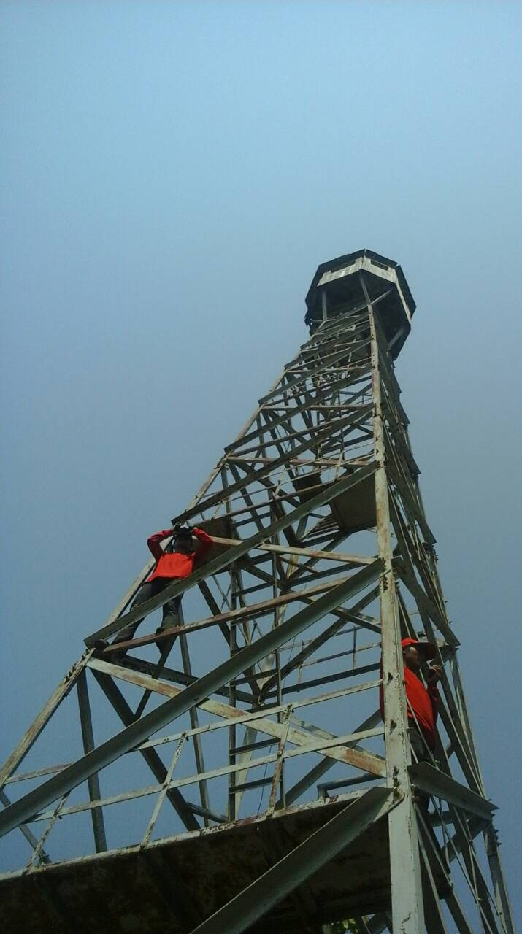
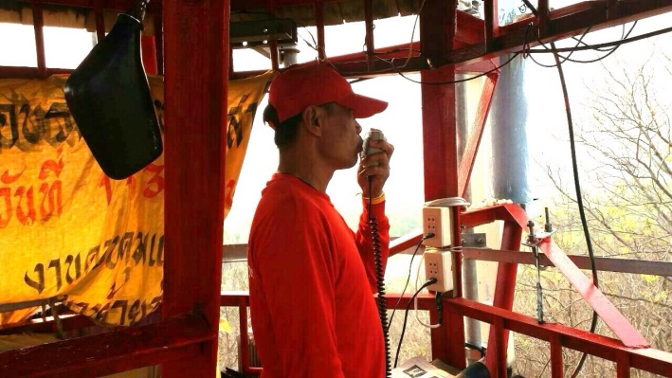
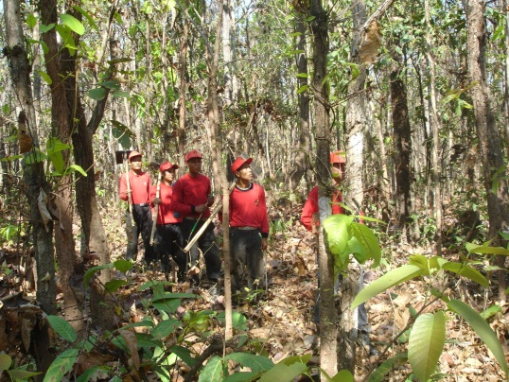
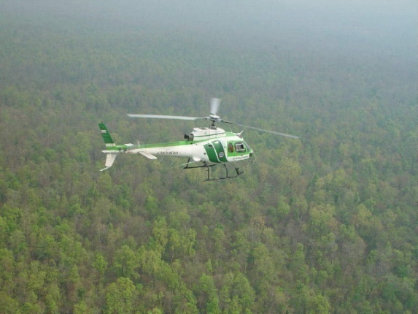
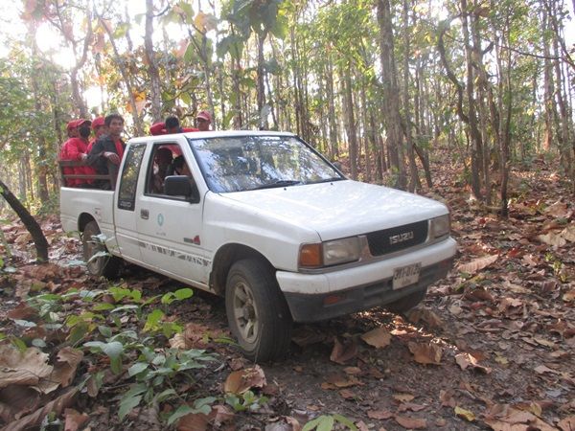
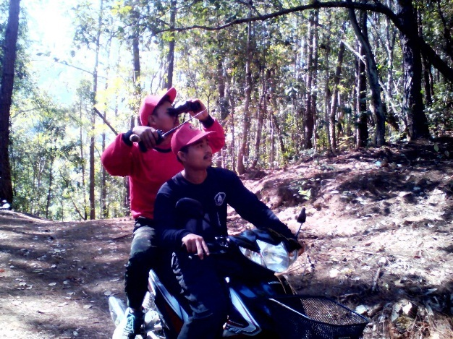




Monitoring tools
Public Report
1362

Slide 29




HKK Wildlife Sanctuary

Slide 30


Slide 31




CCTV System
Source: http://www.fire.uni-freiburg.de/iffn/country/pt/pt_4.htm

Slide 32



Source: http://hopewish.en.made-in-china.com/product/AqkmbTocYwUf/China-Fire-Alarm-System-Thermal-Imaging-Camera.html
Thermal and Visible Camera
Source: http://www.insightrobotics.com

Slide 33




Unmanned Aircraft Vehicle
Source: https://www.icarus.upc.edu/ en/research/unmanned-aerial-systems-uas

Slide 34




UAV
Source: http://www.interpine.co.nz/news/default.aspx

Slide 35



EARTHDATA Fire Information for Resource Management System
Source: https://firms.modaps.eosdis.nasa.gov/

Slide 36

Source: https://worldview.earthdata.nasa.gov/

Slide 37


Flow Chart of Thailand Fire Danger Rating System and Fire Hotspot

Slide 38



Daily report to the main forest fire control task forces by using rapid and daily fire hotspot alert emails, www FDRS, and a smart phone applications (e.g. LINE) by Department of National Park, Wildlife and Plant Conservation (DNP)
A Daily Report by DNP
Which forest fire control responsibility!
Where?
Source: http://portal.dnp.go.th/

Slide 39






Chiangrai Hotspot & Early Burning Application
Sirimongkonlertkun, N. and Yanawongsa, E., 2016

Slide 40



Monitoring Transport of Biomass Burning Aerosols
Himawari-8 Geostationary Monitoring
http://www.data.jma.go.jp/mscweb/data/himawari/sat_img.php?area=se1
http://www.highfirerisk.com.au/imr/Thai_H8_01.htm
Rick McRae, Risk Analyst, Emergency Management, Risk and Spatial Services, ACT Emergency Services Agency, Australia
http://realearth.ssec.wisc.edu/
Notes:
Recent advances in the US (NRL/NOAA) NRT monitoring of fire aerosols

Slide 41
What we need to cover in order to deal with Natural Disasters, especially forest fires?
Prediction (Forecasting and Modeling)
  Smoke and haze monitoring and forested system (7 SEAS and ECMWF-CAMS, Himawari-8)
  Early Warning System for fire (EWR-Fire) based on Fire Danger Rating System (FDRS) such as GFEWS, EFFIS, UATFFDRS, INFFDRS
  Etc.

Slide 42

Smoke and Haze Monitoring By 7 SEAS
Source: http://www.nrlmry.navy.mil/aerosol_web/7seas/7seas.html
Notes:
Recent advances in the US (NRL/NOAA) NRT monitoring of fire aerosols

Slide 43

Forecasted Smoke and Haze By 7 SEAS
Aerosol Optical Depth
24-30 April 2016
Source: http://www.nrlmry.navy.mil/aerosol_web/7seas/7seas.html
Notes:
Recent advances in the US (NRL/NOAA) NRT monitoring of fire aerosols

Slide 44


Forecasted Smoke and Haze By 7 SEAS
18-22 April 2016
25-29 April 2016
Source: http://www.nrlmry.navy.mil/aerosol_web/7seas/
Notes:
Recent advances in the US (NRL/NOAA) NRT monitoring of fire aerosols

Slide 45


Fire Radiative Power – Aerosol Optical Depth
by Copernicus Atmosphere Monitoring Service (CAMS) and
Copernicus Climate Change Service (C3S), implemented by ECMWF.
Source: http://macc.copernicus-atmosphere.eu/d/services/gac/nrt/fire_radiative_power!SE%20Asia!Fire%20Radiative%20Power!macc!od!enfo!fire_radiative_power!2017020700!/
Source: http://www.gmes-atmosphere.eu/d/services/gac/nrt/nrt_opticaldepth!03!Total!SE%20Asia!macc!od!enfo!nrt_opticaldepth!2016121400!!/
Notes:
Recent advances in the US (NRL/NOAA) NRT monitoring of fire aerosols

Slide 46

Forecast Fire Danger Rating for Upper ASEAN and Thailand
Source: http://www2.dnp.go.th/gis/FDRS/FDRS.php/

Slide 47
What we need to cover in order to deal with Natural Disasters, especially forest fires?
Warning FIRMS active fire or fire hotspot alert emails:
  Review historical fire related by EOS directly in WorldView for overall situation
  Forecast Fire Danger Rating System (FDRS)
  Risk maps
  Daily fire fuel survey
  Weather condition
  Fire Radiative Power
  Etc.

Slide 48









Smoke and haze caused by fires in Maechaem area during 16 – 24 April 2016
16 April
17 April
18 April
19 April
20 April
21 April
22 April
23 April
24 April
Source: https://worldview.earthdata.nasa.gov

Slide 49





Fire Weather Index
Source: http://www2.dnp.go.th/gis/FDRS/FDRS.php/

Slide 50

New calibrated Thresholds being used by Global Fire EWS for upper ASEAN (Bill De Groot & Alan Cantin, Natural Resources Canada, Canadian Forest Service) with Global FWI Monthly Forecast for 9 Months for Planning Prescribe Burning and Others
Source: http://www.cefa.dri.edu/CFS/fwi.php and : http://www.fire.uni-freiburg.de/gwfews/forecast_ews.html

Slide 51

Global Wildfire Information System by The European Forest Fire Information System (EFFIS)
Source: http://forest.jrc.ec.europa.eu/effis/applications/global-viewer/

Slide 52

  Weather (wind, precipitation, etc.)
    Windyty (http://www.windyty.com)

Slide 53



Fire Radiative Power
Mark Parrington, ECMWF, 2017
Source: http://www.gmes-atmosphere.eu/d/services/gac/nrt/fire_radiative_power/

Slide 54
What we need to cover in order to deal with Natural Disasters, especially forest fires?
Response
  Forest fire suppression units
  Related agencies and collaborated local communities
  Etc.

Slide 55






Slide 56
What we need to cover in order to deal with Natural Disasters, especially forest fires?
Recovery, Assessment and Mitigation
  Burn Severity Index (BSI)
  Burn Area
  Emissions
  Reforestation
  Public Relation
  Etc.

Slide 57

Burned Areas Detection using Burn Severity Index (BSI)
Ken Brewer and Carl Albury, 2015

Slide 58



Source: http://apps.ecmwf.int/datasets/data/cams-gfas/
Emissions
Source: http://www.globalfiredata.org/index.html

Slide 59
Fire Decision Support System (FDSS)
GIS
RS
Socioeconomics, social dimension
maps, statistics, weather, models, topographic maps
EOS imageries, weather, climate, monitoring, detection, condition,
FDSS
GPS
ICT
Communication technologies, related information & knowledge (research, publication,
Location identifying technologies, accuracy, GNSS

Slide 60

Source: http://cwfis.cfs.nrcan.gc.ca/home

Slide 61
  Conclusions and Challenges
  Need to combine and integrate Lower and Upper ASEAN FDRS together in order to complete the SEA regional picture
  Need to put fire early warning (Forecast FDRS) information into a forest fire planning process and daily forest fire control activities
  Need to develop better accuracy high resolution medium range weather forecast inputs (DA and Ensemble) for FDRS
  Need to have reliable and scientific proved Fire Decision Support System (FDSS) e.g. CWFIS
Disaster Mitigation Workshop at APAN43 on 15-16 Feb 2017

Slide 62
  Conclusions and Challenges
  Need a full cooperation and supports from ASEAN forest fire agencies, people and related
  Need to accept, in Asia, the main cause of fires is “Human,” all advance information or system will mean nothing if we do not solve the real cause, so NEED to make people realize and concern how worse the smoke can do to them and their families!!!!! Moreover, need to provide other without fire alternatives for them to earn a living!
  Need to find easier and simpler communication schema to deliver scientific information.
Disaster Mitigation Workshop at APAN43 on 15-16 Feb 2017

Slide 63
Acknowledgements
Dr. Jeff Schmaltz (NASA/GSFC-LANCE-Rapid Response),
Dr. Diane Davies (NASA-LANCE Operation Manager),
Prof. Dr. Johann Goldammer (GFMC, U. of Freiburg),
Dr. Robert Field (Columbia University, NASA GSFC),
Dr. Bill De Groot (NRCAN-Canadian Forest Service),
Mr. Rick McRae (ACT Emergency Services Agency),
Ms. Minnie Wong (WorldView, NASA-EarthData),
Ms. Anja Hoffmann (GOLD-GOFC Coordinator),
Dr. Jeff Reid and Dr. Edward Hyer (Naval Research Laboratory),
Dr. Mark Parrington (ECMWF)
Dr. Kaseamsan Manomaipiboon (JGSEE),
Dir. Siri Akkakara, Dir. Manus Panmon, Dir. Suraphol Leerawaropat (DNP), Mr. Prayoonyong Nuchaiya and Mr. Narin Jaroonrattanapak (DNP)
Disaster Mitigation Workshop at APAN43 on 15-16 Feb 2017

