Slide 1
Automated Weather and Environment sensor for firewatch in Indonesia
basuki@itb.ac.id
Insitut Teknologi Bandung, ID

Slide 2
Background
Fire in the forestry
No AWS
No sensor connected
The MODIS Data came from satellite, within 24 hours
Land Clearing on Coconut palm oil plantation
More than 10 Million Hectar on Indonesia

Slide 3
Firewatch in Forestry
Iniatiatited by Ministry of Forestry in the early 2001
In 2009 collaboration between Indonesia and Australia (Landgate) for reducing the fire and hazard smoke
Ministry of Forestry , Ministry of Environment and Indonesia National Insitute of Aeronautics and Space (LAPAN)
Australia , LANDGATE
Deliver the Data from satellite through Network (Inherent/NREN in 2010 – 2012)
Ministry of National Education
In 2014
Burning from the Land in Sumatra and Kalimantan causes the smoke to other country
In 2015
Burning from the peatland effected half of the world

Slide 4
Firewatch Initiatives
Ministry of Forestry and LAND-gate Australia
MODIS-Data from NASA
Collaboration Ministry Forestry with Ministry of Education (2010) for delivering the Hotspot information (Fire) through the Inherent (University of Palangkaraya and University of Riau )
In 2015, ITB initiatives again for firewatch
Data Analysis through satellite
Sosialize the environment impact through the social media (Facebook/twitter)
Prevent air filter system solution in classroom
In 2016
Prevent initiatives for building the near realtime model with Authomatic Weather System and Environment Sensor

Slide 5
Google with KML’s data from MODIS NASA
Confidence level :100 %
https://earthdata.nasa.gov/earth-observation-data/near-real-time/firms/active-fire-data

Slide 6
Earth.nullschool.net
The Fire affected by the Wind direction and speed
The indicators :
COsc , Carbon Monoxide surface concentration
Wind directions and speed
a visualization of global weather conditions forecast by supercomputers updated every three hours
Good as a models
Need more precise informartion on the location affected
CO : 3424 ppbv

Slide 7
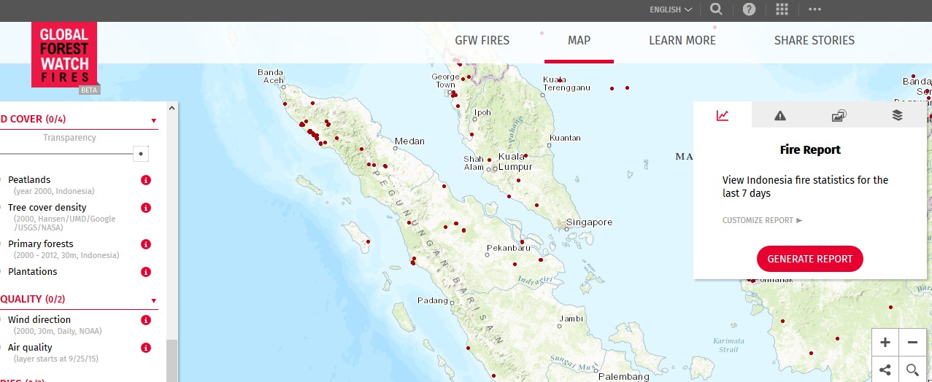
Global Firewatch
Special report for Indonesia(everyday) → 15/02/2017

Slide 8
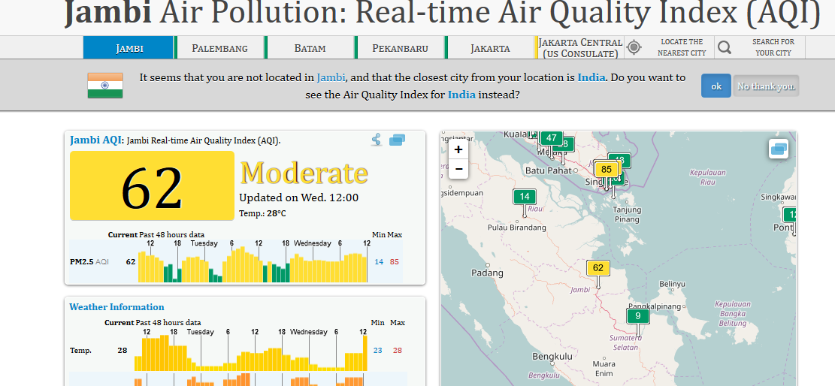
PM2.5 and PM10 sensor
Data : API
http://aqicn.org/city/indonesia/jakarta/us-consulate/south/

Slide 9
IDeate
By combining the satellite data with meteorological records, Field established that Indonesian fires often occur in association with the ultra-dry conditions in the region that accompany El Niño, a major cyclical weather system. These dry out the underlying peat to the point at which it can catch fire and can’t be extinguished until monsoon rains arrive months later. A next step might be to refine the predictions further by including the combined effects of high temperatures and low humidity on peat moisture, says Field.
He also found that less than 4 millimeters of rain per day during the annual dry season, from August to November – combined with El Niño conditions – seems to be a “tipping point” beyond which fires can to suddenly take off.
https://www.newscientist.com/article/2099496-indonesian-fires-sent-huge-smoke-plume-halfway-around-the-globe/?utm_medium=Social&utm_campaign=Echobox&utm_source=Facebook&utm_term=Autofeed&cmpid=SOC%7cNSNS%7c2016-Echobox#link_time=1470082665

Slide 10
Define
What we (Indonesia) need it ?
Automated Weather Station
Rainfall
Temperature
Humidity
Air quality Index and Polution Standard index measurements
NOx, SOx , CO , NH3 , O3 and PM 2.5 (10)
Sensors and sensors network
Prediction models
Socialize to peoples
https://en.wikipedia.org/wiki/Pollutant_Standards_Index

Slide 11
Contraints/obstacle
In the field
There is no power
Limited converage by telecommunications system
No sensor available
Source of the fire
More than 50 km from nearest

Slide 12
Build Prototype
Build prototype for AWS+sensor base on Arduino
Board (I/O)
Communication
GSM/GPRS/Wifi
Ethernet
USB/Storage System
Sensors
Temperature
Wind speed
Wind direction
Humidity
Rainfall rate
CO
Particulate Matters 2.5 and 10 Micron
CH4 ?
Develop Service Oritented Services (SOA) for the
Put the AWS in the area with near forestry/ peatland

Slide 13
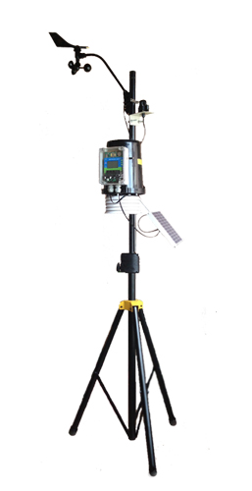
Prototype 1.0
Forestry (School)
GSM/GPRS Modul
TCP/IP
ITB
Web Server
For collecting data
And
Portal
Arduinno
Microcontroller
GPS modul
AWS
-Wind Direction
-Wind speed
-Temperature
Humidity
Rain fall
USB /Storage
CO sensor
And other sensors
Middle Ware
Network of Science Community
NASA/NOAA web server ,etc

Slide 14
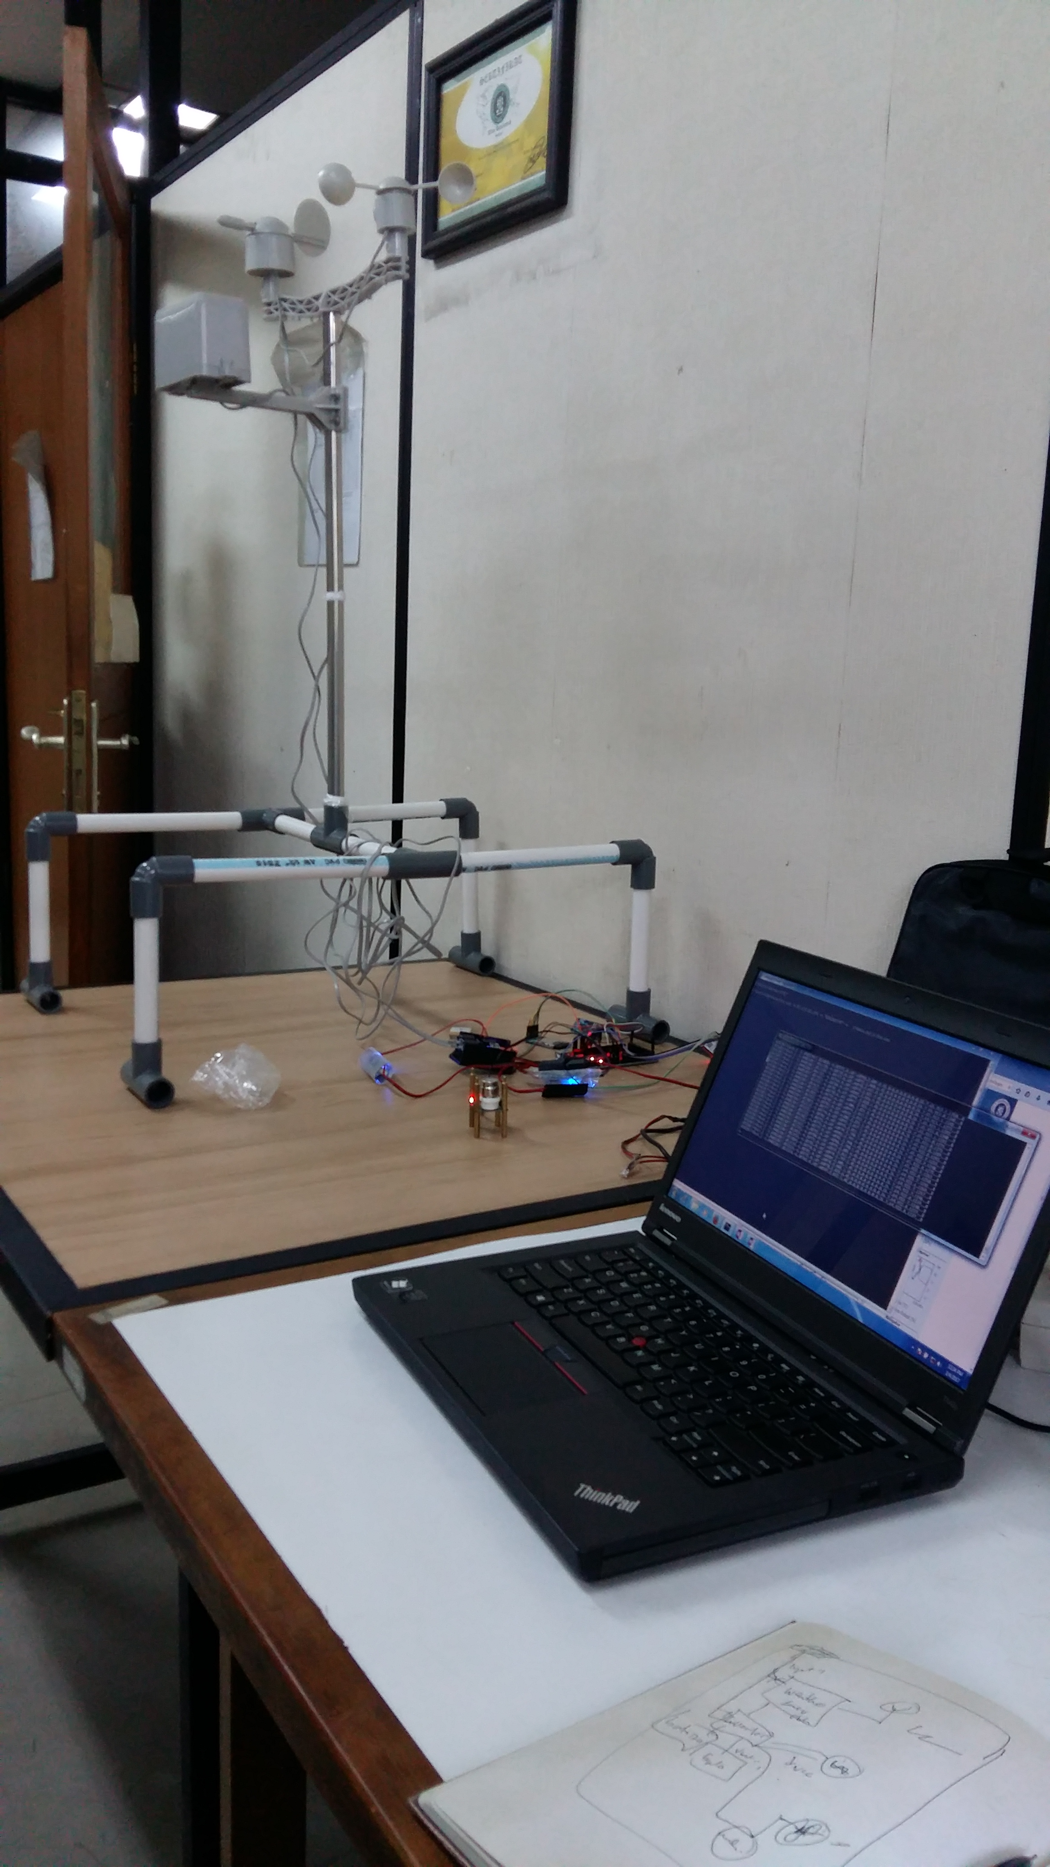
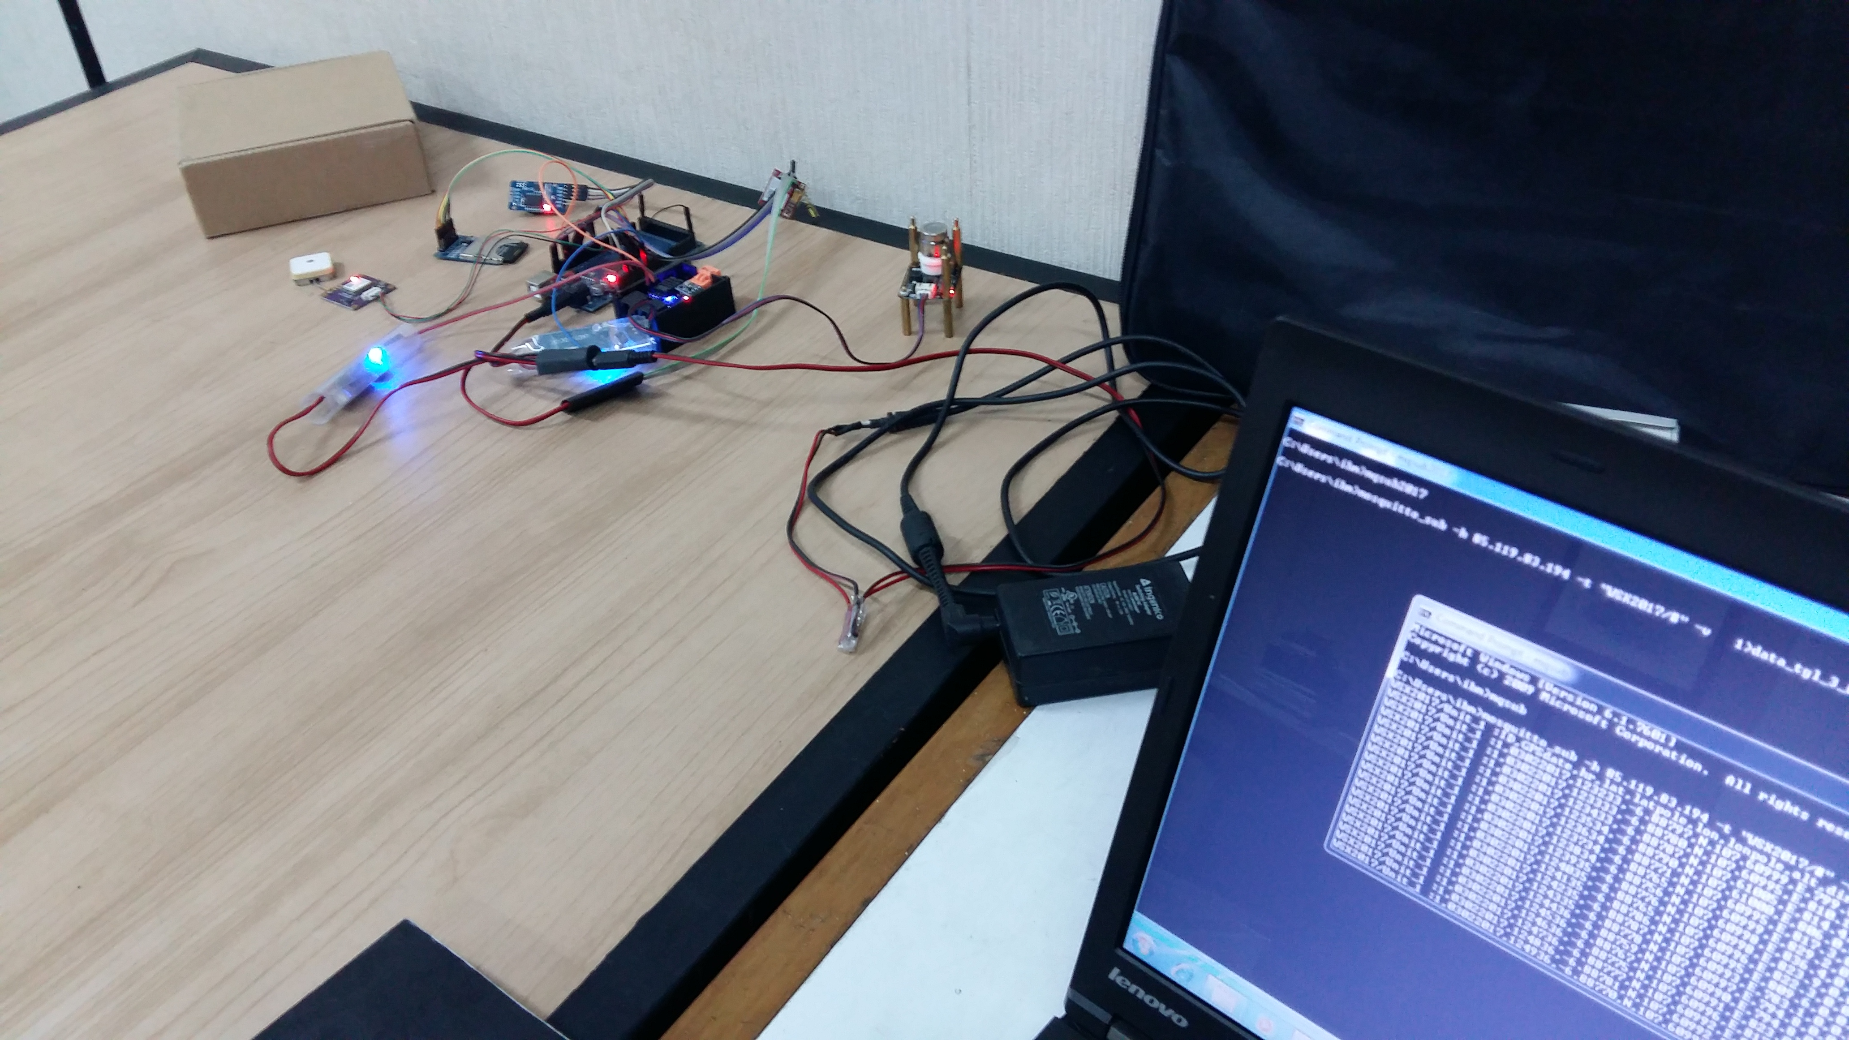
Testing on the Lab
AWS
Windspeed, wind direction, temperature, pressure, humidity, CO2 sensor ,etc
GSM /GPRS

Slide 15
Testing on the field
Calibration of the equipment
Testing in Near Oil Palm Plantation
Measure on reliability of the data and system

Slide 16
Main Challenges (Future)
Data sharing
Data are available only in web based information systems
Need to develop web services to make those data available to others
http://weather.meteo.itb.ac.id/aws.php is one example that have some of their data available to others using web service (by request)
Build the model for reduce impact on Disaster
Fire on Forestry / Land fires
CO/CO2 models
PM (Particulate Mattes 2.5 micron)
Build the Sensor Network
AWS (Automatic Weather Station)
Carbon Monoxide (CO)
Carbon Dioxide (CO2)
Particulate Matter
Methane
Simuation on Environment impact peoples

Slide 17
Thank You

