Slide 1
e-Infrastructure commons Updates
Diego Scardaci
Technical Outreach Expert

Slide 2
Outline
Milestones & Deliverables
Second project review
Activity metrics
Marketplace
EGI ISO 20000 certification
CHM and RDM processes
New requirement queues

Slide 3
WP3 Milestones & Deliverables

Slide 4
WP3 Deliverables and Milestones Delayed deliverables
October 2016: D3.8 - First data accounting prototype (DEM) (STFC)
Submitted to the EC in March

Slide 5
WP3 Deliverables and Milestones End PY2 (Feb 2017)
D3.9 Identity Management for Distributed User Communities (R) (GRNET)
Current status: Submitted to the EC
D3.10 Second release of the accounting and operational tools (OTHER) (CSIC, CNRS, STFC)
Includes Accounting repository, accounting portal, Operations portal, GOCDB, ARGO, messaging infrastructure and security monitoring tools.
Merge of old D3.10, D3.11 and D3.12
Current status: Submitted to the EC
D3.14 Report on data accounting (R) (STFC)
Report of the Data Accounting activity: including the data usage record definition, storage solutions supported and integration with accounting repository
Current status: External Review

Slide 6
WP3 Deliverables and Milestones Next deadlines
April 2017: D3.13 Second release of the EGI Service Registry and Marketplace prototype (DEM) (FMI)
April 2017: M3.6 The second version of the EGI Marketplace is demonstrated (FMI)
June 2017: D3.15 Second Data Accounting prototype (DEM) (STFC)
June 2017: D3.16 Final report on the EGI Service Registry and Marketplace (R) (FMI)
August 2017: D3.17 Final release of the accounting and operational tools (OTHER) (CSIC, CNRS, STFC)

Slide 7
Important dates for PM26 deliverable
D3.13 and M3.6 Marketplace
Start External Review: 01.04
At AMB and PMB: 15.04
At QM: 22.04
At EC: 30.04

Slide 8
Important dates for PM28 deliverable
D3.15 Data Accounting and D3.16 Marketplace
Start External Review: 01.06
At AMB and PMB: 15.06
At QM: 22.06
At EC: 30.06

Slide 9
Important dates for PM30 deliverable
D3.17 Ops tools
Start External Review: 01.08
At AMB and PMB: 15.08
At QM: 22.08
At EC: 31.08
Maybe, the deadline will be brought forward to avoid clash with holidays

Slide 10
WP3 Second project review

Slide 11
Second project review
Lightweight review on April 25th
Only with the project officer
EGI-Engage represented by Tiziana and Yannick
WP3 slides to be prepared for the Project Director
Activity metrics
No annual report
Report to be prepared for the end of the project

Slide 12
WP3 Activity Metrics
M.JRA1.AAI.1: Number of communities adopting federated IdP
M.JRA1.Marketplace.1: Number of entries in the EGI Marketplace (i.e. services, applications etc.)
M.JRA1.Accounting.1: Number of kinds of data repository systems being integrated with the EGI accounting software

Slide 13
WP3 Activity Metrics
M.JRA1.Accounting.2: Number of kinds of storage systems being integrated with the EGI accounting software
M.JRA1.OpsTools.1: Number of new requirements introduced in the roadmap
M.JRA1.OpsTools.2: Number of probes developed to monitor cloud resources

Slide 14
Marketplace Update on the activity status

Slide 15
Prototypes assessment
Two prototypes implemented:
PrestaShop based (Cyfronet)
http://marketplace.egi.eu/
Open IRIS based (FMI)
http://egi.science-it.ch/
Both prototypes implemented the main features requested in the specification
Only minor issues
Opted for PrestaShop:
Could be maintained easier
Large adoption in the commercial world

Slide 16
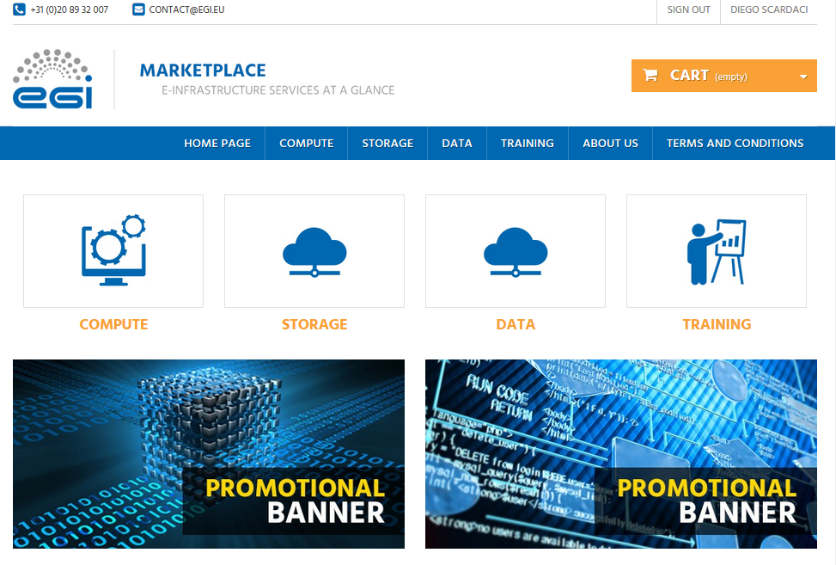
PrestaShop prototype http://marketplace.egi.eu

Slide 17
Plan to move the Marketplace in pre-production by the end of the project
Bug fixing
Registration of the service orders in RT
Integration with the LTOS platform (access.egi.eu)
Customer dashboard:
Review the service order status

Slide 18
EGI ISO 20000 Certificated CHM and RDM processes

Slide 19
EGI Foundation Certifications
ISO 9001:2015
ISO/IEC 20000-1:2011
https://www.egi.eu/about/egi-foundation/certifications/

Slide 20
CHM and RDM processes
From now changes in the EGI tools and deployment of new release must go through:
Change Management process
To approve big requirements
To approve new releases
More details in Matthew’s presentation
Release and Deployment Management process
Use PROC23 to deploy a new release in production
https://wiki.egi.eu/wiki/PROC23

Slide 21
New requirement queues

Slide 22
New requirement queues (1/2)
1 queue per tool:
AAI-Check-in, acc-portal, acc-repository, AppDB, E-grant, GGUS, GOC-DB, Marketplace, messaging, Ops-Portal, service-monitoring
Two SSO groups are associated to each queue:
<queue-name>:
full control of the queue
do not receive any notification after an event on a ticket
for EGI people that monitor the dev activity.
<queue-name>_watchers (the name is misleading)
full control of the queue (can create, modify and update tickets) and receive notifications when a ticket is created, modified and updated
for PT members.

Slide 23
New requirement queues (2/2)
Old requirements queues
only to manage legacy tickets.
will be dismissed in the future.
Please, do not open new tickets in such queue.
The dashboards will be also dismissed in the future.
If a PT still needs a dashboard for some reason, we could update it to point to the new queue.

