Slide 1
Marketplace Update
Dean Flanders
SwiNG / FMI
March 24th, 2017

Slide 2
Update
Test systems
http://egi.science-it.ch
http://marketplace.egi.eu
Initial agreements for Open IRIS:
France Bioimaging
Paul Scherrer Institute (PSI)
Recent initiated pilots for Open IRIS:
MDC in Berlin
UPMC in Paris
Newcastle University
ICM in Paris
EU-Life grants database \ EUResearch
Ongoing pilots for Open IRIS
Pilot Thermo Fisher Scientific
Pilot BioImaging Center in Bordeaux
Presentations / Upcoming presentations for Open IRIS:
UPMC in Paris in March
ICM in Paris in March
MDC and BIH in Berlin in March
Executive Agency for SMEs (EASME) presentation in Brussels in March
ThermoFischer “rent a lab” discussion in April
Basel Area Development meeting in April
S-Labs meeting in May in York

Slide 3
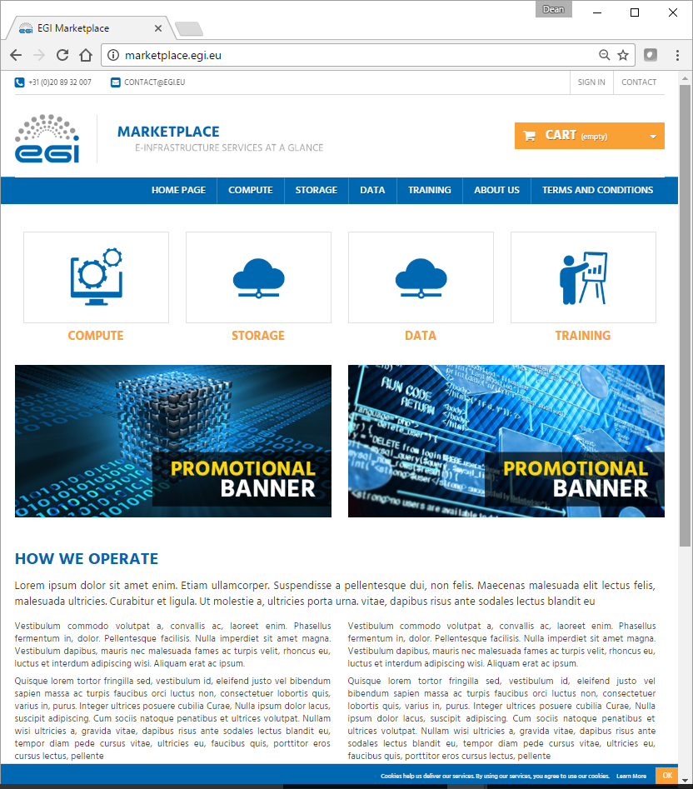
EGI Marketplace Prototype (PrestaShop)

Slide 4
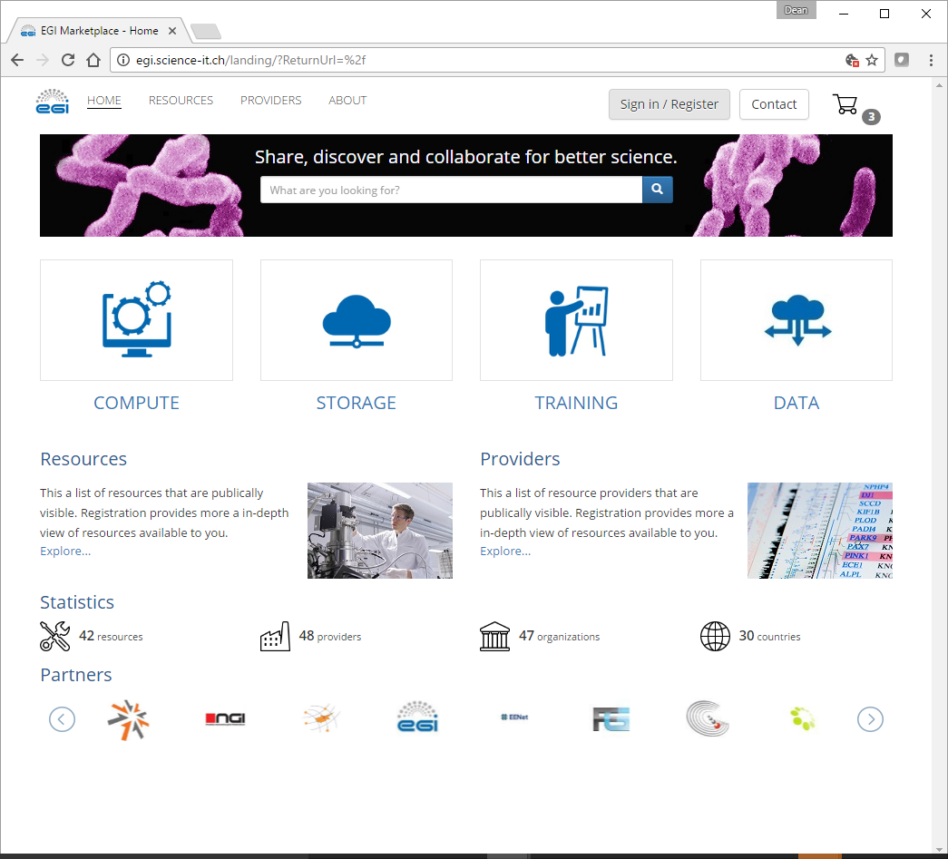
EGI Marketplace Prototype (Open IRIS)

Slide 5
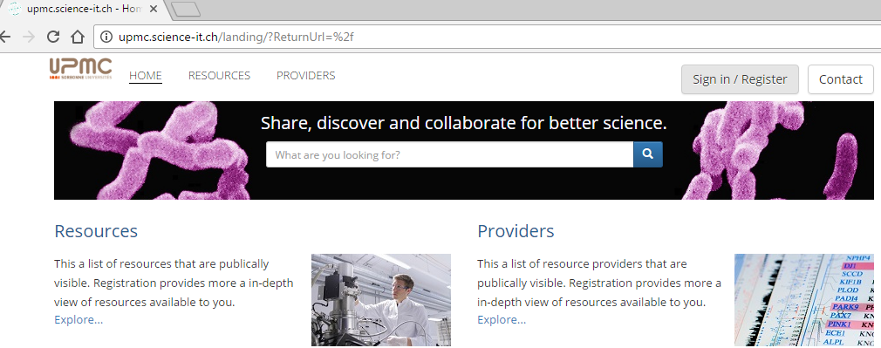
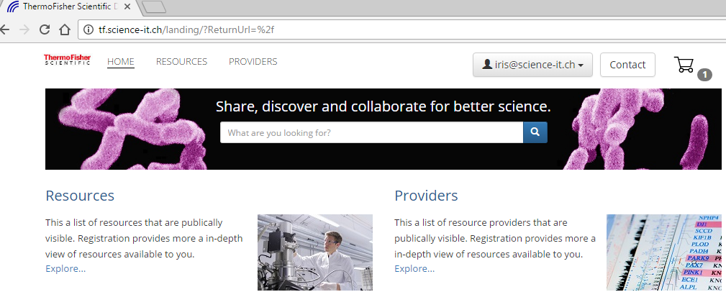
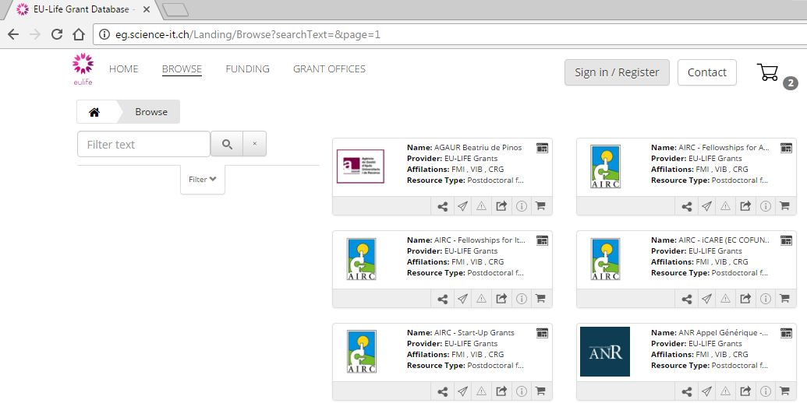
Open IRIS Pilot Use Cases

Slide 6
Statistics from the Current Usage of Overall Platform
The Open IRIS platform that is based on has the following statistics since last meeting:
4000 users -> 4243 users
1167 resources registered -> 1385 resources
182 resource providers -> 194 resource providers
150 registered organizations -> 162 organizations
Over 52K resource usage requests in the past 6 months, 30K resource usage requests in last 3 months

