Slide 1

FitSM Foundation Training
EBI-EMBL – 19 May 2017 – Cambridge
Foundation training in IT Service Management according to FitSM
Version 2.10
This work has been funded by the European Commission. It is licensed under a Creative Commons Attribution 4.0 International License.

Slide 2

Purpose of this training
Become familiar with
  Basic IT service management concepts and terms
  Purpose and structure of FitSM standards and their relationship to other standards
  Process framework underlying FitSM
  Requirements defined in FitSM-1
Achieve the
Foundation Certificate in IT Service Management according to FitSM
issued by TÜV SÜD Examination Institute

Slide 3

About Sy Holsinger
Background
  Studied Business Management & Communications (US)
  Almost 10 years experience in EC projects
At EGI.eu
  Strategy support; market/trend analysis
  Business and sustainability model development
  Project and virtual team management
  In-house ITSM consultant and FitSM trainer
  Member of ITEMO - IT Education Management Organization – FitSM working group
https://www.egi.eu/about/egi-foundation/team/
https://it.linkedin.com/in/syholsinger

Slide 4
FitSM Foundation exam
At the end of this training
Closed book, i.e. no aids are allowed
Duration: 30 minutes
20 multiple choice questions:
  Four possible answers for each question: A, B, C or D
  One correct answer per question
At least 65% correct answers (13 of 20) are required to pass the examination

Slide 5
FitSM qualification program
Expert Level
2 days
2 days
ITIL Expert, ISO/IEC 20000 consultant and auditor
Expert training in IT service management
Expert Bridge
Advanced Level
2 days
2 days
Advanced training in
service planning and delivery
Advanced training in
service operation and control
Foundation Level
Foundation training in IT service management
1 day
Notes:
Full training titles:
Expert training in IT service management according to FitSM
Advanced training in service planning and delivery according to FitSM
Advanced training in service operation and control according to FitSM
Foundation training in IT service management according to FitSM

Slide 6
Training agenda topics
IT Service Management: Introduction, Terms & Concepts
The FitSM Standards Family
IT Service Management – General Aspects
IT Service Management – Processes
Benefits, Risks & Challenges of Implementing IT Service Management
Related Standards & Frameworks

Slide 7
Agenda
MORNING
Session 1 (9:15-10:45)
  Service and service management: Introduction, terms and concepts (45 min)
  The FitSM standard series & Service management – General aspects (40 min)
  Selected sample exam questions (5 min)
Session 2 (11:00-12:45)
  Service management – Processes: SPM, SLM, SRM (45 min)
  Service management – Processes: SACM, CAPM, ISM (40 min)
  Selected sample exam questions (5 min)
AFTERNOON
Session 3 (13:30-14:45)
  Service management – Processes: CRM, SUPPM, ISRM, PM (35 min)
  Service management – Processes: CONFM, CHM, RDM (35 min)
  Selected sample exam questions (5 min)
Session 4 (15:00-16:15)
  Service management – Process: CSI (10 min)
  Benefits, Risks & Challenges of Implementing ITSM (15 min)
  Related standards and frameworks (25 min)
  Exam Prep (25 min)
Exam (16:30-17:15)

Slide 8


Suggestion for an "SLA" between you and us
Please: No use of electronic devices at any time during the training sessions.
Sessions will start on time. Please don't be late.

Slide 9
IT Service Management:
Introduction, Terms & Concepts

Slide 10
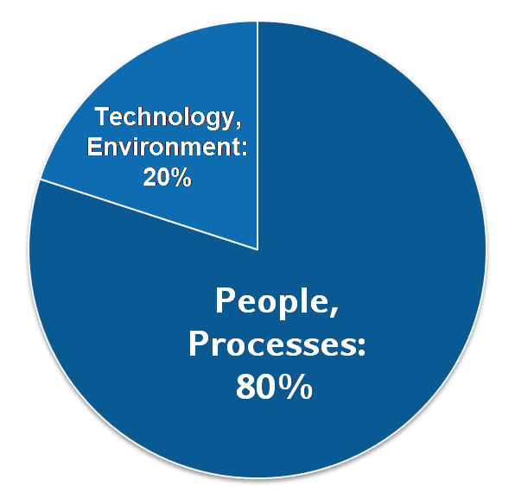
Why IT service management is needed
Why IT service management (ITSM)?
  About 80% of all IT service outages originate from "people and process issues"
  Duration of outages and degradations significantly dependent on non-technical factors
IT service management …
  … aims at providing high quality IT services meeting customers' and users' expectations …
  … by defining, establishing and maintaining service management processes
Reasons for service outages
[Gartner, 2001]
Notes:
Q: How do you think, why do we need IT service management?

Slide 11

What is IT Service Management?

Slide 12
What is IT service management
IT Service Management
Continual Service Improvement
SLAs
Provider
Customer
Do
Check
Act
Plan
+ Abilities
Value
- Constraints
Utility
Warranty
Deming Cycle
(Fit for Purpose)
(Fit for Use)
Availability
Process Orientation = Repeatability
Capacity/Performance
Security
Notes:
Use Bus Example

Slide 13
Service and value
Service is…
  … a means of delivering value to customers …
  … by supporting them in achieving their goals
  … can be provided (sold) on its own
What is value from a customer perspective?
Utility
Warranty
Value
What is the key purpose of the service?
Which additional factors will impact the customers’ service quality / performance perception?
Notes:
Another way is simply to say that a service is anything that can be “sold“ by itself

Slide 14
How would you define a service?

Slide 15
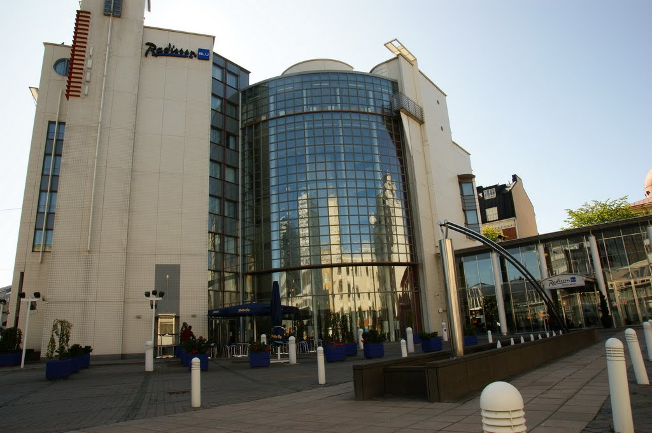
What is a "Service”
Car park
Illuminated hotel sign
Room reservation system
Invoice system
Music in the lobby
Music in the elevator
Room locks / key card readers
"Do not disturb" sign
Coat hook in room
Accommodation
Concierge
Escalators
Elevators
Restaurant
In-room dining
Front desk
Housekeeping
Laundry
Free TV
Pay TV
Minibar
Telephone
Wired Internet
Wireless Internet
Pool
Fitness
Congress rooms
Limousine
Hotel website
Safety facilities
Room lights
Room heating
Room air conditioning
Room furniture
Bathroom facilities
Room decoration
Cleaning
Example: Hotel

Slide 16
What is a "Service”
Car park
Illuminated hotel sign
Room reservation system
Invoice system
Music in the lobby
Music in the elevator
Room locks / key card readers
"Do not disturb" sign
Coat hook in room
Accommodation
Concierge
Escalators
Elevators
Restaurant
In-room dining
Front desk
Housekeeping
Laundry
Free TV
Pay TV
Minibar
Telephone
Wired Internet
Wireless Internet
Pool
Fitness
Congress rooms
Limousine
Hotel website
Safety facilities
Room lights
Room heating
Room air conditioning
Room furniture
Bathroom facilities
Room decoration
Cleaning
Example: Hotel

Slide 17
What is a "Service”
Car park
Illuminated hotel sign
Room reservation system
Invoice system
Music in the lobby
Music in the elevator
Room locks / key card readers
"Do not disturb" sign
Coat hook in room
Accommodation
Concierge
Escalators
Elevators
Restaurant
In-room dining
Front desk
Housekeeping
Laundry
Free TV
Pay TV
Minibar
Telephone
Wired Internet
Wireless Internet
Pool
Fitness
Congress rooms
Limousine
Hotel website
Safety facilities
Room lights
Room heating
Room air conditioning
Room furniture
Bathroom facilities
Room decoration
Cleaning
Example: Hotel

Slide 18
What is a service?
Definition following FitSM-0:
Service: A way to provide value to a user / customer through bringing about results that they want to achieve
Definition following FitSM-0:
Service provider: Organisation or federation or part of an organisation or federation that manages and delivers a service or services to customers
Examples of IT services:
  Provision of standard desktop workstations
  Connectivity: E-Mail, LAN, internet access
  Provision of computational resources
  Provision of standard and special applications
  Storage, backup, archival storage

Slide 19
What is a process?
3 basic facts about IT service management processes:
  ITSM processes support the delivery of IT services.
  To provide one IT service to a customer, often several processes are needed.
  An IT service being successfully delivered is the result from many processes successfully operating and interacting.
Definition following FitSM-0:
Process: Set of activities that bring about a specific objective or set of results from a set of defined inputs.

Slide 20
What comprises a process?
Set of interrelated activities
(across different functions)
Roles and responsibilities
Goal(s), objectives
Clearly defined inputs, triggers and outputs

Slide 21
ITSM Processes + Interfaces
Reports
Define and maintain a service portfolio
To specify all reports and ensure reports are produced according to agreements
SRM
SPM
SP
SLM
SC
Maintain the service catalogue and define/agree SLAs
SLAs
ISM
SACM
CAPM
Policies
Maintain a sufficient level of av./cap./security for all services and service components
Av/Con Plans
Capacity Plans
Controls
Notes:
Picture fixed

Slide 22
Process roles
Process owner:
  Overall accountability for a process
  Defines process goals, monitors their fulfillment
  Has authority to provide / approve resources
Process manager:
  Responsible for the operational effectiveness and efficiency of a process
  Reports to the process owner
Process staff member:
  Responsible for performing a specific process activity
  Escalates exceptions to the process manager
Process owner
1
1..*
Process manager
1
1..*
Process
staff member
Notes:
FitSM-3
Owner – define
Manager – control
Staff - do

Slide 23
Additional key terms
Definition following FitSM-0:
Service management system (SMS): Overall management system that controls and supports management of services within an organisation or federation
Definition following FitSM-0:
Policy: Documented set of intentions, expectations, goals, rules and requirements, often formally expressed by top management representatives in an organisation or federation
Definition following FitSM-0:
Activity: Set of actions carried out within a process
Definition following FitSM-0:
Procedure: Specified set of steps or instructions to be carried out by an individual or team to perform one or more activities of a process

Slide 24


Service management system (SMS)
Policy
1. Abc def ghijk.
2. Abc def ghijk.
3. Abc def ghijk.
4. Abc def ghijk.
Governance level
Top management
Process owners
e.g. Incident handling policy, change policy, security policy
Control level
Process managers
Process teams
Process:
Inputs
Activities and roles
e.g. incident management, change management, security management, …
Outputs
Operational level
Departments
Functions
Persons
Proce-
dures
Person (in a role)
e.g. procedures for classifying and prioritizing incidents
applies
Notes:
System Theory
What is an example of a type of system?
Engine? And its parts
Go bigger, what else? Traffic system, process and procedures for with a governing body

Slide 25
The FitSM Standards Family

Slide 26



What is FitSM?
Standards family for lightweight IT service management
Suitable for IT service providers of any type and scale
Main design principle: Keep it simple!
All FitSM parts are freely released under Creative Commons licenses
FitSM is operated and managed by ITEMO (non-profit)
Certification is provided through TÜV SÜD
www.fitsm.eu
The development of FitSM was originally funded by the European Commission through an EC-FP7 project "FedSM“ (Sept 2015)

Slide 27


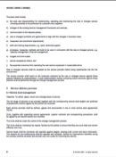
Third way for ITSM
‘Full’ commercial ITSM
FitSM Solution
Less unfamiliar
More achievable
More suitable
Path to ‘full’ ITSM
Freely available
No/little formal ITSM
ISO/IEC 20000
Notes:
Does anyone has experience with itil, iso2k? Any struggles?

Slide 28


FitSM parts
Core Standard
FitSM-0
Overview & vocabulary
Focus of this training
Normative
FitSM-1
Requirements
FitSM-2
Objectives and activities
FitSM-3
Role model
Informational
Implementation aids
FitSM-4
Selected templates and samples
FitSM-5
Selected implementation guides
FitSM-6
Maturity and capability assessment scheme

Slide 29
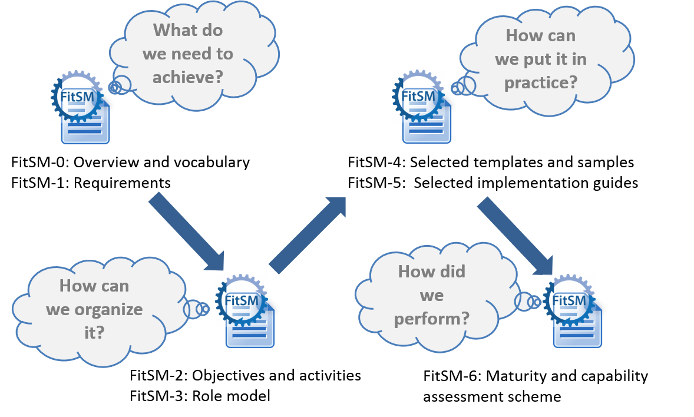
FitSM logic

Slide 30
FitSM process model
Service Portfolio Management
Most strategic
Service Level Management
Service Reporting
Service Availability and Continuity Management
More strategic
Capacity Management
Information Security Management
Customer Relationship Mgmt
Supplier Relationship Management
Incident and Service Request Mgmt
Problem Management
Configuration Management
More operational
Change Management
Release and Deployment Mgmt
Continual Service Improvement

Slide 31
A possible grouping of the FitSM processes
Six main topic areas:
Offer & Agree
Plan & Ensure
SUPPM
Control & Deploy
CONFM
Resolve & Prevent
ISRM
Report & Improve
SRM
Protect & Secure
ISM
SLM
CRM
SACM
CAPM
CHM
RDM
PM
CSI
SPM

Slide 32
FitSM-0: "Overview & vocabulary"
FitSM-0 defines 70 important terms from the IT service management context
In alphabetical order:
  Accessibility of information
  Activity
  Assessment
  Audit
  Availability
  Capability
  Capacity
  Change
  Classification
  Closure
  Competence
  Compliance
  Confidentiality of information
  Configuration baseline
  Configuration item (CI)
  Configuration management database (CMDB)
  Continuity
  Customer
  Document
  Effectiveness
  Efficiency
  Escalation
  Federation member
  Federator
  Incident
  Information security
  Information security control
  Information security event
  Information security incident
  Integrity of information
  IT service
  IT service management (ITSM)
  Key performance indicator (KPI)
  Known error
  Management system
  Maturity
  Nonconformity
  Operational level agreement (OLA)
  Operational target
  Policy
  Post implementation review
  Priority
  Problem
  Procedure
  Process
  Record
  Release
  Request for change
  Risk
  Role
  Service
  Service acceptance criteria (SAC)
  Service catalogue
  Service component
  Service design and transition package
  Service level agreement (SLA)
  Service management
  Service management plan
  Service management system (SMS)
  Service portfolio
  Service provider
  Service report
  Service request
  Service target
  Supplier
  Top management
  Underpinning agreement (UA)
  Underpinning contract (UC)
  User
  Value
Notes:
Speaking the same language – e.g. Helix Nebula, EGI

Slide 33
FitSM-1: "Requirements"
FitSM-1 defines 85 requirements that should be fulfilled by an organisation (or federation) offering IT services to customers.
Compliance with the 85 requirements can be regarded as a "proof of effectiveness".
The 85 requirements are structured as follows:
  16 general requirements (GR)
  69 process-specific requirements (PR)
    Consideration of the 14 IT service management processes from the FitSM process model
    Between 2 and 8 requirements per process

Slide 34
IT Service Management – General Aspects

Slide 35
Top management responsibility: Requirements according to FitSM-1
GR1 Top Management Commitment & Responsibility
Requirements
GR1.1 Top management of the organisation(s) involved in the delivery of services shall show evidence that they are committed to planning, implementing, operating, monitoring, reviewing, and improving the service management system (SMS) and services. They shall: Assign one individual to be accountable for the overall SMS with sufficient authority to exercise this role Define and communicate goals Define a general service management policy Conduct management reviews at planned intervals GR1.2 The service management policy shall include: A commitment to fulfil customer service requirements A commitment to a service-oriented approach A commitment to a process approach A commitment to continual improvement Overall service management goals
Notes:
Why would you need top management committment?
e.g. allocation of resources; gives managers a tool for pushing staff and authority

Slide 36
Documentation: Requirements according to FitSM-1
GR2 Documentation
Requirements
GR2.1 The overall SMS shall be documented to support effective planning. This documentation shall include: Service management scope statement (see GR3) Service management policy (see GR1) Service management plan and related plans (see GR4) GR2.2 Documented definitions of all service management processes (see PR1-PR14) shall be created and maintained. Each of these definitions shall at least cover or reference: Description of the goals of the process Description of the inputs, activities and outputs of the process Description of process-specific roles and responsibilities Description of interfaces to other processes Related process-specific policies as applicable Related process- and activity-specific procedures as required
Notes:
Documentation = time for reflection
Must be meaningful and not for the sack of it
Documentation must have: purpose and clear audience

Slide 37
Documentation: Requirements according to FitSM-1
GR2 Documentation
Requirements
GR2.3 The outputs of all service management processes (see PR1-PR14) shall be documented, and the execution of key activities of these processes recorded. GR2.4 Documentation shall be controlled, addressing the following activities as applicable: Creation and approval Communication and distribution Review Versioning and change tracking

Slide 38
Plan-Do-Check-Act Cycle (PDCA)
Check
Act
Do
Maturity
Plan
Time
Quality management approach according to W. E. Deming
Key principle: continual improvement
Plan-Do-Check-Act can be applied to the whole service management system

Slide 39
PDCA applied to the SMS
Plan:
  Define the scope of the SMS
  Set the timeline for implementing service management processes (service management plan)
Do:
  Implement processes as planned
  Support and enforce practical application of defined processes
Check:
  Monitor key performance indicators (KPIs) to evaluate effectiveness and efficiency
  Perform (internal) audits to determine the level of compliance
  Assess the organisational maturity
Act:
  Identify opportunities for improvements
  Prioritize and initiate improvements
GR3, GR4
GR5
GR6
GR7

Slide 40
Some Sample Exam Questions?

Slide 41
Exam preparation
Which of the following best describes a process?
A documented agreement between a customer and a service provider
A structured set of activities to transform inputs to outputs
A documented set of intentions, expectations, goals, rules and requirements
Detailed working instructions
Notes:
b)

Slide 42
Exam preparation
What should the Deming cycle be used for?
As a model for continual improvement
As a template for defining a service portfolio
As a model for incident root cause analysis
As a model to calculate the costs of service operations
Notes:
a)

Slide 43
Exam preparation
What is the most important motivation for a service management system (SMS)?
To minimize the cost of service delivery
To achieve the maximum level of service quality and availability
To define as many metrics as possible to ensure detailed control
To establish processes that contribute to delivering value for customers through services
Notes:
d)

Slide 44


Slide 45
IT Service Management – Processes

Slide 46
Service Portfolio Management (SPM)
Objective
To define and maintain a service portfolio

Slide 47
SPM: Important terms
Definition following FitSM-0:
Service portfolio: Internal list that details all the services offered by a service provider, including those in preparation, live and discontinued

Slide 48
SPM: Requirements according to FitSM-1
PR1 Service Portfolio Management (SPM)
Requirements
PR1.1 A service portfolio shall be maintained. All services shall be specified as part of the service portfolio. PR1.2 Design and transition of new or changed services shall be planned. PR1.3 Plans for the design and transition of new or changed services shall consider timescales, responsibilities, new or changed technology, communication and service acceptance criteria. PR1.4 The organisational structure supporting the delivery of services shall be identified, including a potential federation structure as well as contact points for all parties involved.
Notes:
SDTP template

Slide 49
SPM: Summary
3 things to remember:
  The service portfolio lists and defines the services that a service provider offers or plans to offer in the future.
  The service portfolio is an "internal tool" for the service provider.
  The service portfolio is the basis for the service catalogue.
Service catalogue
Service portfolio
basis
for
Customer
Notes:
So then what is in the service catalogue?
What kind of information you would keep in portfolio and which in catalogue?

Slide 50
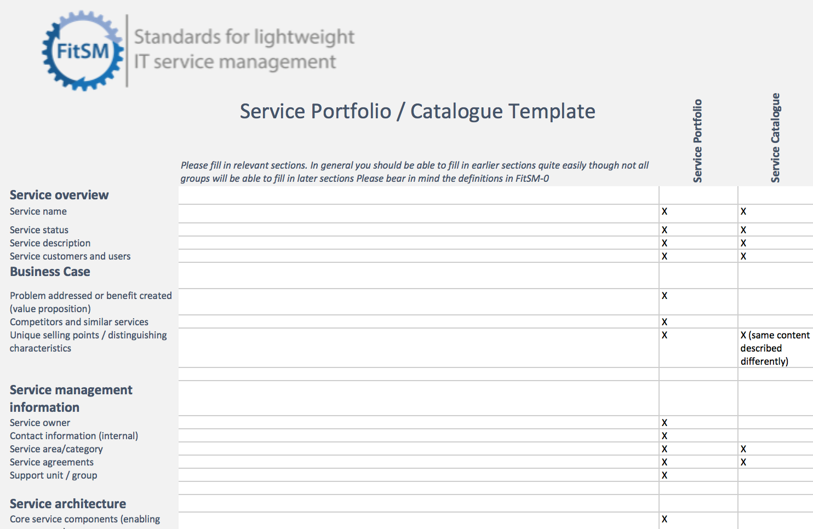
Entry example

Slide 51
Service Level Management (SLM)
Objective
To maintain a service catalogue, and to define, agree and monitor service levels with customers by establishing meaningful service level agreements (SLAs) and supportive operational level agreements (OLAs) and underpinning agreements (UAs) with suppliers
Notes:
ITIL uses UC -> however contract tends to have a legal connotation, which isn’t necessarily always the case
Especially in the academic environment

Slide 52
SLM: Important terms
Definition following FitSM-0:
Service catalogue: User/customer facing list of all live services offered along with relevant information about these services
Notes:
First to show example catalogue

Slide 53
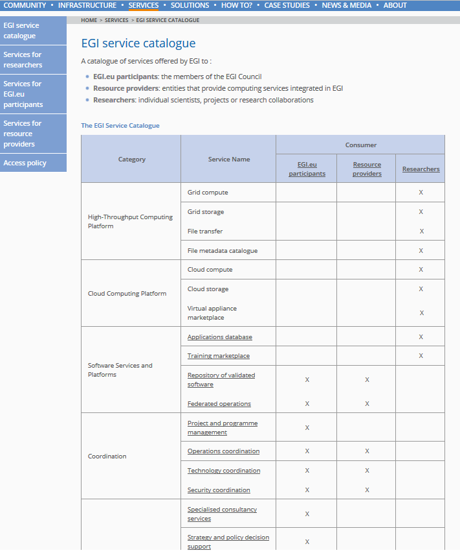
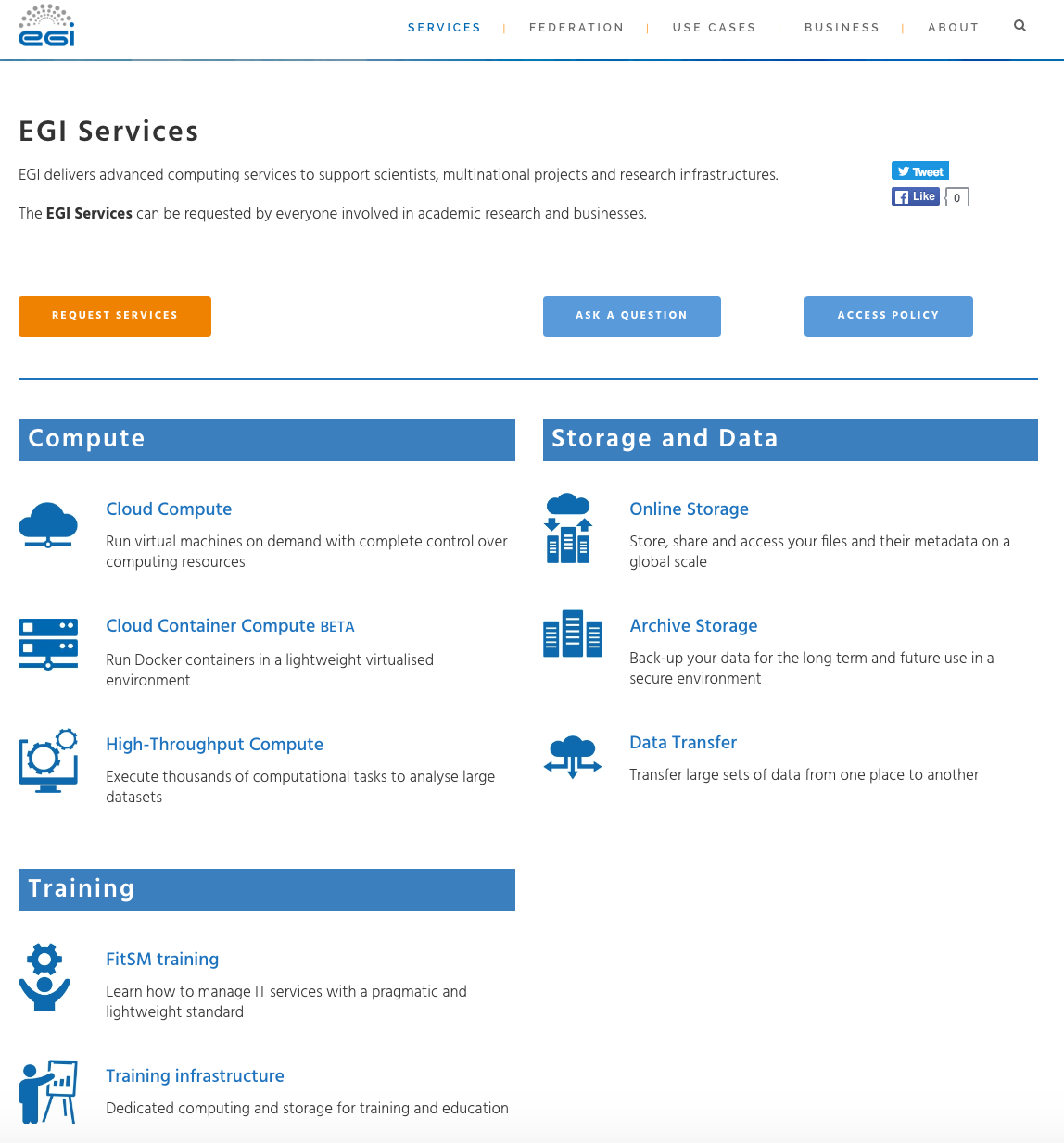
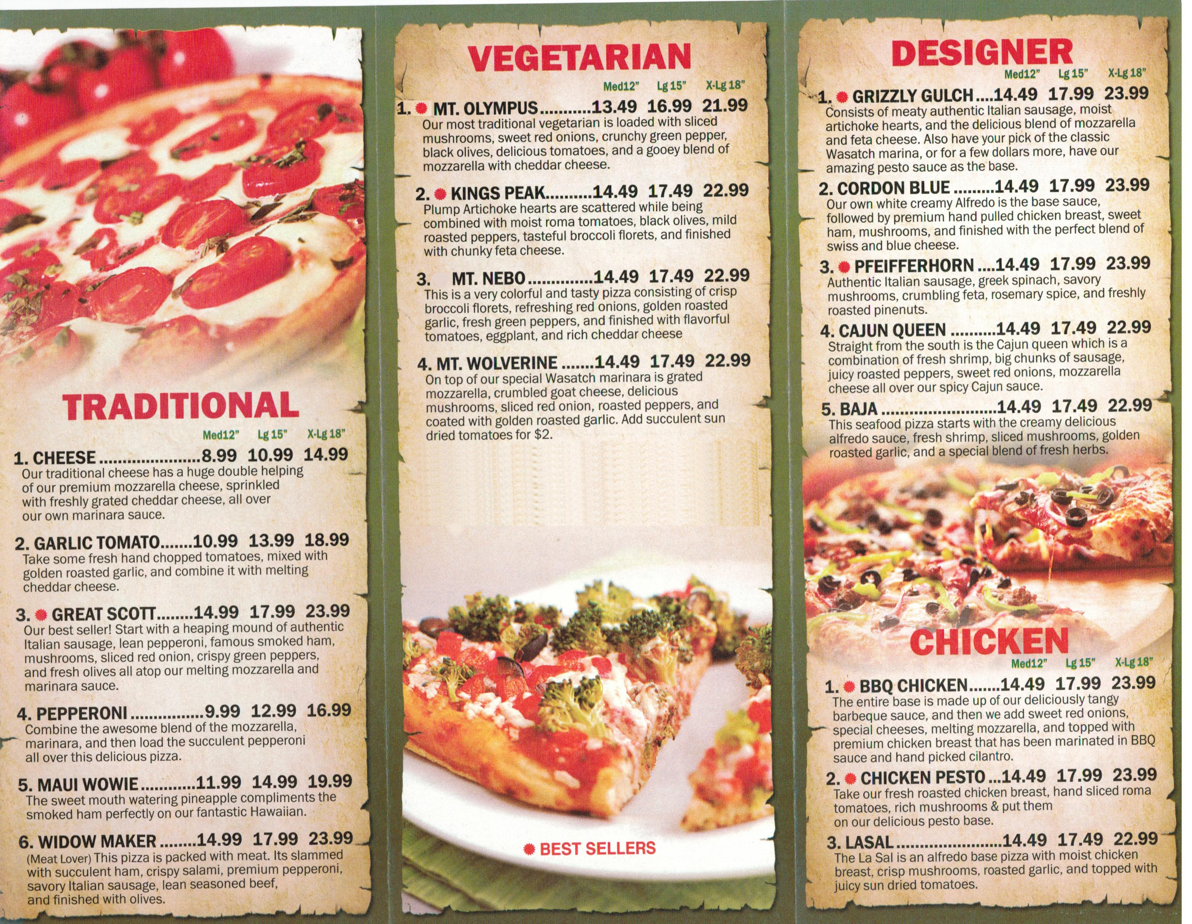
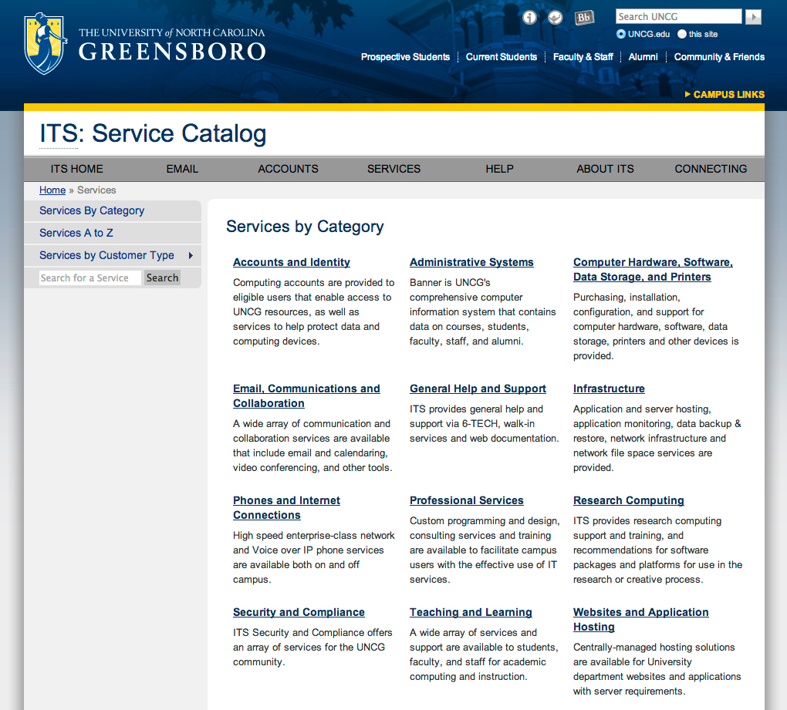
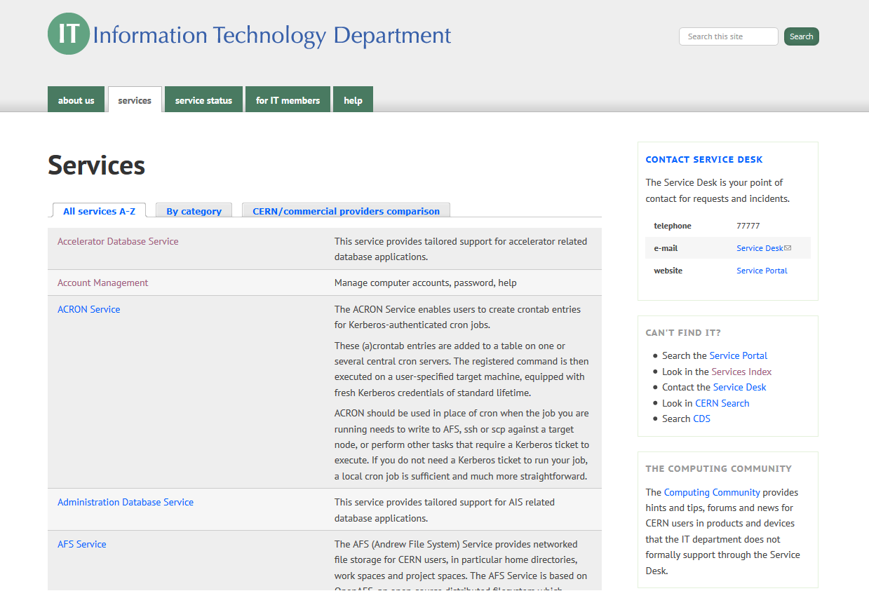
Service Catalogue examples

Slide 54
SLM: Important terms
Definition following FitSM-0:
Service level agreement (SLA): Documented agreement between a customer and service provider that specifies the service to be provided and the service targets that define how it will be provided
Definition following FitSM-0:
Operational level agreement (OLA) Agreement between a service provider or federation member and another part of the service provider’s organisation or the federation to provide a service component or subsidiary service needed to allow provision of services to customers
Definition following FitSM-0:
Underpinning agreement (UA) Documented agreement between a service provider and an external supplier that specifies the underpinning service(s) or service component(s) to be provided by the supplier, and the service targets that define how it will be provided Note: A UA can be seen as a service level agreement (SLA) with an external supplier where the service provider is in the customer role.
Notes:
OLA/UA is needed with key components providers not all of them according to FitSM

Slide 55
SLM: Requirements according to FitSM-1
PR2 Service Level Management
Requirements
PR2.1 A service catalogue shall be maintained. PR2.2 For all services delivered to customers, SLAs shall be in place. PR2.3 SLAs shall be reviewed at planned intervals. PR2.4 Service performance shall be evaluated against service targets defined in SLAs. PR2.5 For supporting services or service components provided by federation members or groups belonging to the same organisation as the service provider or external suppliers, OLAs and UAs shall be agreed. PR2.6 OLAs and UAs shall be reviewed at planned intervals. PR2.7 Performance of service components shall be evaluated against operational targets defined in OLAs and UAs.
Notes:
How many SLAs are needed to cover a service catalogue?
At least 1 = what is this called? A corporate SLA – 1 SLA covering all services
What is a good timeframe to review SLAs? When else might be a good time to review it?

Slide 56
SLM: Defining SLAs
SLAs are agreed between a service provider and its customers
Typical contents in an SLA (included or referenced):
  Scope and description of the service
  Service hours and exceptions
  Service components & dependencies
  Support
    Incident handling
    Fulfilment of service requests
  Service level targets
  Limitations & constraints
  Communication, reporting & escalation
    General communication
    Regular reporting
    SLA violations
    Escalation & complaints
  Information security & data protection
  Additional responsibilities of the service provider
  Customer responsibilities
  Review
  Glossary of terms
Notes:
Show FitSM example of SLA

Slide 57
SLM: Types of service agreements and their relationships
Customer
Service level agreements (SLAs)
Service A
Service B
Service C
(IT) service
provider
Service components
Operational level agreements (OLAs)
Underpinning agreements (UAs)
Internal groups or federation members
Suppliers
Notes:
Use EGI as an example

Slide 58
SLM: Summary
3 things to remember:
  Produce a service catalogue for the customers and agree SLAs with customers.
  Agree OLAs and UAs with supporting parties and suppliers to ensure service targets in SLAs can be met.
  Evaluate service performance based on SLAs.

Slide 59
Service Reporting Management (SRM)
Objective
To specify all service reports and ensure they are produced according to specifications in a timely manner to support decision-making

Slide 60
SRM: Requirements according to FitSM-1
PR3 Service Reporting
Requirements
PR3.1 Service reports shall be specified and agreed with their recipients. PR3.2 The specification of each service report shall include its identity, purpose, audience, frequency, content, format and method of delivery. PR3.3 Service reports shall be produced. Service reporting shall include performance against agreed targets, information about significant events and detected nonconformities.
Notes:
Nice to have in one place all of the different reports that need to be produced for monitoring/management purposes
What kind of reports do you think will be produced?
Where will it say what reports to produced?
Will reports come from other areas? (e.g. processes)

Slide 61
SRM: Summary
3 things to remember:
  Service reports are important to support decision-making.
  Service reports can be useful to demonstrate the level of service quality that has been achieved.
  Agree the reports and their purpose, audience, frequency, content, format and method of delivery with the report stakeholders.

Slide 62
SPM vs SLM vs SRM
Define and maintain the service portfolio – “what do you do”
Reports
->Support
decisions
SPM
Service Portfolio
Internal List
Past-Present-Future
SRM
Specify all reports and ensure reports are produces according to specs
SLM
Service Catalogue
Maintain service catalogue and define/agree SLAs (and OLAs)
Service Level Agreement
External List
Current services and features
How the service is delivered
Other processes

Slide 63
Service Availability & Continuity Management (SACM)
Objective
To ensure sufficient service availability to meet agreed requirements and adequate service continuity in case of exceptional situations

Slide 64
Why Availability AND Continuity?
Availability
Goal: Service is available frequently enough to meet customer needs → continuous operation
Guard against: downtime/unavailability through ‘normal’ failures and issues
Input: SLA
Output: Plans
Continuity
Goal: Sufficient disaster protection to ensure continual operation of key services under all circumstances
Guard against: downtime/unavailability though ‘exceptional’ failures, disasters and crises
Input: SLA, risk assessment
Output: Plans

Slide 65
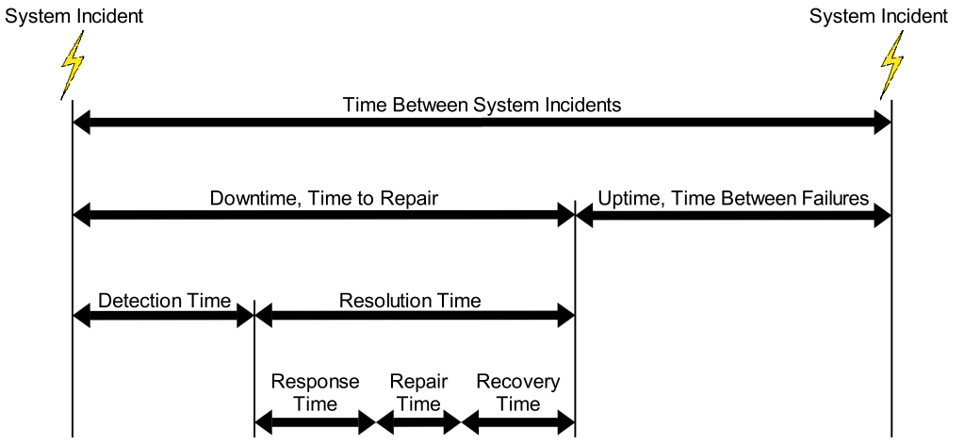
SACM: Important terms & concepts
Definition following FitSM-0:
Availability: The ability of a service or service component to fulfil its intended function at a specific time or over a specific period of time
Agreed service hours - downtime
Availability [%] =
x 100
Agreed service hours
Notes:
Is it part of utility or warranty?

Slide 66
SACM: Requirements according to
FitSM-1
PR4 Service Continuity & Availability Management
Requirements
PR4.1 Service availability and continuity requirements shall be identified taking into consideration SLAs. PR4.2 Service availability and continuity plans shall be created and maintained. PR4.3 Service availability and continuity planning shall consider measures to reduce the probability and impact of identified availability and continuity risks. PR4.4 Availability of services and service components shall be monitored.
Notes:
Same as capacity management, the biggest output of this process is going to the plans, then monitoring and updating them

Slide 67
Capacity Management (CAPM)
Objective
To ensure sufficient capacities are provided to meet agreed service capacity and performance requirements

Slide 68
CAPM vs SACM
Capacity
Availability and continuity
Requirements
Plans (inc forecast)
Monitoring
Requirements
Plans (inc forecast)
Monitoring
Sufficient capacity → Sufficient resources (technical, human, financial…)
More availability → more redundancy

Slide 69
CAPM: Requirements according to
FitSM-1
PR5 Capacity Management
Requirements
PR5.1 Service capacity and performance requirements shall be identified taking into consideration SLAs. PR5.2 Capacity plans shall be created and maintained. PR5.3 Capacity planning shall consider human, technical and financial resources. PR5.4 Performance of services and service components shall be monitored based on monitoring the degree of capacity utilisation and identifying operational warnings and exceptions.

Slide 70
CAPM: Summary
Most important output from this process:
3 things to remember:
  Identify service performance requirements (e.g. from SLAs).
  Plan the resources required to fulfil the requirements and produce a capacity plan.
  Monitor service performance.
Capacity plan(s)
Typical contents:
Agreed / required capacity and performance targets
Planned capacity upgrades, downgrades and re-assignments of resources
Requirements for capacity monitoring and related thresholds

Slide 71
Information Security Management (ISM)
Objective
To manage information security effectively through all activities performed to deliver and manage services, so that the confidentiality, integrity and accessibility of relevant assets are preserved

Slide 72
ISM: What is information security?
Information security aspects:
  Confidentiality
  Integrity
  Accessibility of information
Key aspects

Slide 73

ISM: Confidentiality and integrity
Confidentiality: To protect information from unauthorized disclosure
Integrity: To protect information from modifications, additions, deletions, rearrangement, duplication or re-recording
10110100
01011001
10101100
11001011
10110100
01011001
10101100
11001011
10110100
10100100
01000110
11001011
Alice
Bob
Alice
Bob
Chuck
Chuck
Notes:
Where do you think these aspects will be written/governed? A: policies

Slide 74
ISM: Accessibility
Accessibility: Information is available and usable when required, and the system that provide it can appropriately resist attacks and recover or prevent failures
10110100
01011001
10101100
11001011
Alice

Slide 75
ISM: Requirements according to FitSM-1
PR6 Information Security Management
Requirements
PR6.1 Information security policies shall be defined. PR6.2 Physical, technical and organizational information security controls shall be implemented to reduce the probability and impact of identified information security risks. PR6.3 Information security policies and controls shall be reviewed at planned intervals. PR6.4 Information security events and incidents shall be given an appropriate priority and managed accordingly. PR6.5 Access control, including provisioning of access rights, for information-processing systems and services shall be carried out in a consistent manner.
Notes:
We haven’t gotten to it yet, but does anyone know the relevant ISO standard regarding information security?

Slide 76
ISM: Outputs
Most important outputs from this process:
  Information security policies
    Overall information security policy
    Specific security policies, including …
      Password policy
      E-mail policy
      Mobile device policy
      Access control policy
      Media disposal policy
      …
  Information security risk assessment
  Documented information security controls
Notes:
Controls: measures and enforcement (eg password change after 1 year, type of passowrd)

Slide 77
ISM: Summary
3 things to remember:
  Preserve confidentiality, integrity and accessibility of information assets.
  Identify and treat information security risks.
  Produce and enforce information security policies.

Slide 78
ITSM Processes + Interfaces (Part I)
Reports
Define and maintain a service portfolio
To specify all reports and ensure reports are produced according to agreements
SRM
SPM
SP
SLM
SC
Maintain the service catalogue and define/agree SLAs
Confidentiality
Integrity
Accessibility
SLAs
ISM
SACM
CAPM
Policies
Maintain a sufficient level of av./cap./security for all services and service components
Av/Con Plans
Capacity Plans
Controls
Notes:
Picture fixed

Slide 79
Some Sample Exam Questions?

Slide 80
Exam preparation
Which of the following statements regarding the service portfolio and service catalogue is correct?
The service catalogue of a service provider is highly confidential and must not be made available to customers.
The service portfolio is an internal list that a service provider uses to plan and structure their services, while the service catalogue is a list of all live user/customer-facing services.
The service catalogue covers all technical details of configuration items supporting service delivery.
The service catalogue covers information completely distinct from the information in the service portfolio. Thus, the service portfolio and the service catalogue have nothing in common.
Notes:
b)

Slide 81
Exam preparation
What is one of the major outputs from the service reporting management process?
Specifications of all service reports that have to be produced in regular intervals
A list of all service level agreements (SLAs) that have been changed recently
A configuration baseline taken prior to the deployment of a release
A database providing information on known errors
Notes:
a)

Slide 82
Exam preparation
What is the objective of the service availability and continuity management process?
To ensure effective customer communication
To ensure that information security risks are identified and treated by implementing appropriate controls
To ensure that agreed service continuity and availability commitments can be met
To ensure that supply chains are managed
Notes:
c)

Slide 83
Exam preparation
What is not a requirement on the information security management process according to FitSM-1?
Information security policies shall be defined.
Configuration items shall be uniquely identified and recorded in a configuration management database (CMDB).
Physical, technical and organizational information security controls shall be implemented.
Information security policies and controls shall be reviewed at planned intervals.
Notes:
b)

Slide 84


Slide 85
Customer Relationship Management (CRM)
Objective
To establish and maintain a good relationship with customers receiving services

Slide 86
CRM: Requirements according to FitSM-1
PR7 Customer Relationship Management
Requirements
PR7.1 Service customers shall be identified. PR7.2 For each customer, there shall be a designated contact responsible for managing the customer relationship and customer satisfaction. PR7.3 Communication mechanisms with customers shall be established. PR7.4 Service reviews with the customers shall be conducted at planned intervals. PR7.5 Service complaints from customers shall be managed. PR7.6 Customer satisfaction shall be managed.
Notes:
When would be a good time to review the service with customers?
A: during the SLA review
What would be a source of service complaints?
Customer satisfaction is a hard one, can we think of some examples of how we could better understand customer satisfaction?

Slide 87
Supplier Relationship Management (SUPPM)
Objective
To establish and maintain a healthy relationship with suppliers supporting the service provider in delivering services to customers

Slide 88
SUPPM: Requirements according to
FitSM-1
PR8 Supplier Relationship Management
Requirements
PR8.1 Suppliers shall be identified. PR8.2 For each supplier, there shall be a designated contact responsible for managing the relationship with the supplier. PR8.3 Communication mechanisms with suppliers shall be established. PR8.4 Supplier performance shall be monitored.

Slide 89
Incident & Service Request Management (ISRM)
Objective
To restore normal / agreed service operation within the agreed time after the occurrence of an incident, and to respond to user service requests

Slide 90
ISRM: Important terms
Definition following FitSM-0:
Incident: Unplanned disruption of operation in a service or service component, or degradation of service quality versus the expected or agreed service level or operational level according to service level agreements (SLAs), operational level agreements (OLAs) and underpinning agreements (UAs) with suppliers
Definition following FitSM-0:
Service request: Request for information, advice, access to a service or a pre-approved change Note: Service requests are often handled by the same process and tools as incidents.
Notes:
Why is it important to distinguish between the two?
What is one way we can have a clear record of each? Where?

Slide 91
ISRM: Requirements according to FitSM-1
PR9 Incident & Service Request Management
Requirements
PR9.1 All incidents and service requests shall be registered, classified and prioritized in a consistent manner. PR9.2 Prioritization of incidents and service requests shall take into account service targets from SLAs. PR9.3 Escalation of incidents and service requests shall be carried out in a consistent manner. PR9.4 Closure of incidents and service requests shall be carried out in a consistent manner. PR9.5 Personnel involved in the incident and service request management process shall have access to relevant information including known errors, workarounds, configuration and release information. PR9.6 Users shall be kept informed of the progress of incidents and service requests they have reported. PR9.7 There shall be a definition of major incidents and a consistent approach to managing them.
Notes:
What do you understand by “escalation”?
Is there more than one type of escalation? Yes: functional; hierarchy
Where can we find information about known errors? KEDB

Slide 92
ISRM: Workflow (incident management)
Incident
Record
Classify
Escalate
Prioritize
Yes
Analyze
Escalation
required?
No
Resolve / Restore service
Close

Slide 93

ISRM: Service request or incident?
The capacity of the hard disk drive in my notebook is insufficient!
?
The resource I am trying to access does not respond!
?
It takes a very long time for my transaction to complete!
?
I forgot
my Wiki password!
?
I cannot access my e-mails!
?
Notes:
When it could be incident and when request?

Slide 94
Problem Management (PM)
Objective
To investigate the root causes of (recurring) incidents in order to avoid future recurrence of incidents by resolving the underlying causes, or to ensure workarounds / temporary fixes are available.

Slide 95
PM: Important terms
Definition following FitSM-0:
Problem: The underlying cause of one or more incidents that requires further investigation to prevent incidents from recurring or reduce the impact on services
Definition following FitSM-0:
Known error: Problem which has not (yet) been corrected, but for which there is a documented workaround or temporary fix to prevent (excessive) negative impact on services
Problem Record
Problem Record
Problem Record
Known Error
Known Error
Incident Record
Known Error DB
Request for Change
Incident
Incident
identify problem
investigate root cause
initiate resolution
register problem
identify workaround
Notes:
Closely tied to what process?
What is the difference then?
What is the % of using workarounds vs. problem solving? A: 80% why? Cost – solving problems can be expensive/time consuming – so this is why having a well maintained KEDB is so important
Initiate resolution – not always… if solving costs more than workaround, when likelihood is very low, when you wait for new technology, you foreseen to stop delivering the service “soon”

Slide 96
PM: Requirements according to FitSM-1
PR10 Problem Management
Requirements
PR10.1 Problems shall be identified and registered based on analysing trends on incidents. PR10.2 Problems shall be investigated to identify actions to resolve them or reduce their impact on the services. PR10.3 If a problem is not permanently resolved, a known error shall be registered together with actions such as effective workarounds and temporary fixes. PR10.4 Up-to-date information on known errors and effective workarounds shall be maintained.

Slide 97
PM: Example – From incidents to problems to resolutions
Incident
Management
Problem
Management:
Analysis & Workaround
Problem
Problem
Management: Resolution
Category: SW/Service
Impact: High (all users)
Urgency: Low (no critical SLA violations)
Workaround
Back-up log file
Empty log file
Known error
Error when writing log files causes job interruption
Maximum file size of server log file exceeded
Resolution
Request for Change: Install patch T12-02 on pclx3
Incidents
It takes a very long time for my transaction to complete!
→ Incident re-occurred several times in the past weeks.
Reboot system
Patch available
Notes:
Can user report a problem?

Slide 98
Configuration Management (CONFM)
Objective
To provide and maintain a logical model of all configuration items and their relationships and dependencies
Notes:
This is probably one of the hardest processes out of the 14

Slide 99
CONFM: Important terms
Definition following FitSM-0:
Configuration item (CI): Element that contributes to the delivery of one or more services or service components, and therefore needs to be controlled
Definition following FitSM-0:
Configuration baseline: The correct state of a specified set of configuration items (CIs) at a given point in time Note: Serves as a basis for defining change. A change is a movement from this baseline state to a next state.
Definition following FitSM-0:
Configuration management database (CMDB): Store for data about configuration items (therefore configuration data) Note: The CMDB likely includes attributes of CIs as well as information on relationships between CIs, service components and services.
Notes:
Here you will have to decide the level of granularity of your CIs.
Can you give me some examples of some of the services/equipment?
What would need to be tracked in terms of individual products?

Slide 100
CONFM: Requirements according to
FitSM-1
PR11 Configuration Management
Requirements
PR11.1 Configuration item (CI) types and relationship types shall be defined. PR11.2 The level of detail of configuration information recorded shall be sufficient to support effective control over CIs. PR11.3 Each CI and its relationships with other CIs shall be recorded in a configuration management database (CMDB). PR11.4 CIs shall be controlled and changes to CIs tracked in the CMDB. PR11.5 The information stored in the CMDB shall be verified at planned intervals. PR11.6 Before a new release into a live environment, a configuration baseline of the affected CIs shall be taken.

Slide 101
CONFM: Output and summary
Most important output from this process:
3 things to remember:
  Configuration Management is not about configuring resources
  Configuration Management is about understanding (and documenting) the current configuration
  Current configuration = All relevant CIs and their attributes and relationships
Logical CMDB:
Information on CIs and their attributes
Information on the relationships between CIs
Links to other information systems (physical CMDBs)
CMDB
Notes:
More information on this in the advanced course

Slide 102
Change Management (CHM)
Objective
To ensure changes to configuration items are planned, approved, implemented and reviewed in a controlled manner to avoid adverse impact of changes to services or the customers receiving services

Slide 103
CHM: Important terms
Definition following FitSM-0:
Request for change (RFC): Documented proposal for a change to be made to one or more configuration items (CIs)
Definition following FitSM-0:
Change: Alteration (such as addition, removal, modification, replacement) of a configuration item (CI) that contributes to providing one or more services

Slide 104
CHM: Requirements according to FitSM-1
PR12 Change Management
Requirements
PR12.1 All changes shall be registered and classified in a consistent manner. PR12.2 All changes shall be assessed and approved in a consistent manner. PR12.3 All changes shall be subject to a post implementation review and closed in a consistent manner. PR12.4 There shall be a definition of emergency changes and a consistent approach to managing them. PR12.5 In making decisions on the acceptance of requests for change, the benefits, risks, potential impact to services and customers and technical feasibility shall be taken into consideration. PR12.6 A schedule of changes shall be maintained. It shall contain details of approved changes, and proposed deployment dates, which shall be communicated to interested parties. PR12.7 For changes of high impact or high risk, the steps required to reverse an unsuccessful change or remedy any negative effects shall be planned and tested.

Slide 105
CHM: Workflow
RFC
Filter
Record
Classify
No
Change
refused
Approved?
Assess & Approve
Yes
Implement
Release & Deployment
Management
Review (PIR)

Slide 106
CHM: Summary
3 things to remember:
  All changes to CIs should be controlled by the change management process.
  Typically, there are three main categories of changes:
    Standard change (pre-approved)
    Non-standard change
    Emergency change
  A change advisory board (CAB) may be established. During CAB meetings, requests for non-standard changes are evaluated and discussed.

Slide 107
Release & Deployment Management (RDM)
Objective
To bundle changes of one or more configuration items to releases, so that these changes can be tested and deployed to the live environment together

Slide 108
RDM: Important terms
Definition following FitSM-0:
Release: Set of one or more changes to configuration items (CIs) that are grouped together and deployed as a logical unit

Slide 109
RDM: Requirements according to FitSM-1
PR13 Release & Deployment Management
Requirements
PR13.1 A release policy shall be defined. PR13.2 The deployment of new or changed services and service components to the live environment shall be planned with all relevant parties including affected customers. PR13.3 Releases shall be built and tested prior to being deployed. PR13.4 Acceptance criteria for each release shall be agreed with the customers and any other relevant parties. Before deployment the release shall be verified against the agreed acceptance criteria and approved. PR13.5 Deployment preparation shall consider steps to be taken in case of unsuccessful deployment to reduce the impact on services and customers. PR13.6 Releases shall be evaluated for success or failure.

Slide 110
RDM: Workflow
Change Management
Release planning
Record
Approved
Change
Release building
Classify
Approved
Change
Acceptance testing
Release & Deployment Management
Approved
Change
Readiness review
Assess & Approve
Deployment planning
Deployment preparations
Review (PIR)
Deployment / rollout

Slide 111
ITSM Processes + Interfaces (Part II)
Restore agreed service after a disruption and respond to service requests
Maintain an agreed model of all configuration items (CIs) and their relationships
CMDB
ISRM
CONFM
KEDB
Info on CIs
Updates to the configuration records
Incident Records
PM
CHM
RDM
PIR
Avoid incidents from reoccurring
RfC
Approved Changes
Notes:
Difference between incidents and requests
Difference between ISRM and PM
2 things to do when you have an “approved change”

Slide 112
Some Sample Exam Questions?

Slide 113
Exam preparation
According to FitSM-1, for each customer, a designated contact shall be responsible for managing the customer relationship. What is the reason for this?
To motivate customers not to get in touch with their service provider unless there is a significant reason (like a major incident)
To take away workload from the service desk and support staff, since users can report incidents directly to the customer relationship manager
To ensure that customer representatives have a clear and single contact point to get in touch with their service provider
To ensure that OLAs are defined and agreed through well-defined interfaces
Notes:
c)

Slide 114
Exam preparation
What is not mandatory to be performed in a consistent manner in the incident & service request management process according to FitSM-1?
Registration, classification and prioritization of incidents
Closure of incidents
Registration and classification of problems and known errors
Escalation of incidents
Notes:
c)

Slide 115
Exam preparation
What are the most important activities that need to be carried out in a consistent manner to effectively manage changes?
Maintaining a service catalogue and reviewing services and SLAs
Analyzing trends on incidents and recording known errors
Registering, classifying, assessing and approving changes as well as managing emergency changes
Building, testing and deploying changes as well as maintaining a controlled acceptance test environment
Notes:
c)

Slide 116
Exam preparation
Where are information on configuration items (CIs) such as attributes of CIs and information on relationships between them stored?
Configuration baseline
Configuration management database (CMDB)
Service catalogue
Configuration management catalogue (CMC)
Notes:
b)

Slide 118
Continual Service Improvement Management (CSI)
Objective
To identify, prioritize, plan, implement and review improvements to services and service management

Slide 119
CSI: Requirements according to FitSM-1
PR14 Continual Service Improvement Management
Requirements
PR14.1 Opportunities for improvement shall be identified and registered. PR14.2 Opportunities for improvement shall be evaluated and approved in a consistent manner.
Notes:
Here is the PDCA, which is know as what cycle?
What would be output of this process? Change request

Slide 120
Benefits, Risks & Challenges of Implementing IT Service Management

Slide 121
Benefits and risks in practice
Typical benefits (excerpt):
  Repeatability of desired outputs
  Higher effectiveness and efficiency
  Customer focus, alignment of IT and their customers
  Improved reputation
Potential risks (excerpt):
  Processes and procedures may become too bureaucratic, more paperwork
  Lower effectiveness and efficiency, if …
    staff are not aware of processes and measures and personnel do not accept the system
    top management lacks a clear commitment to IT service management and related actions
    processes are bypassed

Slide 122
Challenges in federated IT service provisioning
Traditional IT service management (ITSM) practices …
  Assume single central control over all service management processes by one organisation acting as the service provider;
  Hardly address collaborative approaches to service delivery.
As a result:
  Applying ITSM in federated environments may be more difficult, and not all concepts / ideas will work.
Important in a federated environment:
  Understanding the roles of the federation members (including the roles or “business models” of the federators involved)

Slide 123
Examples of types of federation
In looser federations:
Individual federation members are responsible for delivering services to their customers largely on their own
→ Few, if any, federation-wide ITSM processes
Invisible coordination
…
Matchmaking
…
Full service integration
Hotel industry
association
Hotel guide,
rating portal
Travel agent,
booking portal
ITSM perspective
Airline with
code sharing
In more tightly integrated federations:
Service delivery to customers requires joint effort from multiple federation members
→ Many, if not all, ITSM processes are federation-wide
Virtual mobile
phone operator

Slide 124
Related Standards & Frameworks

Slide 125
Related standards and frameworks
ISO 9000
ISO/IEC 27000
ISO/IEC 20000
Legend
ITIL
FitSM
IT service management
standard / framework
Quality management
standard
COBIT
Information security
management standard
Software engineering
maturity model
ISO 15504
CMMI
adoption of concepts

Slide 126

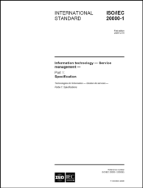


ITIL, ISO/IEC 20000, COBIT
IT Infrastructure Library (ITIL) Number of books with "good practice" in IT Service Management Slogan: "the key to managing IT services" Descriptions of key principles, concepts and processes in ITSM | Popular and wide-spread framework Not a "real" standard, but often regarded to as "de-facto standard" 5 books released by the British Cabinet Office
ISO/IEC 20000 International standard for managing and delivering IT services Requirements for a service management system (SMS) | Developed by a joint committee (JTC) of ISO and IEC Based on ITIL, BS 15000 Auditable, certifiable
Control Objectives for Information and Related Technologies (COBIT) Framework for governance and management of enterprise IT | Developed by ISACA can be combined with ITIL and ISO/IEC 20000
ISO/IEC 20000

Slide 127

ISO 9000, ISO/IEC 27000, CMMI
ISO 9000 International standard for quality management Quality management principles Requirements for a quality management system | Applicable to all organizations and branches Auditable, certifiable Several documents
ISO/IEC 27000 International standard for information security management Requirements for an information security management system (ISMS) More than 100 security controls | Applicable to all organizations and branches Auditable, certifiable Based on BS 7799 Auditable, certifiable Several documents
Capability Maturity Model Integration Maturity and capability model Organizational maturity assessment | Developed by SEI (Software Engineering Institute), Carnegie Mellon University
ISO 9000
ISO/IEC 27000

Slide 128
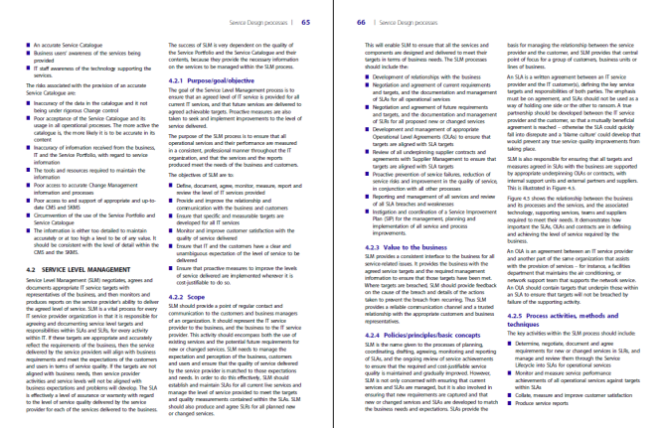
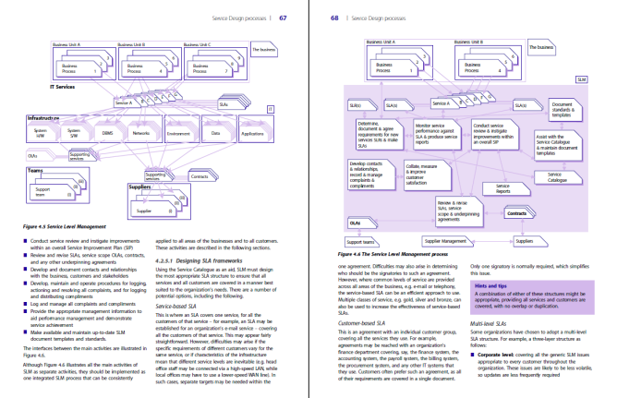
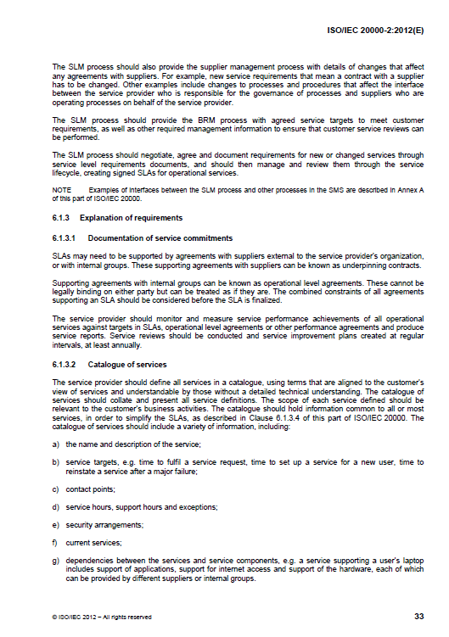
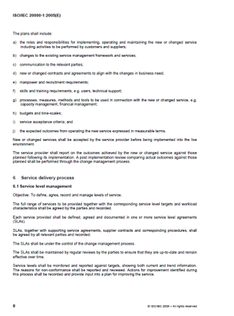
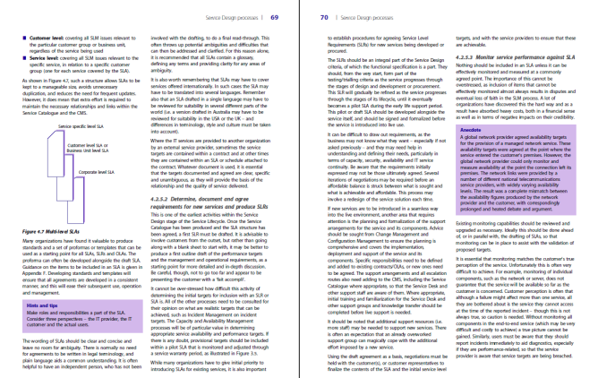

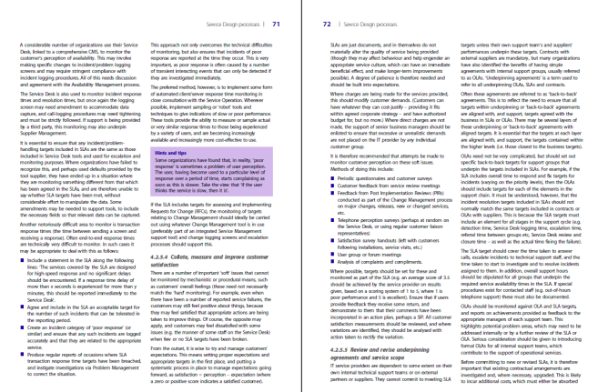
FitSM, ISO/IEC 20000 and ITIL
ISO/IEC 20000
136 pages (3 core documents)
26 pages of requirements (part 1)
FitSM
38 pages (4 core documents)
9 pages of requirements (part 1)
ITIL (good practices)
About 2,000 pages (5 core books)
No requirements

Slide 129
Some Sample Exam Questions?
(extra few for exam prep)

Slide 130
Exam preparation
In a service management system, what is subject to continual improvement?
SLAs and OLAs only
Technical services and related SLAs and OLAs only
Service management processes and procedures only
Services and service components as well as service management processes
Notes:
d)

Slide 131
Exam preparation
Why may it be difficult to apply traditional IT service management approaches (like ITIL, ISO/IEC 20000) to federated IT infrastructures?
Because they are designed for commercial enterprises only.
Because they are not detailed enough.
Because they are limited to ICT infrastructure management rather than following a service-oriented approach.
Because they assume single central control over all service management processes by the service provider and hardly address collaborative approaches to service delivery.
Notes:
d)

Slide 132
Exam preparation
Besides FitSM-1, which of the following standards specifies requirements for a service management system?
ISO/IEC 20000-1
ISO/IEC 27001
ISO 9001
ISO 19011
Notes:
a)

Slide 133
Exam preparation
Where would you expect to find information on (IT) services including service definitions and service targets agreed with customers?
In underpinning agreements (UAs)
In operational level agreements (OLAs)
In the service catalogue and in service level agreements (SLAs)
In service reports and change records
Notes:
c)

Slide 134
Exam preparation
Which of the following statements is correct?
A service is an element that contributes to the provision of one or more configuration items.
The service portfolio shows the relationships between service components and configuration items.
A service may be composed of several service components, which again may be built from configuration items (CIs).
There is no relationship between services, service components and configuration items.
Notes:
c)

Slide 135
Exam preparation
What level of capacity is targeted by the capacity management process?
Sufficient capacity to meet agreed demands
Sufficient capacity to meet all potential future demands
Capacity that would be sufficient to meet the average workload demand from the last 12 months
Capacity that ensures an average resource utilization between 85 and 95 per cent
Notes:
a)

Slide 136
Exam preparation
Establishing a supplier relationship management process is a requirement of FitSM-1. What is not a purpose of this process from a service provider's perspective?
To identify the suppliers
To establish communication mechanisms with suppliers
To set up a configuration management database (CMDB) together with suppliers
To monitor the suppliers' performance
Notes:
c)

Slide 137
Exam preparation
For which process shall problem management ensure that up-to-date information on known errors and effective workarounds is available?
For no other process
For the availability management process
For the configuration management process
For the incident and service request management process
Notes:
d)

Slide 138
Exam preparation
What is subject to the release & deployment management process?
To assess and approve software or infrastructure changes
To investigate and prevent the occurrence of information security incidents
To record all incidents
To bundle changes of one or more configuration items to releases
Notes:
d)

Slide 139


