Slide 1
EGI and EGI-Engage PY2 Overview
Tiziana Ferrari
EGI-Engage Technical Coordinator

Slide 2
Outline
Introduction to EGI
Introduction to EGI-Engage
Key Exploitable Results

Slide 3
The needs of modern research
In research and society, ICT has become one key enabling factor for progress
Changing the modus operandi of research, new possibilities for geographically distributed collaboration and sharing
Data-driven science and more open access to data and scientific results transforming how science is made
All large-scale Research Infrastructures and the long tail of science depend on ICT resources
Need to find synergies and to develop ways to tackle the ICT challenges at a generic level
Effective and cost efficient services that can be of wide and general use

Slide 4
EGI: advanced computing for research
EGI is a federation of over 260 computing and data centres spread across 40+ countries in Europe and worldwide
EGI delivers services to support scientists, multinational projects and research infrastructures
www.egi.eu
Notes:
EGI is a federation of over 300 computing and data centres spread across 50+ countries in Europe and worldwide
EGI delivers services to support scientists, multinational projects and research infrastructures from public and private sector.

Slide 5
EGI’s mission is to create and deliver
open solutions for science and research
by federating digital capabilities,
resources and expertise
between communities and
across national boundaries.
Notes:
EGI’s mission is to create and deliver open solutions for science and research by federating digital capabilities, resources and expertise between communities and
across national boundaries.

Slide 6
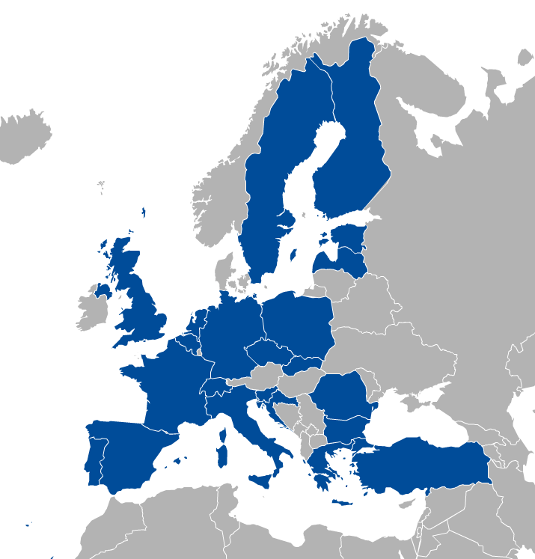
EGI Participants
Major National e-Infrastructures: 22 NGIs
EIRO: CERN
EGI Foundation
(ERICs)

Slide 7
EGI Support to Research
4000 peer reviewed scientific publications in 2016
200 research groups
61,000 users (+30% in EGI-Engage)
Social Sciences
Medical and Health Sciences
Physical Sciences
Natural Sciences
https://www.egi.eu/use-cases/research-stories/

Slide 8
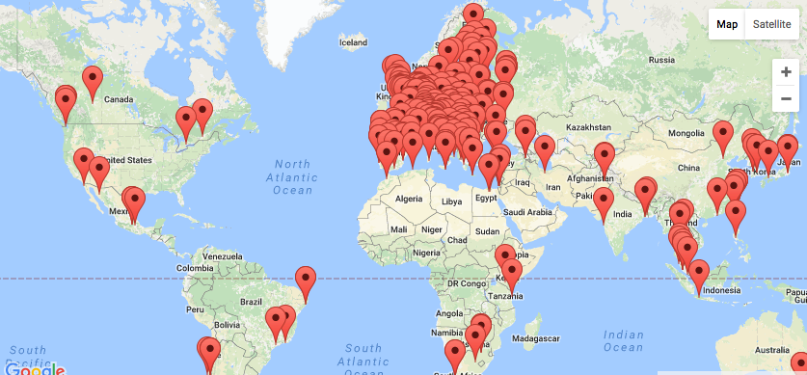
EGI Federation
260+ HTC providers
20 Cloud providers
730 k CPU cores
650 PB online storage
1.7 Million jobs/day
2.6 Billion CPU hours/year

Slide 9
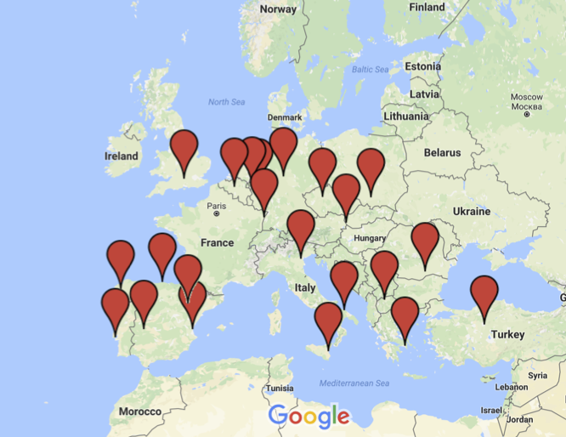
EGI Federated Cloud - Providers

Slide 10
A global system of e-Infrastructures
Africa-Arabia, Asia and Pacific region, China, Europe, India
North and South America, Ukraine
China:
Institute of HEP,
Chinese Academy of Sciences
Europe (mainly)
Africa and Arabia:
Council for Scientific and
Industrial Research, South Africa
Latin America:
Universida de Federal do Rio de Janeiro
India:
Centre for Development of
Advanced Computing
Australia:
Nectar Research Cloud
USA
Canada

Slide 11
Why a federation?
Leverage national e-Infrastructure investments
Open access to national infrastructures and services, support international user groups
Integrated community, private and/or public infrastructures into a scalable data/computing platform for research.
Ease of access via federated identity provisioning and single authentication and authorization framework
Interoperability of scientific applications and data across multiple providers bringing distributed computing to data.

Slide 12
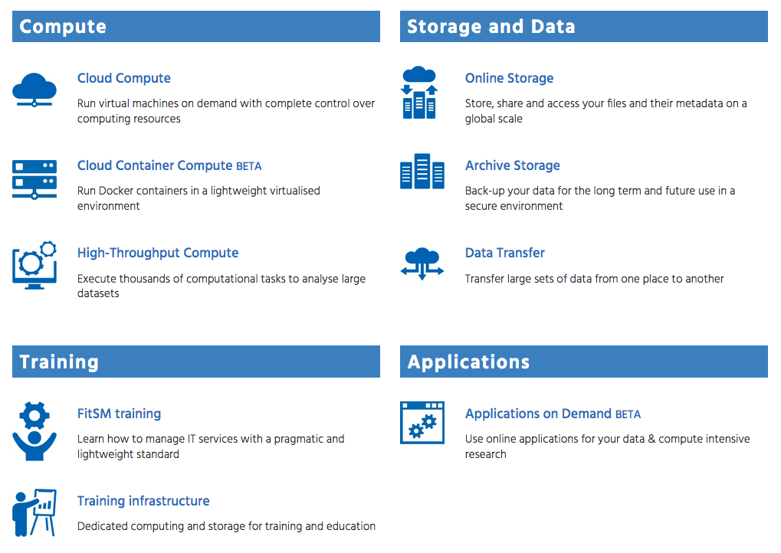
External service catalogue
New
https://www.egi.eu/services/

Slide 13
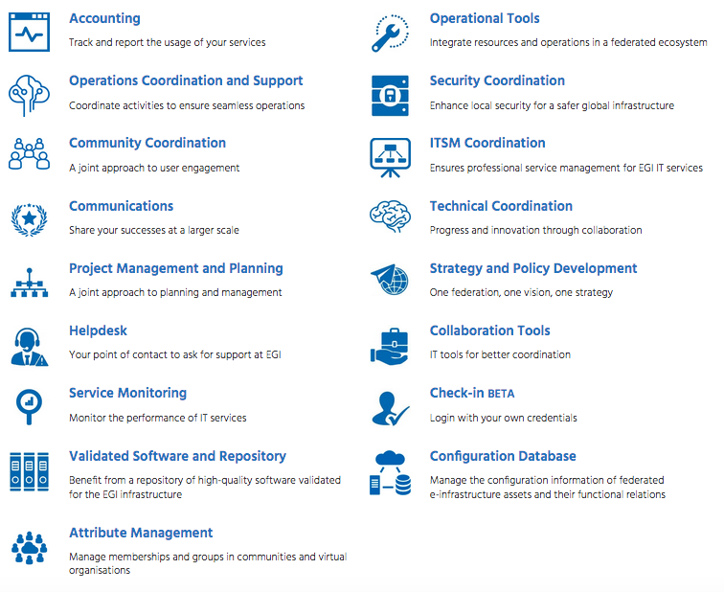
Internal service catalogue for providers of the EGI Federation
New
https://www.egi.eu/internal-services/

Slide 14
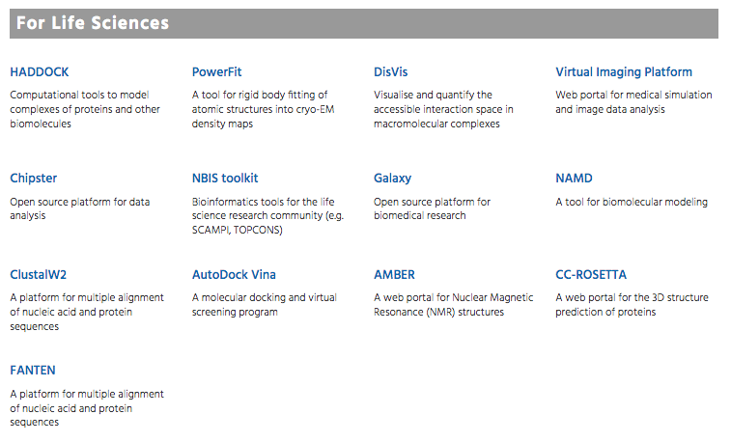
Scientific Applications and Tools from EGI Partners
Life Sciences
Arts and Humanities
Computer Science and Mathematics
Earth Sciences
Multi-disciplinary
https://www.egi.eu/use-cases/scientific-applications-tools/

Slide 15
EGI-Engage support to the service catalogues
SA2 → Integrate Deliver Coordinate
Training Infrastructure
Community coordination
JRA1 → Develop
Accounting
SA1 → Operate and coordinate
Operations Coordination and Support
NA2 → Deliver and coordinate
Communications
Helpdesk
Service monitoring
Validated Software and Repository
Operational Tools
Security Coordination
NA1 → Coordinate
ITSM Coordination
Strategy and Policy
Configuration Database
Applications on demand
Attribute Management
JRA2 → Develop
Cloud Compute
Cloud Container Compute
GPU Compute
Online Storage
Service Portfolio Management
IT Service Management
Scientific applications/tools

Slide 16
IT Service Management in EGI-Engage (1/2)
Customer needs
Understanding of customers’ requirements
Process approach
In delivering and supporting IT services
Roles, Procedures, activities and policies
Consistency
Consistent terminology to avoid bad communication and lack of understanding
FitSM
Reference standard of the EGI-Engage IT SM
IT service operations aligned to customers’ needs

Slide 17
IT Service Management in EGI-Engage (2/2)
Policy
1. Abc def ghijk.
2. Abc def ghijk.
3. Abc def ghijk.
4. Abc def ghijk.
Governance level
Top management
Process owners
e.g. Incident handling policy, change policy, security policy
Control level
Process managers
Process teams
Process:
Inputs
Activities and roles
e.g. incident management, change management, security management, …
Outputs
Operational level
Departments
Functions
Persons
Proce-
dures
Person (in a role)
e.g. procedures for classifying and prioritizing incidents
applies

Slide 18
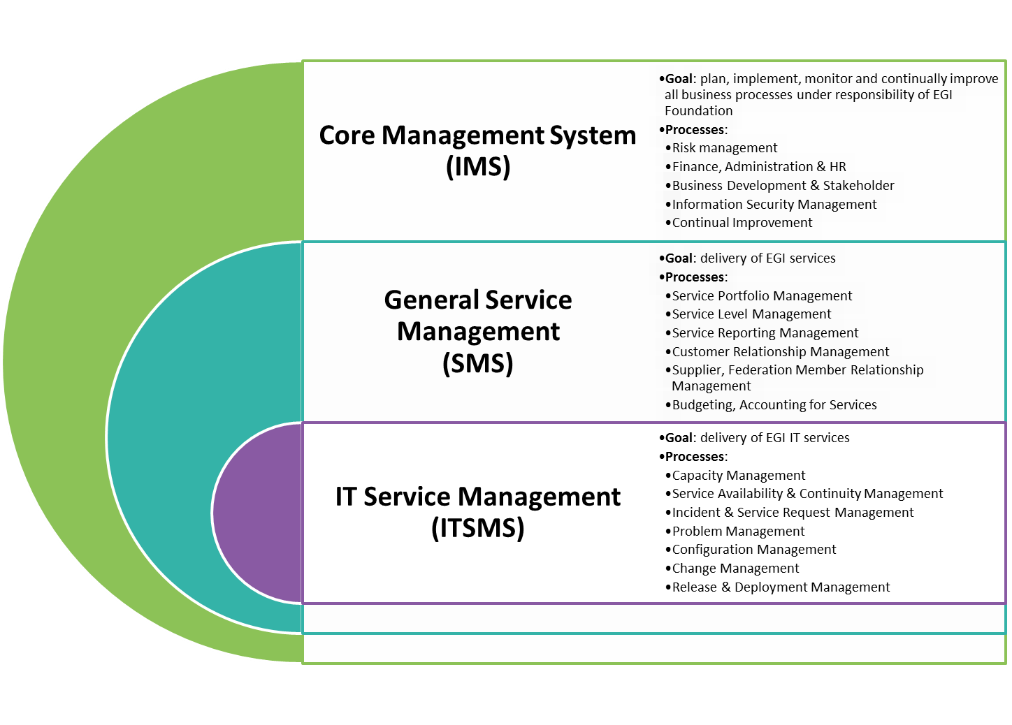
Processes

Slide 19
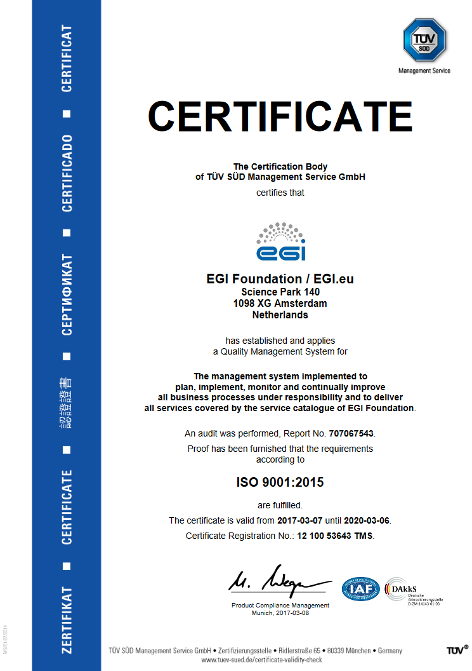
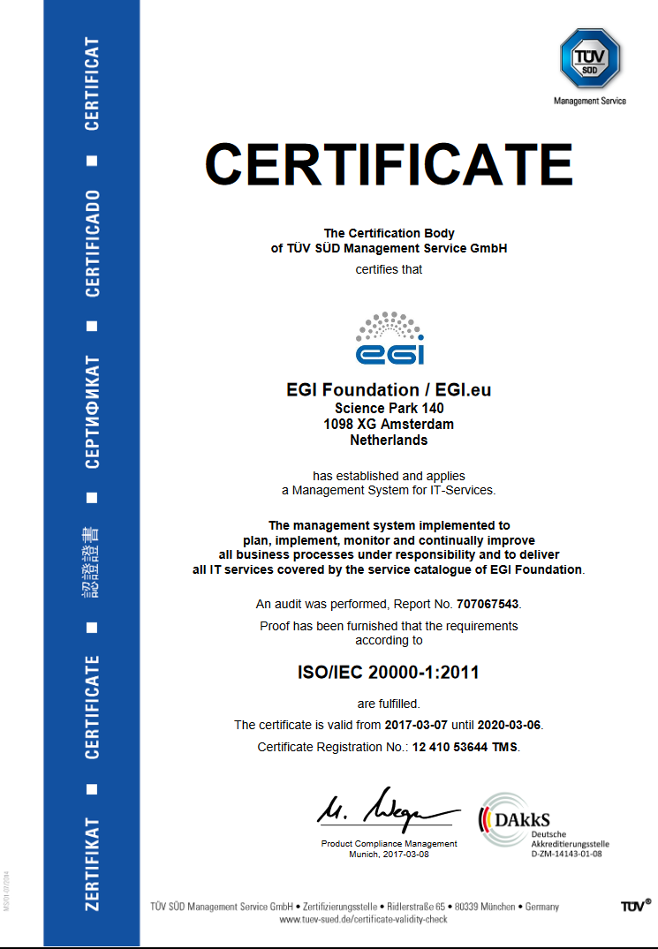
ISO certifications
ISO 9001
ISO 20000

Slide 20
EGI-Engage
A project built
on the Open Science Commons vision to advance its realization
http://www.egi.eu/about/egi-engage/

Slide 21
Objective 1
Ensure the continued coordination of the EGI Community in
Strategy and policy development
Engagement
Technical user support and
Operations of the federated infrastructure in Europe and worldwide
EGI.eu
EIRO
ERIC
EGI
NGI
RP
RP
RP
EGI Federation
NGI
RP
RP
RP
RC
other
PP
TP
EGI Community

Slide 22
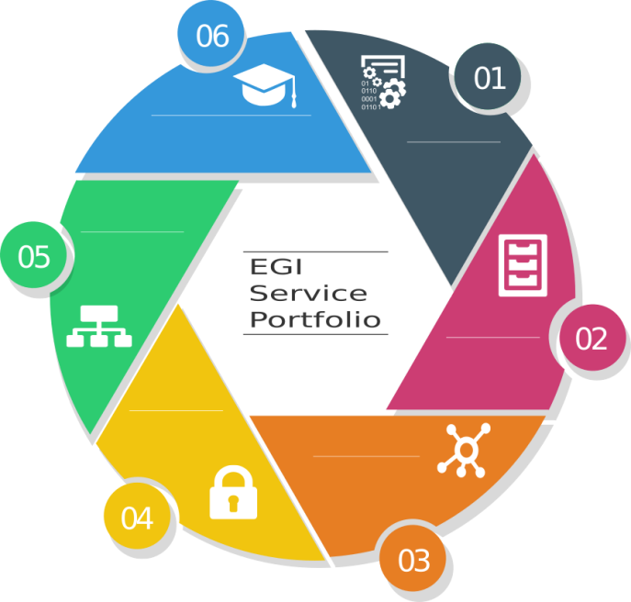
Objective 2
Evolve the EGI services
Capabilities
Business model
Access policies for different target groups
Provide services for
Large and medium size RIs,
Small distributed research projects and communities and single users
Higher education, industry/SMEs

Slide 23
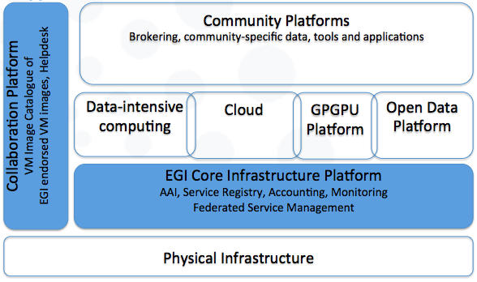
Objective 3
Digital services and applications
Knowledge & Expertise
Research Data
Instruments
Offer and expand an e-Infrastructure Commons solution
Develop existing and new federating services
Core infrastructure platform and Collaboration platform

Slide 24
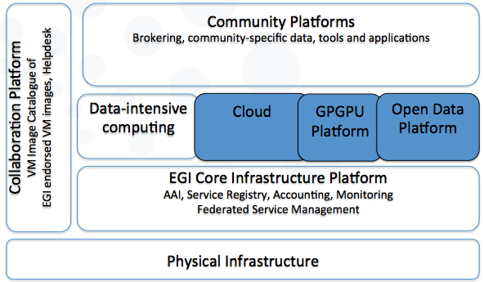
Objective 4
Digital services and applications
Knowledge & Expertise
Research Data
Instruments
Prototype an open data platform and contribute to the implementation of the European Big Data Value
Extend the capabilities of existing EGI platforms (cloud and HTC)
Develop new platforms
Open data platform
Accelerated computing platform

Slide 25
Objective 5 (1/2)
Promote the adoption of the current EGI services and extend them with new capabilities through user co-development
Requirement gathering, co-design, co-development and integration, training and technical user support
Provide new platforms compatible with the EGI Core Infrastructure Platform and drives its evolution → Applications on demand and thematic service
Co-design through a network of Competence Centres
Digital services and applications
Knowledge & Expertise
Research Data
Instruments

Slide 26
Objective 5 (2/2)
Distributed Competence Centre
BBMRI
ELIXIR
EPOS
MoBrain/ INSTRUCT
EISCAT-3D
DARIAH
LifeWatch
Environment (disaster mitigation)
EMSO (new)
ICOS (new)

Slide 27
Work Packages
NA2
Policy, Strategy and Communications
JRA2
Platforms for the Open Data Commons
SA2
Knowledge Commons
SA1
Operations
NA1
Project Management
JRA1
E-Infrastructure Commons

Slide 28
Identification of project results
Training on dissemination and exploitation
Regular interviews with WP personnel
Definition of dissemination and exploitation plans
Selection of Key exploitable results

Slide 29
Analysis
86 results
12 Key Exploitable Results
35 different primary owners
58 technologies integrated

Slide 30
Key Exploitable Results
Services and Software
Improved EGI Service Portfolio
Policies Processes Procedures
Strategy, Governance and Procurement
Policy papers on EOSC
Marketplace
Federated Authentication and Authorization (Check-in)
Federated Cloud Computing
Tools for federated service management
Open Data Platform
Thematic services
Applications on Demand
Integrated Management System and Certification
Security Policies

