Slide 1
WP6 Knowledge Commons
Gergely Sipos
Customer and Technical Outreach Manager, EGI Foundation
SA2 Activity Manager, EGI-Engage

Slide 2
Outline [customize as needed]
WP Overview
Objectives, tasks, partners and effort
Achievements
Training
Engagement and support for new communities
Competence Centres
Use of resources, issues [issues: only main ones which required major changes or escalation]
Summary

Slide 3
WP Overview

Slide 4
SA2 (WP6) objectives
Objective
1. Identify and support communities and users from EGI and its partners
2. Facilitate the integration of scientific applications with EGI’s e-Infrastructure services
3. Co-design and co-develop services for sustainable, structured scientific communities
4. Promote and support the uptake of new services within scientific communities
5. Provide a training framework, foundational training services and domain specific training events for scientific communities, EGI members and partners

Slide 5
SA2 Partners and effort – TBC
SA2 | Task | Leader / Partner
SA2.1 | Training | Gergely Sipos / EGI.eu
SA2.2 | Technical User Support | Enol Fernandez / CSIC
SA2.3 | ELIXIR | Kimmo Mattila / CSC
SA2.4 | BBMRI | Petr Holub / BBMRI-Eric
SA2.5 | MoBrain | Alexandre Bonvin / BCBR – SURFsara
SA2.6 | DARIAH | Davor Davidovic / RBI – SRCE
SA2.7 | LifeWatch | Jesus Marco de Lucas / CSIC
SA2.8 | EISCAT_3D | Ingemar Häggström / EISCAT
SA2.9 | EPOS | Daniele Bailo / INGV – INFN
SA2.10 | Disaster Mitigation | Simon Lin / AS
47 Participants (incl. Asia Pacific and US)
WP Total effort
178 PMs
6 FTEs
Notes:
Provided by PO

Slide 6
Activities and Achievements
Notes:
Main achievements of the work package

Slide 7
Training Task 6.1
Established and operated a cloud-based training infrastructure
For cloud trainings AND for application trainings
4 sites, ~150 vCPUs
Used by ~250 students in 11 courses during the project
Reference courses: 17 topics
Delivered for CCs (as webinars)
Delivered for RI representatives (RI and EGI conferences)
Delivered for research students and researchers (1/2 day tutorials and Summer Schools)
Delivered for NGIs (Webinars, EGI Conferences)
Event delivery and support
42 tutorials at 33 events (19 f2f, 12 webinar-type) – 20 EGI events, 13 external events
Approx. 800 participants in total (~25 on average)
Contributed to 2 summer schools in 2017: CODATA-RDA
Joint activities with EUDAT, GEANT, OpenAire, RDA
Joint events:
‘Design your e-infrastructure’ workshops (2x in 2016; planning for 2017)
Introduction to European E-infrastructures (DI4R, September 2016)
The project established an infrastructure and content catalogue, covering the EGI Service Portfolio
Notes:
ICOS and EMSO, EXTRAS project, long tail of science applications via brokering
RI, projects and single users

Slide 8
EGI serves researchers and innovators
Competence Centres (task 6.3-10)
Review list of communities mentioned, e.g.
Gnubila (Mobrain) is a technology provider, TEISS is a project,
SixSq is a technology partner
Size of individual groups
ELIXIR
BBMRI
INSTRUCT
DARIAH
LifeWatch
EISCAT_3D
EPOS
Disaster Mitigation
WLCG
ELI
CTA
CLARIN
LOFAR
ICOS
EMSO
CORBEL
ENVRIplus
…
Direct engagement (task 6.2)
VRE projects
OpenDreamKit
WeNMR
DRIHM
VERCE
MuG
AgINFRA
CMMST
LSGC
SuperSites Exploitation
Environmental sci.
neuGRID
…
Tools and support for the NGIs
(task 6.2, 1.3)
PeachNote
CEBA Galaxy eLab
Semiconductor design
Main-belt comets
Quantum pysics studies
Virtual imaging (LS)
Bovine tuberculosis spread
Convergent evol. in genomes
Geography evolution
Seafloor seismic waves
3D liver maps with MRI
Metabolic rate modelling
Genome alignment
Tapeworms infection on fish
…
(task 2.3)
Agroknow
CloudEO
CloudSME
Ecohydros
gnubila
Sinergise
SixSq
TEISS
Terradue
Ubercloud
…
ESFRIs, FET flagships
Multinational communities, (e.g. H2020 projects)
Industry, SMEs
‘Long tail of science’

Slide 9
SA2 in EGI: Implementing the CRM IMS process (see details in D2.14)
Outreach and training
Opportunity identification
Opportunity analysis
Handling service requests (also from Website)
Technical onboarding
SLA-OLA negotiation
Service reports
Regular satisfaction reviews (incl. publications)
Complaints
→ SA2.1 Training
SA2.2 Tech. User Support
SA2.3-10 – Comp. Centres
1
2
3
4
5
6
Training (SA2.1)
New communities (SA2.2)
ELIXIR (SA2.3)
BBMRI (SA2.4)
MoBrain (SA2.5)
. . .
Notes:
A general slide on engagement and technical support process of EGI useful, showing how different SA2 tasks fit into this process

Slide 10
Technical user support Task 6.2 Highlights
Support network and support tools
Integrated engagement and Customer Relationship Management with FitSM
Business opportunities → | → Technical onboarding → | Operations (with SLAs, OLAs)
Regular ‘Service satisfaction and capacity planning’ interviews with customers
Service requests from EGI Website (35 requests in the past 5 months)
Coordination/update meetings with the NGI International Liaisons
Engagement and support for new communities
32 communities in 30 months (besides the 8 competence centres)
19 Research Infrastructures and 13 project/platform developer communities
'Design your e-infrastructure' events
Analysis of requirements – Design of suitable service composition
5 community / event (ICOS, EuroArgo, CLL, ELI, …); Co-organised with EUDAT, GEANT,...
The workshop format was adopted by the Dutch NGI at national events
Platform for the Long-tail of science
‘Applications On Demand’ service in the Catalogue
Operational setup with 15 applications, 3 gateways, 3 clouds, 5 HTC clusters
33 users since May (Public opening) → not sure this is good enough good to be mentioned

Slide 11
Achieved maturity (Described in details in D2.14)
1
2
3
4
Early engagement
Co-development.
Prototype/pilot setup
Production setup
15 new communities:
ACTRIS
Agricultural sc.(AGINFRA+)
AnaEE
Blue Cloud institutes
CESSDA
DANUBIUS
EBMRC
ELI (ELItrans)
EMPHASIS
EODC
Human Brain Project
KM3Net
LTER
SKA (AENEAS)
Virgo and LIGO
5 new communities:
BigDataEurope
EuroBioImaging
CLL research initiative
Multi Scale Genomics VRE
PhenoMeNal
7 new communities:
BioExcel
BioISI
EMSO
ENES
Euro-Argo
ESA TEPs
ICOS
OpenDreamKit VRE
4 CCs:
BBMRI
ELIXIR
EPOS
EISCAT_3D
5 new communities:
D4Science
ExTRAS
NBIS
PeachNote
VIP
4 CCs:
DARIAH
Disaster Mit.
LifeWatch
MoBrain
→ TS in EOSC-hub
→ CC in EOSC-hub
→ TS in EOSC-hub
→ CC in EOSC-hub

Slide 12
Support for new communities – Examples
AQUAEXCEL H2020 project
Identified on the CORDIS website in June 2017: “a dedicated e-infrastructure which will support both actual and virtual research experiments'”
Discussions are ongoing in email (external vs. internal services)
NBIS (National Bioinformatics Infrastructure Sweden)
PconsC2, Pcons, TOPCONS2 servers on Federated Cloud
TOPCONS2 predicted more than 2 million protein sequences by 5000 users from 69 countries
1
2
3
4
Early engagement
Co-development.
Prototype/pilot setup
Production setup
European Research Initiative on chronic lymphocytic leukemia
From 2nd Design Workshop
Moved to stage 2 in PY2
VRE with data repository and applications (Galaxy workflows with Perl, R, JavaScript)
Limited demonstrator achieved
Scale-up and plan for community demo
ICOS – Coupling compute with EUDAT storage
From 1st Design Workshop
Reached stage 3 in PY3
Docker containers in the FedCloud
Shared datasets hosted in the EGI ODP
Stage-in/Stage-out EGI ←→ EUDAT B2SAFE
Scalability tests ongoing

Slide 13
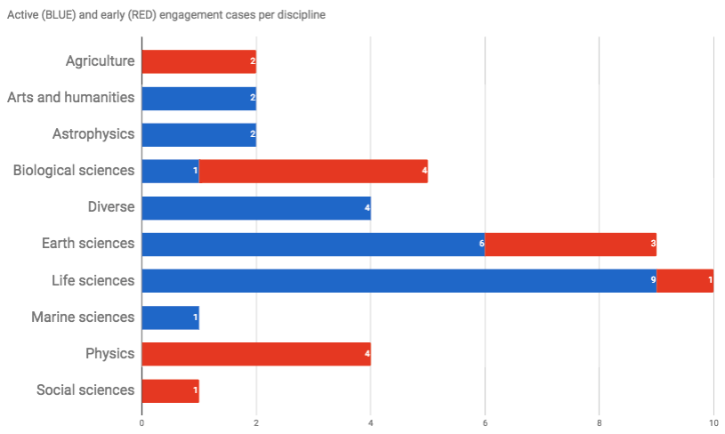
Reach-out per disciplines
Notes:
Life science (incl. Biological scineces) dominate → Because there are so many projects/Ris in this; Because they pro-actively look for capacity. (Note that several of these relate to biodiversity research)
In the second period we broadened our reach: Agriculture; Social sciences; Physics
Still underrepresented: Arts and humanities

Slide 14
Provide feedback on SLA and SLA management in IMS
I think few general slides on customer-facing processes of IMS is beneficial

Slide 15
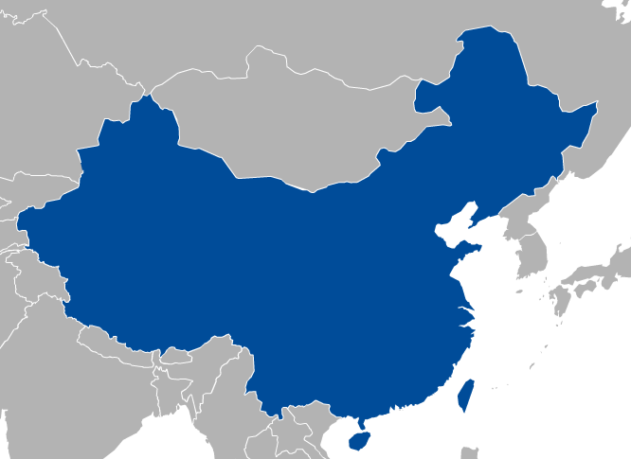
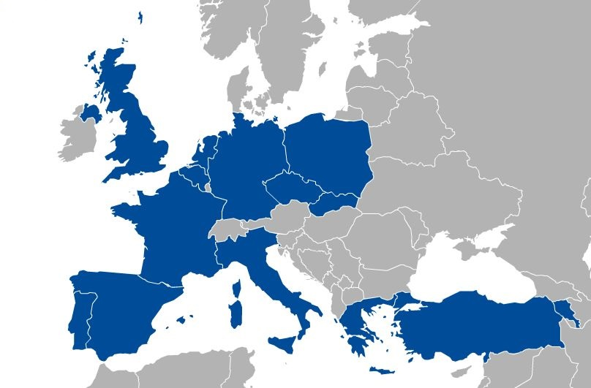
Technical user support Task 6.2 - SLAs
11 SLAs signed and 1 MoU
36 providers
>152 Million of CPU hours
>170TB of storage
>3926 GB of RAM, >1410 vCPU cores
Very crowded, unreadable
Signed SLAs:
Bioinformatics Services to Swedish Life Science (BILS)
Structural biology and brain research
Hydro-metereology (DRIHM)
ESA-Tematic Exploitation Platforms (Terradue)
Climate Change (EMSO)
Art & Humanities (DARIAH, Peachnote)
Medical and Health Science (LSGC-VIP, BioISI, MoBrain)
Astronomy and Astrophysics (EXTraS)
Natural Sciences (D4Science)

Slide 16
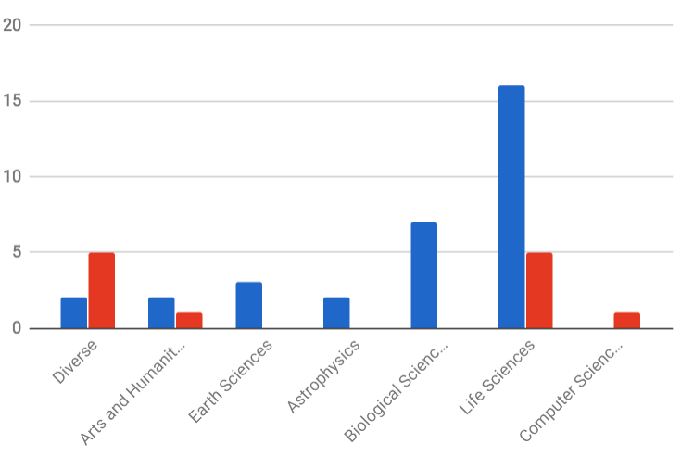
Support for the long-tail of science
Applications On Demand Platform: 30
Roll-out through the NGIs
Webinar; Conference paper; Newsletter articles; Demos
Thematic services: 15
THEMATIC SERVICE
APPS ON DEMAND

Slide 17
Competence Centres: SA2.3-10
ESFRI Landmark
ESFRI Landmark
Distributed Competence Centre
BBMRI
ELIXIR
EPOS
MoBrain/ INSTRUCT
EISCAT-3D
DARIAH
LifeWatch
Environment (disaster mitigation)
EMSO (new)
ICOS (new)
NEW!
ESFRI Landmark
ESFRI Landmark
ESFRI Project
ESFRI Landmark
ESFRI Landmark
ESFRI Landmark
ESFRI Project
Notes:
ESFRI Projects:
The ESFRI Projects have been selected for scientific excellence and maturity and are included in the Roadmap in order to underline their strategic importance for the European Research Infrastructure system and support their timely implementation. The ESFRI Projects can be at different stages of their preparation according to the date of inclusion in the ESFRI Roadmap.
ESFRI Landmarks:
The ESFRI Landmarks are the RIs that were implemented or started implementation under the ESFRI Roadmap and are now established as major elements of competitiveness of the European Research Area. The ESFRI Landmarks need continuous support for successful completion, operation and upgrade in line with the optimal management and maximum return on investment.

Slide 18
Competence Centres: Diverse interests, different maturity
Number of relevant EGI service areas
It would be good to show status by comparison with
Previous review
Thematic service providers in EOSC-hub
Several, interlinked areas
EPOS
CCs in EOSC-hub
ELIXIR
MoBrain
AAI
Federated cloud
Federated Open Data
Application porting
Core platform (AAI, Service registry)
Federated Cloud
VM Marketplace
Application/tool porting
GPGPUs
Federated cloud
Community platform
Application porting
LifeWatch
EISCAT_3D
Federated cloud
AAI Community VREs
Few, independent areas
EMSO
Data catalogue
HTC
Cloud
Data processing Publishing and curation
in the cloud
DARIAH
Real-time search application
Compute apps
BBMRI
Disaster Mitigation
Private clouds
Workflows in the cloud
Data-intensive computing
Community portals
One/two areas
Pilot exploration of e-infra services
Achieved service maturity
Production e-infra services
Notes:
Need to put ICOS somewhere! – OR remove EMSO?

Slide 19
CC achievements
Thematic services from 4 CCs:
MoBrain-8, DARIAH-1, LifeWatch-2, Disaster Mitigation-2
Serving more than 10.000 users
Consumed 1,450,622 CPUh from EGI Cloud
Consumed 76,123,210 CPUh from EGI HTC
Setup of demonstrators/pilots from 5 CCs:
ELIXIR-6, BBMRI-3, EISCAT_3D-1, EPOS-3, EMSO-1
Consumed over 159.134 CPUh from EGI Cloud
More than 130 events/sessions in 30 months
To share experiences
To promote Thematic Services
To demonstrate capabilities and make recommendations to RIs
These outcomes were reported in 22 deliverables and 5 milestones

Slide 20
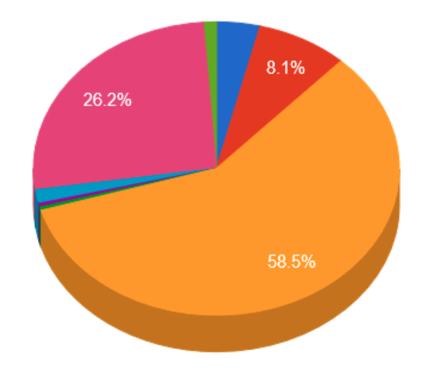
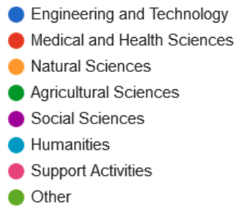
The EGI user base Number of users served in last 6 months
+30% during EGI-Engage
Breakdown per access type at the end of project
Personal certificates: 30.651
Robot certificates (→ CheckIn): 10.412
Thematic services: 20.203
Personal certificate users
<THEMATIC services chart>
Notes:
Showing trends?
Showing ratio of CCs vs the rest? → Was it a big share? Was there a bigger increase in CC domains compared the rest?
Science discipline break-down for each group
→ Personal cert is dominated by WLCG/Physics
Thematic services to reach and serve non-physics communities

Slide 21
User trend: Personal cert users
LSST VO

Slide 22
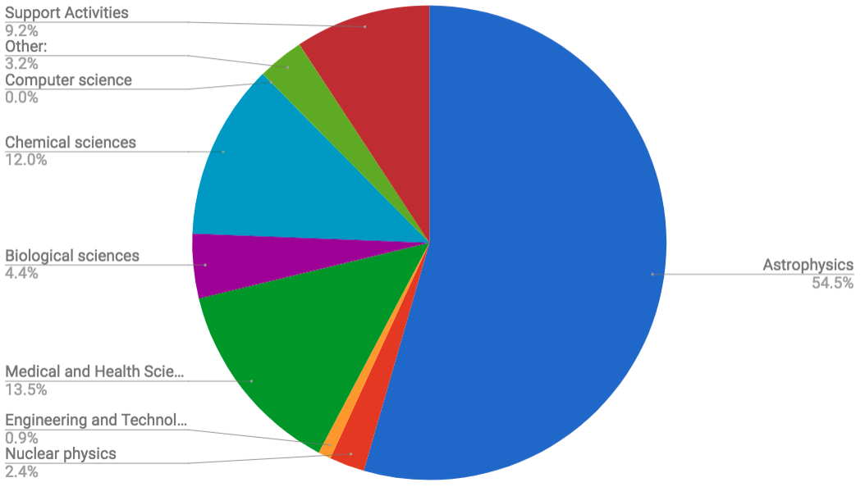
The EGI user base CPUh consumption in last 6 months
9X% WLCG
Withouth WLCG: 41 million CPUh
Showing trends instead?

Slide 23
Details on Communities
See community flash talks after me:
WeNMR/MoBRAIN CC: Community of practice
ELIXIR CC: Implementation phase RI
ICOS (new community): EGI-EUDAT integration
WLCG (heaviest user): Established community, using also EGI’s internal portfolio

Slide 24
Use of Resources and Issues
Notes:
Numbers will be provided by PO, work package leaders must provide explanation

Slide 25
Effort analysis
To be completed when data is finalised

Slide 26
Summary
Notes:
Freedom on way to present

Slide 27
Summary
Objective 1 (O1): The continued coordination of the EGI Community.
CRM process that spans from opportunity identification to operational support
Support 40 communities – 8 CCs and 32 new communities
Established a new workshop format (Design Your E-infrastructure)
Objective 5 (O5): Promotion the adoption and extension of the current EGI services
42 training events; 130+ CC events
Uptake of cloud (by 24 communities); HTC (by 3 communities); Online storage (by 4 communities); AAI and operation tools (by 4 communities)
Services are secured with SLAs to 11 communities
Established and opened the Applications On Demand service
All this was funded in the project with 6 FTE
The real achievement was bringing together 100+ experts to deliver tangible results:
Knowledge commons
Notes:
46 institutes
~0.1 FTE/institute

Slide 28
Key exploitable results
KER name | Description
Software and services
Thematic services integrated | Integrated scientific applications with EGI’s e-Infrastructure services; Co-designed and co-developed services for sustainable, structured scientific communities; Promotion and support of the uptake of new services within scientific communities;
+
collected requirements and feedback for many other services
Helped the roll-out, promotion and support of new service

