Slide 1
Integrated Management System and Certification
Małgorzata Krakowian
Quality manager/WP1

Slide 2
Outline
Introduction
Description
Analysis of result’s impact
Innovation level and capacity
Relevance of the key result
Exploitability level

Slide 3
Introduction

Slide 4
EGI-Engage: Key Exploitable Results
Integrated Management System and Certification
Updated strategy, governance and procurement
Policy papers on the EOSC
Improved EGI Service portfolio
Tools for federated service management
Security policies
Marketplace
Check-in
Federated Cloud Computing
Open Data
Platform
Integrated thematic services
Applications on Demand
Notes:
Policy, Processes and Procedures
Overall goal: Ensure systematic and professional operations and delivery of services

Slide 5
Integrated Management System
Development of management system to plan, implement, monitor and continually improve all business processes under the responsibility of EGI Foundation.
Customer needs
Understanding of customers’ requirements
Process approach
In delivering and supporting services
Roles, Procedures, activities and policies
Consistency
Consistent terminology to avoid bad communication and lack of understanding
Standard
International standards: ISO/IEC 20000-1:2011 and ISO 9001:2015
Service operations aligned to customers’ needs
Repeatability based on defined procedures and templates
Notes:
The implementation of an Integrated Management System (IMS) which integrates all of the distributed organization's systems and processes into one complete framework, enabling an organization to work as a single unit with unified objectives.

Slide 6
Integrated Management System
Policy
1. Abc def ghijk.
2. Abc def ghijk.
3. Abc def ghijk.
4. Abc def ghijk.
Governance level
Control level
Process
Inputs
Outputs
Operational level
Proce-
dures

Slide 7
Integrated Management System Core processes
Risk Management
Finance & Administration
Human resources
Business Development & Stakeholders
Information Security Management
Continual Improvement
The systematic and regular identification, assessment and treatment of risks of any type, including risks related to information security, (IT) service continuity and overall quality.
Effective management of finance, business and office administration.
Ensure effective management of human resources.
Identifying stakeholder and their needs
Manage information security effectively through all activities performed to deliver and manage services, so that the confidentiality, integrity and accessibility of relevant information assets are preserved
Identify, prioritize, plan, implement and review all improvements
Maintain the relationships with the Council participants and funding agencies/policy makers
Review the EGI Strategy and its implementation
Track the definition of Memorandum of Understandings between the EGI Foundation or EGI Foundation led projects and other partners
Notes:
Core – all business processes in EGI
General – delivery of EGI services
IT – delivery of EGI IT services

Slide 8
Integrated Management System General processes
Service Portfolio Management
Customer Relationship Management
Service Level Management
Service Reporting Management
Supplier & Federated members relationship Management
Budgeting & Accounting Management
Manage the service portfolio in order to ensure its regular review and to align new or changed services with business decisions as part of the overall organisation strategy.
Maintain a service catalogue, and to define, agree and monitor service level agreements (SLAs), supportive operation level agreements (OLAs) and underpinning agreements (UA).
Specify all service reports and ensure they are produced according to specifications in a timely manner to support decision-making.
Identify, record and analyse customer opportunities, manage service orders and maintain a good relationship with customers,
Establish and maintain a healthy relations with suppliers supporting the service provider in delivering services to customers, to ensure that the required capacity is provided, and monitor their performance
Ensure effective management of budgeting, accounting for Services
Notes:
Core – all business processes in EGI
General – delivery of EGI services
IT – delivery of EGI IT services

Slide 9
Integrated Management System IT processes
Capacity Management
Service Availability & Continuity Management
Incident & Service Request Management
Problem Management
Configuration Management
Change Management
Release & Deployment Management
Ensures sufficient capacities are provided to meet agreed service levels and performance requirements for services that are part of our catalogue.
Ensure sufficient service availability to meet agreed requirements and adequate service continuity in case of exceptional situations
Restore normal / agreed service operation within the agreed time after the occurrence of an incident; respond to user service requests, namely user request for information, advice, access to a service or a pre-approved change
Investigate the root causes of (recurring) incidents in order to avoid future recurrence of incidents by resolving the underlying problem, or to ensure workarounds / temporary fixes are available
Provide and maintain a logical model of all configuration items and their relationships and dependencies
Ensure changes to Configuration Items are planned, approved, implemented and reviewed in a controlled manner to avoid adverse impact of changes to services or the customers receiving services
Identify one or more changes of one or more configuration items to releases, so that these changes can be tested and deployed to the live environment
Notes:
Core – all business processes in EGI
General – delivery of EGI services
IT – delivery of EGI IT services

Slide 10
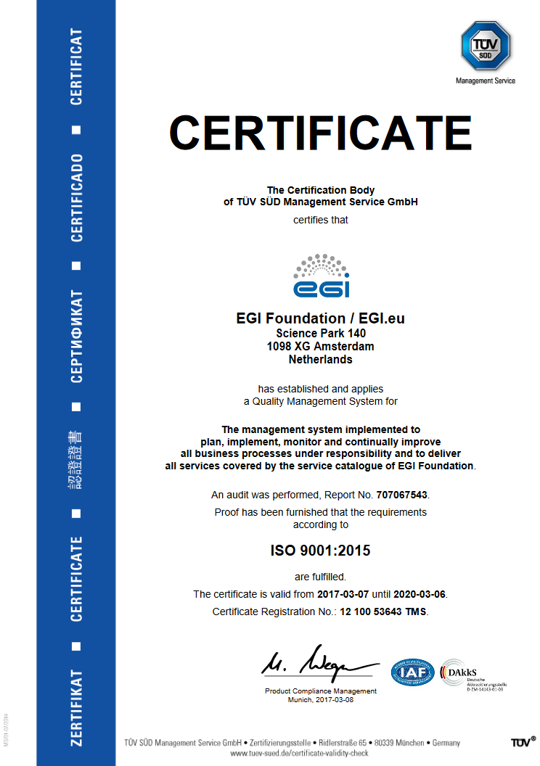
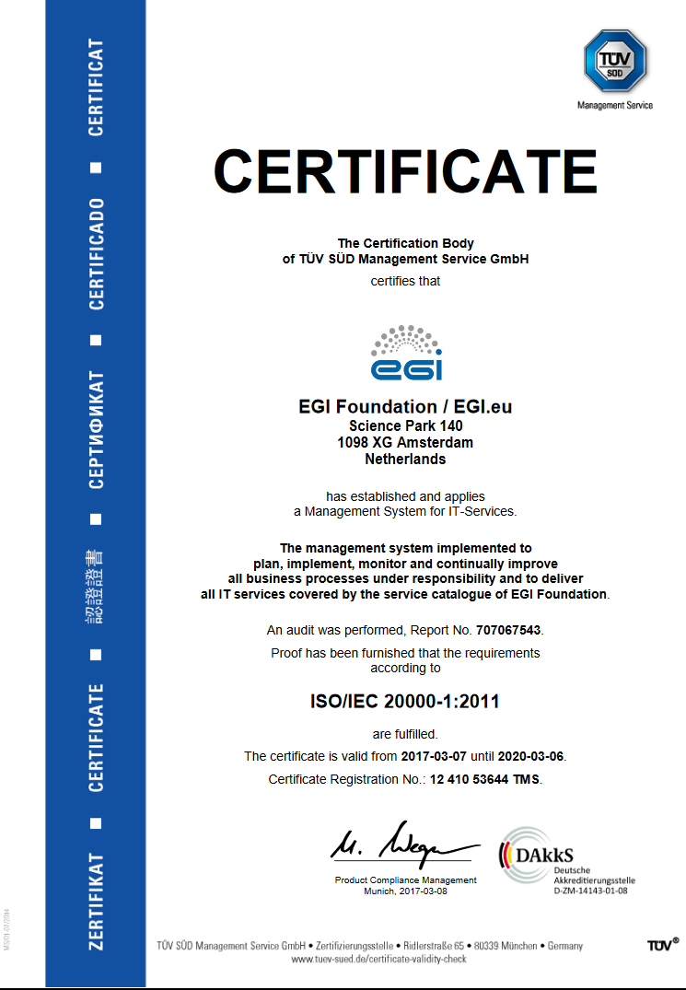
ISO certifications
ISO 9001
ISO 20000

Slide 11
ISO certifications
ISO 9001:2015
Requirements for a quality management system
Defines a set of requirements which indicate a certain general level of professionalism, repeatability and adherence to the key quality principles
Covers all business processes including administration and finance, human resources, quality management, risk management, business relationships and continuous improvement.
ISO/IEC 20000-1:2011
Requirements for a service management system
Defines requirements which indicate a high level of capability in delivering “good services” to customers
Is an IT specialization of ISO 9000 designed to cover delivery of all IT-related services
Notes:
(process-oriented approach, customer focus, healthy relationship with interested parties, continual improvement, leadership, decision-making based on facts, involvement of people, systematic approach)

Slide 12
Analysis of result’s impact

Slide 13
Innovation level and capacity
Innovation level:
It puts in place standard processes, procedures and agreements for managing the infrastructure efficiently and effectively.
It increased clarity on expectations between EGI partners and also customers.
Decision-making has a clearer flow between organizations and individual teams.
Innovation Capacity:
Promote EGI as trusted partner.
Knowledge and experience can be reused by other e-infrastructures through consultancy, audits, workshops and trainings.
Notes:
Innovation level
Describe which are the main benefits derived by using this result, who is using today and who is expected to use it in the next three years
Innovation Capacity within the next 3 years

Slide 14
Relevance of the key result Exploitability level
Relevance to Work Programme and societal Challenges:
Impact 2. Better optimisation of the use of IT equipment for research
Relevance of Result for Policy domain of EOSC:
Share knowledge and experience in EOSC-Hub project.
Exploitation:
Promote the adoption of good practices in IT Service Management
Deliver paid training to improve individual expertise of IT Service Managers and Decision Makers in the Federation and User Communities
Professionally brand the organisation as certified entity, thus emphasising the high quality and reliability of services.
Offer Audit-as-a-Service (AaaS) and paid consultancies in the future.
Notes:
Relevance of Result for Policy domain of EOSC
The extent of the benefits derived from the
project result for EOSC

Slide 15
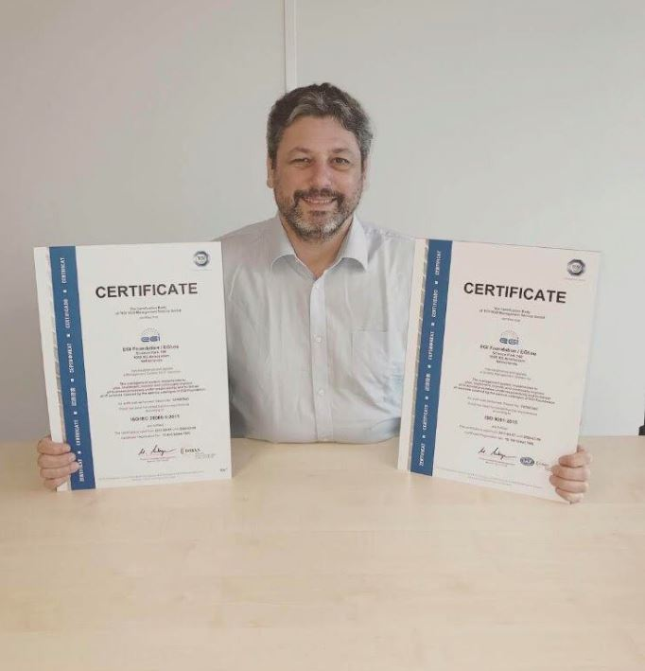
Dissemination activities
EGI website:
Webpage
Call on footer
News:
Improving service delivery:
EGI is awarded ISO certifications
Newsletter:
The EGI ISO certifications:
new and improved service delivery
EGI-Engage:
a list of key exploitable results
Interview in Primeur Magazine with Yannick Legré:
EGI to finalize service catalogue and ISO certification

Slide 16
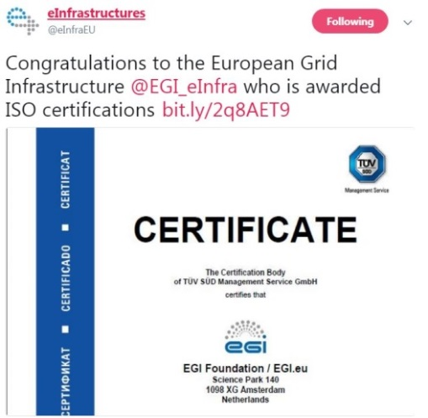
Dissemination activities
Social Media:
LinkedIn article:
Improving service delivery: EGI is awarded ISO certifications
Twitter:
The EGI Federation is the only publicly-funded
e-Infrastructure worldwide to be ISO certified!
Congratulations to the European Grid Infrastructure
who is awarded ISO certifications
The EGI Federation is the only publicly funded e-Infrastructure
worldwide to be ISO certified!
YouTube:
EGI to finalize service catalogue and ISO certification

