Slide 1
WP5 Operations
Peter Solagna
SA1 work package leader
EGI Foundation

Slide 2
Outline [customize as needed]
WP Overview
Objectives, tasks, partners and effort
Infrastructure status overview
Achievements
[list areas as applicable]
Use of resources, issues [issues: only main ones which required major changes or escalation]
Summary

Slide 3
WP Overview

Slide 4
SA1 Partners and effort
SA1 | Task | Leader / Partner
SA1.1 | Operations Coordination | Peter Solagna / EGI.eu
SA1.2 | Development of Security Operations | David Kelsey / STFC
SA1.3 | Integration, Deployment of Grid and Cloud Platforms | Peter Solagna / EGI.eu
9 Participants
PY1 effort
42 PMs
Project Total effort
106 PMs
3.5 FTEs
Notes:
Provided by PO

Slide 5
SA1 (WP5) objectives
Tasks | Task Objectives
TSA1.1 Operations coordination | Coordinate the operational activities of the EGI production infrastructure. Supplier Federation members Relations Management (SFRM) Capacity Management (CAP) Service Availability and Continuity Management (SACM) Incident, Service Request and Problem Management (ISRM, PM) Configuration Management (CONFM) Change and Release Management (CHM, RDM)
TSA1.2 Development of security operations | Evolve the security activities in EGI to support the new technologies and resource provisioning paradigms, maintaining a secure and trustworthy infrastructure. Information security management (ISM)
TSA1.3 Integration, deployment of grid and cloud platforms | Integrate and deploy platforms on cloud and grid resources to support new use cases for the existing and new EGI users.

Slide 6
Infrastructure updates
Notes:
Main achievements of the work package

Slide 7
EGI Federated operations
Operations Coordination TSA1.1
OMB
Core services
Operations Centre
Operations Centre
Operations Centre
Operations Centre
National Infrastructure
National Infrastructure
EIRO
Research Infrastructure
RC
RC
RC
RC
RC
RC
RC
RC
RC
RC
RC
RC
Notes:
Architecture of EGI Operations, EGI.eu, NGIs/EIROs, Resource Centres, Core activities

Slide 8
Operations Level Agreement framework
Core Services OLA
EGI Foundation
Core services
EGI SLA
TSA1.1
RP OLA
Operations Centre
National Infrastructure
TSA1.1
RC OLA
TSA1.1
RC
RC
RC
Notes:
Architecture of EGI Operations, EGI.eu, NGIs/EIROs, Resource Centres, Core activities

Slide 9
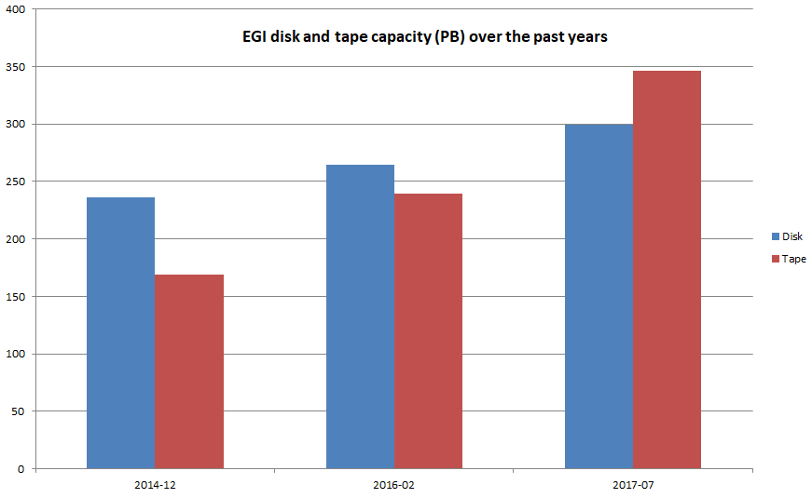
High Throughput computing (HTC)
Year | Logical cores | Increase
2014-12 | 527248 | +21%
2016-02 | 599671 | +14%
2017-07 | 731824 | +22%
Year | Disk (TB) | increment | Tape (TB) | increment
2014-12 | 236.2 |  | 168.8
2016-02 | 264.2 | 11,85% | 239.8 | 42,06%
2017-07 | 299.2 | 13,27% | 346.4 | 44,46%
Notes:
Do not report about hep-spec, the data collected in the past are wrong.

Slide 10
HTC capacity consumption
 | 2015 | 2016 (increment) | 2017 (Jan-Aug) (increment)
Total normalized CPU time consumed (Billion HEP-SPEC 06 hours) | 20.43 | 24.96 (+22.15%) | 20.64 (+18.19%)
Total number of jobs (Million) | 578.8 | 624.5 (+7.9%) | 436.7 (+9.16%)
Average number of jobs per day (Million) | 1.59 | 1.71 | 1.8

Slide 11
Federated cloud usage statistics

Slide 12
Activities and Achievements
Notes:
Main achievements of the work package

Slide 13
Operations Centres coordination
OMB coordination
Regularly held once a month
Face to face meetings during the EGI events
Most relevant topics
Operations activities roadmap
Operational policies and procedures approval or discussion
Software and services decommissioning
Operational procedures and manuals
2 procedures, and 4 manuals updated in PY2
2 reviews the OLA framework documents in PY2
Review of the resource centres performances every month
Average of 11 resource centres to follow-up per month
Average of 2 sites temporarily suspended per month
Particular attention devoted to cloud sites

Slide 14
Services of the internal portfolio
The EGI internal portfolio services are centrally provided services (both technical and human) that enable the EGI federation. Service providers are chosen with a bid process open to all EGI members.
Phase 2 services
Core service | Core service
Operations Portal | Security coordination
Accounting Repository | Acceptance criteria
Accounting Portal | Collaboration tools/IT support
SAM central services | Staged rollout
Monitoring central services | Software provisioning infrastructure
Security monitoring and related support tools | Incident management helpdesk
Service registry (GOCDB) | 1st and 2nd level support (core platform, community platform)
Catchall services | AppDB
Operations support | e-Grant
Phase 1 (May 2015 – April 2016)
Final performance assessment (May 2015)
Phase 2 (May 2016 – December 2017)
Bidding during 2015
4 performance assessments
Phase 3 (January 2018 – December 2020)
Bidding during 2016
Starting in 2018
WP5 Operations
Notes:
Explain the funding scheme

Slide 15
Core activities
The EGI Core activities are centrally provided services (both technical and human) that enable the EGI federation. Service providers are chosen with a bid process open to all EGI members.
Phase 3 services
Core service | Core service
Operations Portal | Security coordination and tools
Accounting Repository and portal | UMD/CMD quality assurance
UMD/CMD infrastructure | Collaboration tools/IT support
Monitoring | Marketplace and resource allocation
Workload manager | Incident management helpdesk
Service registry (GOCDB) | 1st and 2nd level support (core platform, community platform)
Services for the AAI | AppDB
Phase 1 (May 2015 – April 2016)
2 performance assessment during the project
Phase 2 (May 2016 – December 2017)
Bidding during 2015
4 performance assessments during the project
Phase 3 (January 2018 – December 2020)
Bidding during 2016
Starting in 2018
NEW
NEW
NEW
WP5 Operations
Notes:
Explain the funding scheme

Slide 16
Software provisioning
The goal of the EGI software provisioning process
Verify the quality of the software updates in production, before large-scale deployment, to minimise the probability of negative effects on the infrastructure
Unified Middleware Distribution (UMD), Cloud Middleare Distribution (CMD)
UMD
External TP
Internal TP
CMD
Quality assurance
Staged rollout
Community repositories

Slide 17
Software provisioning
The goal of the EGI software provisioning process
Verify the quality of the software updates in production, before large-scale deployment, to minimise the probability of negative effects on the infrastructure
Unified Middleware Distribution (UMD), Cloud Middleare Distribution (CMD)
Remove from production non-supported or vulnerable software releases
EOL Plan
OMB
Decommission campaign
Technology Provider
Vulnerability Assessment
Patch
Avaialble
Implementation of
the vulnerability
handling procedure
Software Vulnerability
Group

Slide 18
Major releases and supported platforms
PQ1
PQ2
PQ3
PQ4
PQ5
PQ6
PQ7
PQ8
PQ9
PQ10
UMD-3
UMD
SL6, CentOS7
UMD-4
CMD-OS
CentOS7, Ubuntu Xenial
CMD-OS Mitaka
CMD-ONE
CentOS7, Ubuntu Xenial
CMD-ONE 5
Type of release | # releases PY2 | # component updates PY2
Major and regular updates | 6 | 102
Revision and emergency updates | 14 | 34
Decommissioned software | Period
SL5 platform | Feb 2016 - Oct 2016
dCache 2.10-2.13 | Feb 2017 – Aug 2017
Keystone-VOMS, cloud info provider, ooi | Jun 2016 – Jun 2017
Notes:
Major releases and platforms
High throughput services
UMD-3: SL6
UMD-4: SL6, CentOS7
Cloud services
CMD-OS: Open Stack Mitaka, CentOS7, Ubuntu Xenial
CMD-ONE: Open Nebula 5, CentOS7, Ubuntu Xenial

Slide 19
Support to the Fedcloud sites
VO SLA implementation coordination
Follow up with technical issues and quality of service
Coordination of middleware updates (from JRA2) deployment

Slide 20
Security threat risks assessment
A complete revision and update of the previous security threat risk assessment has been completed in PY1
Focus on cloud and changing technology
Actions upon major risks:
Personal information leaked by software
New technologies introduce vulnerabilities
Incidents are not reported to EGI CSIRT
“EGI Policy on the processing of personal data”
Updated: “Strategy and Vulnerability Issue Handling”
Cloud SSC

Slide 21
Cloud services security challenge
Security Service Challenges (SSC) are used to assess EGI’s readiness to respond to a security incident affecting the infrastructure.
50% of the federated cloud sites participated
The SSC produced two results
It was a good training for the security staff at the sites that participated
It has been a source of useful information about the current security status of the sites for the EGI CSIRT
Development of the SSC framework
Communication challenge End of June ‘17
Test and announcement Beginning of July ’17
Run the SSC Second half of July ’17
Evaluation and reporting August ‘17

Slide 22
Security policies
Completed review of all the security policies
Updated the templates, the terminology, and the content with big or small improvements
Some policies have been modified to a larger extent, in the area of the following topics:
New technologies and services
Top level security policy
Applicable to any type of service (central, or distributed) federated in EGI
New AAI tools and processes
Acceptable Authentication Assurance policy
Enable federated AAI on EGI services by defining minimal requirements and best practices
VO Operations and Membership management policy
Enable ‘combined assurance’ using information provided by the identity provider and the community

Slide 23
Collaborations with the international security community
Wise Information Security for collaborating E-infrastructures. EGI Security have been particularly active in:
Contributed to the creation of the community and is still represented in the steering committee
Leading the WISE SCIV2-WG,
Results have been endorsed by EGI, EUDAT, GEANT, GridPP, MYREN, PRACE, SURF, WLCG and XSEDE
Risk assessment working group
Directly benefit from the EGI security threat risks assessment
Continuous collaboration with OSG, EUDAT, and CTSC (NSA Security centre of excellence)
Support the coordination of IGTF and euGridPMA
X.509 based identity federation used also by OSG and PRACE
Notes:
Wise Information Security for Collaborating E-infrastructure); a global trust community we helped create, where security experts share information and work together, creating collaboration among different e-infrastructures.

Slide 24
E-CEO Challenge integration in Fedcloud
EGI-Engage collaborated with ESA through Terradue
Thematic Exploitation Platform enabled: ESA Geohazards TEP
Federated cloud sites are providing computing capacity to ESA’s users
ESA TEP
RECAS BARI (IT)
GoeGrid (DE)
BeGrid-BELNET (BE)
100IT (UK)
CYFRONET-CLOUD (PL)
CESGA (ES)
GRNET (GR)
3 Use cases: 2 DLR, 1 EPOS
5 sites tested and enabled for the TEP use case
2 sites on hold due to technical limitations
Specific network and DNS configuration enabled for the VO
VMI distributed automatically through AppDB
550k cpu hours in the last 18 months
SLA
SLA
SLA
SLA
SLA
SLA
SLA

Slide 25
iMarine VRE integration with Federated cloud
Cloud resources made available by federated cloud sites resources are exploited by the iMarine communities through two VREs operated by the D4Science infrastructure
64 cores and 152 GB RAM
35 helpdesk requests solved
5 resource centres contributing to the SLA
5 classes of computational models supported
FFNN, clustering, time series analysis, maximum entropy niche modelling, CMSY
226 distinct users used federated cloud resources through the VREs
About 9,000 computational tasks submitted
350k CPU hours in the last 18 months

Slide 26
Use of Resources and Issues
Notes:
Numbers will be provided by PO, work package leaders must provide explanation

Slide 27
Summary
Notes:
Freedom on way to present

Slide 28
Summary
Objective 1 (O1): The continued coordination of the EGI Community.
Continued operations coordination
Roll in production of phase II internal portfolio services, organised bid for phase III
Release of the Cloud Middleware Distribution
Evolution of the security policies and processes
Objective 2 (O2): EGI Solutions, related business models and access policies.
One
Two
Three
Objective 5 (O5): Promotion the adoption and extension of the current EGI services
Support in production ESA thematic exploitation platform
Support in production the iMarine virtual research environment
Notes:
Achievements grouped by objectives

Slide 29
Key exploitable results
KER name | Description
Policies, Processes and Procedures
Security policies | Definition/update of a security policy framework to deal with the evolution of the EGI services and also to make them more general and re-usable by other initiatives
Software and services
Applications on Demand | A service providing researchers dedicated access to computational and storage resources, as well as other facilities needed to run scientific applications.

