Slide 1
WP4/JRA2 Development of EGI Technical Platforms
Matthew Viljoen
WP4 Leader

Slide 2
Outline
WP Overview
Objectives, tasks, partners and effort
Task JRA 2.1 Federated Open Data (Lead: Cyfronet)
Task JRA 2.2 Federated Cloud (Lead: IFCA-CSIC)
Task JRA 2.3 e-Infrastructure Integration (Lead: EGI)
Task JRA 2.4 Accelerated Computing (Lead: SAVBA)
Summary

Slide 3
JRA2 (WP4) objectives
Tasks | Project Objectives
TJRA2.1 Federated Open Data | Analysis of open data use cases and requirements Design and develop the Open Data platform prototype Open Data platform demonstrator
TJRA2.2 Federated Cloud | Evolve the federated IaaS Cloud platform with functionalities required by the CCs Extend ‘open standards’-based interfaces exposing new capabilities Maintain interface support for future versions of popular Cloud Management Frameworks (CMFs)
TJRA2.3 e-Infrastructure Integration | Integration for gCube and the D4Science infrastructure EGI-EUDAT Harmonisation for Virtual Research Environments Canadian Advanced Network for Astronomical Research
TJRA2.4 Accelerated Computing | Enabling accelerated computing support in the Information System Enabling accelerated computing support in the HTC and Cloud middleware frameworks

Slide 4
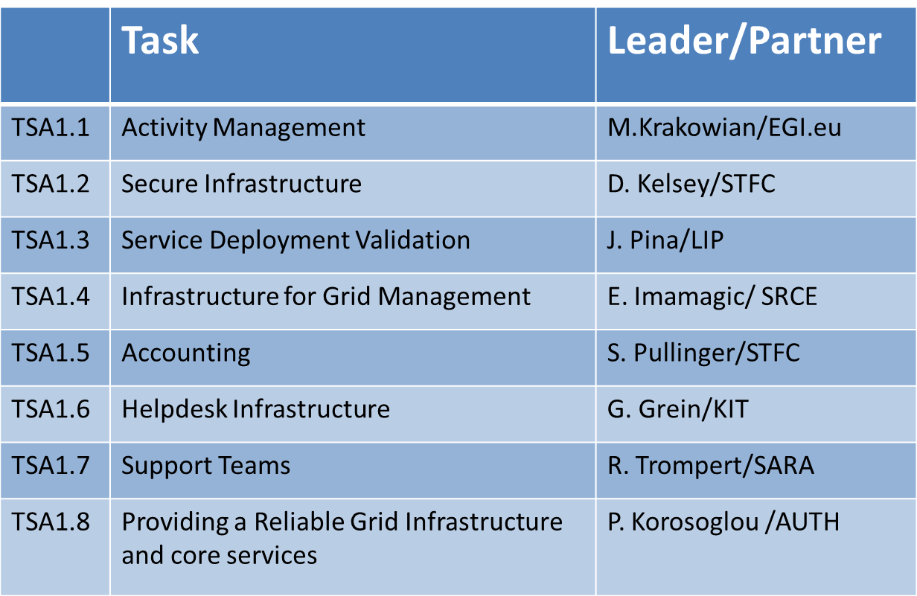
Partners and effort
57 Countries
58 Beneficiaries
PY4 effort (exc UNF)
1123 PMs
94 FTEs
Total effort (inc UNF)
4863 PMs
405 FTEs
Notes:
Provided by PO

Slide 5
WP Overview

Slide 6
Compute
Storage
Data
Security
Operations
Training
Design Phases
Cloud Compute
Data Transfer
Configuration Database
Discovery
Online Storage
Attribute Management
FitSM
JRA2.2
Alpha
Cloud
ContainerCompute
Content Distribution
Service Monitoring
Beta
Archive Storage
Training Infrastructure
IdP Proxy
High Throughput
Compute
Federated Data Manager
Production
Helpdesk
Retired
JRA2.4
Data Hub
JRA2.1
Notes:
JRA 2.1 – federated open data
JRA 2.2 – federated cloud
JRA 2.4 – HTC + Cloud accelerated computing
(no JRA 2.3 – e-Infrastructure Interoperatibility)
Addressing technological gaps – meeting user needs that isn’t met by EGI at present, mainly because technology isn’t there

Slide 7
Task JRA2.1
Federated Open Data

Slide 8
JRA2.1 Aim
A new prototype platform (and services) to enable the easy discovery, access and usage of:
reference open data
user data
Notes:
=

Slide 9
Community Requirements
REQ1. Publication of open research data based on policies
REQ2. Make large data sets available without transferring them completely
REQ3. Enabling complex metadata queries
REQ4. Integration of the open data access data management with community portals
REQ5. Data identification, linking and citation
REQ6. Enabling sharing of data between researchers under certain conditions
REQ7. Sharing and accessing data across federations
REQ8. Long term data preservation
Plan to use external services (e.g. EUDAT)
REQ9. Data provenance
Notes:
at the beginning of the project, custom questionnaires were created and distributed to: Biological and Medical Sciences
(Human Brain Project, MoBRAIN, BBMRI) Environmental and Earth Sciences(EMSO, LifeWatch)
Agriculture(Agrodat.hu, agINFRA)Astronomy & Astrophysics (A&A)(CTA, LoFAR, CANFAR) – for results, see M4.1
requirements summarized here.
9 originally, we’ve concentrated on only 8 – no Long Term Preservation

Slide 10
Open Data Platform architecture
DOI Registrar (e.g. DataCite)
Community Portal
EGI User 1 (VO x)
Anonymous
User 1
EGI User 2
(Onedata space)
Anonymous
User 2
REST
Web GUI
POSIX
HTTP
OAI-PMH
CDMI
REST
Space Manager
Space Manager
Open Data Manager
Metadata Registry
OAI-PMH Data
Provider
Authentication and Authorization
Long Term Retention
Open Data Platform
EGI Site 1
EGI Site 2
EGI Site 3
Cloud storage
EUDAT
Notes:
ODP is a solution for a a gateway to storage – it’s not duplicating anything.
Federated approach of accessing data. Complexity completely hidden from users, who only need to chose 1) the data they want and 2) how they want to access it
Top – users accessing the way they chose Say each in turn.
Openaire – service for discovering journals, datasets. Fed by a metadata protocol called OAIPMH Open Archives Initiative Protocol for Metadata Harvesting)
DOIs – Digital Object Identifiers. Allow citation of datasets
Bottom – disparate storage with plugins installed making them work with ODP.

Slide 11
Open Data Platform Interactions
Public Services
For Data Discovery
2: opendata publish
collection Data-set-1.1
-> DOI.1
3: discover data
-> DOI.1
Snapshot
Data-set-1.1
4: Visit Collection
Web Page (HTTP)
5: opendata mount remote
DOI.1 /localdir/
Data-set-1.1
Mounted to
/localdir/
1: opendata create
snapshot Data-set-1
6: opendata fork DOI.1
Data–set-1
Cloned
Data-set-1.1
Private Resources
Private Resources
Notes:
An example of how users formation interact with the ODP
User has a dataset on a private resource
Snapshots the data (Makes the the data readonly) & publishes it. Gets a DOI
Another user discovers it, visits the collection via ODP and mounts it.
User may forks the collection by copying to own space & continues to work on it privately.

Slide 12
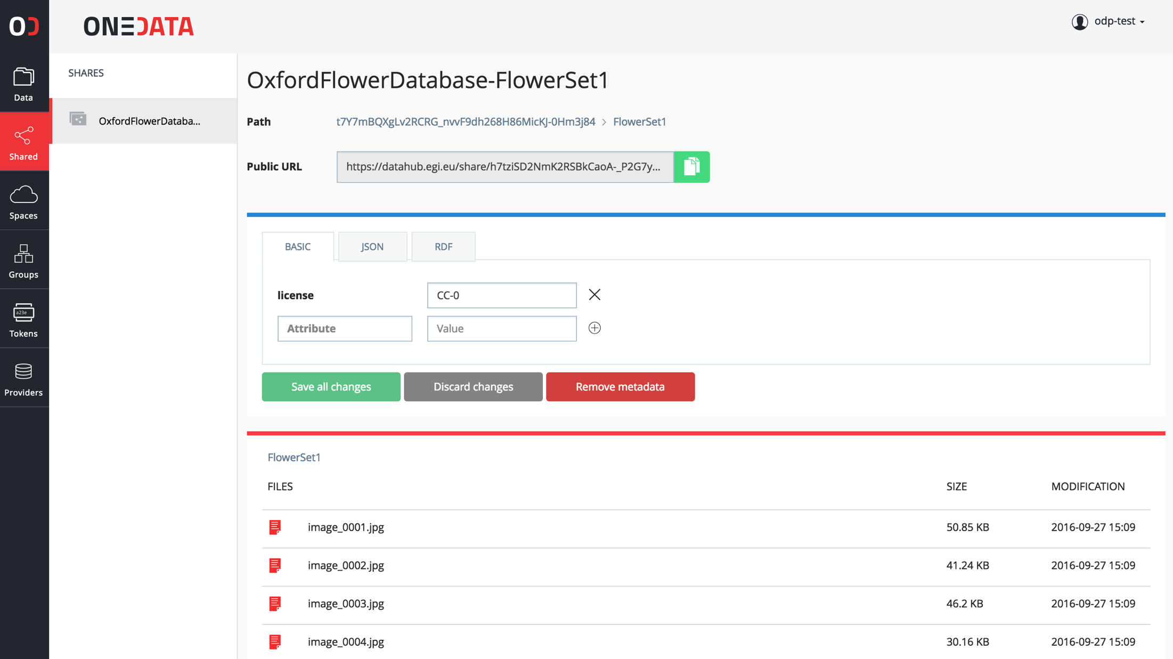
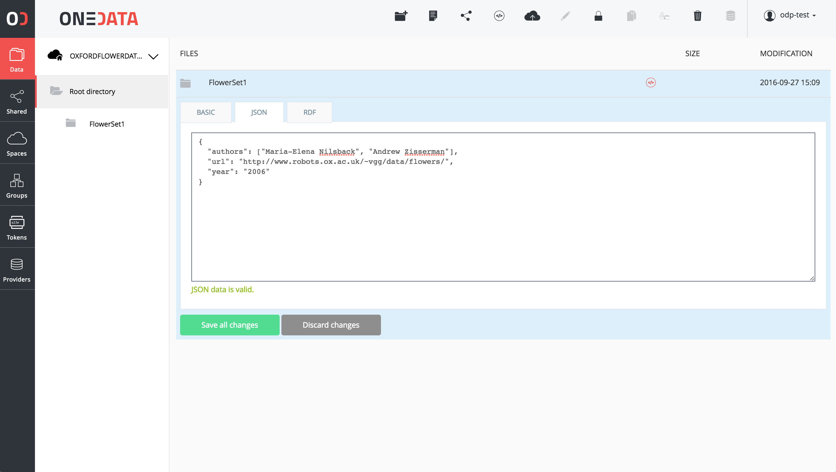
Advanced metadata support
Metadata can be attached to resources (files, folders) in simple key-value form, JSON or RDF
Users can define custom indexes over the metadata in order to filter their data collections
Metadata can be used for Open Data collections when published
Notes:
conforming to ANY schema deemed useful to users.
Annotations. Provenance. etc.
maybe Dublin Core schema.

Slide 13
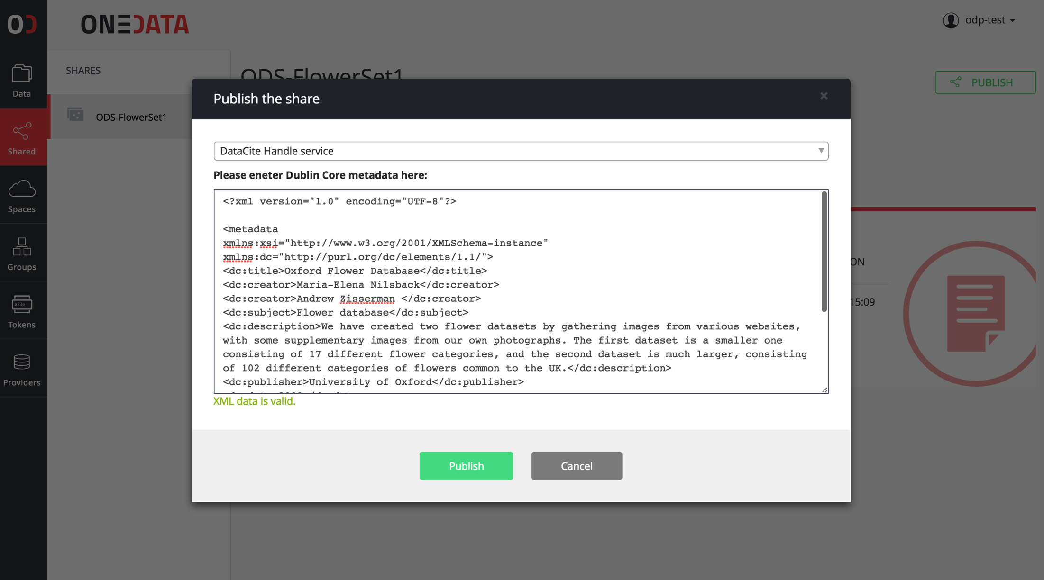
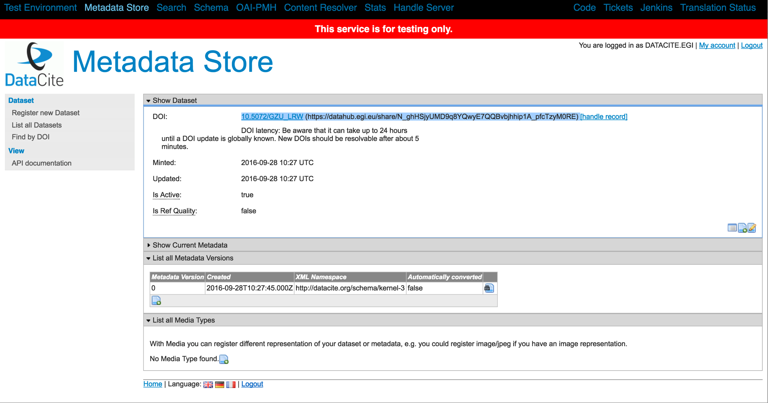
DOI registration
ODP supports Handle system-based identifier services (e.g. DOI and PID)
Any user can register such service, provided they have a valid account with the registrar
Each file or collection can be accessed directly using DOI identifier
Notes:
Tested with the testing instance of DataCite, provider of DOIs.
Update layout (use different one to make sure you have no overlapping EGI logo

Slide 14
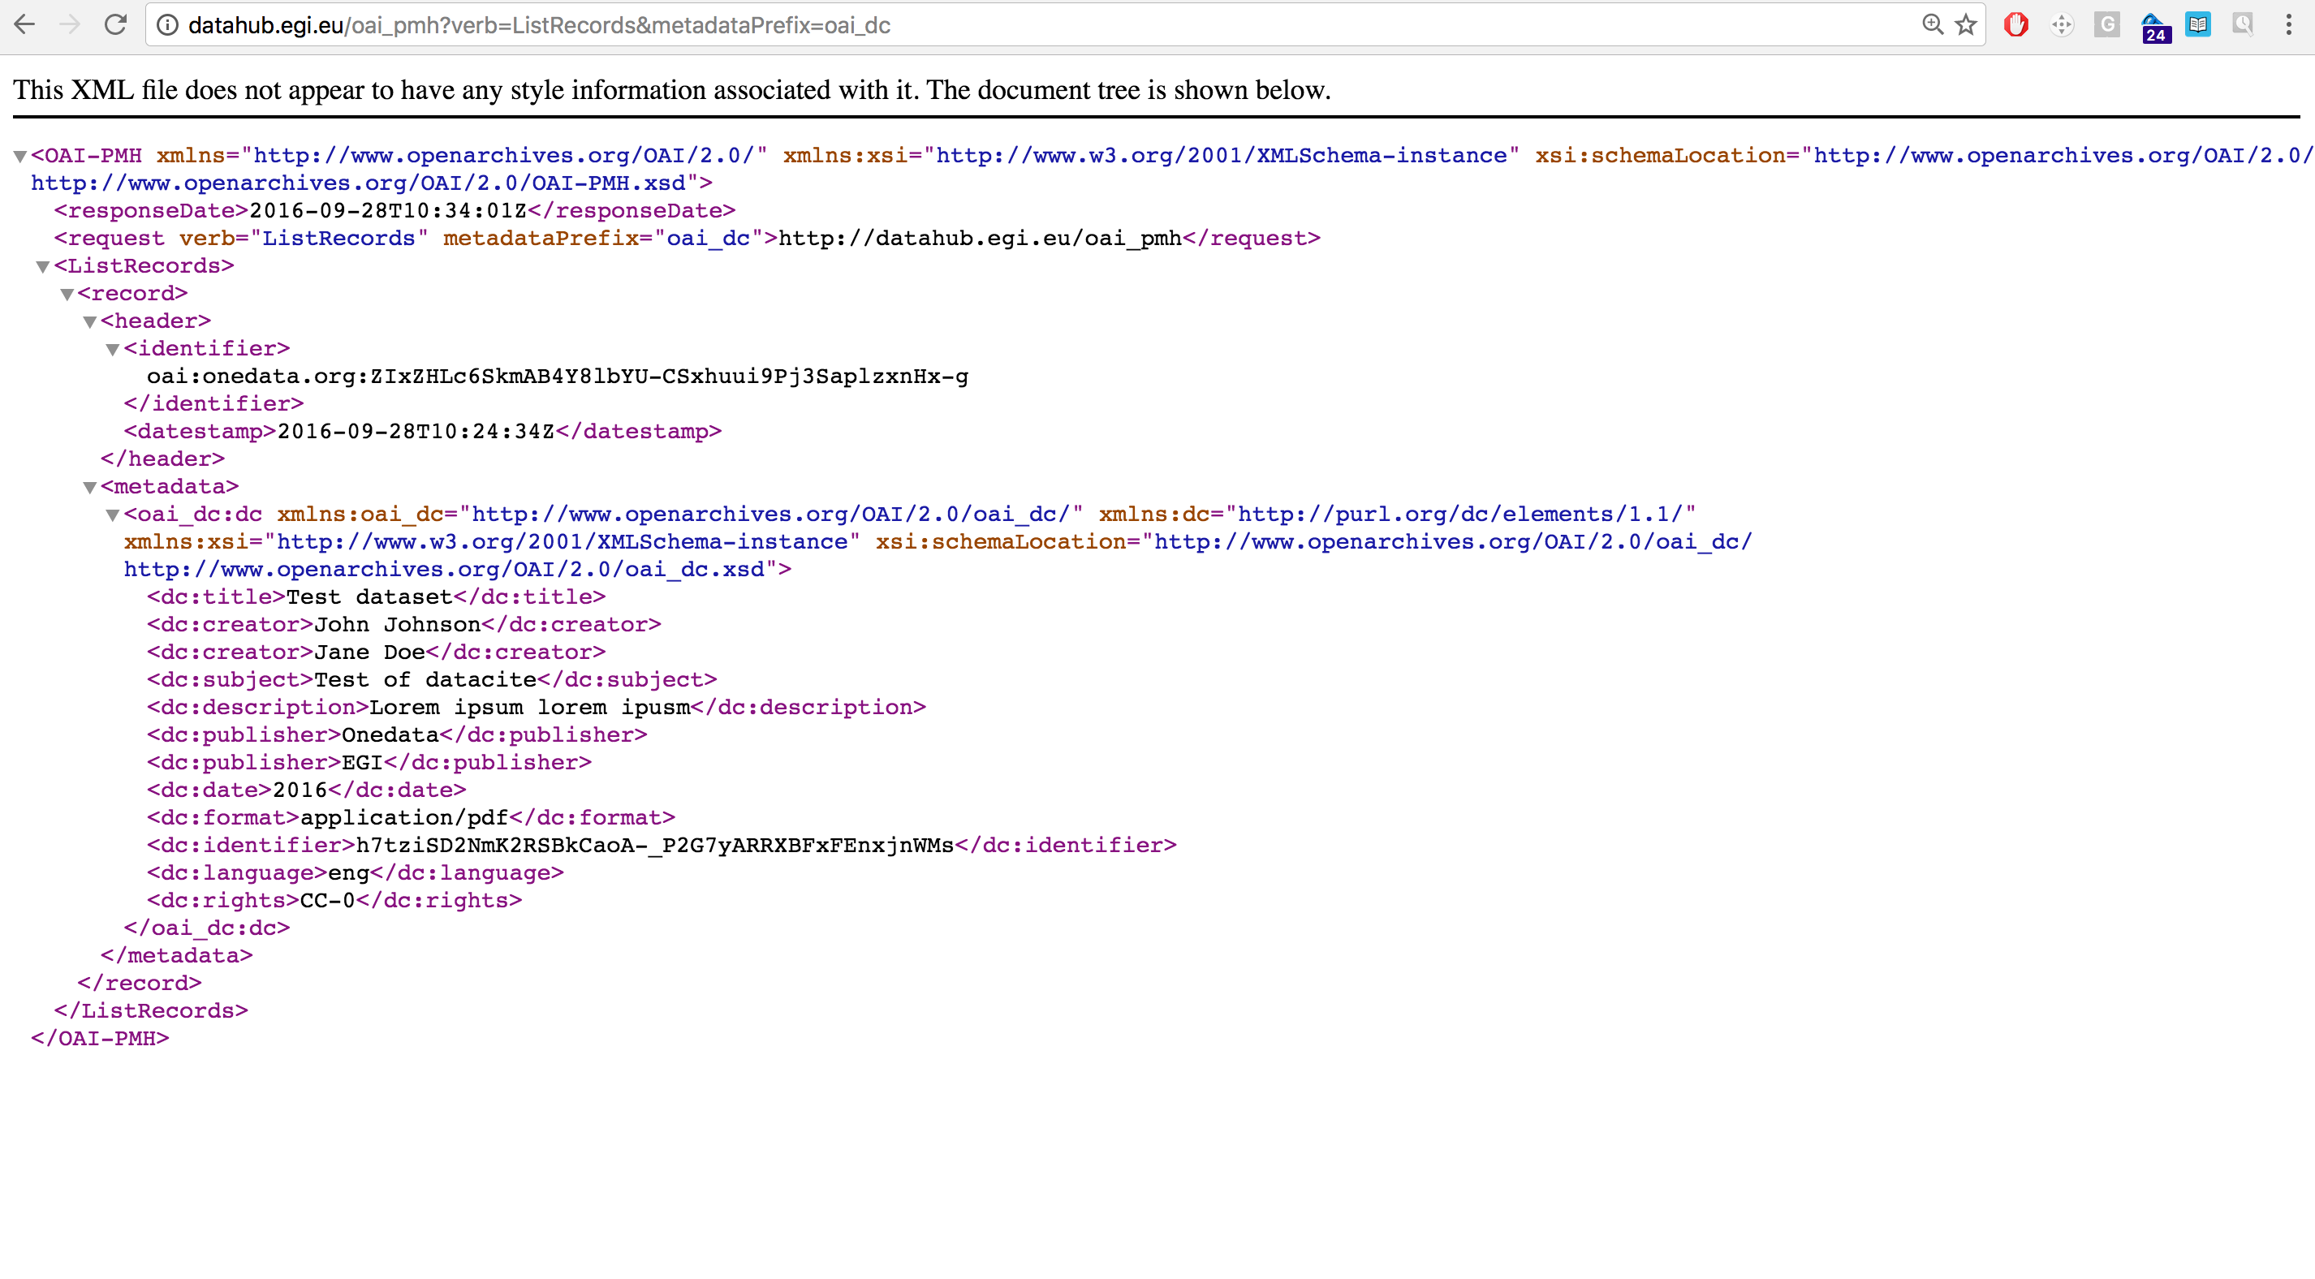
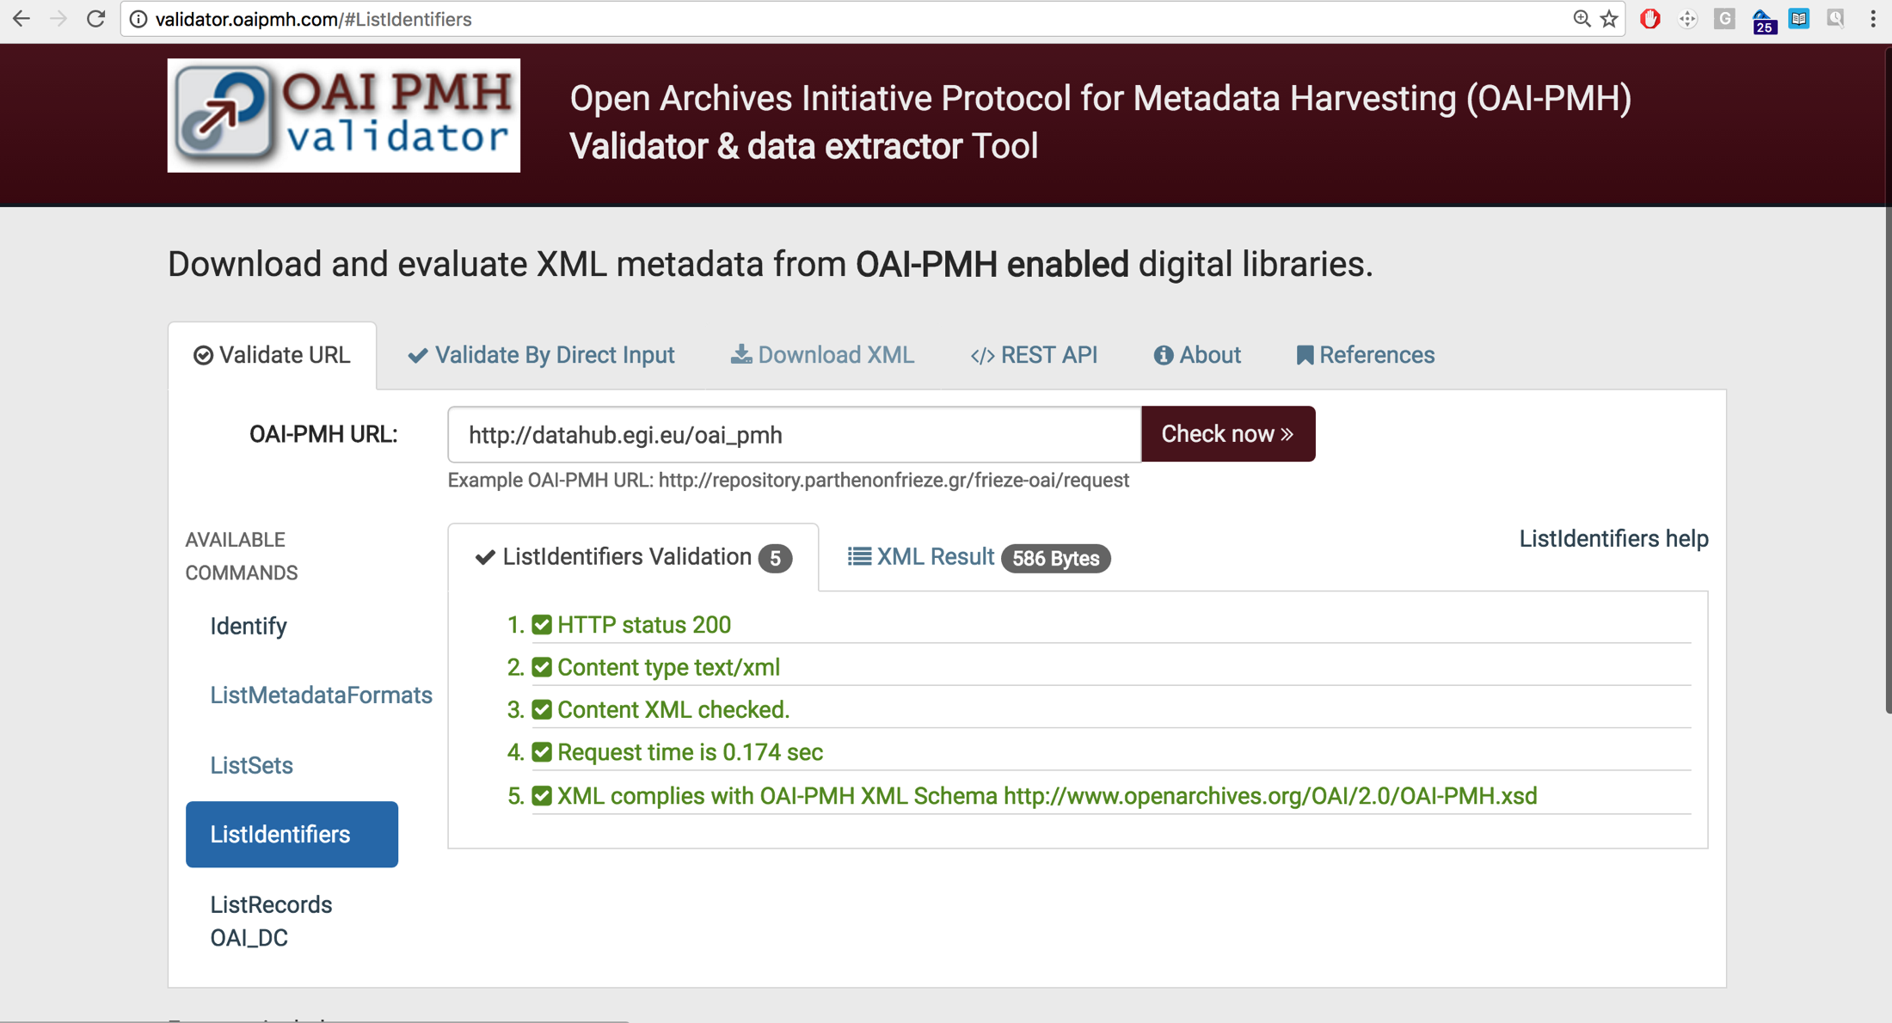
OAI-PMH interface
ODP supports full OAI-PMH Data Provider protocol
By default ODP will expose all metadata of shares which have been made publicly available
Currently Dublin Core is supported for record metadata but can be extended in the future
Notes:
OAI PMH (Open Archives Initiative Protocol for Metadata Harvesting) was developed as part of this task.
low level mechanism for exposing the records and content of a repository. Can be used for repo interoperability
demoed at DI4R – dataset created with metadata. Assigned DOI & metadata explosed through OAI-PMH

Slide 15
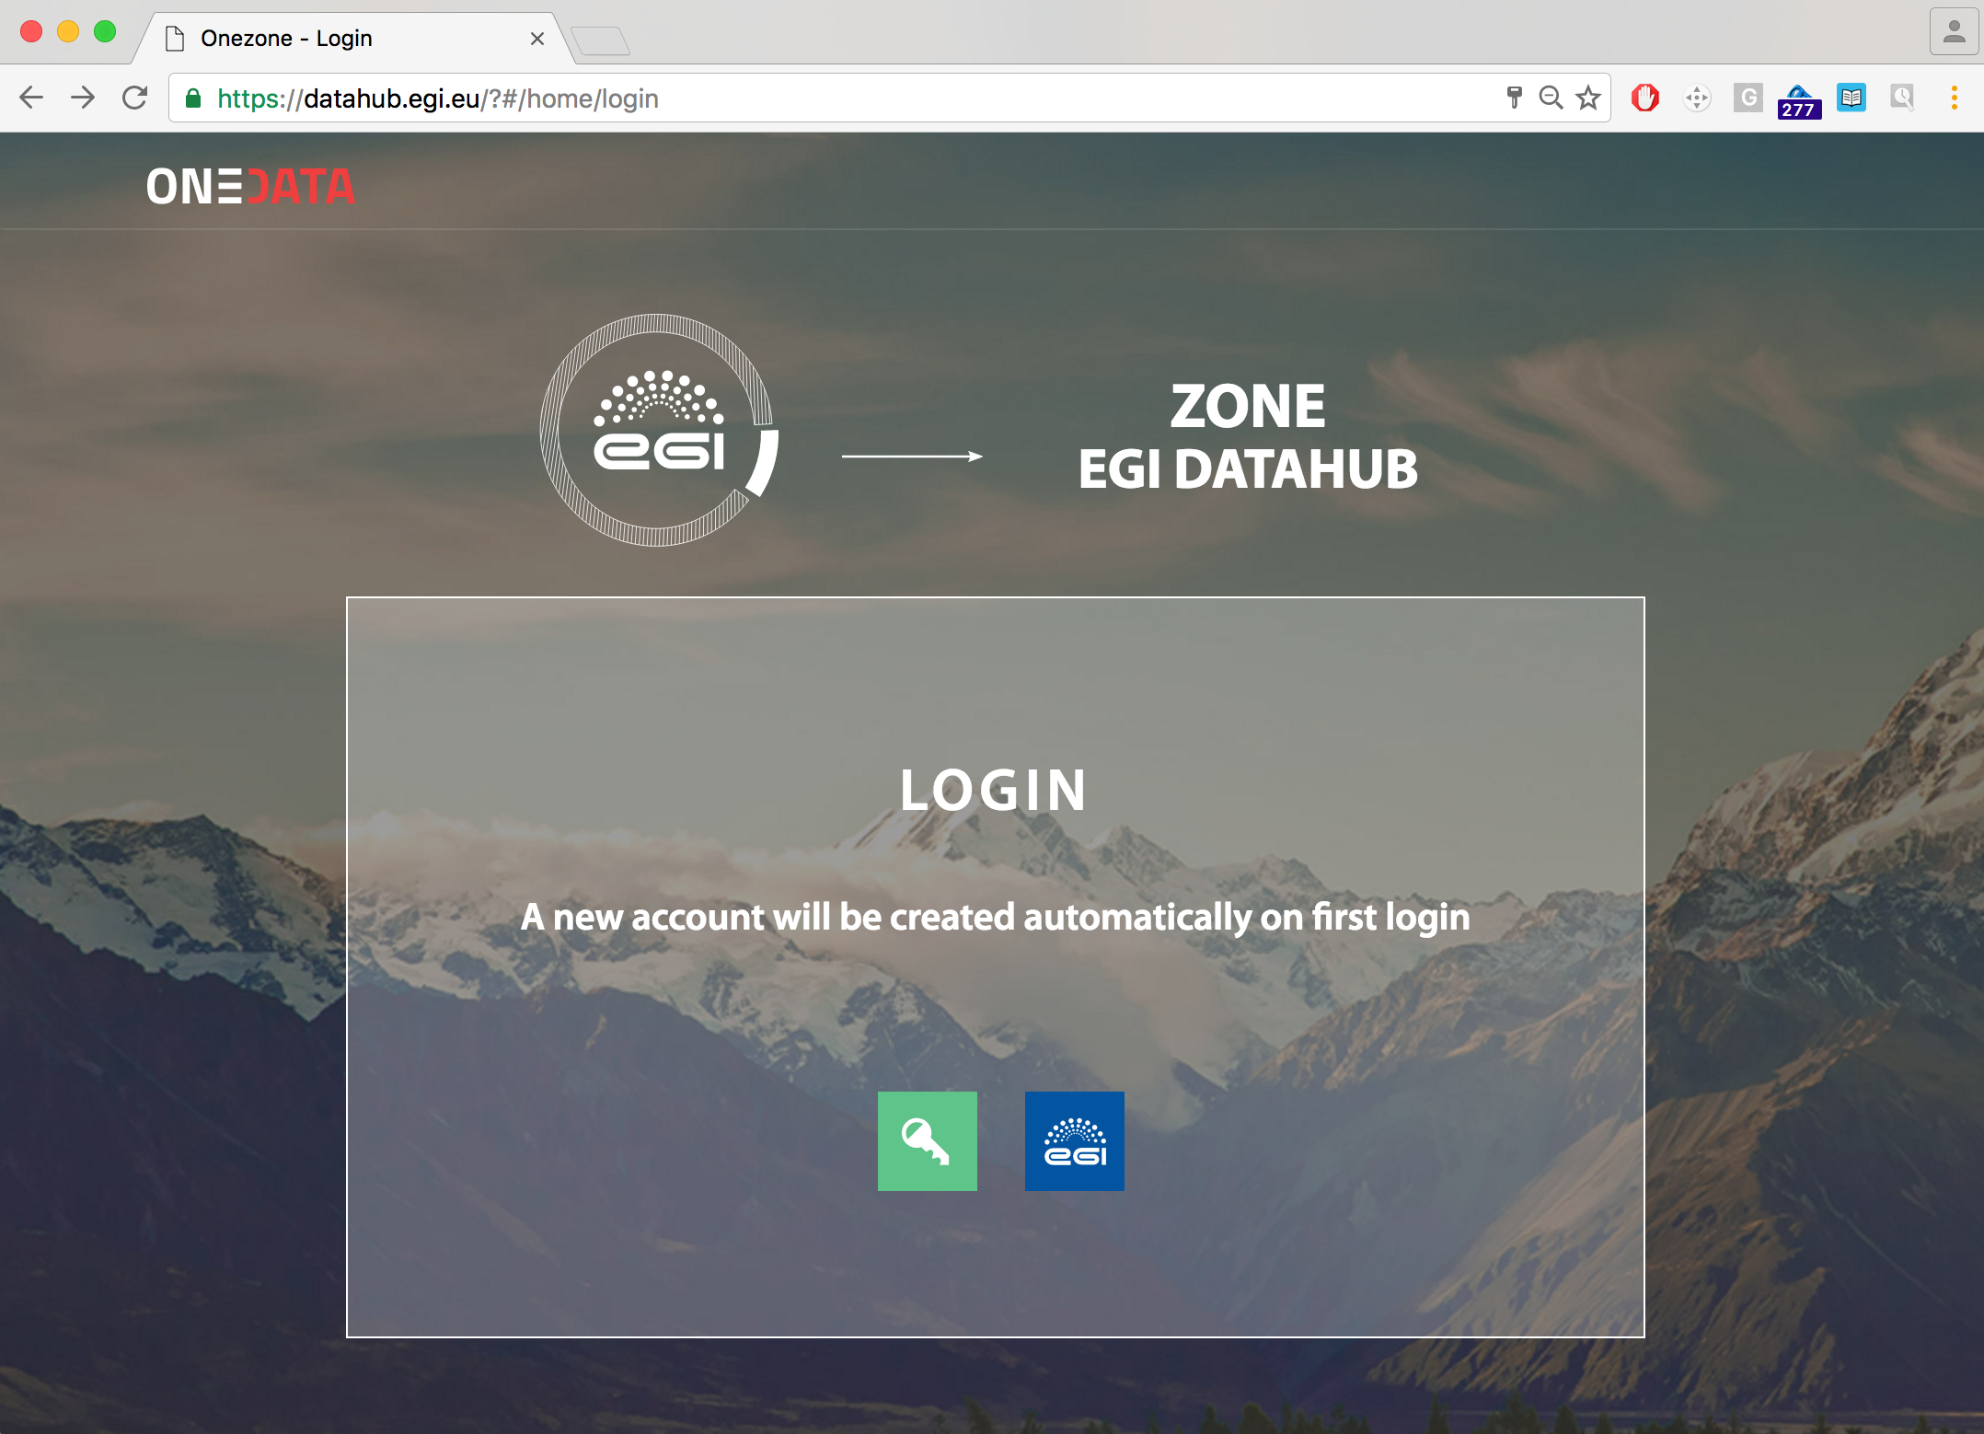
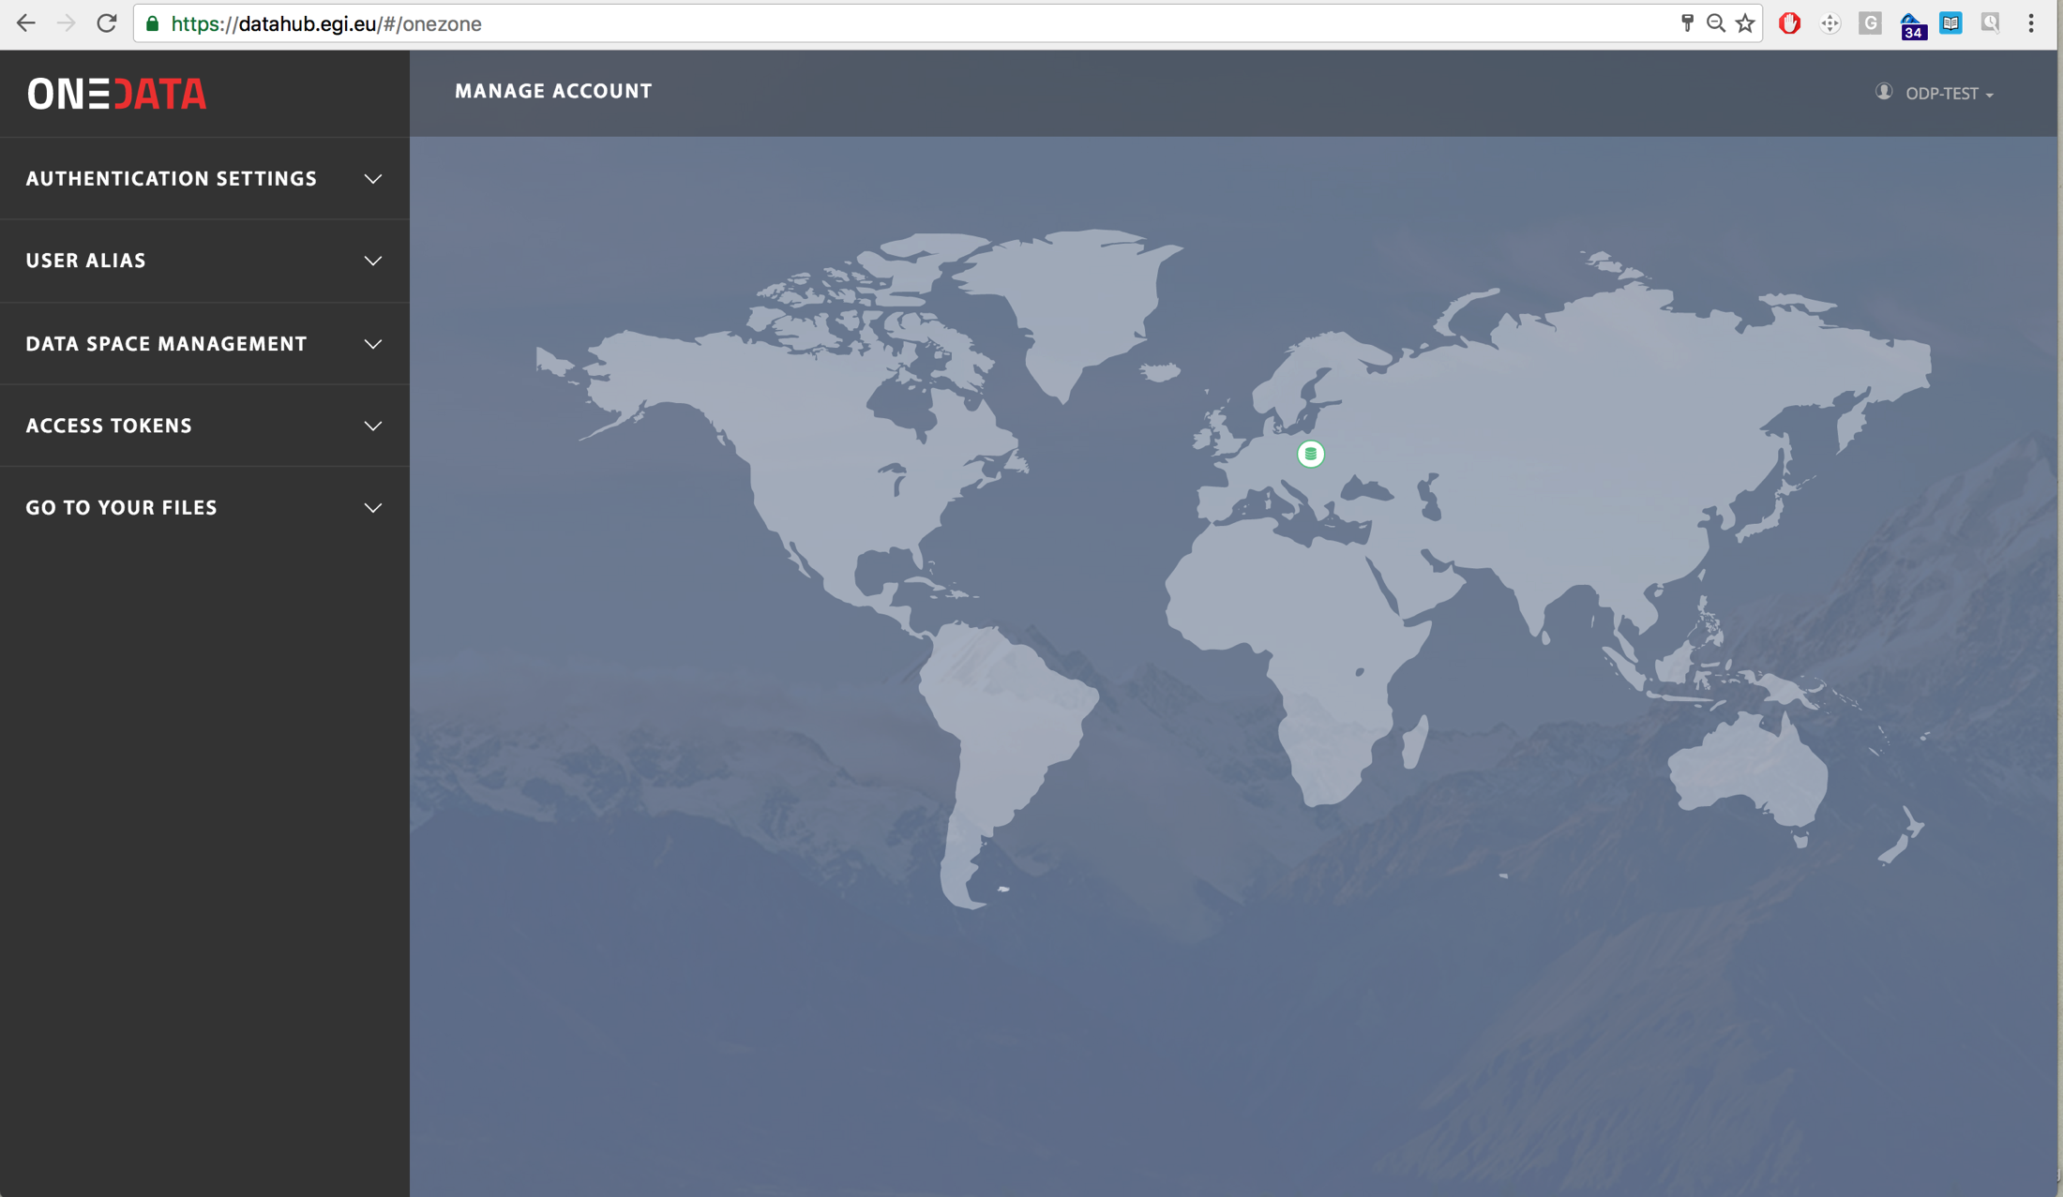
EGI DataHub (https://datahub.egi.eu)
A single point of entry for Open Data sets managed on FedCloud
EGI DataHub provides access to reference scientific data of public interest
Provides integration with EGI AppDB service for automatic open data set computation
Notes:
Not in the orig. DoA, but we decided it would be a useful output of this task.
A prototype EGI Data as a Service – EGI DataHub for federating open data

Slide 16
EGI Federated Data Gateway
Means for exposing user data to computing
Enabling technology for storage to be exposed to users
Means for storage providers to easily expose storage to users/VOs
Notes:
Also same tech allows fed data managing of user data and brining it to computing.

Slide 17
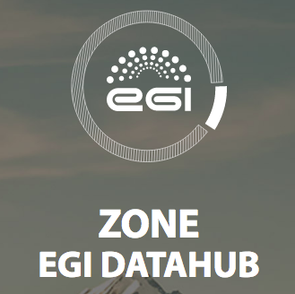
Data intensive computing across multiple clouds
Private cloud 1
Institutional cloud 2
Public cloud
VM
VM
VM
VM
VM
VM
VM
VM
VM
POSIX/S3
POSIX/S3
POSIX/S3
Shared storage
Notes:
Brings the possibility of scalable, data intensive computing to communities regardless of their domain.
Seemless access to multiple clouds – private, institutional, public.
Multiple VMs accessing the same data via shared storage SPANNING these clouds.
Accessible via the EGI DataHub
Possibility of publishing data via a DOI and depositing it into a long term archive such as B2SAFE from EUDAT

Slide 18
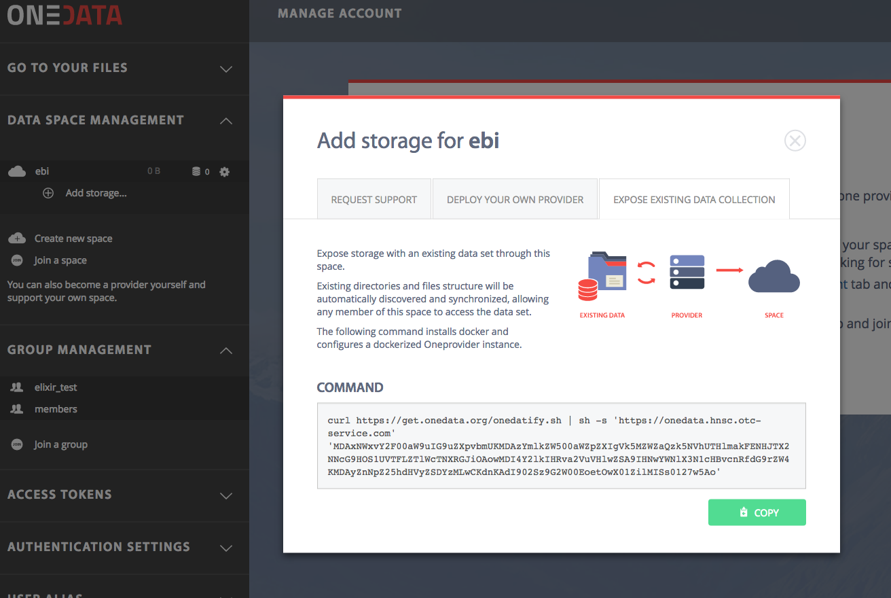
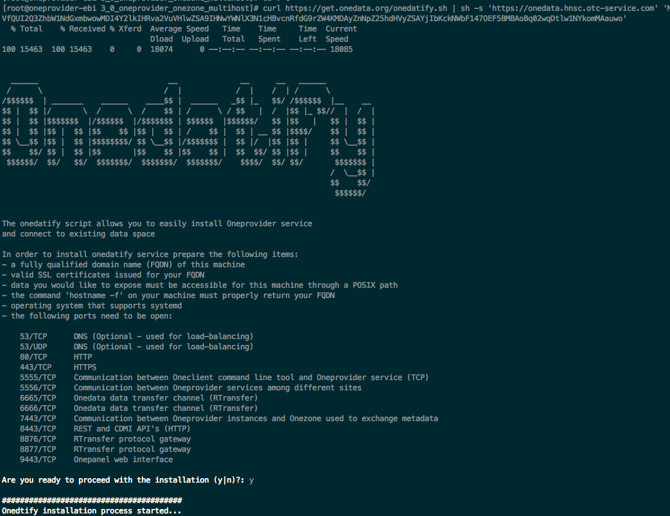
Onedatify – legacy data access
Open Data Platform enables seamless exposing of existing datasets directly from legacy storage
Easy to use script automatically installs and configures Oneprovider service, and connects it to EGI DataHub
Notes:
e.g. for PanCancer 60TB indexed and made available for EGI DataHub
Developed as part of Engage

Slide 19
Preparation for production
Nagios probes developed for Onedata components: Onezone, Oneprovider
Usecases successfully completed advanced testing of Onedata (Earth Observation PoC)
Independent audit of documentation and security within INDIGO-DataCloud
Completed INDIGO Staged Rollout, will be added to the EGI repositories

Slide 20
Task JRA2.2
Federated Cloud

Slide 21
JRA2.2 Aim
Improve user experience
AppDB VMops Dashboard
Develop new required functionality
VM snapshotting, resource modification
Develop improved tools
Cloudkeeper, cloud-info-provider, AAI in OpenStack
Promoting EGI FedCloud adoption

Slide 22
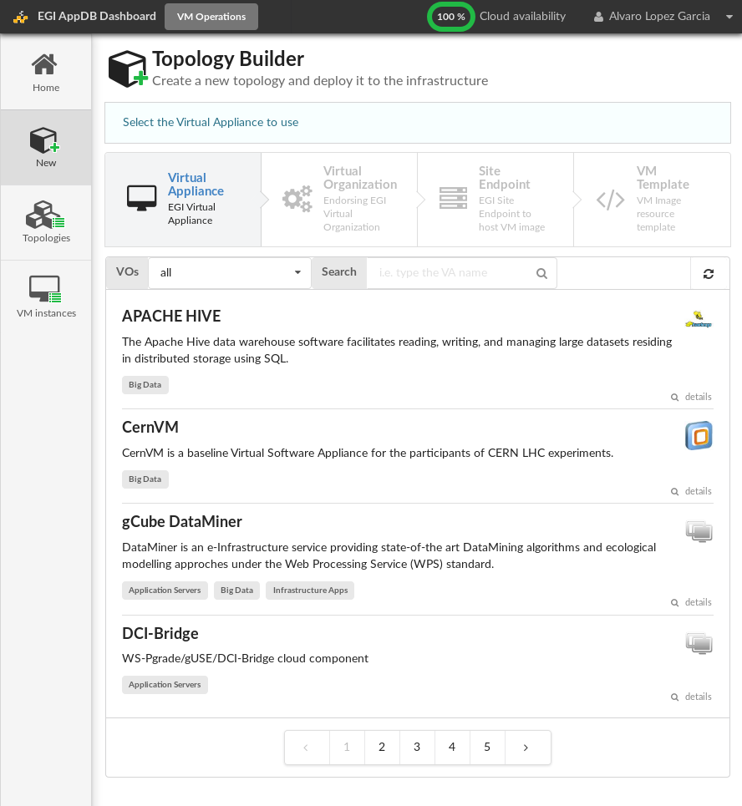
AppDB VMOps Dashboard
Web interface to deploy different topologies in the EGI Federated Cloud
Based on the VMIs registered in the AppDB
Control of the complete topology life-cycle
Infrastructure Manager (IM) as a backend
http://go.egi.eu/datahub - for a demo from EGI/INDIGO-DataCloud, from 1:32 to 3:39
Notes:
been used in FedCloud trainings
and from new users (e.g. from EOSCpilot) – good feedback

Slide 23
OCCI Improvements
Development and inclusion of VM snapshotting and VM resize support into new OCCI 1.2 standard
Requested by EGI user communities
New implementation: OOI
Initially targeted to OpenStack
New architecture to ensure compatibility across CMF releases
Now adopted by Synnefo (same codebase)
OCCI 1.2 support implemented in OOIand rOCCI
Notes:
OCCI is the Open Cloud Computing Interface
a low level protocol and API for VM management tasks, independent of cloud management implementations (e.g. OS, ON)
enables interop. of tools: e.g. for deployment, scaling, monitoring

Slide 24
VM Image synchronization tools
VM Image synchronization
availability, propagation of updates/bugfixes
New product developed: CloudKeeper
New design and architecture
Decoupled different actions in separated components: VMI dowload, transformation, upload
One single tool performing CMF-agnostic actions, per-CMF plugins to upload images
Aggrement on new metadata published at the AppDB and propagated via CloudKeeper

Slide 25
Information System
Refactored to use a template language and engine
Same tool with different renderings
e.g. JSON rendering for INDIGO-DataCloud
Complete GLUE 2.1 draft into cloud-info-provider
Comments sent to OGF GLUE-WG
Approval of standard by end of year (expected)

Slide 26
Accounting
Implementation of v0.4 of the OGF UR for cloud accounting
Backwards compatibility with old v0.2
Added support for long-running VMs
Added support for new OpenStack authentication libraries

Slide 27
Authentication, authorization
OpenStack Keystone
Refactored Keystone-VOMS to use pyOpenSSL
Added support for V3 authentication in OpenStack related tools
Pilot for OpenID Connect support
OpenStack support
Added support in rOCCI and monitoring probes

Slide 28
Task JRA2.3
e-Infrastructures Integration

Slide 29
JRA2.3 Aim
Promotion of cross e-Infrastructure technical interoperability
Future proofing via alignment of standards
Improved service to users regardless of their e-Infrastructure
In scope: EGI-EUDAT, iMarine/D4Science, CANFAR

Slide 30
EGI-EUDAT integration use cases
First use case ‘universal’ use case:
User to instantiate a VM on the EGI cloud federation for the execution of a computational job consuming data preserved onto EUDAT resources. The results of such analysis can be staged back to EUDAT storages, and if needed, allocated with Permanent Identifiers (PIDs) for future use
Requirement driven use cases:
Call for cross-infrastructure case-studies in PM15 for driving developments selected ICOS and EPOS use cases
ENES use case started on May 2017 after contacts during EGI Conference
Build from the universal use case to interact with B2STAGE and B2SAFE EUDAT services and EGI DataHub from resources started on EGI Cloud Compute

Slide 31
gCube/D4Scienceintegration
D4Science FedCloud Connector
Relies on jOCCI SDK
Using EGI VOMS authentication
VA on AppDB
Able to spawn VMs on demand to execute computational models
JRA2 Platforms for the Data Commons
Notes:
d4science is a generic virtual research environment providing common services to ranges of earth scientists: computing, data
Bult on gCube open source sw

Slide 32
gCube/D4Science exploitation
SLA establishment (Nov 2016)
5 resource providers (CESGA, GeoGrid, IISAS, INFN-BARI, UPV-GRyCAP)
Testing of the integration (Nov 2016 – Apr 2017)
Solved issues with networking configuration
Tested reliability and availability of sites
Production (since May 2017)
Users of the VREs now using EGI Federated Cloud as a platform for the execution of their models
Notes:
now requesting more resources that we are in discussions about

Slide 33
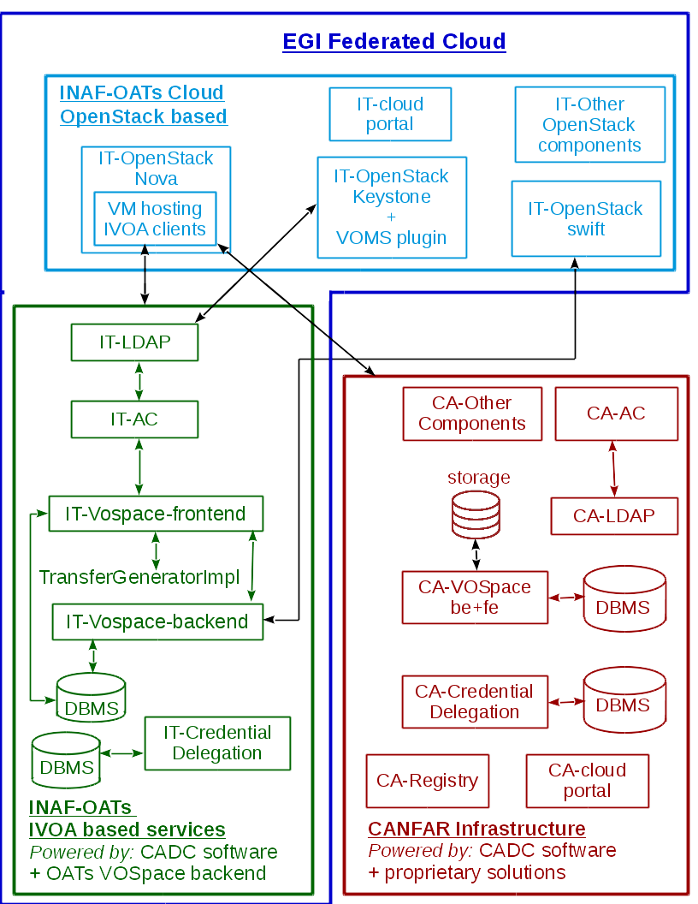
CANFAR interoperability
CADC software modified – now allows deploy/configuration on EGI resources and interoperbility from different VOSpaces
IVOA compliant software installed at INAF, available for FedCloud user
JRA2 Platforms for the Data Commons
Notes:
CANFAR is the Canadian Advanced Network for Astronomy Research, a community platform for astronomy based on IVOA standards running on Compute Canada resources
Offers data access to astronomical data (archives and catalogues), Access control (GMS), user storage (VOSpace), cloud processing integrated with telescope data collections (OpenStack)
In 2014, > 7,000 users, > 1 PiB of data handled

Slide 34
CANFAR interoperability ongoing work
Infrastructure / Deployment:
full implementation of EGI CheckIn with the CADC Access Control components
deployment procedure to provide services deployed in containers
Software development:
Work on VOSpace to VOSpace high performance data movement for data exchange between infrastructures
Documentation:
Documentation versioning (software versioning related)
Improved users and developers guides
Standards:
SSO and authorization mechanisms standardisation activity, particularly regarding the grouping and authorization aspects, in the framework of the IVOA projects.
JRA2 Platforms for the Data Commons

Slide 35
Architecture: IaaS Federation
EGI AAI
Community Platforms
AppDB VMOps
IaaS Federated Access Tools
IaaS API
IaaS API
IaaS API
Cloud Management Framework
Cloud Management Framework
Cloud Management Framework
EGI Federation services:
Accounting, Monitoring, Configuration Database, Information Discovery, VM Marketplace
JRA2 Platforms for the Data Commons
Notes:
Simplified as much as possible the architecture to facilitate the integration of new sites.
Not imposing any specific IaaS API for resource providers, up to the communities to require OpenStack / OCCI / others
Introduce new layer of IaaS Federated Access Tools to manage the underlying complexity. These are tools like IaaS provisioning systems that allow to define infrastructure as code and manage and combine resources from different providers, thus enabling the portability of application deployments between them.
EGI has tested and developed guides for several of these tools, which are developed by external technology providers, e.g. IM from INDIGO –DataCloud or commercial/open source products like Terraform from Hashicorp, or SlipStream from sixsq
All federation components that talk with the EGI federation services now using only public APIs so no need for invasive deployment into the sites
A pilot AWS integration test was performed to check if the architecture could fit also commercial players

Slide 36
Task JRA2.4
Accelerated Computing

Slide 37
JRA2.4 Aim
Economically maximise computing potential by exploiting GPGPUs
Ensure easy adoption of GPGPUs
Notes:
Accelerated Computing – a way to utilize energy efficient and powerful High Performance Computing capabilities. This is where it fits in the overall architecture diagram.
GPGPU – General Purpose Graphics Processing Unit, originally developed for better graphics rendering (by offloading processing from the CPU to the graphics card) thanks to the demands of the gaming industry
Now very prevalent and a cost effective means of increasing processing power in hardware.
2 parts to this work – enabling GPGPUs for High Through Computing, HTC and GPGPUs for Cloud, we’ll deal with them separately here.

Slide 38
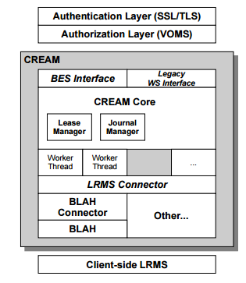
Accelerated computing in HTC
Starting from previous work of EGI Virtual Team (2012) and GPGPU Working Group (2013-2014)
CREAM-CE is the most popular grid interface (Computing Element) to a number of LRMSes (Torque, LSF, Slurm, SGE, HTCondor)
Most recent versions of these LRMSes do support natively GPUs (and MIC cards), i.e. servers hosting these cards can be selected by specifying LRMS directives
CREAM must be enabled to publish this information and support these

Slide 39
Work done
Identified the relevant GPU related parameters
supported by the different LRMSes, and abstracted them
to significant JDL attributes
Implemented the needed changes in CREAM
Core and and BLAH components
Extended the GLUE 2.1 schema draft with
accelerator information
Wrote the info-providers according to
extended GLUE 2.1 draft specifications
Testing and certification of the prototype
Releasing a CREAM update with full
GPU/MIC support
Notes:
MICs – Many Integrated Cores, a new arch from Intel
BLAH (Batch Local Ascii Helper) – protocol to manage jobs on different Local Resource Mgmnt Systems (LRMS)
a minimal interface for job submission

Slide 40
Summary
The CREAM GPU-enabled prototype was tested at 5 sites
LRMSes: Torque, LSF, HTCondor, Slurm, and SGE LRMSes
3 new JDL attributes defined: GPUNumber, GPUModel, MICNumber
At 3 sites the prototype is run in “production”: QMUL and ARNES (Slurm) and CIRMMP (Torque/Maui)
New classes and attributes describing accelerators proposed and included in GLUE2.1 draft after discussion with the OGF WG
A major release of CREAM is ready
with GPU/MIC support for most LRMSes
with the GLUE2.1 draft prototype as information system
future official approval of GLUE 2.1 would occur after the specification is revised based on prototype lessons learned
with new Puppet module for the CE site with support for GPU/MIC and GLUE 2.1
its CentOS7 version will be included in the next UMD 4.6.0 scheduled at mid November 2017
Notes:
CIRMMP is fully dedicated to MoBrain/WeNMR/West-Life community (i.e. structural biology) via the enmr.eu VO, see also the full reports in EGI_Engage deliverables D6.7 (CIRMMP - metalloproteins and metalloenzymes research)
At QMUL their main user is icecube, they do simulations. (IceCube Neutrino Observatory, Antarctica)

Slide 41
Accelerated computing in Cloud
For using GPGPU in clouds, the GPGPU must be supported in all layers including virtualization, CMF and higher tools
Virtualization technologies
KVM with PCI passthrough
Widely used but with limitation
Virtualized GPU is in a early stage:
NVIDIA GRID vGPU (XenServer, VMWare hyperv. only)
SR-IOV based AMD MxGPU (VMWare hyperv. only)
Intel GVT-G recently added to Linux 4.10 kernel
Container-based technologies
LXD with GPU is promising
But limited support in cloud middleware
Notes:
Rather than software development, this task is mainly:
advanced config of Cloud Mgmnt Frameworks
testing/benhmarking
documentation & ease of deployment
has led to GGPU enabled FedCloud sites in prod.

Slide 42
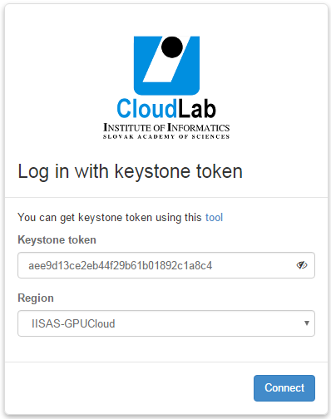
IISAS-GPUCloud site
Openstack GPGPU site at IISAS
Site is integrated into EGI Federated Cloud and in production
Access via command line or via the Openstack Horizon portal

Slide 43
IISAS-LXD site
Experimental site with Openstack, LXD and GPGPU
More stable and flexible manipulation with GPGPU
Lower overhead
Experimental only
Limitation
GPU properties are not defined
Block storage supports are limited
Notes:
lxd pure-container hypervisor – an advanced system container manager that uses containers rather than VMs

Slide 44
Information system
GLUE 2.1 as starting point for Accelerator-aware info provider
For HTC:
New GLUE object, the Accelerator Environment, representing a set of homogeneous accelerator devices.
New attributes and associations for existing objects such as Computing Manager, Computing Share and Execution Environment.
For Cloud: Cloud Compute Virtual Accelerator
New entity, the Cloud Compute Virtual Accelerator
New attributes and associations for existing objects such as Cloud Compute Service
Notes:
other work related to GPGPU includes other services req for integration into the eInfra:
INFO SYSTEM – included in automatic discovery of resources

Slide 45
Accounting
For clouds, extended accounting records with new items for describing accelerators:
AcceleratorCount,
AcceleratorProcessors,
AcceleratorDuration,
AcceleratorWallDuration,
AcceleratorBenchmarkType,
AcceleratorBenchmark,
AcceleratorType
Modification of accounting tools for supporting new accelerator-related items

Slide 46
Docker support
For easy exploitation of accelerated computing
Chose a site with GPGPUs
Bring up a VM with a GPGPU-enabled flavour
Run docker
$>docker run --name=XXXXXX \
--device=/dev/nvidia0:/dev/nvidia0 \
--device=/dev/nvidia1:/dev/nvidia1 \
--device=/dev/nvidiactl:/dev/nvidiactl \
--device=/dev/nvidia-uvm:/dev/nvidia-uvm.
Works with udocker from INDIGO-Datacloud (used in production by MoBrain CC)
Notes:
for ease of usage.

Slide 47
Activities and Achievements
I am considering removing this – the main points are in the Summary slide
Notes:
Main achievements of the work package

Slide 49
Use of Resources and Issues
Notes:
Numbers will be provided by PO, work package leaders must provide explanation

Slide 50
Resources and Issues
JRA2.1
CYFRONET EGI DataHub setup and maintenance. Testing and supporting EOPoC. Not in DoA
JRA2.2
GRNET Contribution to Cloudkeeper. Not in DoA
UPV IM/AppDB support activities.
JRA2.4
IISAS Bringing cloud GPGPU to production. DoA only required a prototype

Slide 51
Summary
Notes:
Freedom on way to present

Slide 52
Summary
Objective 3 (O3): Offer and expand an e-Infrastructure Commons solution
Introduction of an Open Data Platform
Improve integration of FedCloud by developing improvements of different Cloud Middleware Frameworks
Intregration with partner e-Infrastructures in Europe and worldwide
Objective 4 (O4): Open data platform and the European Big Data Value.
Prototype of EGI DataHub for sharing open data
Prototype of EGI Federated Data Gateway for federating user data
Tools for data publishing and importing of existing data
Objective 5 (O5): Promotion the adoption and extension of the current EGI services
Enhancement of OCCI with new extensions (snapshots of running VM and changing resources of running VMs)
Development of the AppDB VMOps Dashboard
Accelerated computing capability brought to production on the Fedcloud and a production ready prototype CREAM now ready for HTC
Notes:
Achievements grouped by objectives

Slide 53
Key exploitable results
KER name | Description
Software and services
Tools for federated service management | Technological innovation and new services in the area of Service Registry and Marketplace and resource allocation. Evolved EGI accounting system. Adapted operations tools to new technologies and to satisfy new requirements from service providers and user communities.
Open Data Platform | A platform designed to make data discoverable and available in an easy way across all EGI federated resources
Improved Federated Cloud Computing | Improved EGI federated Cloud platform with new IaaS capabilities; Integrated existing commercial and public IaaS Cloud deployments and e-Infrastructures with the current EGI production infrastructures
Notes:
All KERs have been met.
Adapted operations tools to new technologies and to satisfy new requirements from service providers and user communities. – ODP, cloudkeeper, appdb vmops dashboard, occi (but isn’t this already covered by WP3???)

