Slide 1
WP6 Knowledge Commons
Gergely Sipos
Customer and Technical Outreach Manager, EGI Foundation
SA2 Activity Manager, EGI-Engage

Slide 2
Outline
WP Overview
Objectives, tasks, partners and effort
Activities and achievements
Training (SA2.1)
Engagement and support for new communities (SA2.2)
Competence Centres (SA2.3-10)
Use of resources
Summary

Slide 3
WP Overview

Slide 4
SA2 (WP6) objectives
Objective
1. Identify and support communities and users from EGI and its partners
2. Facilitate the integration of scientific applications with EGI’s e-Infrastructure services
3. Co-design and co-develop services for sustainable, structured scientific communities
4. Promote and support the uptake of new services within scientific communities
5. Provide a training framework, foundational training services and domain specific training events for scientific communities, EGI members and partners

Slide 5
From opportunities to operational setups
Opportunity
Customer support case
Operation
User story (business case)
Community national footprint
Potential EGI services
NGI support
Cost-Value-Support analysis
Technical requirements
Soft. devel. &integration
SLA – OLAs
Service satisfaction reviews (3/6/12 months)
Improvement suggestions
Publications, users
Capacity plan updates
Helpdesk requests; Complaints
Customer relationship management
Business development
Service Level Management
9001:2015
2000-1:2011
Notes:
NGIs support is critical in all the three stages:
Willingness to support Opportunities
Contribute with technologies and effort
High quality operations (IT and staff)

Slide 6
SA2 Partners and effort – TBC
SA2 | Task | Leader / Partner
SA2.1 | Training | Gergely Sipos / EGI.eu
SA2.2 | Technical User Support | Enol Fernandez / CSIC
SA2.3 | ELIXIR | Kimmo Mattila / CSC
SA2.4 | BBMRI | Petr Holub / BBMRI-Eric
SA2.5 | MoBrain | Alexandre Bonvin / BCBR – SURFsara
SA2.6 | DARIAH | Davor Davidovic / RBI – SRCE
SA2.7 | LifeWatch | Jesus Marco de Lucas / CSIC
SA2.8 | EISCAT_3D | Ingemar Häggström / EISCAT
SA2.9 | EPOS | Daniele Bailo / INGV – INFN
SA2.10 | Disaster Mitigation | Simon Lin / AS
47 Participants (incl. Asia Pacific and US)
WP Total effort
178 PMs
6 FTEs
Notes:
Provided by PO

Slide 7
Activities and Achievements
Notes:
Main achievements of the work package

Slide 8
Training Task 6.1
Established and operated a cloud-based training infrastructure
For cloud trainings AND for application trainings
4 sites, ~150 vCPUs
Used by ~250 students in 11 courses during the project
Reference courses: 17 topics. Recurring: Cloud, Security, Data Management, Containers
Delivered for CCs (as webinars)
Delivered for RI representatives (RI and EGI conferences)
Delivered for research students and researchers (1/2 day tutorials and Summer Schools)
Delivered for NGIs (Webinars, EGI Conferences)
Event delivery and support
42 tutorials at 33 events (19 f2f, 12 webinar-type) – 20 EGI events, 13 external events
Approx. 800 participants in total (~25 on average)
Contributed to 2 summer schools in 2017: CODATA-RDA
Joint activities with EUDAT, GEANT, OpenAire, RDA
‘Design your e-infrastructure’ workshops (2x in 2016; planning for 2017)
Introduction to European E-infrastructures (DI4R, September 2016)
The project established an infrastructure and content catalogue, covering the EGI Service Portfolio
Notes:
ICOS and EMSO, EXTRAS project, long tail of science applications via brokering
RI, projects and single users

Slide 9
Task 6.2: Serving researchers and innovators
Competence Centres (task 6.3-10)
Size of individual groups
ELIXIR
BBMRI
INSTRUCT
DARIAH
LifeWatch
EISCAT_3D
EPOS
Disaster Mitigation
WLCG
ELI
CTA
CLARIN
LOFAR
ICOS
EMSO
CORBEL
ENVRIplus
…
Direct engagement (task 6.2)
Tools and support for the NGIs
(task 6.2)
(task 2.3)
PeachNote
CEBA Galaxy eLab
Semiconductor design
Main-belt comets
Quantum pysics studies
Virtual imaging (LS)
Bovine tuberculosis spread
Convergent evol. in genomes
Geography evolution
Seafloor seismic waves
3D liver maps with MRI
Metabolic rate modelling
Genome alignment
Tapeworms infection on fish
…
OpenDreamKit
WeNMR
DRIHM
VERCE
PhenoMeNal
BioExcel
Multiscale Genomics
AgINFRA
LSGC
…
100% IT
CFD Support
CloudEO
CloudSME
Ecohydros
EOproc
IBM Research
mITSM
Numeca
Peachnote
RHEA
SixSq
Terradue
UberCloud
ESFRIs, FET flagships
Multinational communities, (e.g. H2020 projects)
Industry, SMEs
‘Long tail of science’

Slide 10
From opportunities to active customers
Outreach and training
Opportunity identification → Opportunity DB
Or service orders from Website, Marketplace
Opportunity analysis → Customer DB
Technical onboarding
SLA-OLA negotiation
Operation
Service reports
Regular satisfaction reviews (incl. publications)
Complaints
1
2
3
4
5
6
Training (SA2.1)
New communities (SA2.2)
ELIXIR (SA2.3)
BBMRI (SA2.4)
MoBrain (SA2.5)
. . .

Slide 11
Technical user support Task 6.2 Highlights
Support network and support tools
Integrated engagement and Customer Relationship Management with FitSM
Regular ‘Service satisfaction and capacity planning’ interviews with customers
Since April 2016: 14 interviews; 15 improvement suggestions
Service orders from EGI Website (35 requests in the past 5 months)
Coordination meetings with the NGI International Liaisons → For national support
Engagement and support for new communities
32 communities in 30 months (besides the 8 competence centres)
19 Research Infrastructures and 13 project/platform developer communities
'Design your e-infrastructure' events
Analysis of requirements – Design of suitable service composition
5 community / event (ICOS, EuroArgo, CLL, ELI, …); Co-organised with EUDAT, GEANT, OpenAIRE
The workshop format was adopted by the Dutch NGI at national events
Services for the long-tail of science
‘Applications On Demand’ and Thematic services (See KER presentation earlier today)
Operational setup with 45 applications and 3 application porting gateways

Slide 12
Achieved maturity (Described in details in D2.14)
1
2
3
4
Early engagement
Co-development.
Prototype setup
Operations
Opportunity DB:
ACTRIS
AnaEE
Blue Cloud institutes
CESSDA
DANUBIUS
EBMRC
ELI (ELItrans)
EMPHASIS
Human Brain Project
KM3Net
LTER
SKA (AENEAS)
Multi Scale Genomics VRE
BigDataEurope
BioImaging-ES
CLL research initiative
BioExcel
AGINFRA+
EODC
New communities:
ENES
Euro-Argo
ICOS
OpenDreamKit VRE
PhenoMeNal
ELI-NP
4 CCs:
BBMRI
ELIXIR
EPOS
EISCAT_3D
9 New communities:
D4Science (SLA)
ExTRAS (SLA)
NBIS (SLA)
PeachNote (SLA)
VIP (SLA)
EMSO (SLA)
ESA TEPs (SLA)
BioISI (SLA)
DRIHM (SLA)
4 CCs:
DARIAH (SLA)
Disaster Mit.
LifeWatch
MoBrain (SLA)
→ CC in EOSC-hub
→ CC in EOSC-hub
→ TS in EOSC-hub
TS in
EOSC-hub
11 SLAs signed. 36 providers pledge
>152 Million of CPU hours
>170TB of storage
>3926 GB of RAM
>1410 vCPU cores

Slide 13
Support for new communities – Examples
AQUAEXCEL H2020 project
Identified on the CORDIS website in2017: “a dedicated e-infrastructure which will support both actual and virtual research experiments'”
Discussions are ongoing (using EGI external vs. internal services)
NBIS (National Bioinformatics Infrastructure Sweden)
Contacted EGI via the support channel
PconsC2, Pcons, TOPCONS2 servers on Federated Cloud
TOPCONS2 alone predicted more than 2 million protein sequences by 5000 users from 69 countries
1
2
3
4
Early engagement
Co-development.
Prototype/pilot setup
Operations
European Research Initiative on chronic lymphocytic leukemia
Applied to 2nd Design Workshop
Moved to stage 2 in PY2
VRE with data repository and applications (Galaxy workflows with Perl, R, JavaScript)
Limited demonstrator achieved
Scale-up ongoing, plan for community demo
Euro-Argo (ocean climate)
Contact established at ENVRIplus Week 2015
Participated in 1st Design Workshop
Data subscription and delivery service
Combining EGI Federated Cloud and B2SAFE
Demonstr. at ENVRIplus Week 2017 + Paper
Development continues in EOSC-hub

Slide 14
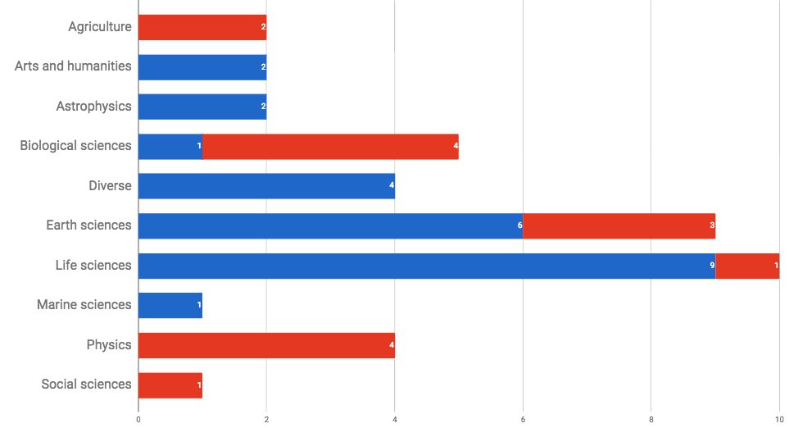
Working with new communities: per discipline
Legend:
ACTIVE COLLABORATION
EARLY ENGAGEMENT
Notes:
Life science (incl. Biological scineces) dominate → Because there are so many projects/Ris in this; Because they pro-actively look for capacity. (Note that several of these relate to biodiversity research)
In the second period we broadened our reach: Agriculture; Social sciences; Physics
Still underrepresented: Arts and humanities

Slide 15
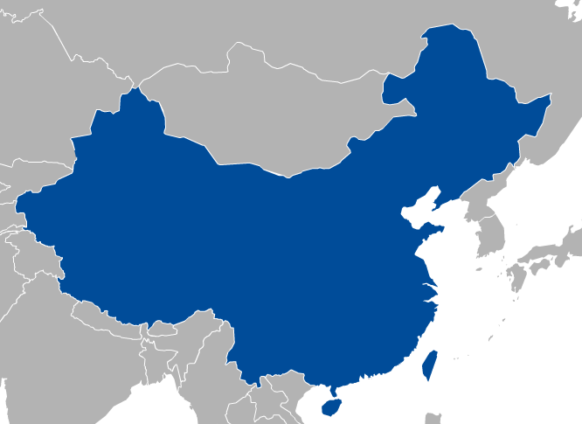
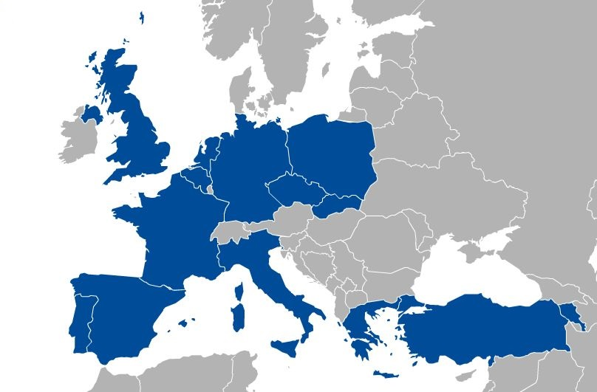
Technical user support Task 6.2 - SLAs
11 SLAs signed and 1 MoU
36 providers
>152 Million of CPU hours
>170TB of storage
>3926 GB of RAM, >1410 vCPU cores
Very crowded, unreadable
Signed SLAs:
Bioinformatics Services to Swedish Life Science (BILS)
Structural biology and brain research
Hydro-metereology (DRIHM)
ESA-Tematic Exploitation Platforms (Terradue)
Climate Change (EMSO)
Art & Humanities (DARIAH, Peachnote)
Medical and Health Science (LSGC-VIP, BioISI, MoBrain)
Astronomy and Astrophysics (EXTraS)
Natural Sciences (D4Science)

Slide 16
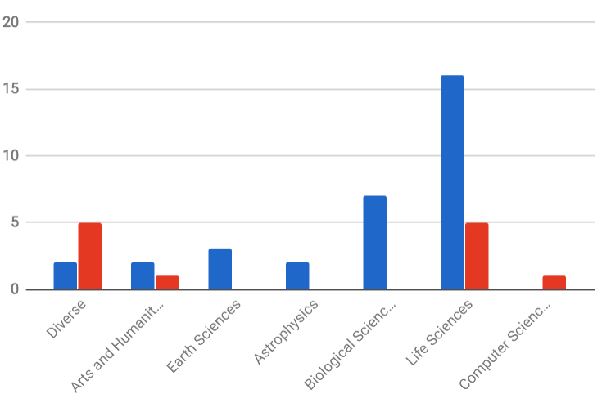
Support for the long-tail of science
Applications On Demand Platform: 30 apps.
Roll-out through the NGIs (Jan-May 2017)
Webinar; Conference paper; Newsletter articles; Demos
First NGI event based on this tool: Croatia, October 2017
Thematic services: 15
Legend: THEMATIC SERVICE
APPS ON DEMAND

Slide 17
Competence Centres: SA2.3-10
ESFRI Landmark
ESFRI Landmark
Distributed Competence Centre
BBMRI
ELIXIR
EPOS
MoBrain/ INSTRUCT
EISCAT-3D
DARIAH
LifeWatch
Environment (disaster mitigation)
EMSO (new)
ICOS (new)
NEW!
ESFRI Landmark
ESFRI Landmark
ESFRI Project
ESFRI Landmark
ESFRI Landmark
ESFRI Project
ESFRI Landmark
Notes:
ESFRI Projects:
The ESFRI Projects have been selected for scientific excellence and maturity and are included in the Roadmap in order to underline their strategic importance for the European Research Infrastructure system and support their timely implementation. The ESFRI Projects can be at different stages of their preparation according to the date of inclusion in the ESFRI Roadmap.
ESFRI Landmarks:
The ESFRI Landmarks are the RIs that were implemented or started implementation under the ESFRI Roadmap and are now established as major elements of competitiveness of the European Research Area. The ESFRI Landmarks need continuous support for successful completion, operation and upgrade in line with the optimal management and maximum return on investment.

Slide 18
PY1 → PY2 → PY3 → EOSC-Hub
22 deliverables, 5 milestones
Requirement collection & system design
Tests, evaluation
Dissemin./
Exploitation
ELIXIR | Compute Platform with AAI 5 use cases (M6.3) | Operates in 3 nodes (D6.10) | Application demos (D6.15) | ELIXIR AHM ’17, AHM ’18 | CC in EOSC-hub
BBMRI | Private clouds (M6.2) | Deployed at biobank-SE Under setup in biobank-CZ (D6.11) | Workflows and PIDs (D6.8, D6.16) | BioBanking annual event
MoBrain | Community portal | Done | Done (D6.4) | 75+ events | SLA in place TS in EINFRA12
 | Cryo-EM in the cloud (SCIPION) | Done | Done (D6.14)
 | GPGPU application gateways | Completed (D6.7) | Completed (D6.12)
DARIAH | Data repository | Done (D6.2) | Completed (D6.17) | 20 events | SLA in place TS in EOSC-hub
 | Real-time search | Done (D6.5)
 | Application gateway | Completed
LifeWatch | Cloud infra. Services & VREs | Marine VRE, GBIF | Cloud site in Seville | Approx 10k users (D6.18) | TS in EOSC-hub
 | Apps. for citizen science | Done | Done (D6.1)
EISCAT_3D | Data Portal | Done–Proof-of-concept (D6.3) | For PoC completed | EISCAT Symposium ’16 | CC in EOSC-hub
 | Data & Compute Portal | Completed (D6.3) | Ext. portal (D6.21) | EISCAT Symp’17
EPOS | 3 use cases (M6.4) | Completed (D6.19) | Completed- AAI, Compute, Data (D6.23) |  | CC in EOSC-hub
Disaster Mitigat. ELIXIR | 2 simulation gateways | gWRF and iCOMCOT gateways | Completed (D6.9) | 3 cases (D6.20): Typhoon Haiyan MY flood ‘14-15 Forest fire dust | CC in EOSC-hub
 |  |  |  | Climate change case (D6.22)
Co-development
Operation
Cloud certification work in EOSC-hub
Notes:
SA2.3-10: 13 deliverables in next 12 months

Slide 19
CC achievements
Thematic services from 4 CCs:
MoBrain-8, LifeWatch-2, DARIAH-1, Disaster Mitigation-2
Serving more than 10,000 users
50+ scientific papers
Consumed 5,964,421 cloud CPUh (LifeWatch, MoBrain, ELIXIR, DARIAH)
Consumed 76,123,210 HTC CPUh (MoBrain)
Setup of demonstrators/pilots from 5 CCs:
ELIXIR-6, BBMRI-3, EISCAT_3D-1, EPOS-3, EMSO-1
Consumed over 159,134 CPUh from EGI Cloud
More than 130 events in 30 months
To share experiences
To promote Thematic Services
To demonstrate capabilities & make recommendations to Ris

Slide 20
Cloud adoption – CPUh use
Increase in VOs supported by the project:
…
...
TOTAL
Natural
Support
Medical Engineering
Humanities

Slide 21
Increase in cloud usage
Natural sciences
Biological Sciences/Structural biology: WeNMR (+43% 2015-2016) – EGI-Engage competence centre
Biological Sciences/Bioinformatics: NBIS (starting platform)
Biological Sciences: ELIXIR (started in 2017, EGI-Engage competence centre)
Biological Sciences/Marine and Freshwater Biology and Earth Sciences: EMSO - European Multidisciplinary Seafloor and water-column Observatory (starting, +44.6%)
Biological Sciences/Biodiversity conservation: LifeWatch (active user since 2014) – EGI-Engage competence centre
Physical Sciences/Nuclear Physics: ELI-NP (starting community, 2017)
Astronomy and Astrophysics: EXTRaS (starting community, 2017)
Earth Sciences: Geohazards ESA exploitation platform (starting platform, +6,100%)
Earth Sciences/Seismology: VERCE (staring platform 2017) – EGI-Engage Competence Centre
Earth Sciences: NEXTGEOSS platform (started in 2017)
Health and Medicine
Basic Medicine/Neuroscience: biomed (starting D4SCIENCE platform, +288%)
Agricultural Sciences
Agriculture, Forestry and Fisheries (starting community, +826%) – EGI-Engage infrastructure integration action
Humanities
Arts/Musicology: peachnote (production platform, constant usage)
Arts: DARIAH Research Infrastructure (semantic annotation platform, starting, +607%) – EGI-Engage Competence Centre

Slide 22
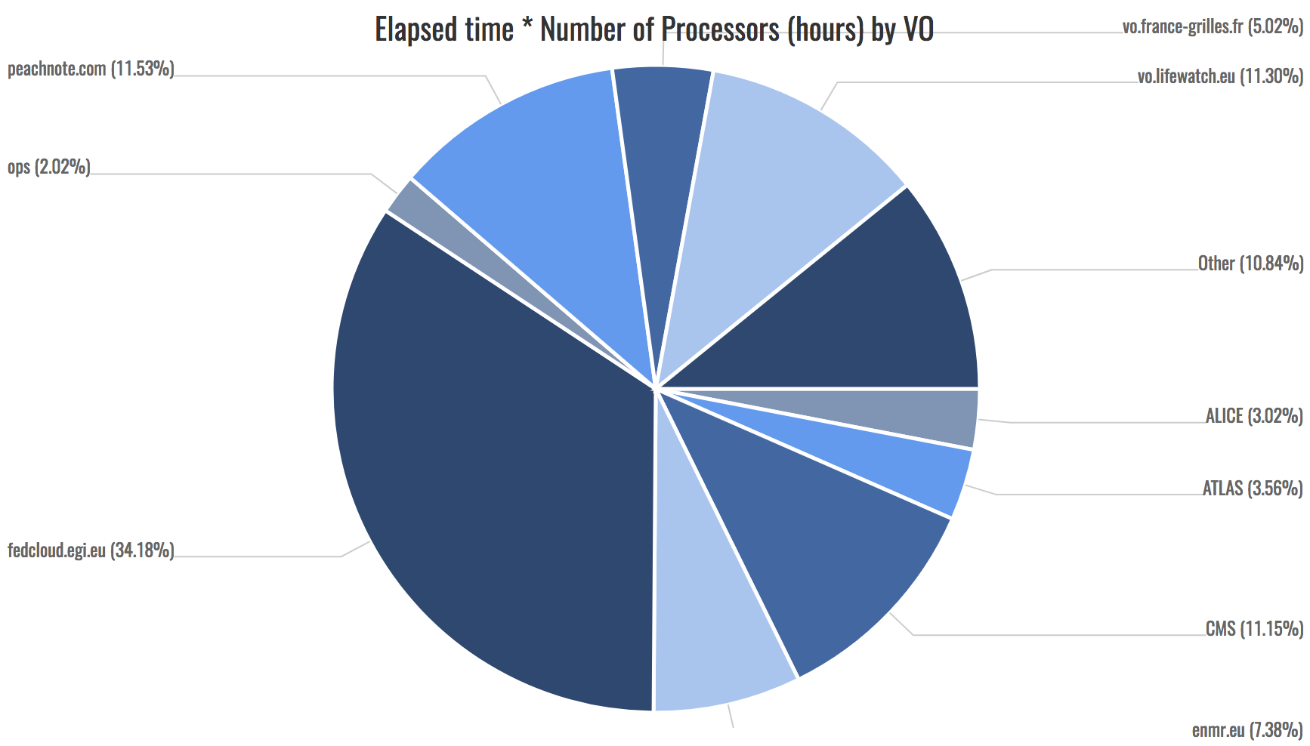
Cloud adoption – CPUh use
French nat. VO
Thematic service (new comm)
Thematic service (CC)
Other 29: 10,84%
Experimenting
users/communities
LHC-related
Thematic service (CC)

Slide 23
HTC infrastructure use
Incl. physical sciences

Slide 24
HTC infrastructure use
Step down with 2 magnitudes
Use is shifting to cloud
Without physical sciences

Slide 25
Users
+30% during EGI-Engage. Stats about personal certificate users:
Physical sciences
Increasing cloud CPUh → Thematic service access (robot certificates and CheckIn)
Notes:
Showing trends?
Showing ratio of CCs vs the rest? → Was it a big share? Was there a bigger increase in CC domains compared the rest?
Science discipline break-down for each group
→ Personal cert is dominated by WLCG/Physics
Thematic services to reach and serve non-physics communities

Slide 26
Details on Communities
See community flash talks after me:
WeNMR/MoBRAIN CC: Community of practice, in production before EGI-Engage
ELIXIR CC: Prospective user of federation services
ICOS (new community): EGI-EUDAT integration
LHC: Established user of EGI federation services

Slide 27
Use of Resources and Issues
Notes:
Numbers will be provided by PO, work package leaders must provide explanation

Slide 28
Effort analysis
To be completed when data is finalised

Slide 29
Summary
Notes:
Freedom on way to present

Slide 30
Summary
Objective 1 (O1): The continued coordination of the EGI Community.
CRM process that spans from opportunity identification to operational support
Support 40 communities – 8 CCs and 32 new communities
Established a new workshop format (Design Your E-infrastructure)
Objective 5 (O5): Promotion the adoption and extension of the current EGI services
42 training events; 130+ CC events
Uptake of cloud (by 24 communities); HTC (by 3 communities); Online storage (by 4 communities); AAI and operation tools (by 4 communities)
Services are secured with SLAs to 11 communities
Established and opened the Applications On Demand service
All this was funded in the project with 6 FTE
The real achievement was bringing together 100+ experts to deliver tangible results:
Knowledge commons
Notes:
46 institutes
~0.1 FTE/institute

Slide 31
Key exploitable results
KER name | Description
Software and services
Thematic services integrated | Integrated scientific applications with EGI’s e-Infrastructure services; Co-designed and co-developed services for sustainable, structured scientific communities; Promotion and support of the uptake of new services within scientific communities;
+
collected requirements and feedback for many other services
Helped the roll-out, promotion and support of new service

