Slide 1
Integrated Management System and Certification
Małgorzata Krakowian
Quality manager

Slide 2
EGI-Engage: Key Exploitable Results
Integrated Management System and Certification
Updated strategy, governance and procurement
Policy papers on the EOSC
Improved EGI Service portfolio
Tools for federated service management
Security policies
Marketplace
Check-in
Federated Cloud Computing
Open Data
Platform
Integrated thematic services
Applications on Demand
Notes:
Policy, Processes and Procedures
Overall goal: Ensure systematic and professional operations and delivery of services

Slide 3
EGI Services
Type
IT
Model
Distributed
Centralized
Non-IT
Target group
Internal
External
Funding
Paid
Projects
….
Notes:
Take into account different target groups, types of services and model they are provided

Slide 4
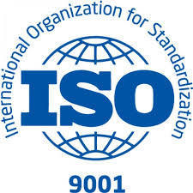
Integrated Management System
Development of management system to plan, implement, monitor and continually improve all business processes under the responsibility of EGI Foundation.
Customer focus
Continual Improvement
Factual approach to decision making
People involvement
Mutually beneficial supplier relations
Leadership
Systematic approach to management
Key quality principles
Process approach
9001:2015
2000-1:2011
Notes:
The implementation of an Integrated Management System (IMS) which integrates all of the distributed organization's systems and processes into one complete framework, enabling an organization to work as a single unit with unified objectives.
process-oriented approach, customer focus, healthy relationship with interested parties, continual improvement, leadership, decision-making based on facts, involvement of people, systematic approach

Slide 5
Integrated Management System
ISO 9001:2015
Covers all business processes including administration and finance, human resources, quality management, risk management, business relationships and continuous improvement.
Defines a set of requirements which indicate a certain general level of professionalism, repeatability and adherence to the key quality principles
ISO/IEC 20000-1:2011
Is an IT specialization of ISO 9000 designed to cover delivery of all IT-related services
Defines requirements which indicate a high level of capability in delivering “good services” to customers
Notes:
(process-oriented approach, customer focus, healthy relationship with interested parties, continual improvement, leadership, decision-making based on facts, involvement of people, systematic approach)

Slide 6
Integrated Management System
19 processes in total
How each process is defined?
Procedures, Policies, Interfaces
Roles and responsibilities
Goals, requirements, KPIs
Inputs and outputs

Slide 7
Integrated Management System
Core Management System
The management system implemented to plan, implement, monitor and continually improve all business processes under responsibility of EGI Foundation.
General Service Management
The management system implemented to deliver all services covered by the service catalogue of EGI Foundation.
IT Service Management
The management system implemented to deliver all IT services covered by the service catalogue of EGI Foundation.

Slide 8
Integrated Management System Core processes
Risk Management
Finance & Administration
Human resources
Business Development & Stakeholders
Information Security Management
Continual Improvement
The systematic and regular identification, assessment and treatment of risks of any type
Effective management of finance, business and office administration
Ensure effective management of human resources
Stakeholder management (including Council participants and funding agencies/policy makers), review the EGI Strategy and its implementation
Manage information security to ensure confidentiality, integrity and accessibility of relevant information assets
Identify, prioritize, plan, implement and review all improvements
Notes:
Core – all business processes in EGI
General – delivery of EGI services
IT – delivery of EGI IT services

Slide 9
Integrated Management System General processes
Service Portfolio Management
Customer Relationship Management
Service Level Management
Service Reporting Management
Supplier & Federated members relationship Management
Budgeting & Accounting Management
Manage the service portfolio; alignment of new or changed services with organisation strategy
Maintain a service catalogue; define, agree and monitor relevant agreements (SLA, OLA, UA)
Specify all service reports and ensure its production according to specifications in a timely manner to support decision-making
Identify, record and analyse customer opportunities; manage service orders and maintain a good relationship with customers
Establish and maintain a healthy relations with suppliers supporting the services; ensure the required capacity and monitor performance
Ensure effective management of budgeting, accounting for services
Notes:
Core – all business processes in EGI
General – delivery of EGI services
IT – delivery of EGI IT services

Slide 10
Integrated Management System IT processes
Capacity Management
Service Availability & Continuity Management
Incident & Service Request Management
Problem Management
Configuration Management
Change Management
Release & Deployment Management
Ensures sufficient capacities to meet agreed service levels and monitor performance requirements for services
Ensure sufficient service availability to meet agreed requirements and adequate service continuity in case of exceptional situations
Restore normal / agreed service operation in case of an incident; respond to user service requests
Investigate the root causes of (recurring) incidents in order to avoid future recurrence of incidents
Provide and maintain an information about logical model of service components and its configuration
Ensure changes are planned, approved, implemented and reviewed in a controlled manner
Manage releases, so that changes can be tested and deployed to the live environment
Notes:
Core – all business processes in EGI
General – delivery of EGI services
IT – delivery of EGI IT services

Slide 11
Integrated Management System
Quality controls
Internal audits: 4
External audits: 2
Management reviews: 3

Slide 12
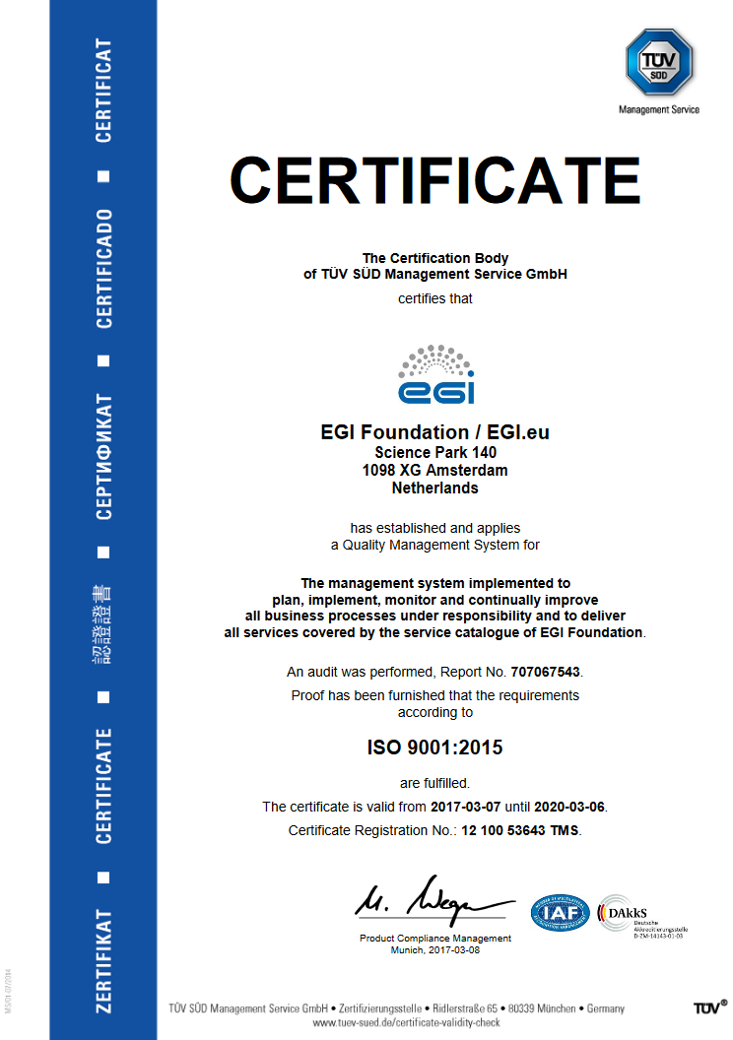
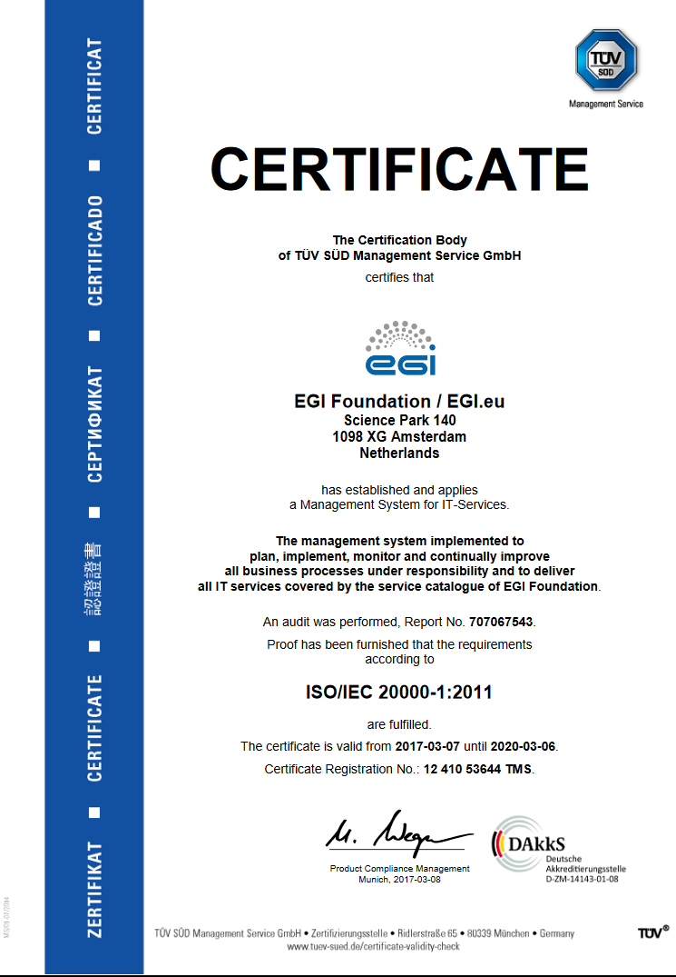
ISO certifications
ISO 9001
ISO 20000

Slide 13
Analysis of result’s impact

Slide 14
Innovation level and capacity
Innovation level:
It puts in place standard processes, procedures and agreements for managing the infrastructure efficiently and effectively.
It increased clarity on expectations between EGI partners and also customers.
Decision-making has a clearer flow between organizations and individual teams.
Provision of trainings to other e-infrastructures
Innovation Capacity:
Knowledge and experience can be reused by other e-infrastructures through consultancy, audits, workshops and trainings.
Notes:
Innovation level
Describe which are the main benefits derived by using this result, who is using today and who is expected to use it in the next three years
Innovation Capacity within the next 3 years

Slide 15
Relevance of the key result Exploitability level
Relevance to Work Programme and societal Challenges:
Impact 2. Better optimisation of the use of IT equipment for research
Relevance of Result for EOSC:
IMS parts can be adopted by the EOSC and EGI will provide the expertise.
Exploitation:
Promote the adoption of good practices in IT Service Management
Deliver more paid training to improve individual expertise of IT Service Managers and Decision Makers in the Federation and User Communities
Professionally brand the organisation as certified entity, thus emphasising the high quality and reliability of services.
Offer Audit-as-a-Service (AaaS) and paid consultancies in the future.
Notes:
Relevance of Result for Policy domain of EOSC
The extent of the benefits derived from the
project result for EOSC

Slide 16
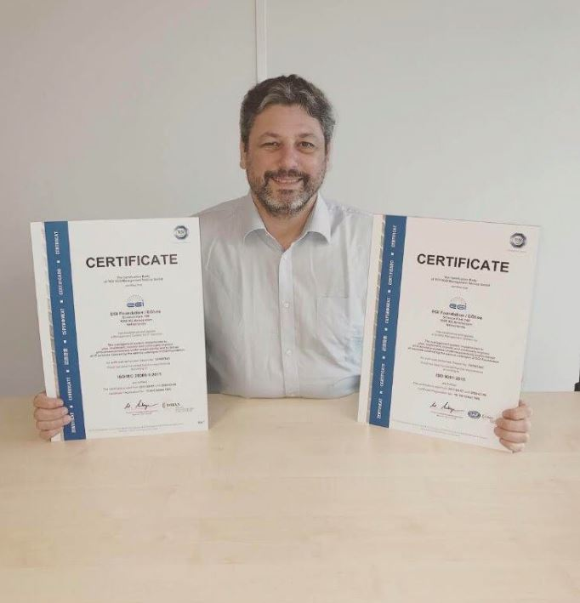
Dissemination activities
EGI website:
Webpage
Call on footer
News:
Improving service delivery:
EGI is awarded ISO certifications
Newsletter:
The EGI ISO certifications:
new and improved service delivery
EGI-Engage:
a list of key exploitable results
Interview in Primeur Magazine with Yannick Legré:
EGI to finalize service catalogue and ISO certification

Slide 17
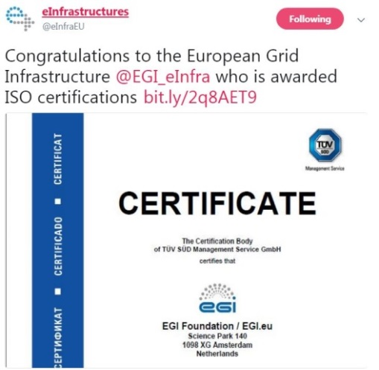
Dissemination activities
Social Media:
LinkedIn article:
Improving service delivery: EGI is awarded ISO certifications
Twitter:
The EGI Federation is the only publicly-funded
e-Infrastructure worldwide to be ISO certified!
Congratulations to the European Grid Infrastructure
who is awarded ISO certifications
The EGI Federation is the only publicly funded e-Infrastructure
worldwide to be ISO certified!
YouTube:
EGI to finalize service catalogue and ISO certification

